Slide 1
Designing
Object-Oriented APIes That Last
Gael Fraiteur

Slide 2


About Me
Gael Fraiteur. Born in Belgium in 1978. First line of code aged 12. Living in Prague since 2001. Founder and CEO of PostSharp since 2004 – now a 9-people company. Dad of 5. Music lover.

Slide 3
About PostSharp
Since 2004.
Thousands of customers worldwide.
We help you eradicate repetitive code by
automating design patterns.
15+ ready-made patterns.
Framework to implement your own patterns.
Typically 15% decrease of code size.

Slide 4
Qualities of a Good API
Usability
Power
Simplicity
Learnability
Matching Mental Models
Productivity
Consistency
Error-Prevention
Expressiveness
Extensibility
Evolvability
Performance
Robustness
Source: making APIs more usable with improved API designs, documentation, and tools. Jeffrey Stylos. 2009.

Slide 5
Agenda
A philosophy of Object-Oriented Design
Design for a Context
Design for Learnability
Design for Evolvability
Design for Extensibility
Design for Performance
Design with Errors

Slide 6
A philosophy of Object-Oriented Design

Slide 7
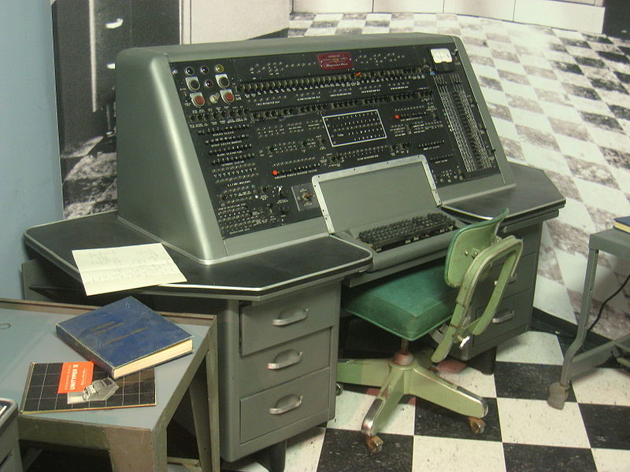
back in
1951
Notes:
UNIVAC1 control station

Slide 8
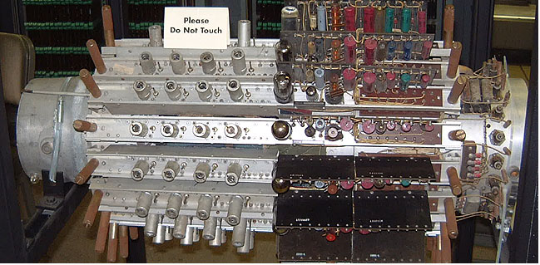
hardware was fun but quite simple to use
1.4 KB
Notes:
Mercury delay line memory of UNIVAC 1 (1951) → approx. 13 KB
http://univac1.0catch.com/#b2
1 line = 10 words of 12 6-bit characters = 90 bytes
1 tank = 16 lines = 1.4 KB
126 mercury channels in 7 mercury tanks
http://en.wikipedia.org/wiki/File:Mercury_memory.jpg

Slide 9
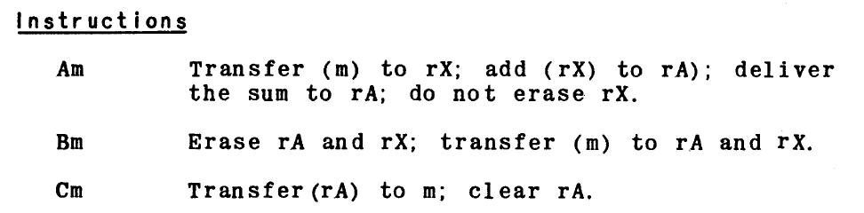
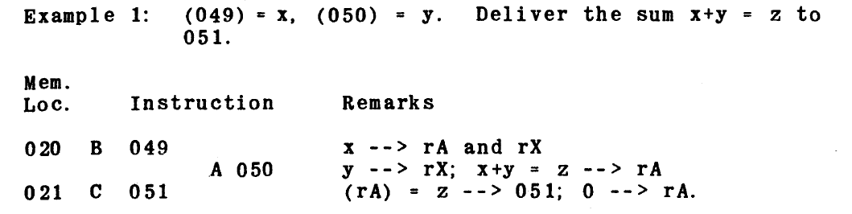
Univac Assembly Language
Notes:
Programming for the UNIVAC FAC-TRONIC system, 1935 by Remington Rand inc
http://bitsavers.informatik.uni-stuttgart.de/pdf/univac/univac1/UNIVAC_Programming_Jan53.pdf

Slide 10
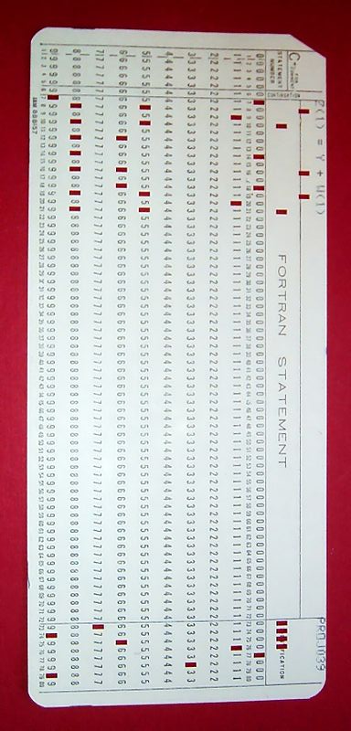
FORTRAN (1955)
1955 - FORTRAN I
  Global Variables
  Arrays
1958 - FORTRAN II
  Procedural Programming
  (no recursion)
  Modules
Notes:
http://en.wikipedia.org/wiki/File:FortranCardPROJ039.agr.jpg

Slide 11
“
The new invention caught quickly, no wonder, programs computing nuclear power reactor parameters took now
HOURS INSTEAD OF WEEKS
to write, and required much
LESS PROGRAMMING SKILL
Notes:
http://www.ibiblio.org/pub/languages/fortran/ch1-1.html
20x less statements than assembly

Slide 12
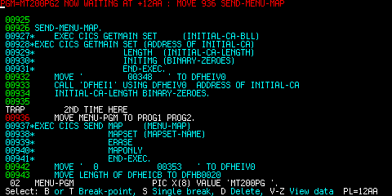
COBOL (1959)
Data Structures
Verbose Syntax

Slide 13
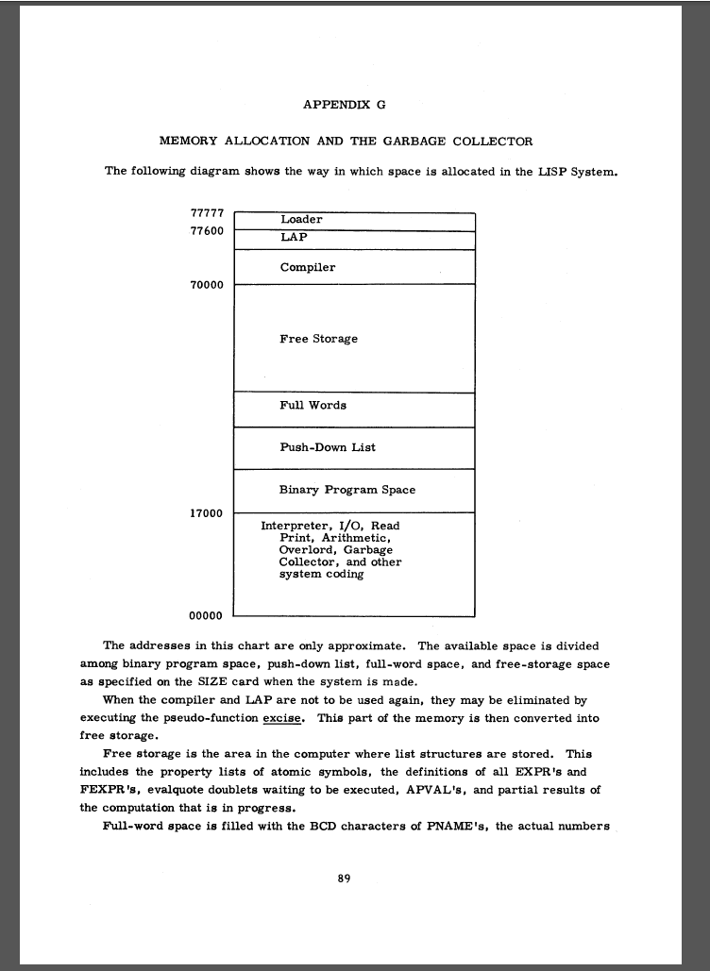
LISP (1959)
Variable Scopes (Stack)
Garbage Collection
Notes:
LISP 1.5 Programmer’s Manual

Slide 14
Simula (1967)
Begin
Class Glyph;
Virtual: Procedure print Is Procedure print;
Begin
End;
Glyph Class Char (c);
Character c;
Begin
Procedure print;
OutChar(c);
End;
Glyph Class Line (elements);
Ref (Glyph) Array elements;
Begin
Procedure print;
Begin
Integer i;
For i:= 1 Step 1 Until UpperBound (elements, 1) Do
elements (i).print;
OutImage;
End;
End;
Ref (Glyph) rg;
Ref (Glyph) Array rgs (1 : 4);
! Main program;
rgs (1):- New Char ('A');
rgs (2):- New Char ('b');
rgs (3):- New Char ('b');
rgs (4):- New Char ('a');
rg:- New Line (rgs);
rg.print;
End;
Classes as
abstraction mechanism
Virtual procedures
Object references
Coroutines
Notes:
LISP 1.5 Programmer’s Manual

Slide 15
An evolutionary point of view on languages
What stuck:
What did not stick
Make the language
close to the way human think.
Implement concept of locality and information hiding.
Make the language
close to the way human talk.
Implementing mathematical abstractions.

Slide 16
Myth: Programming is a math-ish activity
In reality, programming is
Cognitive: the real scarce resource is human intelligence
Social: communication and collaboration practices (source control, task boards, …) are essential; division of labor; social norms and fashions ; …
Temporal: development and maintenance can span decades

Slide 17
What is an API?
An API is an interface between you and them.
An API defines a relationship.
Implementation
User
You control
You are responsible
They control
They are responsible
They consume
You provide

Slide 18
Design for a Context

Slide 19
Design for an audience
Level of experience
What do they value?
  Simplicity / productivity
  Performance
  Extensibility
Early or late adopters (VS, C# version)
Consider several APIs for several audiences
Do not assume you are the target audience of your API.

Slide 20
Design for a Language
C# Version | Feature
2.0 | Generics
 | Nullable Types
 | Anonymous Methods
3.0 | Anonymous Types
 | Query Expressions
 | Extension Methods
 | Initializers
4.0 | Dynamic
 | Named/Optional Args
5.0 | Async
 | Caller info
6.0 | Static Imports
7.0 | Tuples and deconstruction
 | ref locals and returns
7.1 | in, ref struct, readonly struct
Which language version your audience is likely to use?
  Absolutely minimal
  Minimal for idiomatic experience
Which minimal framework version is required?

Slide 21
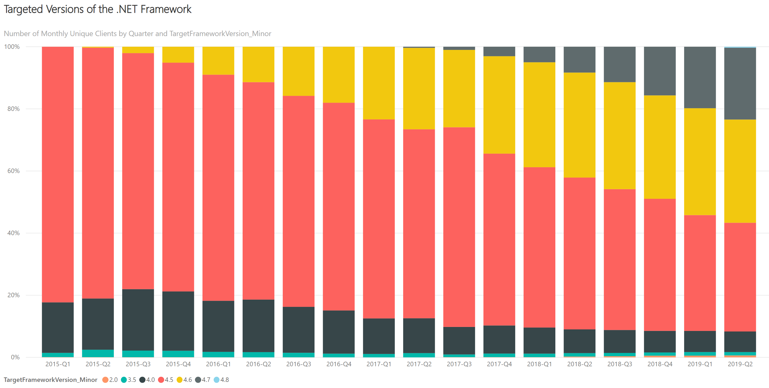
Design for a framework version

Slide 22
Respect the Patterns of Your Platform
Build on what people are already familiar with.
Copy concepts and terminology of well-known (but even unrelated) APIs
Examples
  Factory
  Chain of Responsibility
  Events
  using ( IDisposable )
  Async vs callback
  CancellationToken

Slide 23
Design for Learnability
Names, Documentation, and IntelliSense

Slide 24
Find Meaningful Analogies
Find for systems with similar semantics in the physical world.
  E.g. source/sink, pipeline, factory
Example: PostSharp.Patterns.Recording Namespace
  Recording, Recorder, Recordable: tape recorder analogy
  RestorePoint: backup/restore analogy
  UndoOperations / RedoOperations: determined by typical use case

Slide 25
Naming Golden Rules
Be absolutely consistent. Don’t use synonyms.
Don’t use abbreviations.
Principle of Least Astonishment

Slide 26
Respect the Grammar
Types
Methods
Fields, properties & parameters
Events
Nouns
Respect usual suffixes
Verb (infinitive for action, third-person for predicates)
Nouns, or third-person verb for predicates
Verbs:
Past participle when after the action
Present participle when before the action

Slide 27
Organize Namespaces
Root namespace: keep it simple and short, focus on main use case
Children namespaces for side use cases (e.g. configuration)
Minimize the required number of using for a use case

Slide 28
Design for Opportunistic Learners
Who are Opportunistic Learners?
How to please them?
Start with example code and modify it
Intuitive
Trial and Errors
Will not read the doc
Design for IntelliSense
Use familiar patterns, analogies, names
Have self-explanatory error messages that say how to fix the issue.

Slide 29
Documenting an API
Reference Doc
Programming Guide
Examples
Aka API Documentation
How-To, Walkthroughs, Concepts
Typically XML comments in C#
Precise and non-ambiguous
Document everything
Pay attention to the terms you use
Consider renaming the APIs according to the doc
Organized per topic
Mix how-tos with conceptual discussions.
Start the title with a verb
Introduce complexity progressively
Consider refactoring the API if the how-to is cumbersome
As simple as possible
but not simpler
One example per feature
Must compile

Slide 30
Iterate and Give It Time
Iterate Several Times
Good API Is Like Good Wine
Design API
Write Samples
Write Documentation
Implement API
Never, ever RTM an undocumented API.
Avoid adding a new API in a bugfix release. It would have no time to mature.

Slide 31
Design for Evolvability
Backward Compatibility Planned

Slide 32
Levels of Breaking Changes
Binary
Source Code
Already-compiled code will work.
No chance to fix.
Source code will work, but need to be recompiled.
Can be fixed.

Slide 33
Breaking change in sealed* types
Class
Interface
Method
Change base class
Remove child interface
Seal unsealed class
Remove member
Remove child interface
Change parameter type
Change return type
Add parameter (even optional)
Reorder parameters
Rename optional parameter
Change parameter default value
Fields and Properties
Generic Parameters
All Members
Make read-only
Change in Variance or Covariance
Add constraint
Change type
Rename
* sealed = possible to implement from a different assembly

Slide 34
Breaking change in unsealed* types
Additionally…
Class
Interface
Method
Add abstract member
Change/remove protected member
Add member
Add child interface
Seal virtual method
* sealed = possible to implement from a different assembly

Slide 35
Breaking changes in serialized types
When it matters
What it affects
Whenever serialized data crosses a process boundary
Persistent storage
  Avoid, use data contracts.
Inter-process messages
  Avoid, use data contracts.
Out-of-process cache
  add version number to the cache key
Any serialized type, even private.
  Type name
  Field names
  Field types
  Meaning of data

Slide 36
Minimize visibility
Expose as little as possible
  internal vs public
  private protected vs protected
Seal classes by default or design them for inheritance
No public field

Slide 37
Evolving a public API
Classes
  Never modify a member signature
  Add a new one
  Mark the previous one as [Obsolete].
Interfaces
  Always create a new interface
Assemblies
  Moving types: use [TypeForwardedFrom]

Slide 38
Respect Abstractions
API
Your WHAT
Implementation
Your HOW
Public
Private
Cannot change
Will change

Slide 39
Address design unstability during development/review phase
Hotspots = parts of the API that change frequently during development
Refactor hotspots until they become stable
Refactor groups of parameters into standalone classes or structs.

Slide 40
Semver specification
“
Given a version number MAJOR.MINOR.PATCH, increment the:
MAJOR version when you make incompatible API changes,
MINOR version when you add functionality in a backwards compatible manner, and
PATCH version when you make backwards compatible bug fixes.
Additional labels for pre-release and build metadata are available as extensions to the MAJOR.MINOR.PATCH format.
https://semver.org/

Slide 41
NuGet Packaging
Use semantic versioning for your package versions.
If your organization releases several packages, prepare for versioning mess.
  Do not assume users will have the same version of all your packages.
  Specify permissive dependencies in your nuspec
<dependency id="PostSharp.Patterns.Diagnostics.Redist" version="[6.2.14,7.0)" />
<dependency id="NLog" version="4.4.11" />

Slide 42

Useful Tools
JustAssembly: can detect breaking changes in your releases
Microsoft.CodeAnalysis.FxCopAnalyzers
C# add-ons like PostSharp’s [InternalImplement]
This Photo by Unknown Author is licensed under CC BY-SA-NC

Slide 43
Design for Extensibility

Slide 44
Avoid extensibility by inheritance
Use of interfaces instead of public non-sealed virtual or abstract methods.
Extensibility by inheritance is fine as a private extension mechanism (internal methods, sealed classes)
INSTEAD OF
CONSIDER
public abstract class CachingBackend
{
protected abstract Task AddCoreAsync(string key, object value);
public async Task AddAsync(string key, object value)
{
// TODO: Add some logging and validation.
await AddCoreAsync(key, value);
}
}
public interface ICachingBackend
{
Task AddAsync(string key, object value);
}
public sealed class CachingBackend
{
private ICachingBackend impl;
public async Task AddAsync(string key, object value)
{
// TODO: Add some logging and validation.
await this.impl.AddAsync(key, value);
}
}

Slide 45
Changing an extensibility API without breaking changes
public interface ICachingBackend
{
Task AddAsync(string key, object value);
}
public interface ICachingBackend2
{
Task AddAsync(string key, object value, CancellationToken cancellationToken);
}
internal class CachingBackendAdapter : ICachingBackend2
{
private readonly ICachingBackend legacy;
public CachingBackendAdapter(ICachingBackend legacy)
{
this.legacy = legacy;
}
public Task AddAsync(string key, object value,
CancellationToken cancellationToken)
{
cancellationToken.ThrowIfCancellationRequested();
return this.legacy.AddAsync(key, value);
}
}
public abstract class CachingBackend
{
private ICachingBackend2 impl;
public async Task AddAsync(string key, object value,
CancellationToken cancellationToken = default)
{
// TODO: Add some logging and validation.
await this.impl.AddAsync(key, value, cancellationToken);
}
}

Slide 46
Rule of Three
Create at least 3 plug-ins or extension

Slide 47
Designing for Performance
Make sure you can improve performance without breaking compatibility

Slide 48
Performance Tips
Golden rule: avoid performance bugs that would require a breaking change to fix
Analyze which parts of your API are performance-critical and which are not.
Do not optimize non-critical API parts for performance.

Slide 49
Avoid short-lived objects: ‘using’ cookies
Use value-type cookie types for your using(…) APIes.
DO NOT
DO
class ContextStack
{
private readonly Stack<string> stack = new Stack<string>();
public string Current => this.stack.Peek();
public IDisposable WithContext( string name )
{
this.stack.Push( name );
return new ContextHandle( this );
}
private class ContextHandle : IDisposable
{
// ...
}
}
class ContextStack
{
private readonly Stack<string> stack = new Stack<string>();
public string Current => this.stack.Peek();
public ContextHandle WithContext(string name )
{
this.stack.Push( name );
return new ContextHandle( this );
}
public struct ContextHandle : IDisposable
{
// ...
}
}
1 alloc per call of WithContext
0 alloc per call of WithContext

Slide 50
Avoid short-lived objects: IEnumerable
Consider implementing value-type Enumerator
INSTEAD OF
CONSIDER
class Whatever<T> : IEnumerable<T>
{
private readonly T[] array;
public IEnumerator<T> GetEnumerator()
{
foreach ( T item in this.array )
{
yield return item;
}
}
IEnumerator IEnumerable.GetEnumerator() => this.GetEnumerator();
}
class Whatever<T> : IEnumerable<T>
{
private readonly T[] array;
Enumerator GetEnumerator() => new Enumerator( this.array );
IEnumerator<T> IEnumerable<T>.GetEnumerator()
=> this.GetEnumerator();
IEnumerator IEnumerable.GetEnumerator() => this.GetEnumerator();
public struct Enumerator : IEnumerator<T>
{
// ...
}
}
1 alloc per foreach
0 alloc per foreach

Slide 51
Avoid using short-lived objects: async
Use ValueTask instead of Task. It’s a breaking change to fix that.
Btw, always pass a CancellationToken in a public method, even if unused
DO NOT
DO
public async Task DoSomethingAsync()
{
// ...
}
public async ValueTask DoSomethingAsync(
CancellationToken cancellationToken = default)
{
// ...
}
1 alloc per method call even upon
synchronous completion
0 alloc per method call upon
synchronous completion

Slide 52
Avoid short-lived objects: delegates
Do not force the caller to instantiate a closure class.
Avoid boxing.
INSTEAD OF
CONSIDER
public class MyTuple<T1,T2,T3>
{
T1 item1;
T2 item2;
T3 item3;
public void ForEach( Action<object> action )
{
action( item1 );
action( item2 );
action( item3 );
}
}
public class MyTuple<T1, T2, T3>
{
T1 item1;
T2 item2;
T3 item3;
public void ForEach<TPayload>( IAction<TPayload> action, ref TPayload payload )
{
action.Execute( item1, ref payload );
action.Execute( item2, ref payload );
action.Execute( item3, ref payload );
}
}
public interface IAction<TPayload>
{
void Execute<TItem>( in TItem item, ref TPayload payload );
}
5 allocs per call of ForEach
(closure class typically needed)
0 alloc per call of ForEach

Slide 53
Avoid short-lived objects: option parameters
Consider read-only value-type options, passed by referenced
INSTEAD OF
CONSIDER
public class FormatterOptions
{
public bool UnquotedStrings { get; set; }
public string DateFormat { get; set; }
public FormatterOptions WithUnquotedStrings( bool value )
{
return new FormatterOptions { UnquotedStrings = value,
DateFormat = this.DateFormat };
}
}
public interface Formatter<T>
{
void Format( StringBuilder stringBuilder, T value,
FormatterOptions options );
}
public readonly struct FormatterOptions
{
public bool UnquotedStrings { get; }
public string DateFormat { get; }
public FormatterOptions( bool unquotedStrings, string dateFormat )
{
this.UnquotedStrings = unquotedStrings;
this.DateFormat = dateFormat;
}
public FormatterOptions WithUnquotedStrings( bool value )
{
return new FormatterOptions( value, this.DateFormat );
}
}
public interface Formatter<T>
{
void Format( StringBuilder stringBuilder, T value,
in FormatterOptions options );
}

Slide 54
Useful Tools
BenchmarkDotNet
  Test APIs with dummy/empty implementations
  Measure GC activity
This Photo by Unknown Author is licensed under CC BY-SA-NC

Slide 55
Design with Errors
Errare humanum est

Slide 56
Expect programming errors
Assume developers will use your API incorrectly.
Make sure trivial errors do not have catastrophic outcomes (e.g. in security).
Example: require read permission by default to read a field.

Slide 57
Use exceptions properly
Accepting to execute a method is like accepting a contract
Precondition failures
Environment failures
Bugs
Check
Shit happens
It’s your fault
ArgumentException
InvalidOperationException
IOException
WebException
OutOfMemoryException
→ Consider making your object atomic against these exceptions
NullReferenceException
FormatException
InvalidCastException

Slide 58
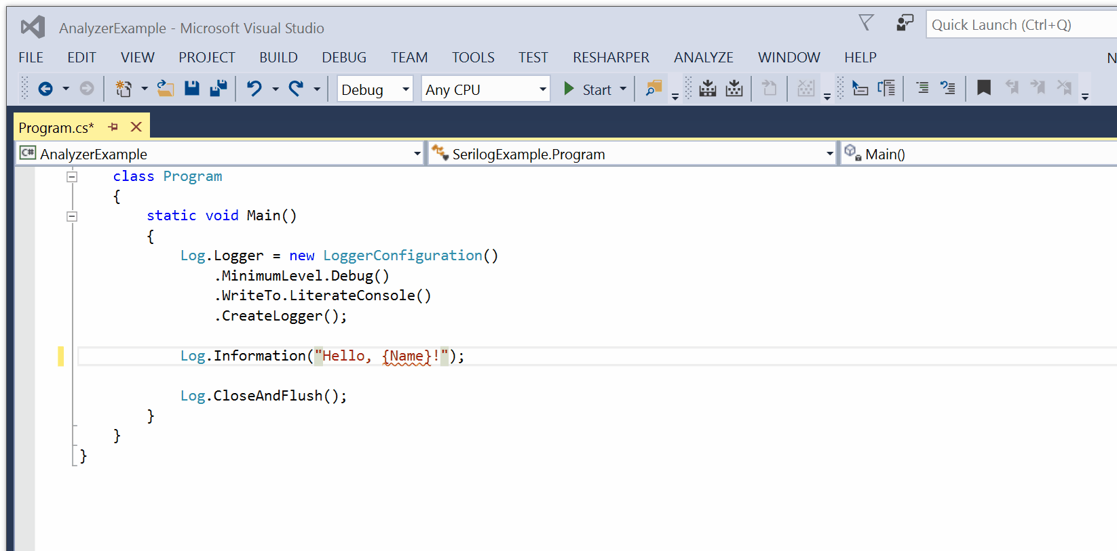
Provide Design-Time or Build-Time Assistance
Build an analyzer for your API
Example:
  Visual Studio SDK Analyzers
  Serilog Analyzers

Slide 59
Useful Tools
Roslyn analyzers
  design-time, complex
PostSharp Architecture Framework
  build-time, simpler
This Photo by Unknown Author is licensed under CC BY-SA-NC

Slide 60
Summary

Slide 61
Pillars of a Good API
Design for Human Beings
  Cognitive and social qualities vs mathematical and technological
Design for a Context
  Language, Framework Versions
  Values and Experience of Audience
Design for Learnability
  Naming
  Familiarity
  Discoverability
Design for Evolvability
  Beware of breaking changes
  Versioning & packaging
  Evolvable extensibility
  Evolvable performance
Design with Errors
  Exceptions
  Design-Time Analyzers

Slide 62
Gael Fraiteur
gael@postsharp.net

