Slide 1


React a Redux
Pavel Kříž
software engineer, HAVIT, s.r.o.
kriz@havit.cz | @krizmaister

Slide 2




Agenda
ES6/7 [20]
React [45]
Redux [70]
  Diskuze

Slide 3

Event loop & callbacky
Arrow function & this
Promise & async await
Class

Slide 4
const obj1 = {a: 1, b: 2};
const obj2 = {a: 5, c: 2};
const obj3 = {...obj1, ...obj2}; // { a: 5, b: 2, c: 2 }
const arr1 = [4, 7, 8];
const arr2 = [0, 1, 7];
const arr3 = [...arr1, ...arr2]; // [ 4, 7, 8, 0, 1, 7 ]
const { a, ...obj3WithoutA } = obj3;
console.log(obj3WithoutA); // { b: 2, c: 2}

Slide 5
const obj = {a: 1, b: 2, c: 3};
const { a, b } = obj;
console.log(a, b) // 1, 2
const arr = [4, 7, 8];
const [a, b] = arr;
console.log(a, b) // 4, 7

Slide 6
Event loop a asynchronní kód s callbacky
Promise
Arrow function
Class
Event loop

Slide 7
Event loop
let JS = "";
let listeners = [];
while (true) {
eval(JS);
if (!listeners.length) break;
JS = waitFor(listeners);
}

Slide 8
Jak řešíme
asynchronní operace?

Slide 9
Nepatří mezi parametry funkcí
Nejasné pořadí v signatuře
Error handling
Podmíněné asynchronní funkce
Callback hell

Slide 10
Promise a async await
Promise
Arrow function
Class
Event loop

Slide 11
Promise
const myPromise = fetch('https://catappapi.herokuapp.com/users/123');
myPromise.then(response => response.json())
.then(jsonData => console.log(jsonData.imageUrl))
.catch(err => console.log(err))

Slide 12
Promise
Promise.resolve(value)
Promise.reject(errValue)
Promise.all([prom1, prom2, prom3])
Promise.race([prom1, prom2, prom3])

Slide 13
console.log("Who‘s gonna win?");
Promise.resolve("Promise!")
.then(value => console.log(value));
console.log("Console!");

Slide 14
Async Await
async function sayJoke() {
try {
const result = await fetch("https://api.icndb.com/jokes/random");
console.log("Joke: ", result.data);
} catch( err ) {
console.error(err);
}
}

Slide 15
Konečně máme class!
Promise
Arrow function
Class
Event loop

Slide 16
class Child extends Parent {
doStuff() {
super.doStuff();
}
}

Slide 17
class Child extends Parent {
doStuff() {
super.doStuff();
}
}
function Child () {}
Child.prototype = Object.create(Parent.prototype);
Child.prototype.doStuff = function() {
Parent.prototype.doStuff();
}

Slide 18
Arrow Function a práce s this
Promise
Arrow function
Class
Event loop

Slide 19
Arrow function
function myOldFunction(param) {
// do fancy stuff
}
const myArrowFunction = (param) => {
// do fancy stuff
}

Slide 20
function fun() {
console.log(this)
}
fun();
const obj = { fun };
obj.fun();

Slide 21
class MyComponent extends Component {
sayHello() {
console.log("Hello!");
}
handleItemClick() {
this.sayHello();
}
render() {
return <button onClick={ this.handleItemClick }>
Click Me!
</button>
}
}

Slide 22
class MyComponent extends Component {
sayHello() {
console.log("Hello!");
}
handleItemClick = () => {
this.sayHello();
}
render() {
return <button onClick={ this.handleItemClick }>
Click Me!
</button>
}
}

Slide 23

Souhrn
Event Loop
Promise a Asynch/Await
Class
Arrow function

Slide 24

Typy komponent
Virtuální DOM
Life cycle komponent
Code sharing – HoC & Function as Child
DI – Provider pattern & Context API

Slide 25
class
function
state
lifecycle
ref
jednoduché
snadno testovatelné
defaultní volba

Slide 26
class Counter extends React.Component {
state = { count: 0 };
handleClick = () => this.setState(prevState =>
({ count: prevState.count + 1 })
);
render() {
return <button onClick={this.handleClick}>
{ `${this.state.count} ${this.props.buttonName}` }
</button>
}
}

Slide 27
…
<Counter buttonName="Click Me!" />
…

Slide 28
const Logger = (props) => {
const handleClick = () => {
console.log('Yeah!!!')
}
return <button onClick={handleClick}>{ props.buttonName }</button>
}

Slide 29
…
<Logger buttonName="Click Me!" />
…

Slide 30
Jak to funguje?
Virtuální DOM
Life cycle
Code sharing
DI
Typy komponent
Virtuální DOM

Slide 31
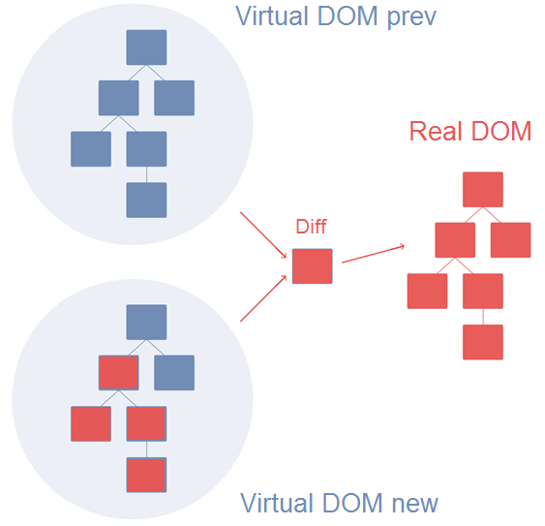

Slide 32
Life Cycle komponent
Life cycle
Code sharing
DI
Typy komponent
Virtuální DOM

Slide 33
constructor(props)
componentWillMount
render
componentDidMount
Running
props changed
unmount
state changed
componentWillReceiveProps
(nextProps)
shouldComponentUpdate
(nextProps, nextState)
false
componentWillUnmount
true
componentWillUpdate
(nextProps, nextState)
render
componentDidUpdate
(prevProps, prevState)

Slide 34
constructor(props)
getDerivedStateFromProps
(nextProps, prevState)
render
componentDidMount
Running
props changed
unmount
state changed
getDerivedStateFromProps
(nextProps, prevState)
shouldComponentUpdate
(nextProps, nextState)
false
componentWillUnmount
true
render
getSnapshotBeforeUpdate
(prevProps, prevState)
componentDidUpdate
(prevProps, prevState, snapshot)

Slide 35
A co Dependency injection?
Life cycle
Code sharing
DI
Typy komponent
Virtuální DOM

Slide 36
props
props
props
props
props

Slide 37
Provider
context
context

Slide 38
Context API
const { Provider, Consumer } = React.createContext('light');
class App extends React.Component {
render() {
return
<Provider value='light' >
<Toolbar />
</Provider>
}
}

Slide 39
Context API
const Toolbar = () =>
<div>
<MyButton />
</div>
const MyButton = () =>
<Consumer>
{ (theme) => <Button theme={theme} /> }
</Consumer>

Slide 40
Context API – Multiple Contexts
const ThemeContext = React.createContext('light');
const LocalizationContext = React.createContext('EN');
class App extends React.Component {
render() {
const { lang, theme } = this.props;
return <ThemeContext.Provider value={theme}>
<LocalizationContext.Provider value={lang}>
<Layout />
</LocalizationContext.Provider>
</ThemeContext.Provider>
}
}

Slide 41
Context API – Multiple Contexts
const Layout = () =>
<ThemeContext.Consumer>
{ (theme) =>
<LocalizationContext.Consumer>
{ (user) => <Content lang={lang} theme={theme} /> }
</LocalizationContext.Consumer>
}
</ThemeContext.Consumer>

Slide 42
Jak na Code sharing v Reactu?
Life cycle
Code sharing
DI
Typy komponent
Virtuální DOM

Slide 43
Higher Order Component

Slide 44
„Higher-order component is a function that takes
a component and returns a new component.“
- Facebook

Slide 45
const HOC = (WrappedComponent) => {
return class PropsProxyHOC extends React.Component {
render() {
return <WrappedComponent {...this.props} someOtherProp={…} />
}
}
}

Slide 46
Function as Child Component

Slide 47
„Function as Child Components is pattern
based on components that receive a function as their child.“

Slide 48
class MyLogicSharingComponent extends React.Component {
//… shared logic here
render() {
return this.props.children(this.data);
}
}
class RegularComponent extends React.Component {
render() {
return <MyLogicSharingComponent>
{ (data) => <div>{ data }</div> }
</ MyLogicSharingComponent>
}
}

Slide 49
Hooks
[V 16.7.0 Alpha]

Slide 50
useState
import { useState } from 'react';
const Example = () => {
const [count, setCount] = useState(0);
return <div>
<p>You clicked {count} times</p>
<button onClick={() => setCount(count + 1)}>
Click me
</button>
</div>
}

Slide 51
useState
import { useState } from 'react';
const Example = () => {
const [count, setCount] = useState(0);
return <div>
<p>You clicked {count} times</p>
<button onClick={() => setCount((prevCount) => prevCount + 1)}>
Click me
</button>
</div>
}

Slide 52
useEffect
import { useState, useEffect } from 'react';
const Example = () => {
const [count, setCount] = useState(0);
useEffect(() => {
document.title = `You clicked ${count} times`;
});
return <div>
<p>You clicked {count} times</p>
<button onClick={() => setCount((prevCount) => prevCount + 1)}>
Click me
</button>
</div>
}

Slide 53
useEffect
useEffect(
() => {
const subscription = props.source.subscribe();
return () => {
subscription.unsubscribe();
};
},
[props.source]
);

Slide 54
useContext
import { useContext } from 'react';
const function Example() {
const locale = useContext(LocaleContext);
const theme = useContext(ThemeContext);
// ...
}

Slide 55
useMutationEffect
useLayoutEffect
useRef
useMemo
others…

Slide 56
Souhrn
Typy komponent a Virtuální DOM
Life Cycle
Dependency Injection
Code Sharing (HoC, Function as Child, Hooks)

Slide 57

Základní mechanismy
Redux Store
Redux Observable
Middleware
Redux Thunk
Redux Saga

Slide 58
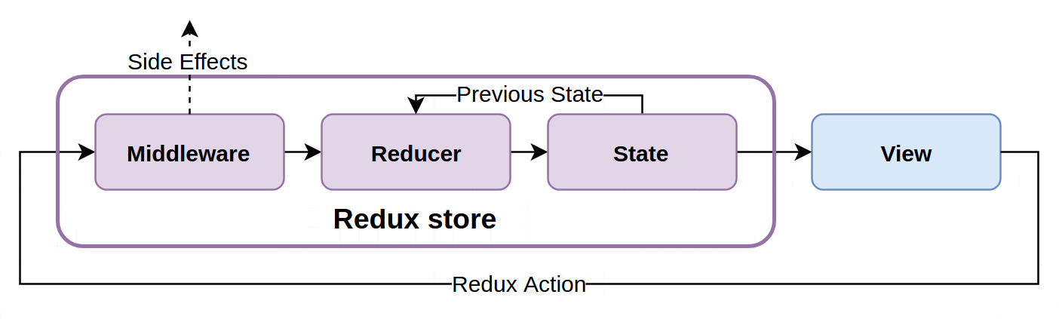

Slide 59
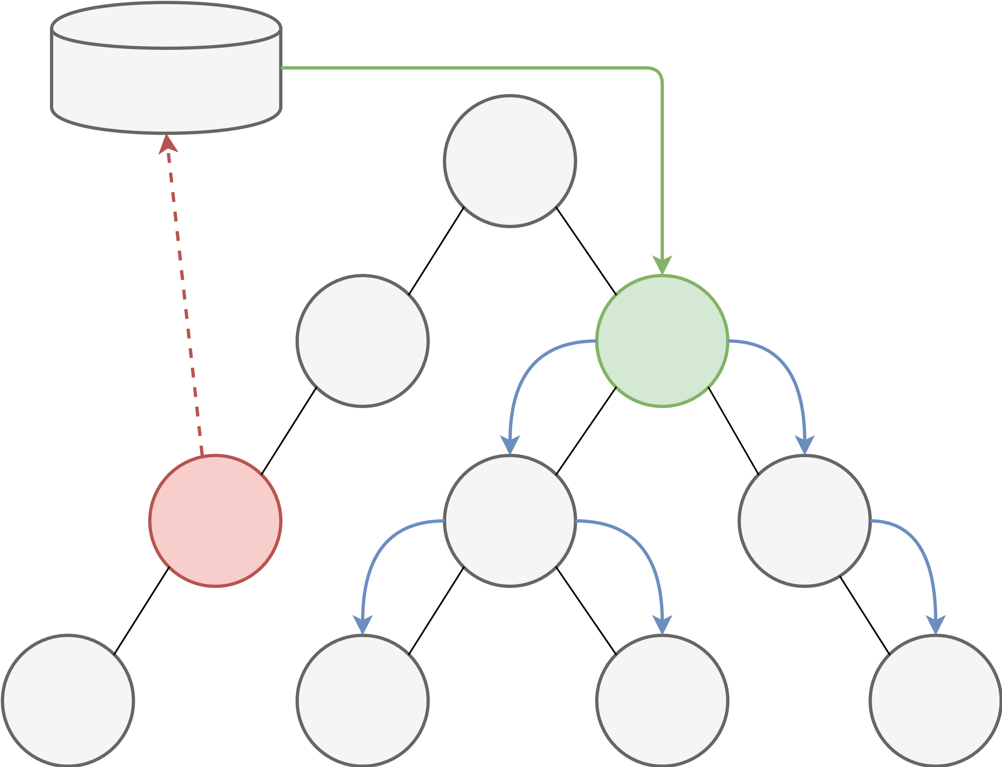
Store
subscribe
dispatch

Slide 60
dispatch({
type: 'ADD_ITEM',
text: 'Koupit rohlíky'
});
dispatch({
type: 'REMOVE_ITEM',
id: 15
});

Slide 61
const addItem = (text) => ({
type: 'ADD_ITEM',
text
});
const removeItem = (id) => ({
type: 'REMOVE_ITEM',
id
});

Slide 62
Redux Store a
Reducery
Middleware
Redux Observable
Redux Thunk
Základy
Redux Store
Redux Saga

Slide 63
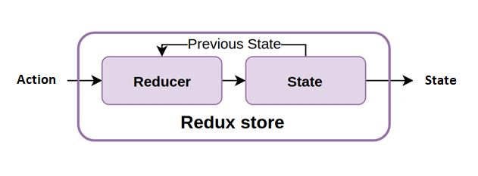

Slide 64
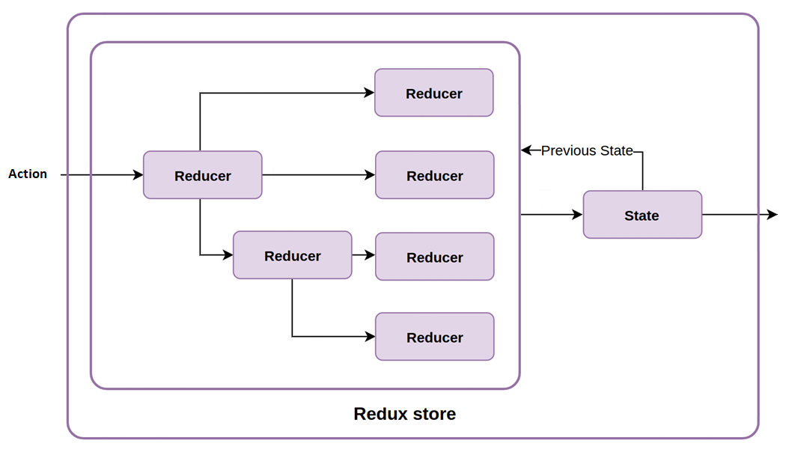

Slide 65
let nextTodoId = 0;
const todo = (state = [], action) => {
switch (action.type) {
case 'ADD_ITEM':
return [...state, { text: action.text, id: nextTodoId++}]
case 'REMOVE_ITEM':
return state.filter(item => item.id !== action.id);
default:
return state;
}
}

Slide 66
My ale side effecty v aplikacích
potřebujeme

Slide 67
Middleware
Middleware
Redux Observable
Redux Thunk
Základy
Redux Store
Redux Saga

Slide 69
const loggingMiddleware = (store) => (next) => (action) => {
console.log(`Redux Log Before: `, store.getState(), action);
next(action);
console.log(`Redux Log After: `, store.getState());
}

Slide 70
„Currying is the technique of translating the evaluation of a function that takes multiple arguments into evaluating a sequence of functions, each with a single argument“

Slide 71
Currying
function add(x, y) {
return x + y;
}

Slide 72
Currying
function add(x) {
return function(y) {
return x + y;
}
}

Slide 73
Currying
const add = x => y => x + y;

Slide 74
Currying a Partial application
const add = x => y => x + y;
const addTwo = add(2);
const result = addTwo(5);

Slide 75
Partial application
const createSettings = defaultSettings => optionalSettings => {
return {…defaultSettings, …optionalSettings};
}
const settingsWithDefault = createSettings({
url: "/api/endpoint",
method: "post"
});
const mySettings = settingsWithDefault({ data: 55 });

Slide 76
Partial application jako DI mechanismus

Slide 77
getCustomer(connection, id) => Customer

Slide 78
const myDbConnection = ….
const getCustomer = connection => id => {
// digging data from DB
return customer;
}
const getCustomerFromDB = getCustomer(myDbConnection);
const customer = getCustomerFromDB(894);

Slide 79
const loggingMiddleware = (store) => (next) => (action) => {
console.log(`Redux Log Before: `, store.getState(), action);
next(action);
console.log(`Redux Log After: `, store.getState());
}

Slide 80
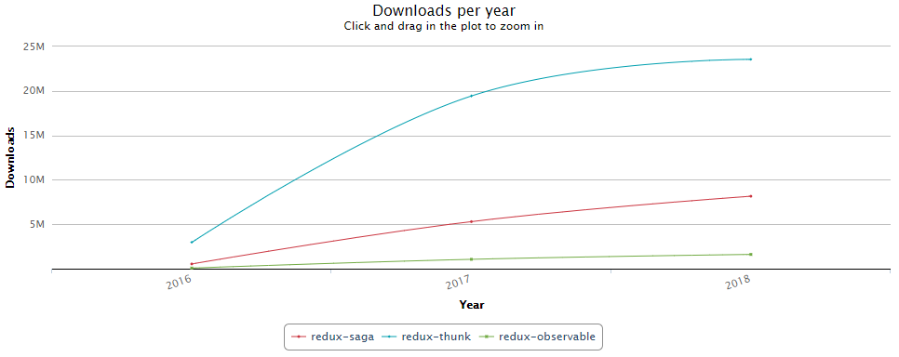
Downloads per year
Downloads
https://npm-stat.com/

Slide 81
Redux Thunk
Middleware
Redux Observable
Redux Thunk
Základy
Redux Store
Redux Saga

Slide 82
const getUser = (id) =>
(dispatch, getState) => {
dispatch({type : "API_REQUEST"});
axios.post(`/api/users/${id}`)
.then(response => dispatch({
type : "API_SUCCESS",
payload : response
}),
error => dispatch({type : "API_ERROR", error })
);
};
}

Slide 83


Middleware
Redux Observable
Redux Thunk
Základy
Redux Store
Redux Saga

Slide 84


Slide 85
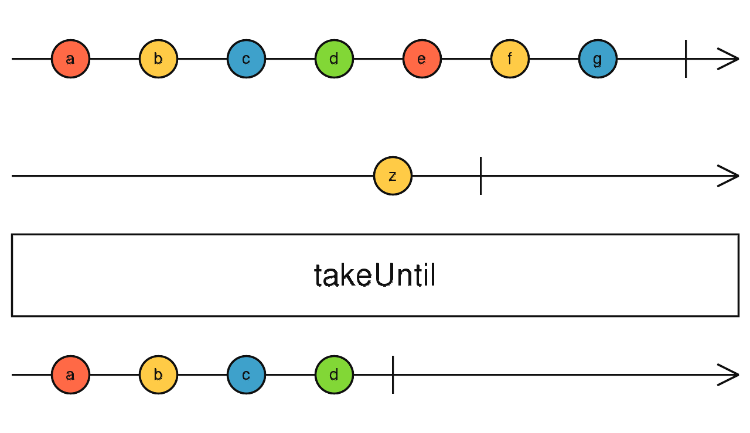
http://reactivex.io/rxjs/class/es6/Observable.js~Observable.html#instance-method-takeUntil

Slide 86
const source$ = Rx.Observable.fromEvent(document.body, 'click');
source$.pipe(
map(value => value.offsetX + value.offsetY),
filter(offsetSum => offsetSum > 200),
debounceTime(500),
forEach(value => console.log(`Every 500 ms ${value}`));
)

Slide 87
reduces
update state
actions
view

Slide 88
reduces
actions
epics
update state
actions
view
actions

Slide 89
const pingEpic = (action$, state$) => action$.pipe(
filter(action => action.type === 'PING'),
delay(1000),
mapTo({ type: 'PONG' })
)

Slide 90
const pingEpic = (action$, state$) => action$.pipe(
ofType('PING'),
delay(1000),
mapTo({ type: 'PONG' })
)

Slide 91
takeUntil
throttle
debounce
filter, mapTo, zip, concat, race…
others…

Slide 92
Deklarativní
Síla je v obsluze komplexních Async operací
  cancelation
  zřetězení Ajax requestů
  debouncing/throttling
Rozšíření pro Redux – Tooling

Slide 93
Middleware
Redux Observable
Redux Thunk
Základy
Redux Store
Redux Saga

Slide 94
Generátory
function* range(start, end, step) {
while (start < end) {
yield start;
start += step;
}
}
const iterator = range(0, 10, 2);
console.log(iterator.next()); // { value: 0, done: false }​​​​​
console.log(iterator.next()); // { value: 2, done: false }​​​​​
console.log(iterator.next()); // { value: 4, done: false }​​​​​
console.log(iterator.next()); // { value: 6, done: false }​​​​​
console.log(iterator.next()); // { value: 8, done: false }​​​​​
console.log(iterator.next()); // { value: undefined, done: true }​​​​​

Slide 95
Generátory
function* range(start, end, step) {
while (start < end) {
yield start;
start += step;
}
}
for (let i of range(0, 10, 2)) {
console.log(i) // 0, 2, 4, 6, 8
}

Slide 96
Generátory – předávání hodnoty generátoru
function* generator() {
const res = yield 10;
console.log(res === 32);
return 42;
}
const iterator = generator();
const resA = iterator.next(); // => { value: 10, done: false }
const resB = iterator.next(32); // => { value: 42, done: true }

Slide 97
To je všechno?

Slide 98
functionA
functionB

Slide 99
functionA*
functionB*

Slide 100
functionA
asyncFunctionB
1. iterace
delay
2. iterace

Slide 101
functionA*
asyncFunctionB
delay
async

Slide 102
Generátory – asynchronní kód
function fetchUsers() {
return Promise.resolve({users: [{ id: 1, name: 'test user' }]})
}
function fetchProducts() {
return Promise.resolve({products: [{ id: 2, name: ' test product' }]})
}
runGenerator(function* () {
const products = yield fetchProducts()
console.log('fetched products:' products)
const users = yield fetchUsers()
console.log('fetched users: ', users)
})

Slide 103
Generátory – asynchronní kód
function runGenerator(gen) {
const iterator = gen()
const run = result => {
const { value, done } = iterator.next(result)
if(done)
return
value.then(res => run(res))
}
run()
}

Slide 104
generátory versus async/await

Slide 105
generátory async/await
superset async/await slabší ale, pokrývá většinu běžných případů
function* / yield async / await
generátor vrací iterátor async funkce vrací vždy promise
k řízení async jsou nutné knihovny minimální boilerplate

Slide 106
async/await lze implementovat pomocí generátorů a promisů

Slide 107
Root Saga
Stejné jako Root Reducer

Slide 108
Watcher Saga
Sledují akce a spouští příslušné Worker Ságy

Slide 109
Worker Saga
Obsahují logiku

Slide 110

Middleware
root saga
action
Watcher1
rootReducer
Watcher2
Watcher3

Slide 111
Worker
Worker
Worker
Watcher1
Worker
Watcher2
Worker
Watcher3
Worker
Worker

Slide 112
function* watchUsersWorkflow() {
yield takeEvery('REQUEST_USERS', fetchUsers);
yield takeEvery('SELECT_USER', selectUser);
}
function* fetchUsers() {
…
}
function* selectUser() {
…
}

Slide 113
function* watchFetchUsers() {
yield takeLatest('REQUESTED_USERS', fetchUsers);
}
function* fetchUsers() {
const users = yield fetch('…/users');
…
}

Slide 114

const iterator = fetchUsers()
const realValue = iterator.next().value;
const expectedValue =
expect(realValue).toEqual(expectedValue);

Slide 115
function* watchFetchUsers() {
yield takeLatest('REQUESTED_USERS', fetchUsers);
}
function* fetchUsers() {
const users = yield call(fetch, '/users');
…
}

Slide 116
const iterator = fetchUsers()
const realValue = iterator.next().value;
const expectedValue = call(fetch, '…/users');
expect(realValue).toEqual(expectedValue);

Slide 117
{
fn: fetch,
args: ['users']
}

Slide 118
Neblokující efekty

Slide 119
…
const users = yield call(fetch, '…/delete-users');
...

Slide 120
fork
Attached tasks
spawn
Detached tasks

Slide 121
Completion
Erorr propagation
Cancellation
Attached tasks

Slide 122
root
watch
watch
work
work
work
fork

Slide 123
spawn
root
watch
watch
work
work
work

Slide 124
function* rootSaga() {
yield [
watcherSaga1(),
watcherSaga2(),
watcherSaga3(),
]
}

Slide 125
function* rootSaga() {
const sagas = [ watcherSaga1, watcherSaga2, watcherSaga3 ];
yield sagas.map(saga =>
spawn(function* () {
while (true) {
try {
yield call(saga)
} catch (e) {
console.log(e)
}
}
})
)
}

Slide 126
Concurrency flow

Slide 127
takeEvery
Pro každou akci spustí novou ságu (task)
takeLatest
Pro každou akci spustí novou ságu (task) a předchozí stornuje
all
Spouští tasky paralelně a blokuje, dokud všechny nedoběhnou
race
Také paralelně a blokuje, dokud nedoběhne první (ostatní storno)

Slide 128
throttling
debouncing
retry

Slide 129
Souhrn
Základní koncept
Redux store a Reducery
Middleware
Redux Thunk
Redux Observable
Redux Saga

Slide 130



Slide 131


Slide 132
Diskuze
Pavel Kříž
software engineer, HAVIT, s.r.o.
kriz@havit.cz | @krizmaister

Slide 133
Děkuji za pozornost
Pavel Kříž
software engineer, HAVIT, s.r.o.
kriz@havit.cz | @krizmaister

