Slide 1
Windows Server 2019
Lukáš Radil
KPCS CZ
radil@kpcs.cz
Notes:
1 070 600 903 nhd668

Slide 2
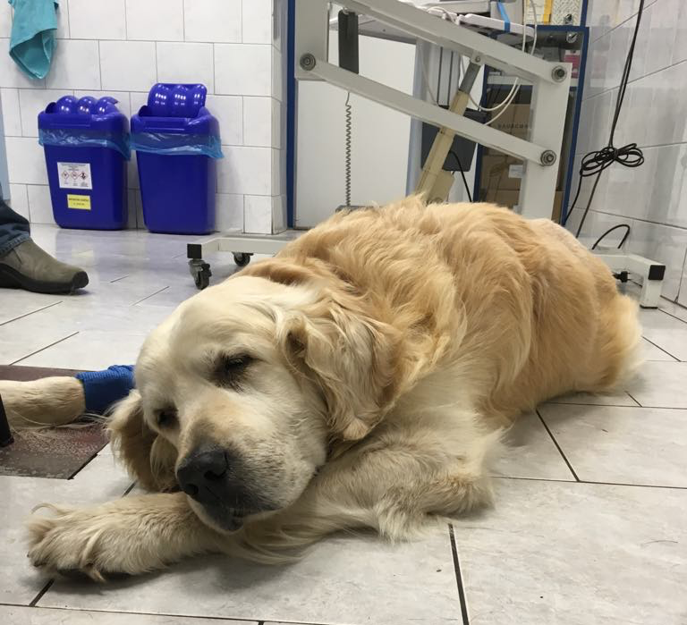
Omlouvám se za změnu termínu

Slide 3
Historie
Windows Server 2008
System Center 2008
Windows Server 2012
System Center 2012
Windows Server 2012 R2
System Center 2012 R2
Microsoft Azure
Windows Server 2016
System Center 2016
Microsoft Azure
Introduced
virtualization
platform/
management
Industry-leading
scale and
performance
Azure as
design point
Cloud-first
innovation:
Infrastructure
and application
platform

Slide 4
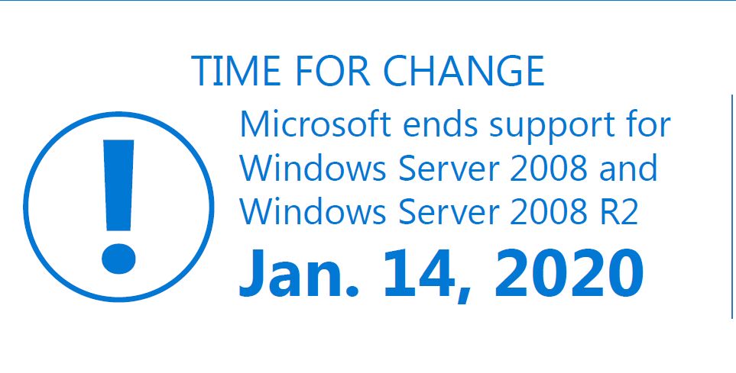
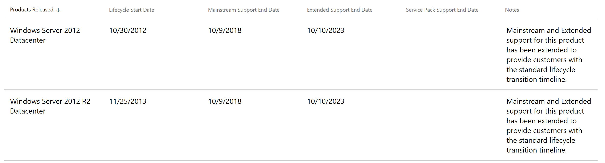
Proč upgrade?

Slide 5
Proč upgrade?
Hybrid Cloud – Windows Admin Center a.k.a. Project Honolulu
Security – Windows Defender ATP
Windows Subsystem for Linux ☺
Containers – ještě menší a efektivnější
Storage Replica
Storage Migration Service

Slide 6
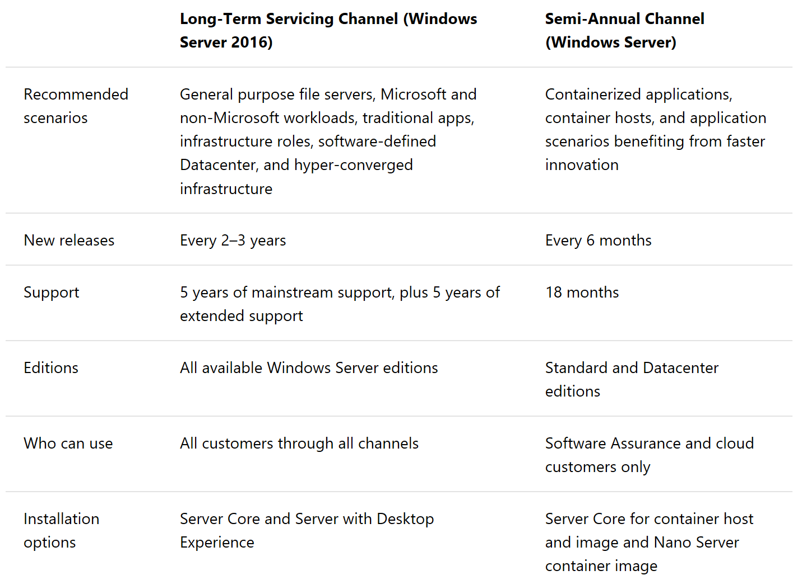

Slide 7
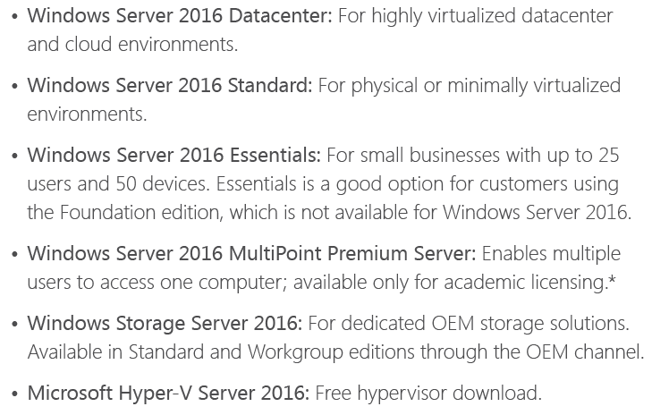
Edice – stejné jako 2016

Slide 8
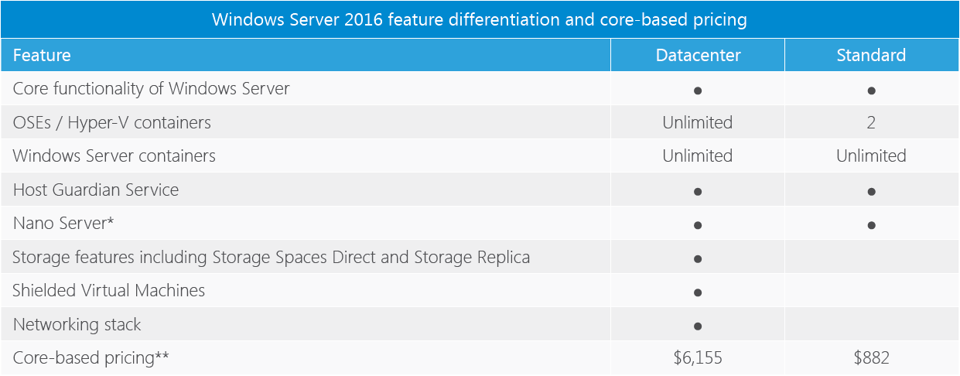
Features

Slide 9
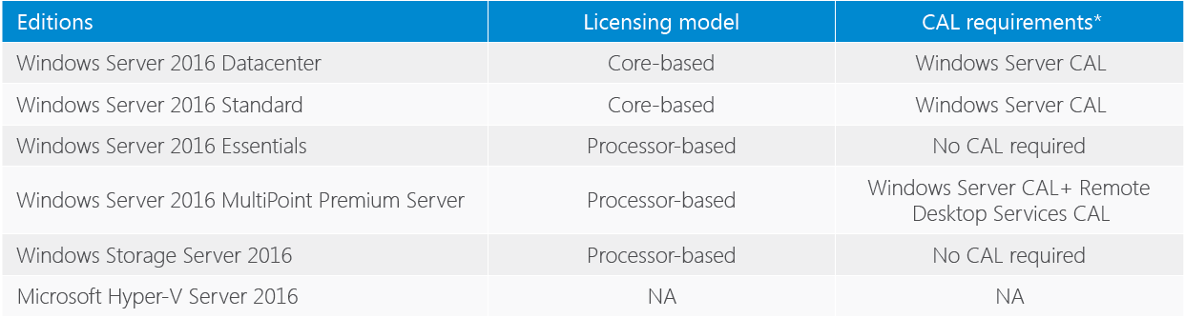
Licensing models

Slide 10
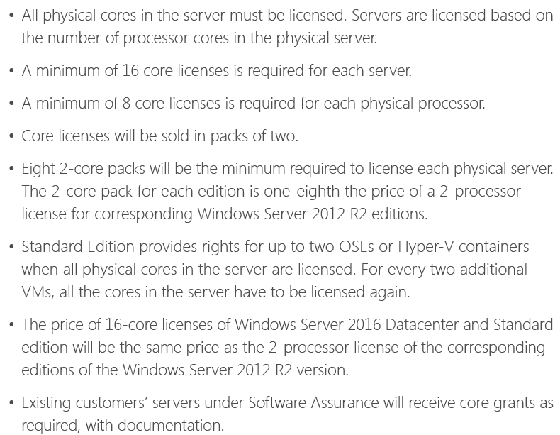
Core based licensing

Slide 11
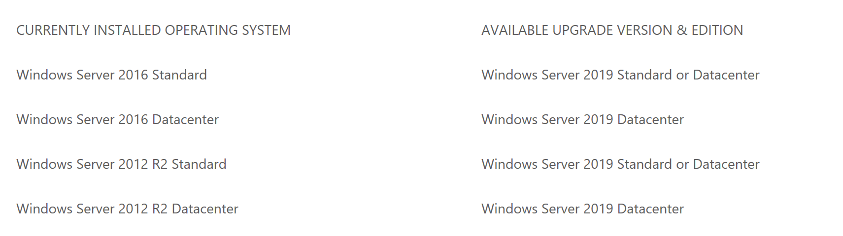
Jak na upgrade

Slide 12
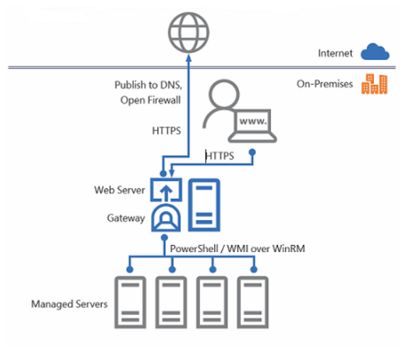
Project Honolulu
UI v prohlížeči
Admin Center Gateway
WinRM a PowerShell remoting na spravované servery

Slide 13
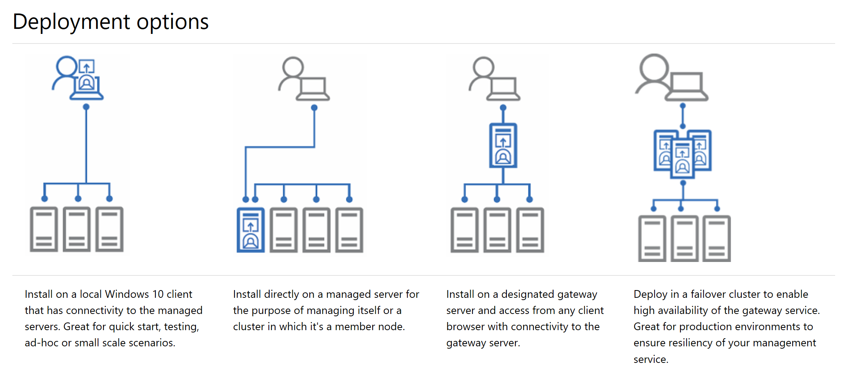

Slide 14
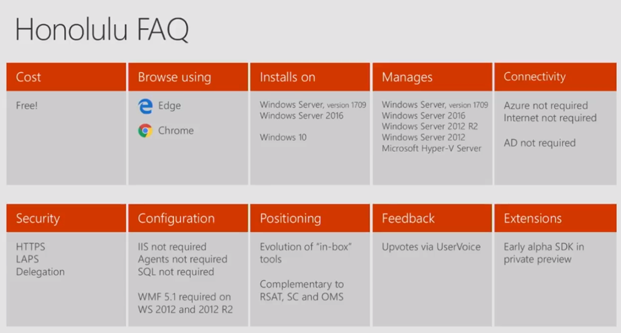

Slide 15
Project Honolulu
https://blogs.technet.microsoft.com/technetczsk/2017/10/27/project-honolulu/
https://www.altaro.com/hyper-v/project-honolulu/

Slide 16
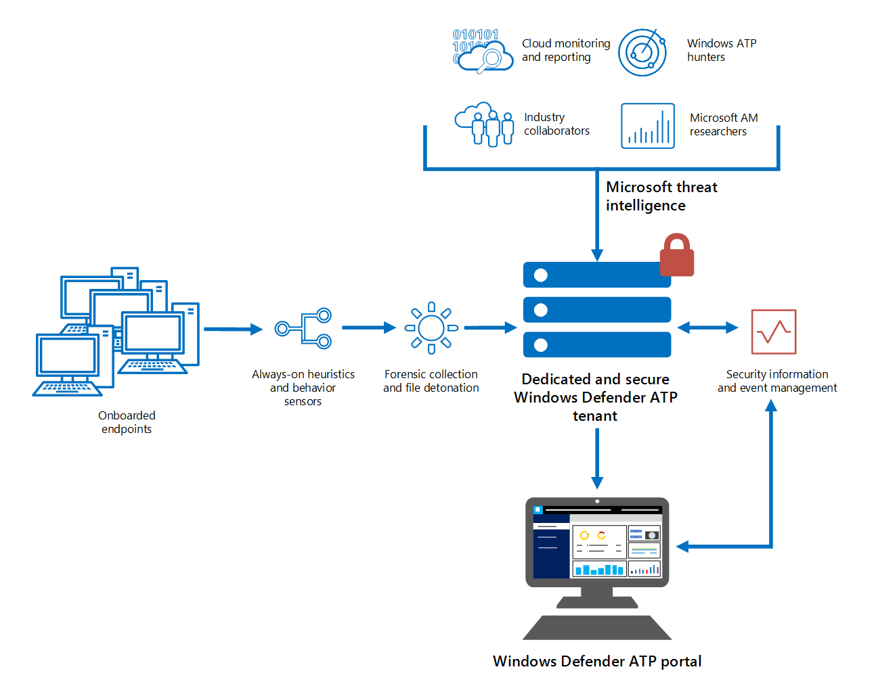
Windows Defender ATP

Slide 17
Windows Defender ATP
Endpoint behavioral sensors: Embedded in Windows Server 2019, these sensors collect and process behavioral signals from the operating system (for example, process, registry, file, and network communications) and sends this sensor data to your private, isolated, cloud instance of Windows Defender ATP.
Cloud security analytics: Leveraging big-data, machine-learning, and unique Microsoft optics across the Windows ecosystem (such as the Microsoft Malicious Software Removal Tool, enterprise cloud products (such as Office 365), and online assets (such as Bing and SmartScreen URL reputation), behavioral signals are translated into insights, detections, and recommended responses to advanced threats.
Threat intelligence: Generated by Microsoft hunters, security teams, and augmented by threat intelligence provided by partners, threat intelligence enables Windows Defender ATP to identify attacker tools, techniques, and procedures, and generate alerts when these are observed in collected sensor data.

Slide 18
Windows Defender ATP - onboard
Microsoft Monitoring Agent součástí OS
Path: “HKLM\SOFTWARE\Policies\Microsoft\Windows Advanced Threat Protection”
Name: "AllowSampleCollection"
Value: 1
Pokud máte jiný Anti-X agent
Path: HKLM\SOFTWARE\Policies\Microsoft\Windows Advanced Threat Protection
Name: ForceDefenderPassiveMode
Value: 1

Slide 19
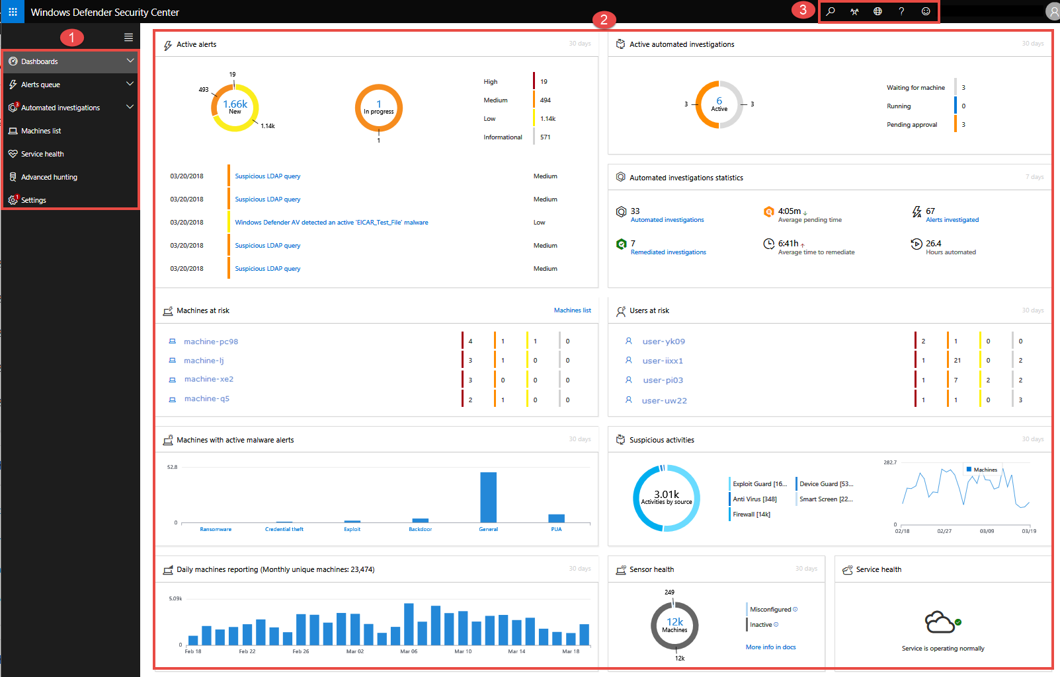

Slide 20
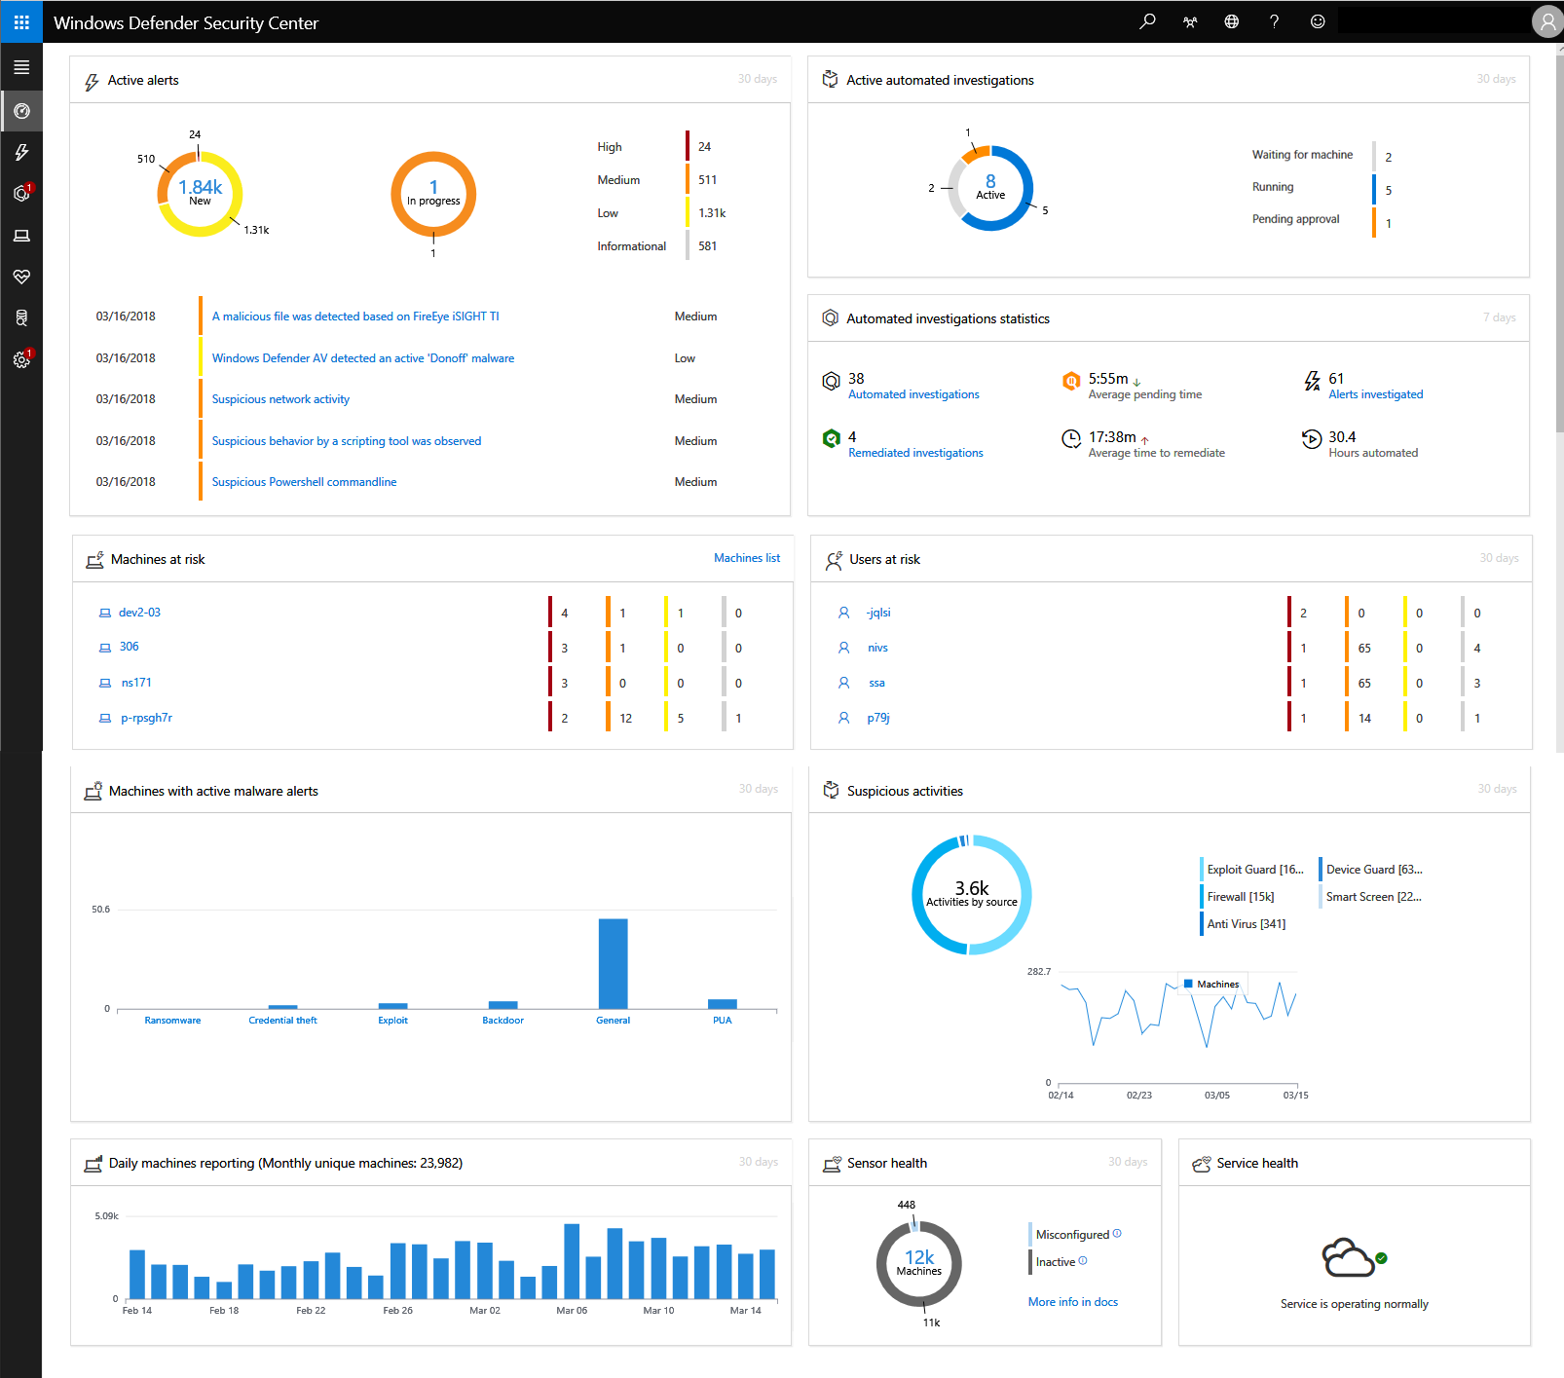

Slide 21
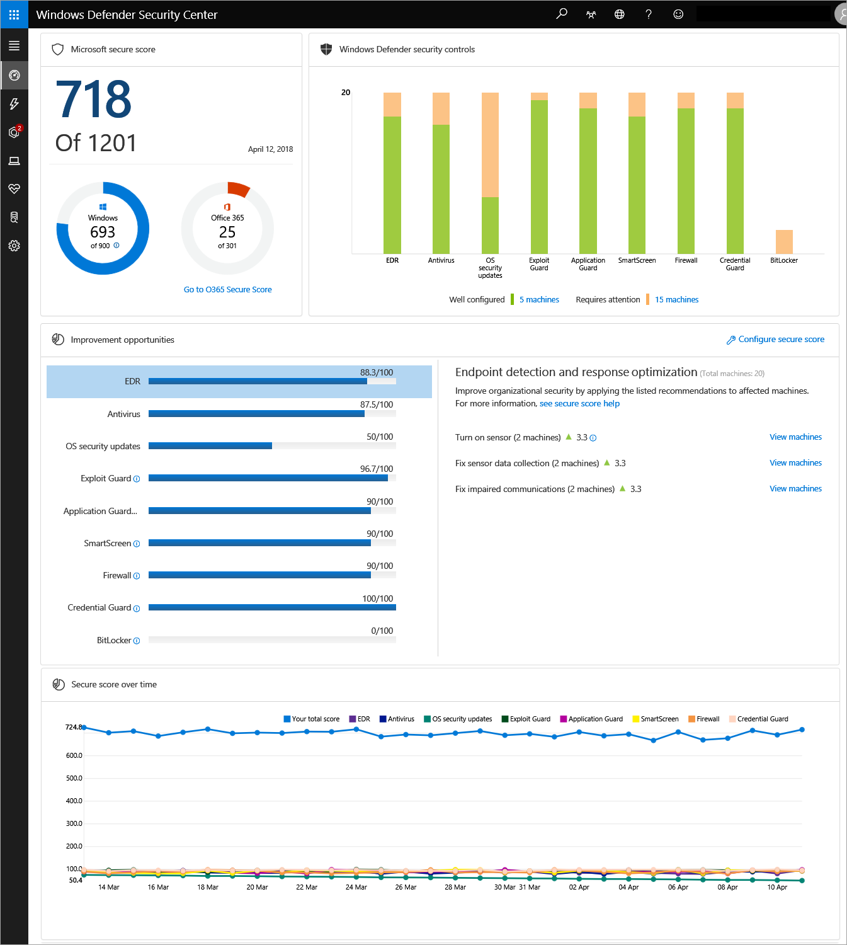

Slide 22
Windows Subsystem for Linux
Enable-WindowsOptionalFeature -Online -FeatureName Microsoft-Windows-Subsystem-Linux

Slide 23
Storage replica
Jak na to?

Slide 24

Storage Replica
Protection of key data and workloads
  Synchronous replication: Storage agnostic mirroring
  of data in physical sites with crash-consistent volumes ensuring zero data loss at the volume level.
  Increase resilience: Unlocks new scenarios for metro-distance cluster to cluster disaster recovery and stretch failover clusters for automated high availability.
  Complete solution: End-to-end for storage and clustering, including Hyper-V, Storage Replica, Storage Spaces, Cluster, Scale-Out File Server, SMB3, Deduplication, Resilient File System (ReFS), NTFS, and Windows PowerShell.
  Streamlined management: Graphical management for individual nodes and clusters through Failover Cluster Manager and Azure Site Recovery.
STRETCH CLUSTER AND CLUSTER TO CLUSTER
Site 1
Site 2

Slide 25
Storage Replica
Replication
Block-level, volume-based
Synchronous & asynchronous
SMB 3.1.1 transport
Flexibility
Any Windows data volume
Any fixed disk storage
Any storage fabric
Management
Failover Cluster Manager
Windows PowerShell & WMI
Azure Site Recovery
End to end MS Storage Stack

Slide 26
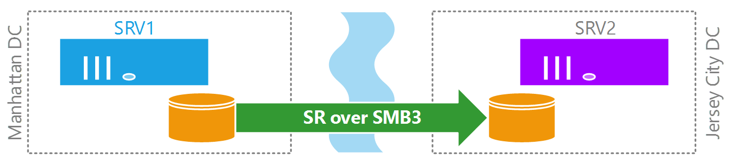
Server to Server
Two separate servers
Manual failover
Synchronous or asynchronous

Slide 27
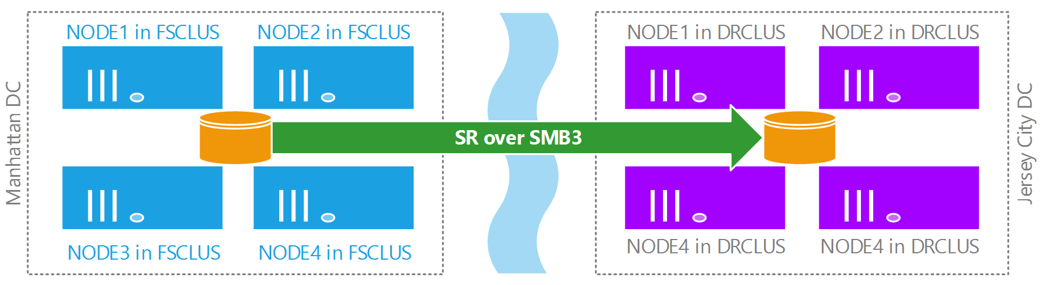
Cluster to Cluster
Two separate clusters
Manual failover
Synchronous or asynchronous

Slide 28
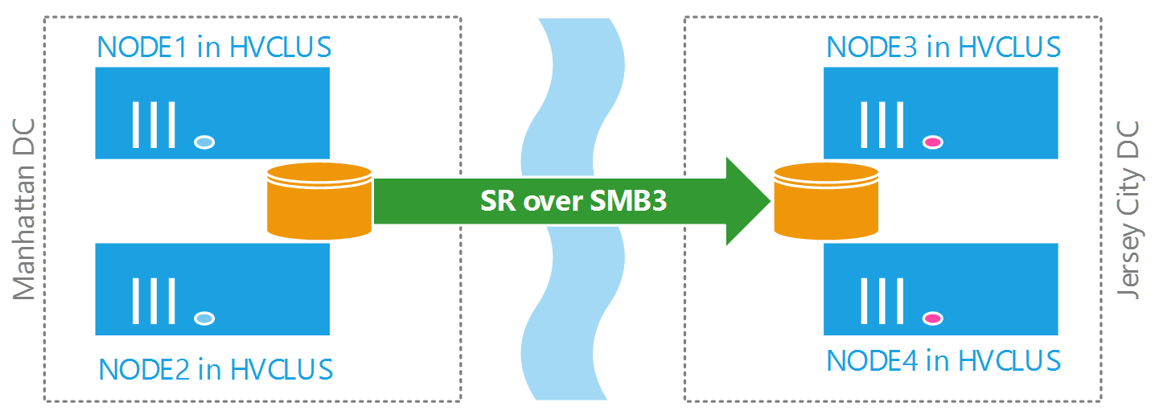
Stretch Cluster
Single cluster
Automatic failover
Synchronous
50+ km

Slide 29
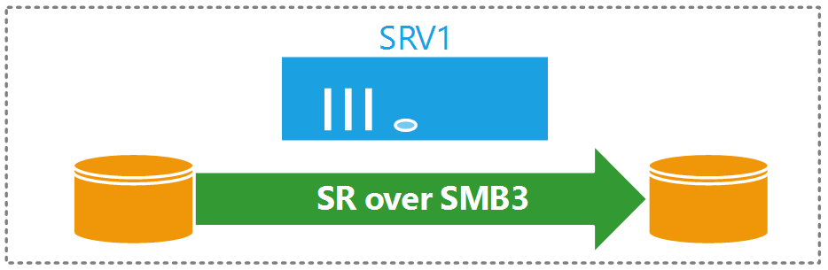
Server to Self
A single server replicating to itself (one volume to another)
Seed data onto storage for shipment

Slide 30
Blocks, not files
This is not DFSR
This is not DFSR!
Replicating storage blocks underneath the CSVFS, NTFS, or ReFS volume
Don’t care if files are in use
Write IOs are all that matter to Storage Replica

Slide 31
Recommendations for Synchronous
Network latency
  ≤5ms round trip average
    Assuming the light speed vacuum ideal, 5ms is ~1500km round trip
    Reality: optical fiber reduces by ~35%, you cross switches, routers, firewalls, etc.
    Financial limits, availability
  End result: most customers end up 30-50km
Network Bandwidth
  ≥1 Gbps network - end to end - between servers is a starting point (Windows Server logo requires 1Gb NIC)
  It depends on your IO and sharing of the pipe (SR may not be the only traffic for the DR site)
  Learn your IOPS math (125MB/s of IO = ~1Gb/s network usage)
Log volume performance and size
  Flash (SSD, NVME, etc.)
  Larger logs allow faster recovery from larger outages and less rollover, but cost space

Slide 32
Recommendations for Asynchronous
Network latency
  Doesn’t matter
Network bandwidth
  As much or as little as you need
  Depends on your write IO
Log volume performance and size
  Same as previous slide

Slide 33
Prerequisities
Active Directory Domain Services forest.
Storage Spaces with SAS JBODs, Storage Spaces Direct, fibre channel SAN,
shared VHDX, iSCSI Target, or local SAS/SCSI/SATA storage.
SSD or faster recommended for replication log drives.
Microsoft recommends that the log storage be faster than the data storage.
Log volumes must never be used for other workloads.
At least one ethernet/TCP connection on each server for synchronous
replication, but preferably RDMA.
At least 2GB of RAM and two cores per server.
A network between servers with enough bandwidth to contain
your IO write workload
Average of 5ms round trip latency or lower, for synchronous replication.
Asynchronous replication does not have a latency recommendation.

Slide 34
Test-SRTopology cmdlet
Checks requirements and recommendations for bandwidth, log sizes, IOPS, etc…
Runs for specified duration
Gives you a tidy HTML report with recommendations

Slide 35
DEMO environment

Slide 36
DEMO
Storage Replica environment preparation
Enable Firewall rules
Install Storage Replica Feature
Run Test-SRTopology

Slide 37
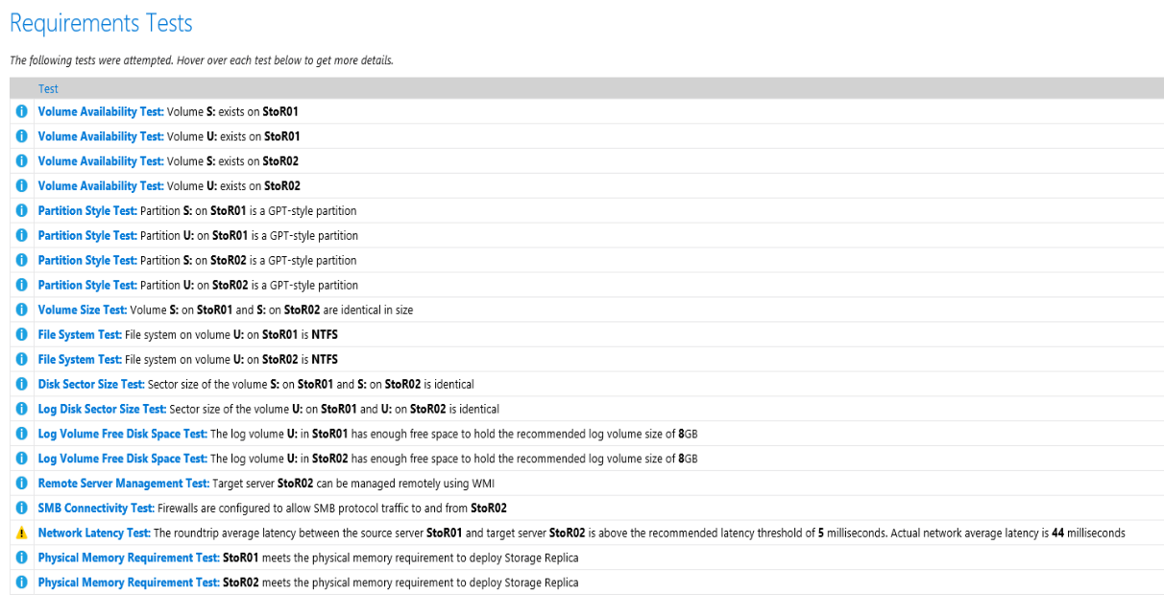
What is inside Test-SRTopology report?

Slide 38
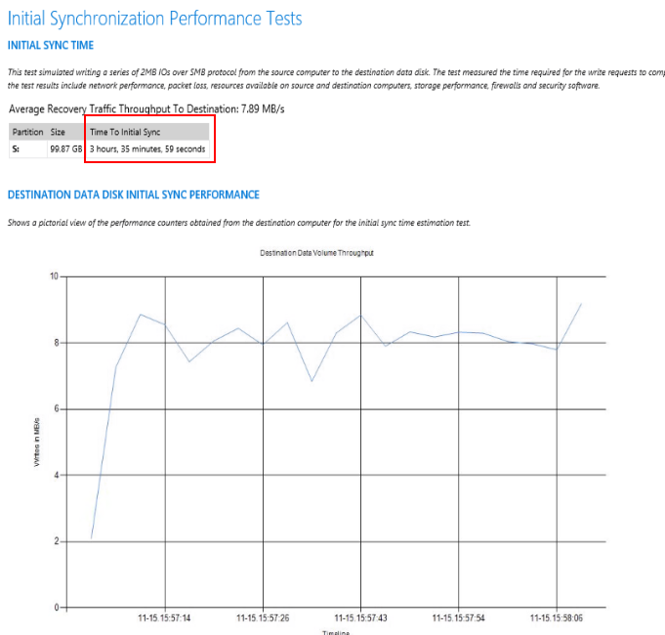
What else is inside Test-SRTopology

Slide 39
DEMO – Create Storage Replica

Slide 40
Create Storage Replica
New-SRGroup
  The New-SRGroup cmdlet creates a replication group. A replication group contains one or more data volumes and an associated log volume. A replication group is the container for replication.
New-Srpartnership
  The New-SRPartnership cmdlet creates a replication partnership between two new or existing replication groups. This cmdlet can create the complete replication topology. It can also tie together separately created replication groups.

Slide 41
DEMO – Create Storage Replica
Create test data on all volumes
New-SRGroup
New-SRpartnership

Slide 42
Remarkable
Storage Replica Group has only SINGLE Log
Storage Replica Group can have MORE Replicas
Data volume is available ONLY on source
Log volumes are available on both sites, but LOG itself is hidden

Slide 43
Get Replica status
Get-SRPartnership
  Information about partnership between two SERVERS. Defines which groups are in partnership, which is source and which destination
Get-SRGroup
  A replication group contains replicated VOLUMES, replication PROPERTIES, and replication STATE. Partnerships join replication groups to form a source and destination topology.
Get-Srdelegation
  The Get-SRDelegation cmdlet gets security delegation on a Storage Replica server. This cmdlet displays all users you been delegated the ability to manage Storage Replica
Get-SRAccess
  The Get-SRAccess cmdlet gets the security access required between failover clusters to replicate by using Storage Replica. You do not have to use this cmdlet for stretch clusters or server-to-server replication.

Slide 44
Get Replica status
Get-SRNetworkConstraint
  The Get-SRNetworkConstraint cmdlet gets replication network constraints for Storage Replica partnerships. You can apply network constraints to one or more network adapter interfaces to control which networks Storage Replica can use. By default, Storage Replica uses networks according to the rules of SMB Multichannel. Network constraints are an allowed list.

Slide 45
Get Replica status
Get-SRGroup
do{
$r=(Get-SRGroup -Name "Replication 2").replicas
[System.Console]::Write("Number of remaining bytes {0}`n", $r.NumOfBytesRemaining)
Start-Sleep 10
}until($r.ReplicationStatus -eq 'ContinuouslyReplicating')
Write-Output "Replica Status: "$r.replicationstatus

Slide 46
DEMO – Get Information
Get information about
  Partnership
  Replica Groups
  Delegation

Slide 47
Remarkable – Get information
Get-SRGroup – a lot of important information
  AllowVolumeResize : False
  IsAutoFailover :
  IsCluster : False
  IsEncrypted : False
  IsInPartnership : True
  IsPrimary : False
  IsSuspended : False
  IsWriteConsistency : False
  LastInSyncTime : 11/19/2017 3:09:08 PM
  LogSizeInBytes : 8589934592
  LogVolume : U:\
  Name : StoR02.training.lab-ReplGrp1
  NumOfReplicas : 1
  ReplicationMode : Synchronous
  ReplicationStatus : ContinuouslyReplicating

Slide 48
Remarkable – Get information
(Get-SRGroup).replicas
  CurrentLsn : 12
  DataVolume : S:\
  LastInSyncTime :
  LastKnownPrimaryLsn : 12
  LastOutOfSyncTime :
  NumOfBytesRecovered : 0
  NumOfBytesRemaining : 0
  PartitionId : a7ac90b4-e9c8-4daa-b589-0404c275aedf
  PartitionSize : 107237867520
  ReplicationMode : Synchronous
  ReplicationStatus : ContinuouslyReplicating
Notes:
LSN = LOG SEQUENCE NUMBER

Slide 49
Replication Status
ContinuouslyReplicating
WaitingForQuorum
RecoveringFromReplicationLog
Failed
ReplicationSuspended
ConnectingToSource
WaitingForDestination
LogRecordCopyFromSource
BlockCopyFromSource
InitialBlockCopy
ContinuouslyReplicating_OutOfRPO
ContinuouslyReplicating_InRPO
LogRecordCopyToDestination
BlockCopyToDestination
NotInPartnership

Slide 50
Managing Replicas
Set-SRPartnership
  The Set-SRPartnership cmdlet modifies a replication partnership between two existing replication groups. You can use this cmdlet to add replicated volumes. You can also change the direction of replication which makes a source volume into a destination volume.
Sync-SRGroup
  The Sync-SRGroup cmdlet starts or resumes replication for a replication group. If you pause replication, Storage Replica dismounts the volume. Applications and users cannot access this volume until you run Sync-SRGroup
Suspend-SRGroup
  The Suspend-SRGroup cmdlet pauses replication for a replication group. If you pause replication, Storage Replica dismounts the volume. Applications and users cannot access this volume until you run the Sync-SRGroup cmdlet.

Slide 51
Managing replicas
Set-SRGroup
  The Set-SRGroup cmdlet modifies settings of an existing replication group. A replication group contains one or more data volumes and an associated log volume. A replication group is the container for replication.
Set-SRNetworkConstraint
  The Set-SRNetworkConstraint cmdlet creates or modifies a replication network constraint for servers and partnerships. You can apply network constraints to one or more network adapter interfaces, in order to control which networks Storage Replica can use. Any networks not specified by this cmdlet are no longer used by Storage Replica.
Export-SRConfiguration
  The Export-SRConfiguration cmdlet exports the replication configuration for a computer to a Windows PowerShell .ps1 configuration script. You can use this .ps1 file as a configuration backup to reapply in event that Storage Replica settings are damaged or removed. You can also use this file to migrate settings to another computer.

Slide 52
Managing Replicas
Grant-SRAccess
  The Grant-SRAccess cmdlet grants security access between failover clusters to enable replication by using Storage Replica. You do not have to use this cmdlet for stretch clusters or server-to-server replication.
Grant-SRDelegation
  The Grant-SRDelegation cmdlet creates a security delegation on a Storage Replica server. Security delegations enable non-administrator users to configure and modify replication. This cmdlet updates members of the well-known local groups Storage Replica Administrators and Remote Management Users.

Slide 53
DEMO – Managing Replicas
Revert replica
Select network to replication
Export Storage Replica configuration

Slide 54
Storage Replica Decommissioning
Remove-SRPartnership
  The Remove-SRPartnership cmdlet removes an existing replication partnership. A partnership is the replication relationship between replication groups on a pair of servers, a pair of clusters, or nodes in a stretch cluster.
Remove-SRGroup
  The Remove-SRGroup cmdlet removes a replication group. A replication group contains one or more data volumes and an associated log volume. A replication group is the container of replication.
Remove-SRNetworkConstraint
  The Remove-SRNetworkConstraint cmdlet removes all current replication network constraints for the specified servers and replication groups. Network constraints are not iterative. To modify constraints, use the Set-SRNetworkConstraint cmdlet.

Slide 55
Storage Replica Decommissioning
Revoke-SRDelegation
  The Revoke-SRDelegation cmdlet revokes a security delegation on a Storage Replica server. Security delegations enable non-administrator users to configure and modify replication. This cmdlet updates members of the well-known local groups Storage Replica Administrators and Remote Management Users.
Revoke-SRAccess
  The Revoke-SRAccess cmdlet revokes security access between failover clusters that allowed replication by using Storage Replica. You do not have to use this cmdlet for stretch clusters or server-to-server replication.

Slide 56
DEMO – Storage Replica Decommissioning
Remove SR partnership
Remove SR Group
Clear SR metadata

Slide 57
FAQs
Is Storage Replica supported on Nano Server?
  YES ☺
Can I configure one-to-many replication or transitive (A to B to C) replication?
  NO
Can I grow or shrink replicated volumes replicated by Storage Replica?
  Set-SRGroup -AllowVolumeResize $TRUE
Can I bring a destination volume online for read-only access?
  Mount-SRDestination -Name RG2 -Computername SRV2 -TemporaryPath T:\

Slide 58
FAQ
Can I configure Storage Spaces Direct in a stretch cluster with Storage Replica?
  This is not a supported configuration in Windows Server.
Can I configure Scale-out File Server (SOFS) in a stretch cluster?
  While technically possible, this is not a recommended configuration in Windows Server due to the lack of site awareness in the compute nodes contacting the SOFS.
Can I configure replication to restrict bandwidth usage?
  Set-SmbBandwidthLimit -Category StorageReplication -BytesPerSecond x

Slide 59
FAQ
What are the log volume best practices?
  The optimal size size of the log varies widely per environment and workload, and is determined by how much write IO your workload performs.
    A larger or smaller log doesn’t make you any faster or slower
    A larger or smaller log doesn’t have any bearing on a 10GB data volume versus a 10TB data volume, for instance
  A larger log simply collects and retains more write IOs before they are wrapped out.

Slide 60
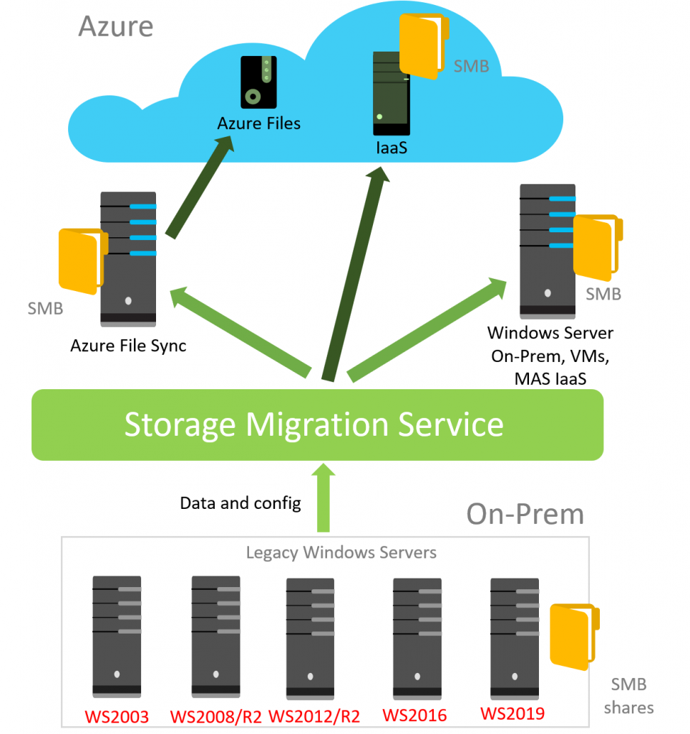
Storage Migration Service

