Slide 1
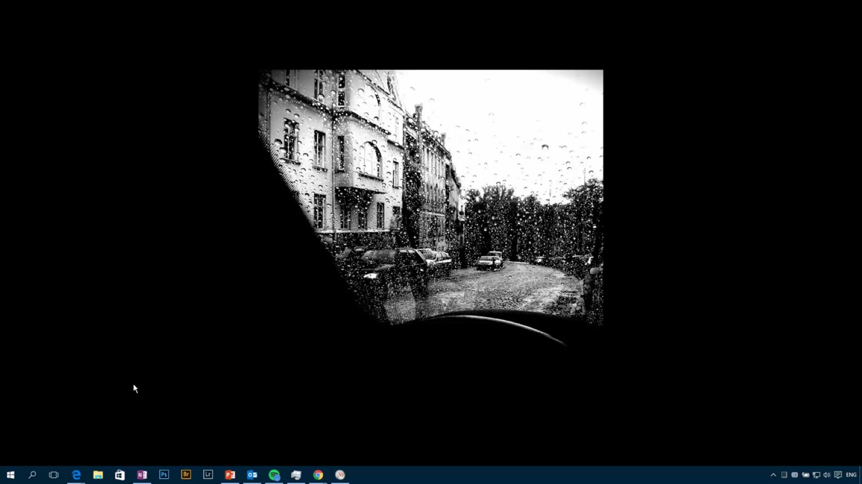

Slide 2
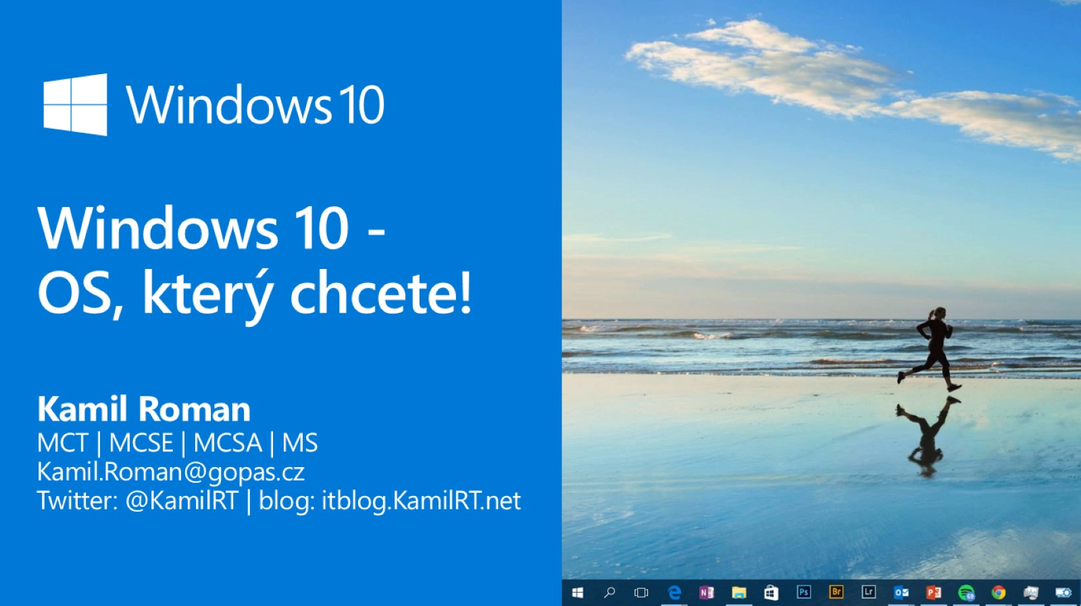
Windows 10 -
OS, který chcete!

Slide 3
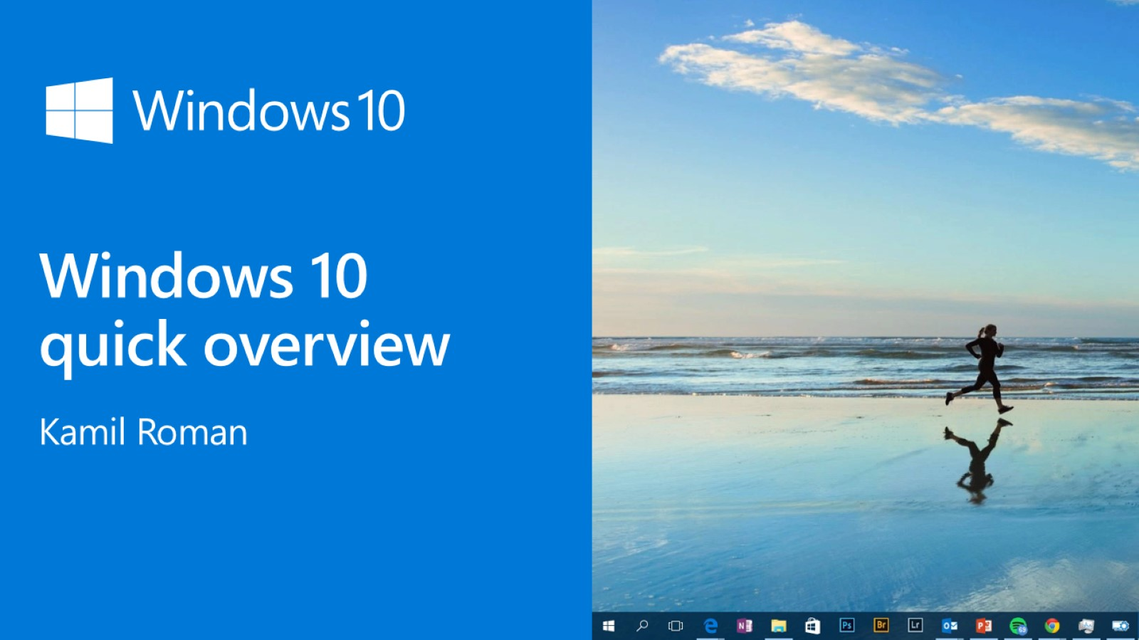
Windows 10 quick overview

Slide 4
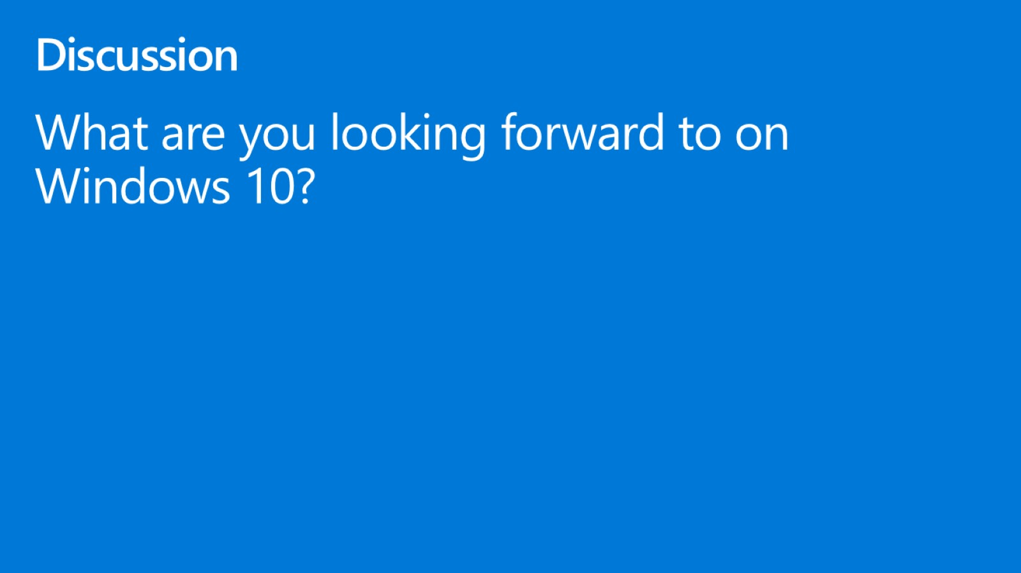
Discussion

Slide 5
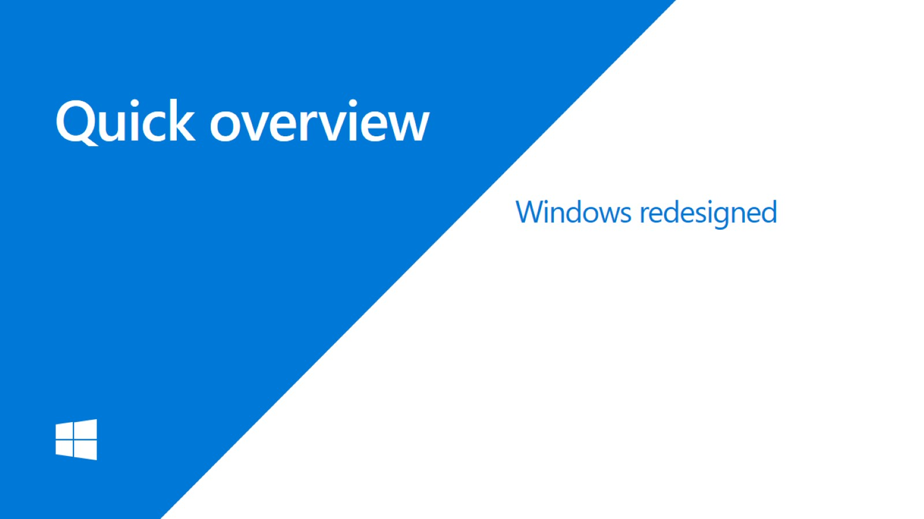
Quick overview

Slide 6
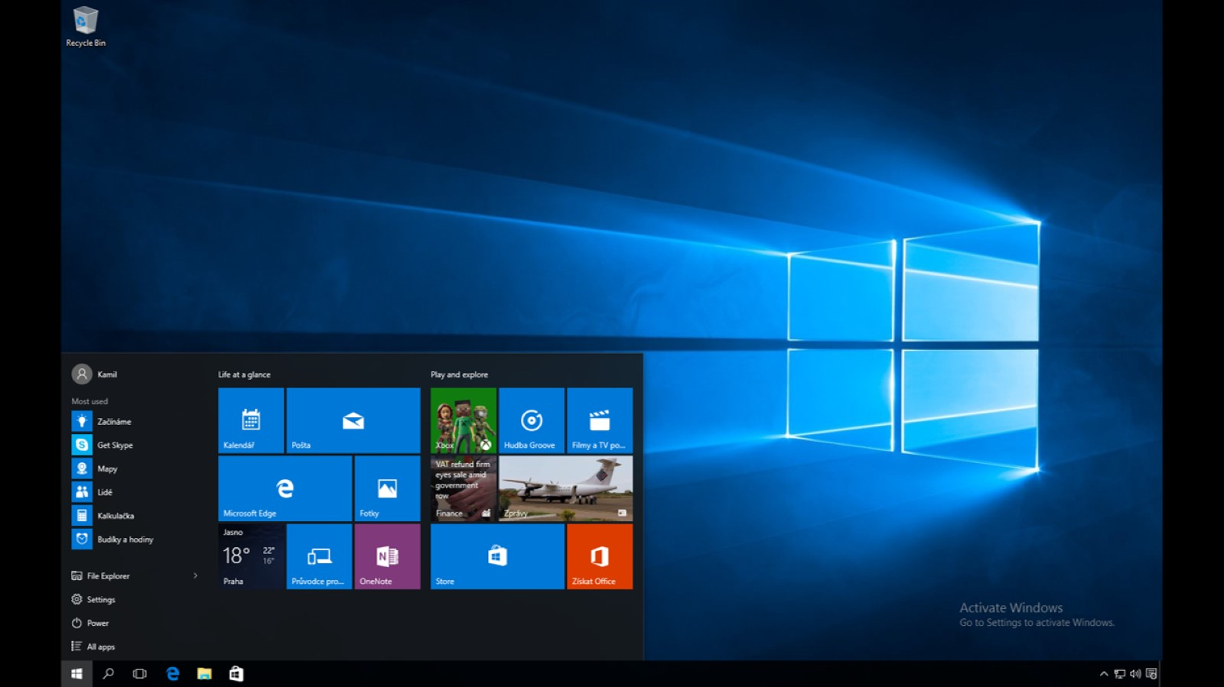

Slide 7
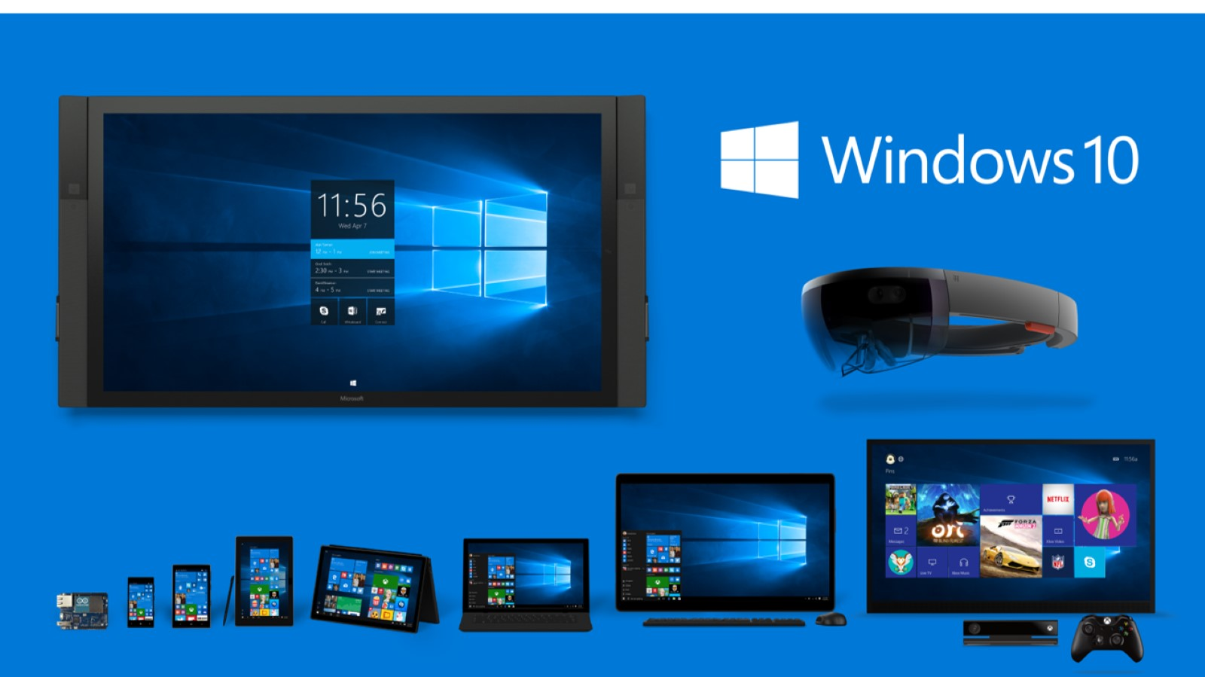

Slide 8
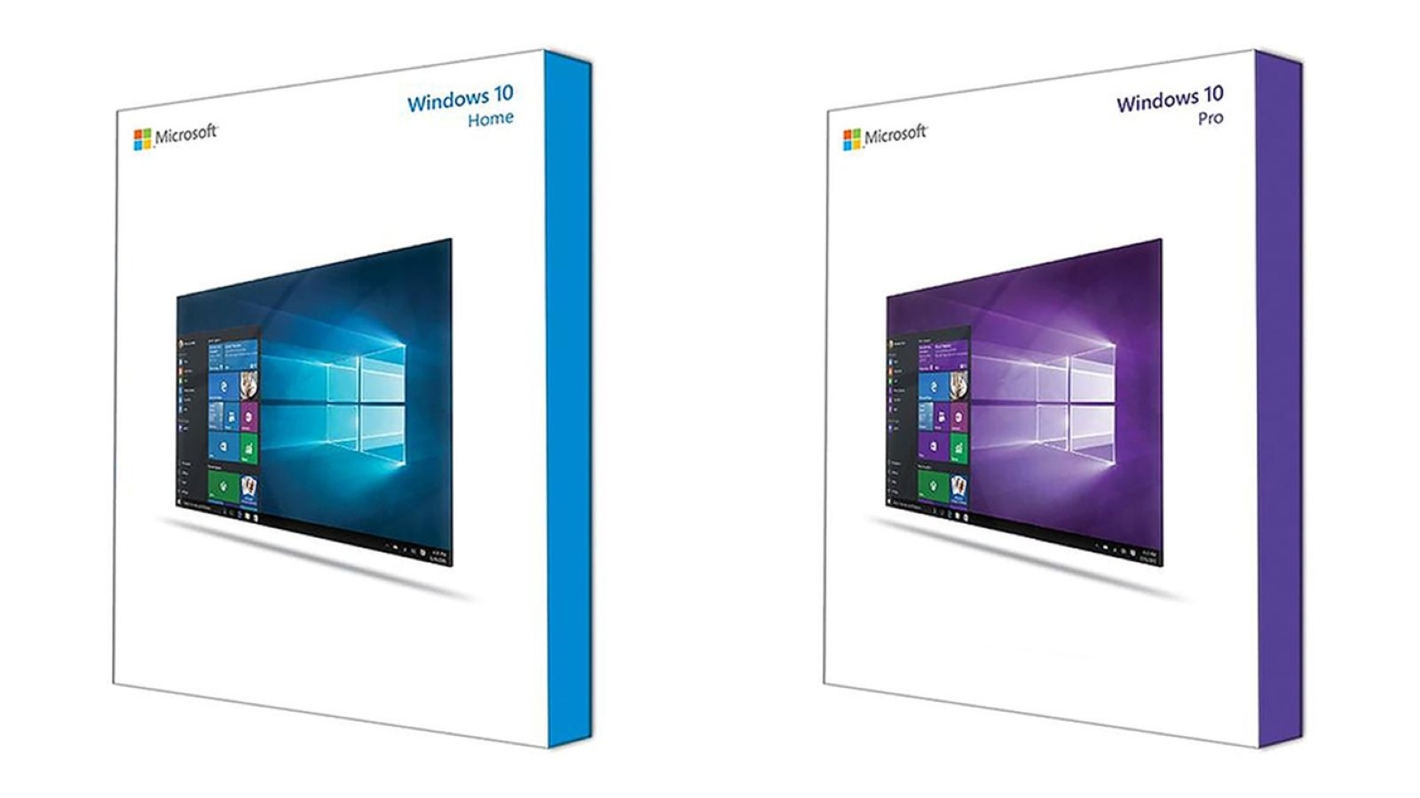

Slide 9

Quick overview

Slide 10
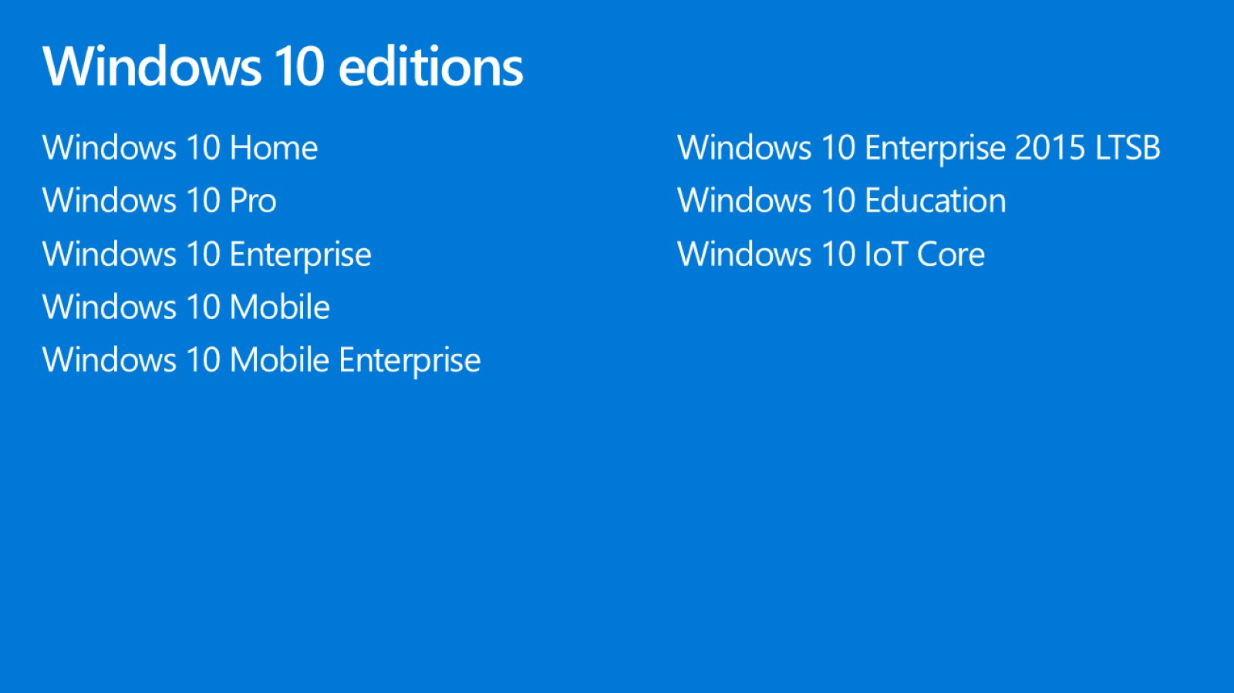
Windows 10 editions

Slide 11
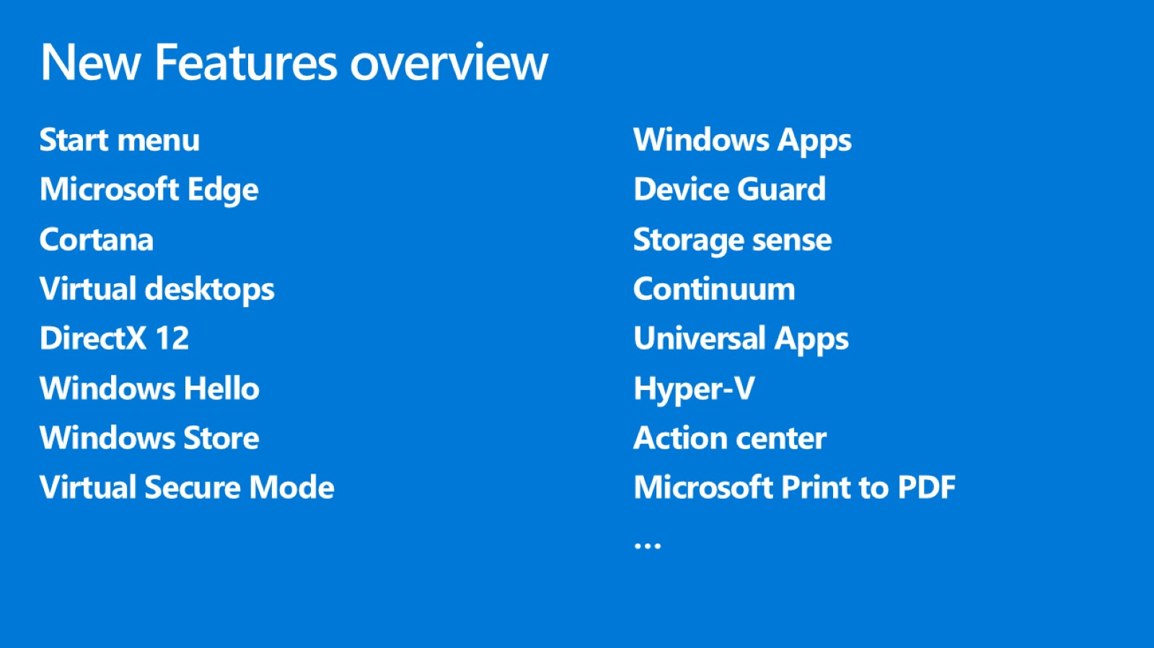
New Features overview

Slide 12

Start menu

Slide 13
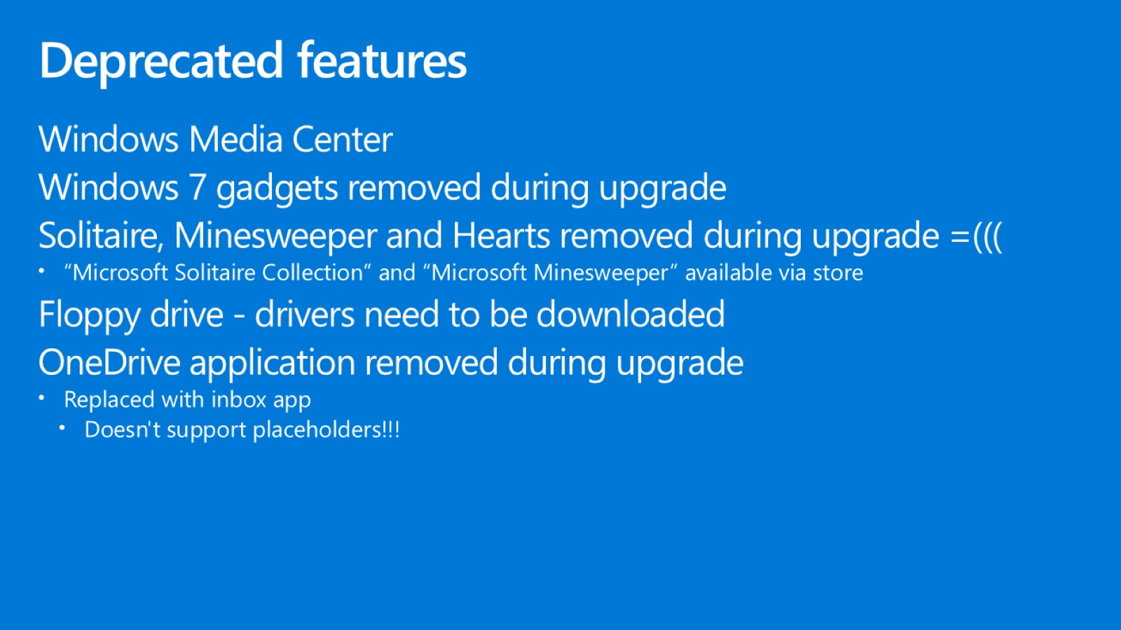
Deprecated features

Slide 14

Quick overview

Slide 15
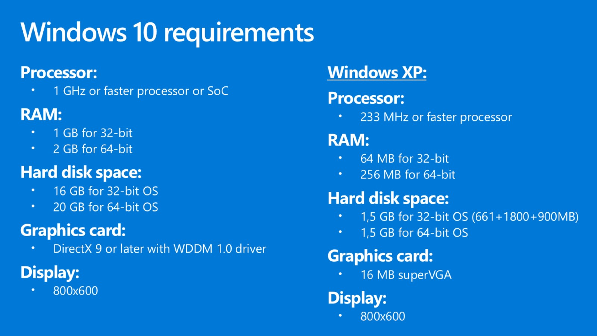
Windows 10 requirements

Slide 16
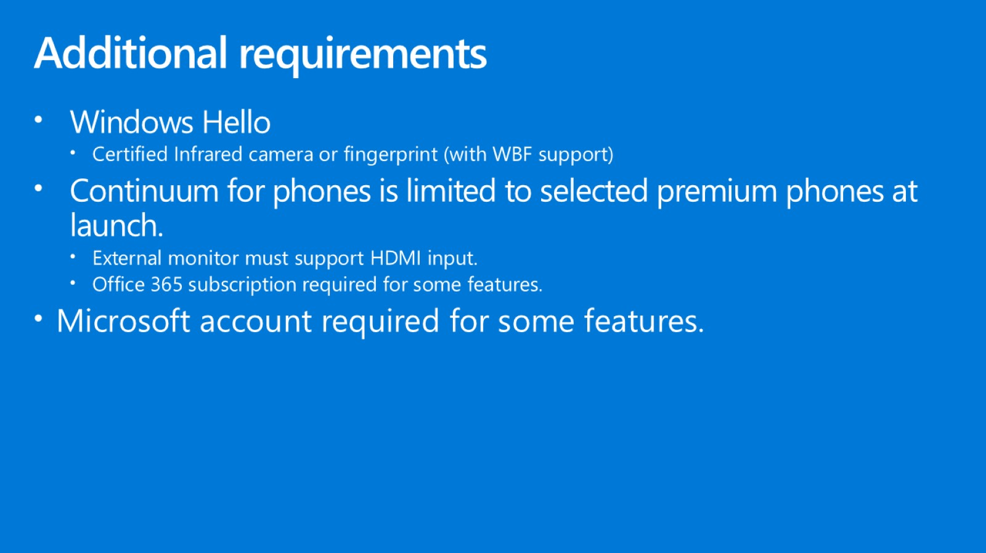
Additional requirements

Slide 17
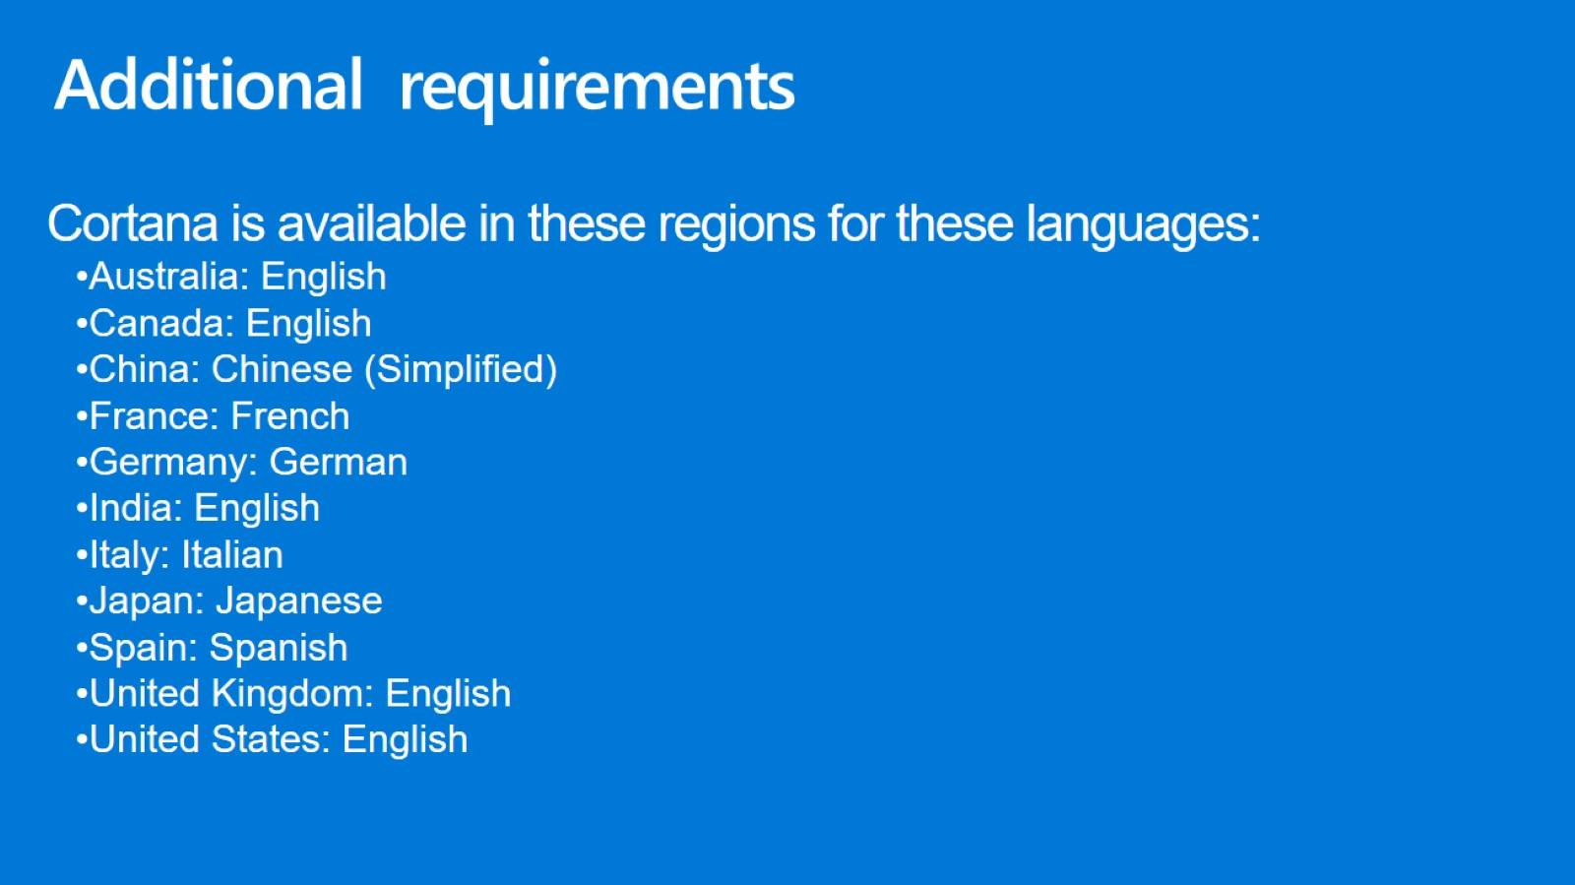
Additional requirements

Slide 18
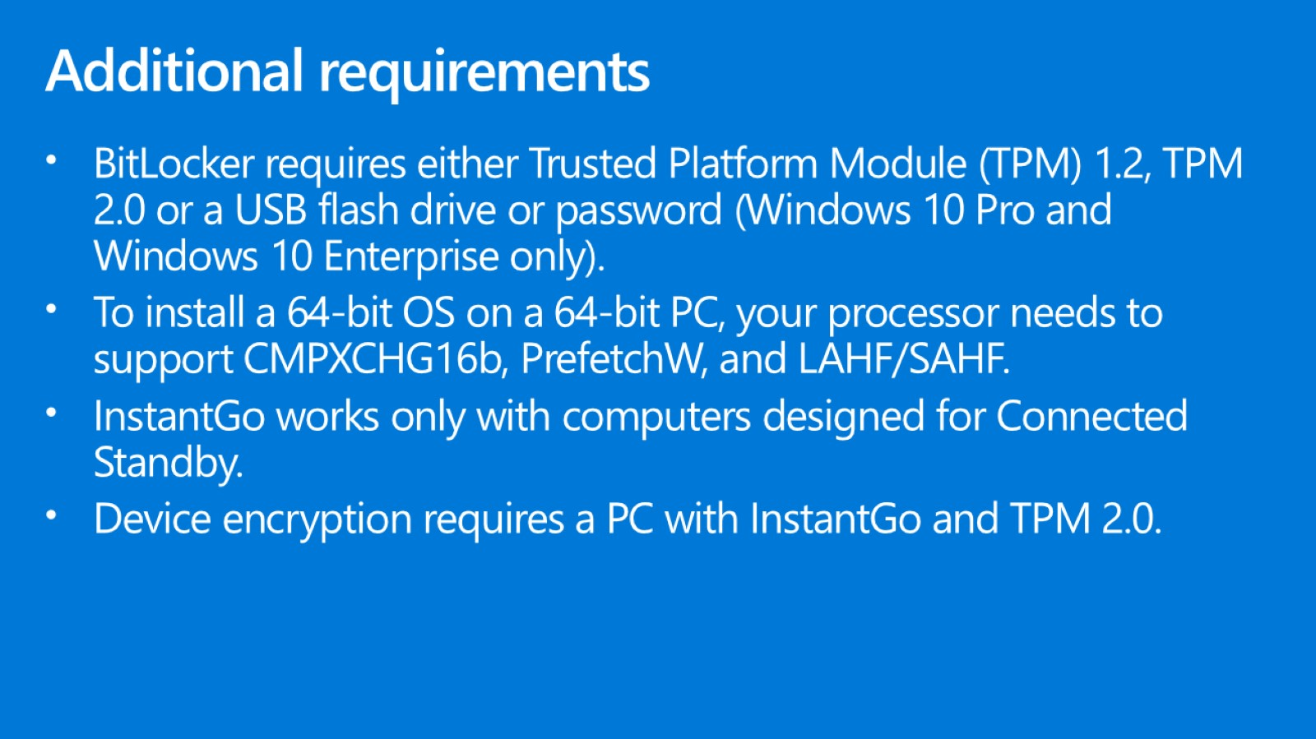
Additional requirements

Slide 19
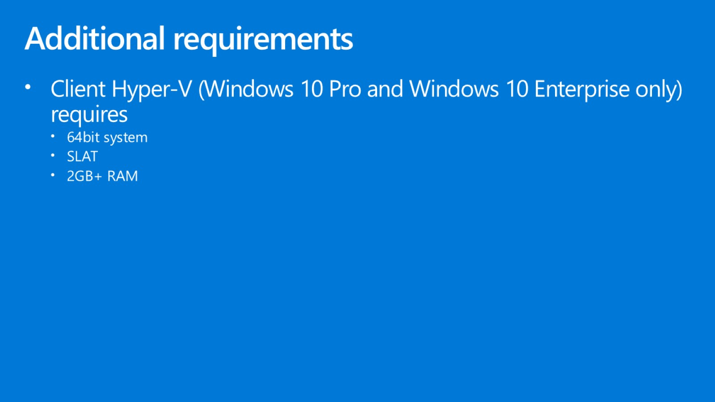
Additional requirements

Slide 20

Quick overview

Slide 21
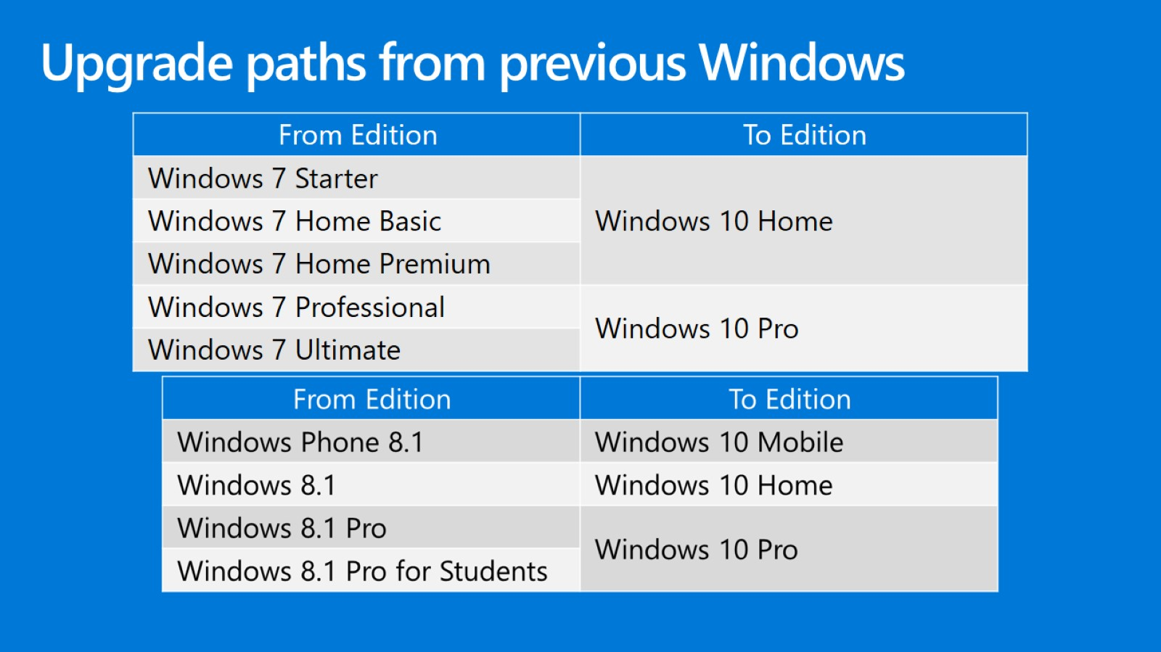
Upgrade paths from previous Windows

Slide 22
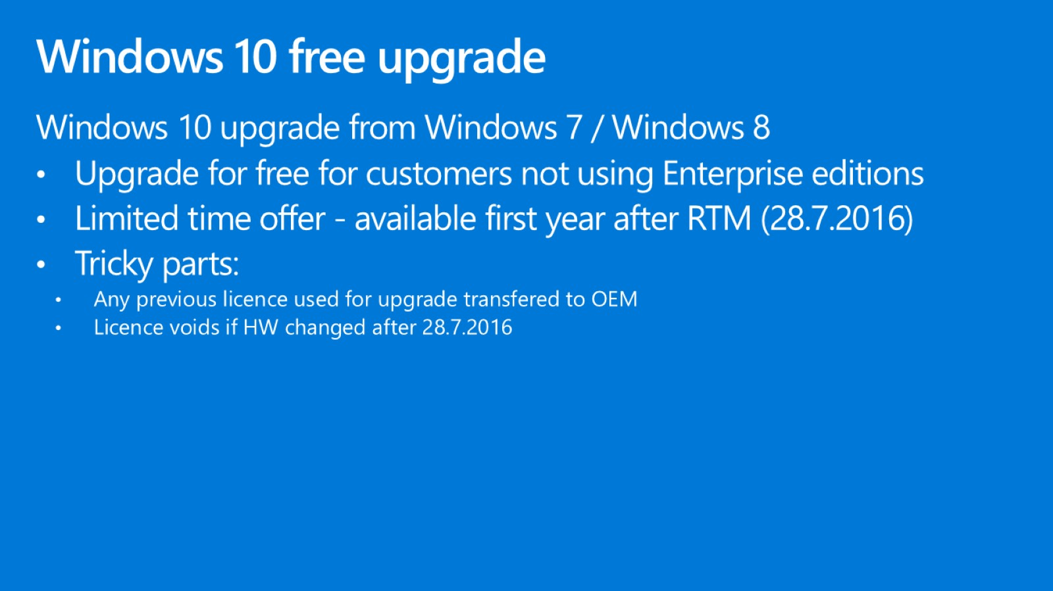
Windows 10 free upgrade

Slide 23
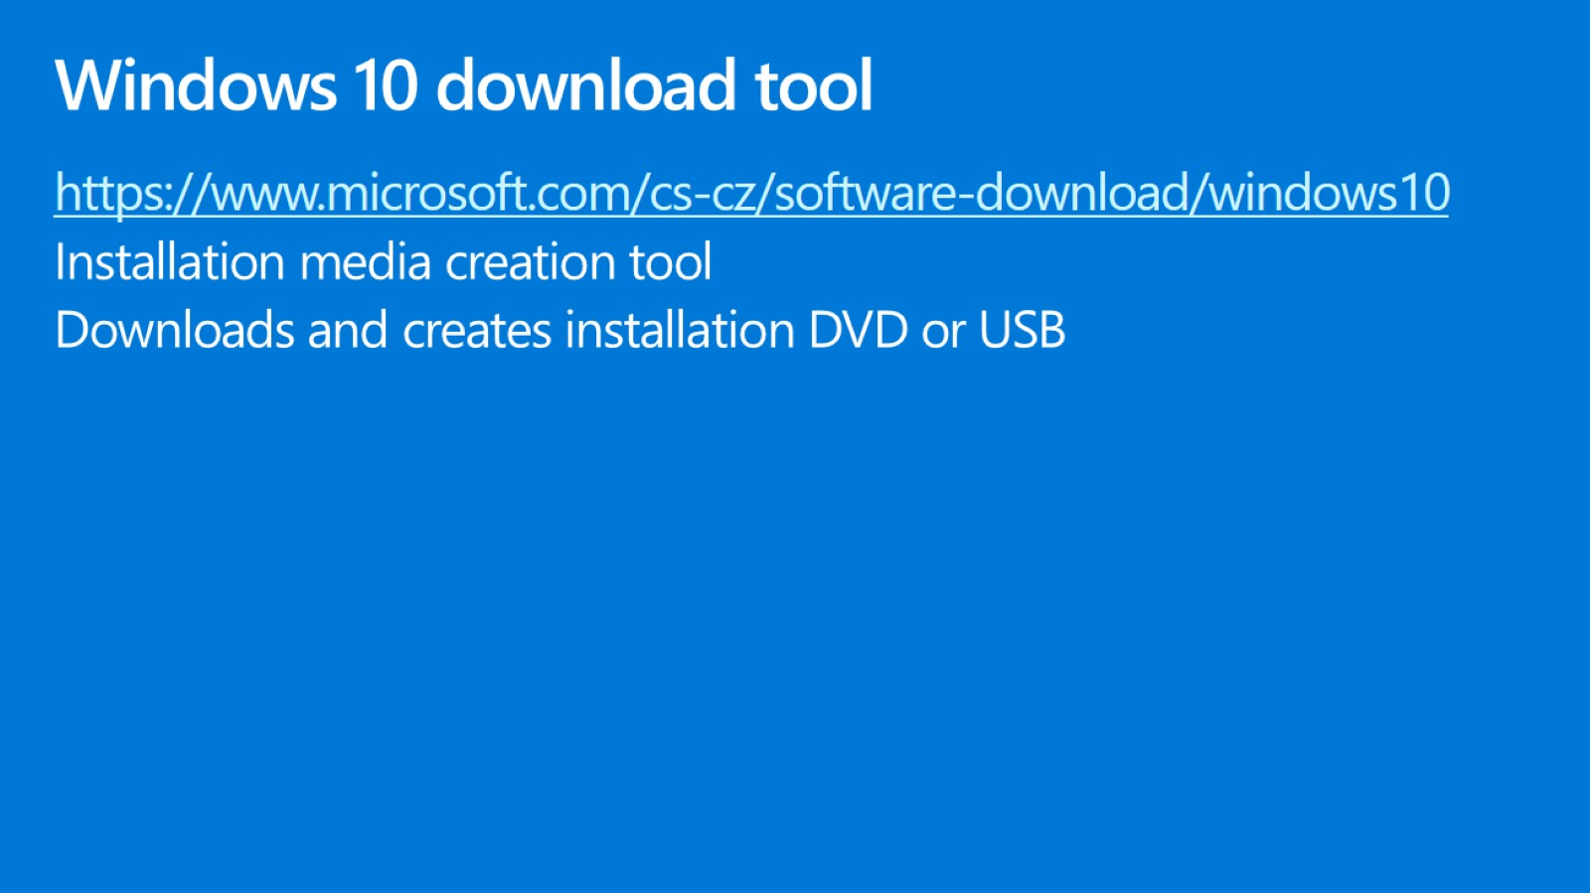
Windows 10 download tool

Slide 24
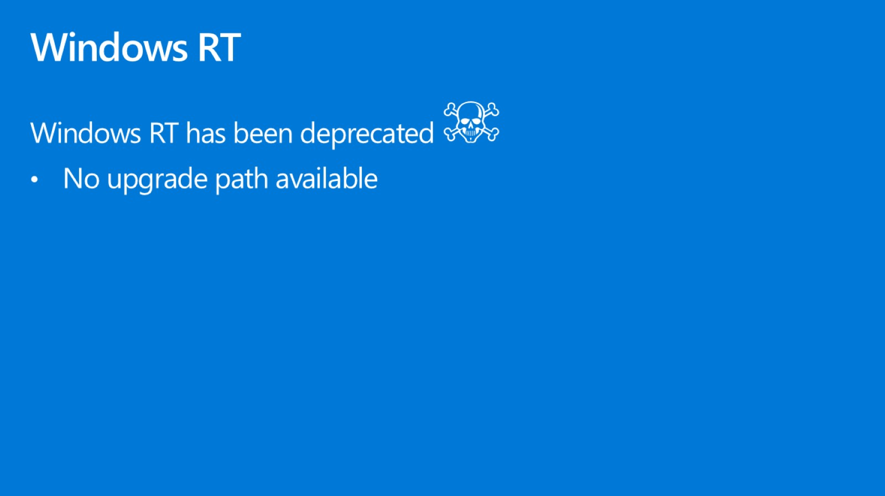
Windows RT

Slide 25
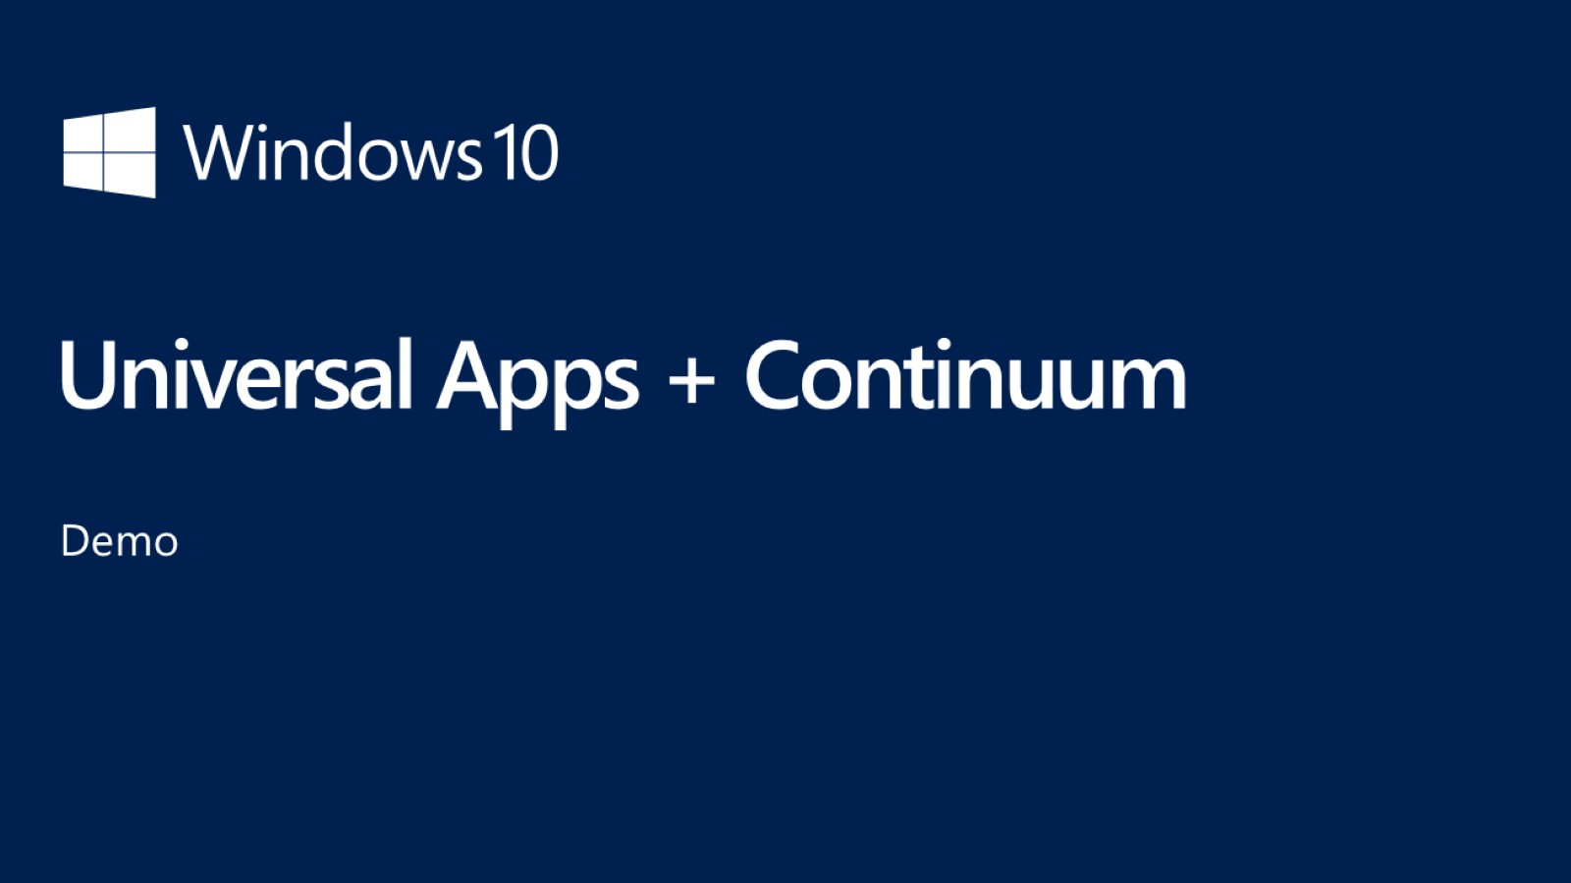
Universal Apps + Continuum

Slide 26
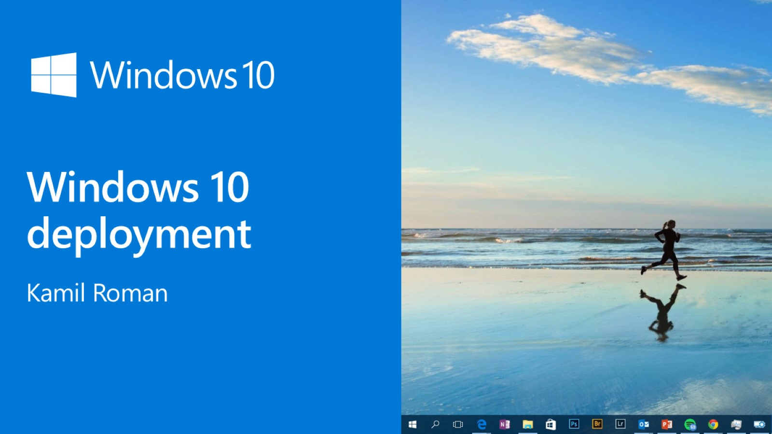
Windows 10 deployment

Slide 27
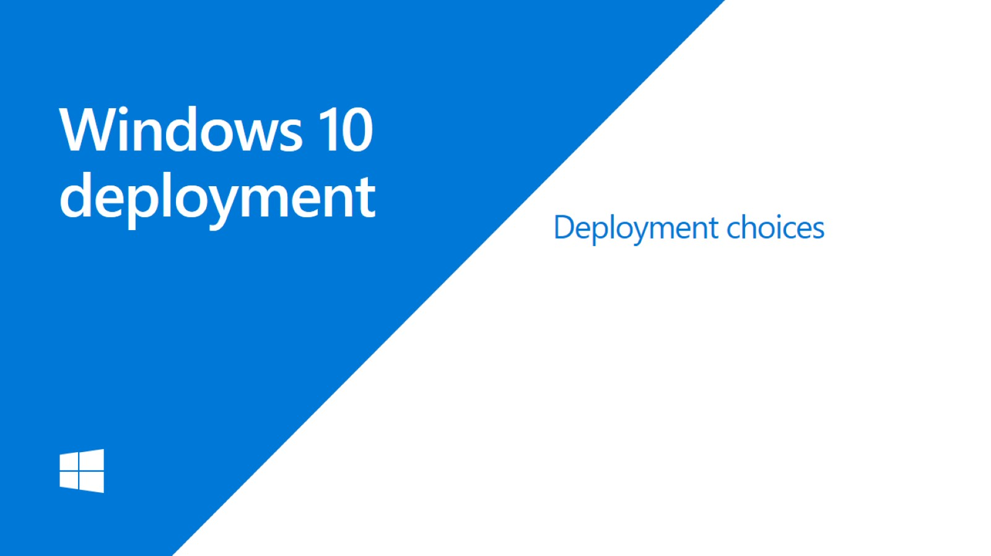
Windows 10 deployment

Slide 28
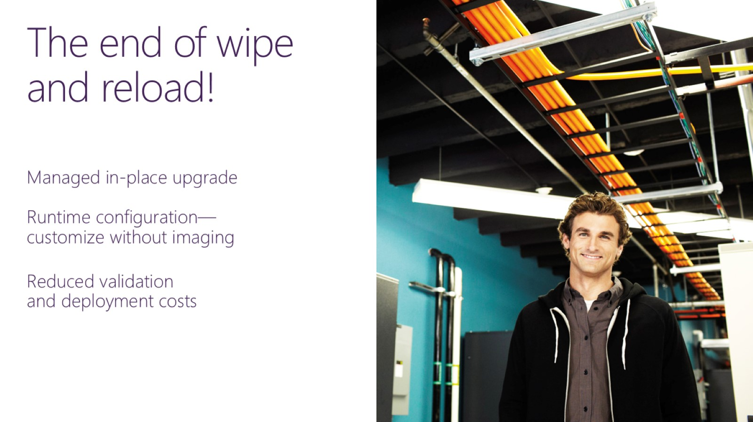
The end of wipe and reload!

Slide 29
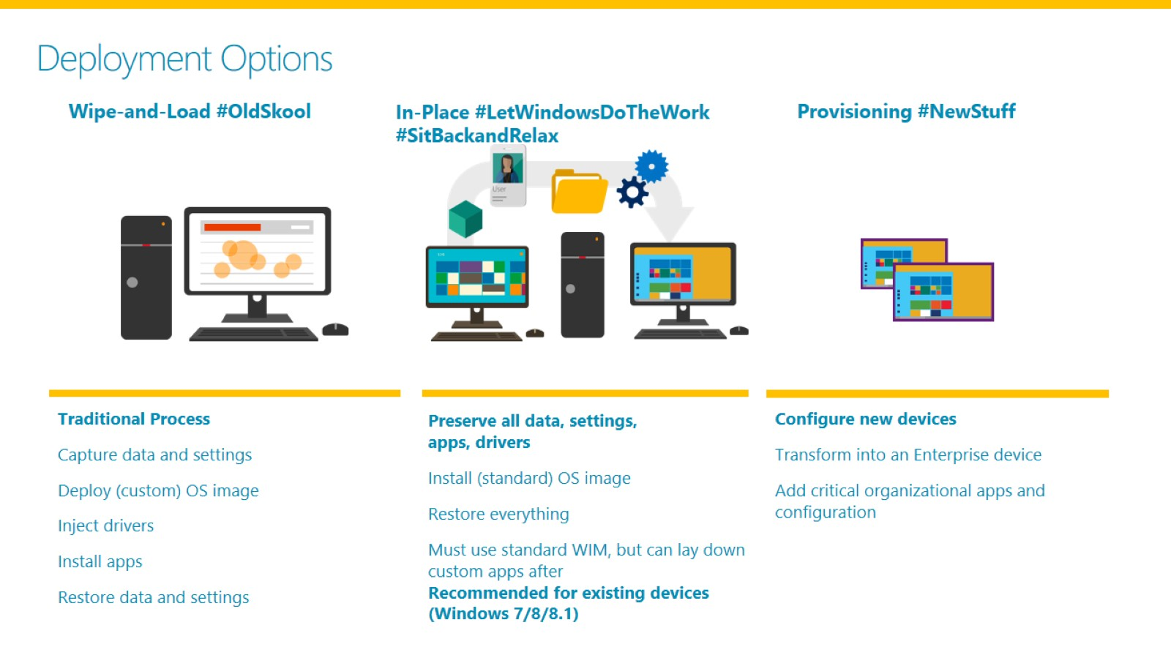
Deployment Options

Slide 30
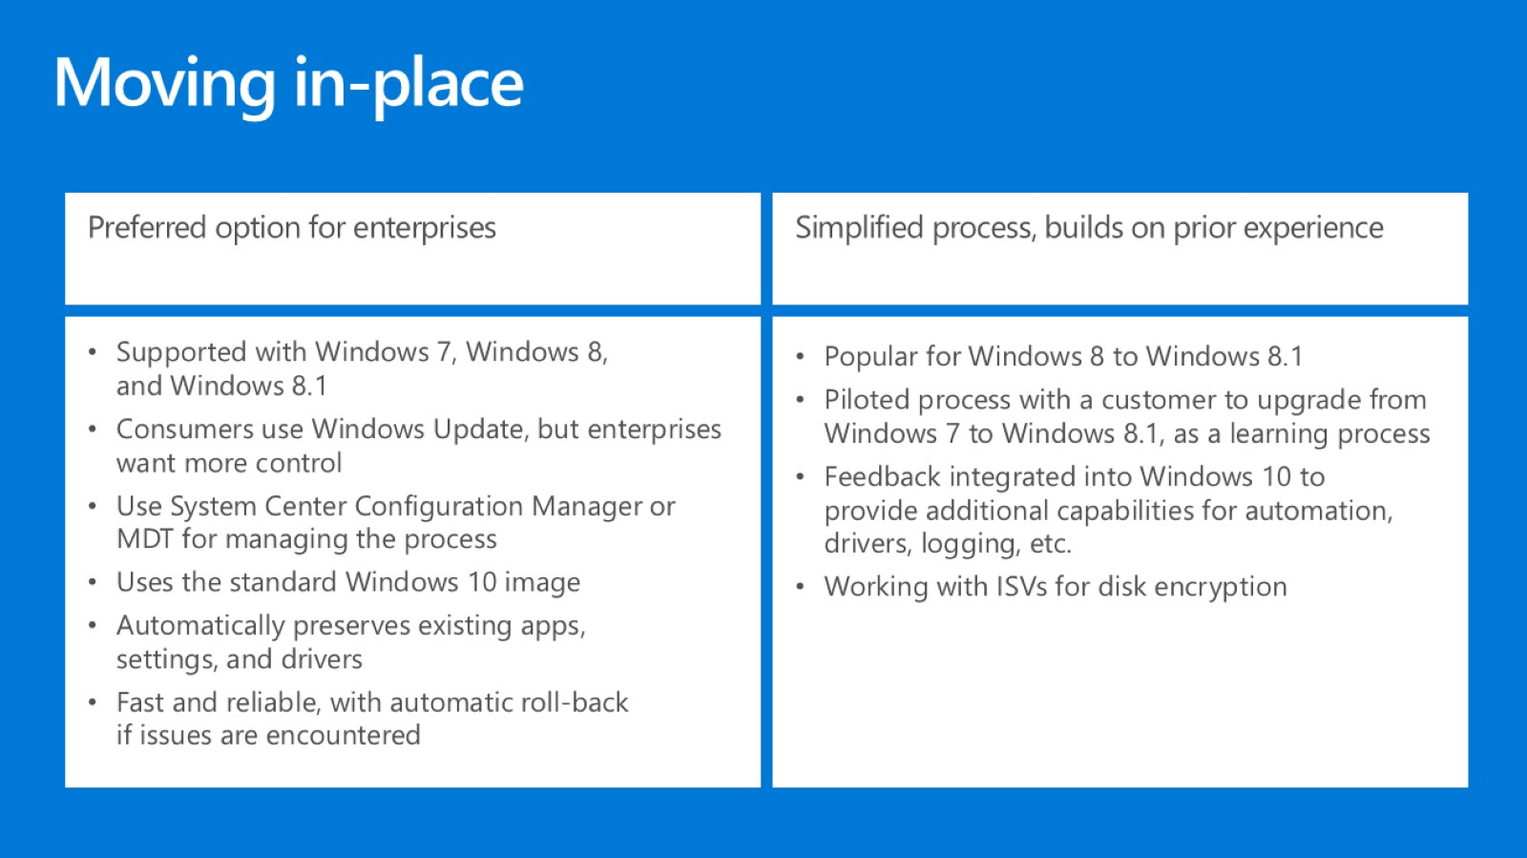
Moving in-place

Slide 31
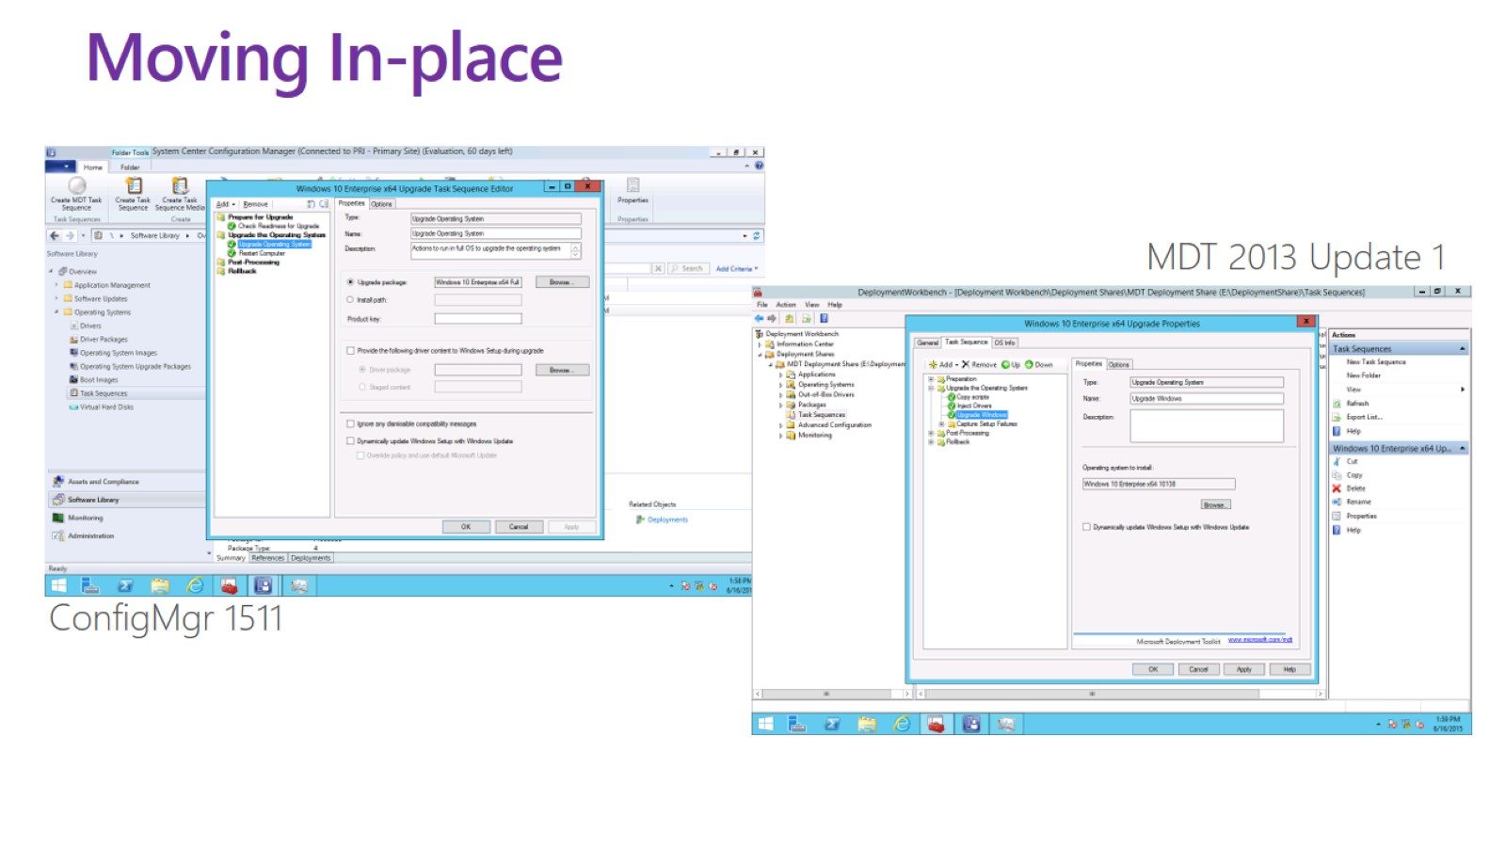
Moving In-place

Slide 32
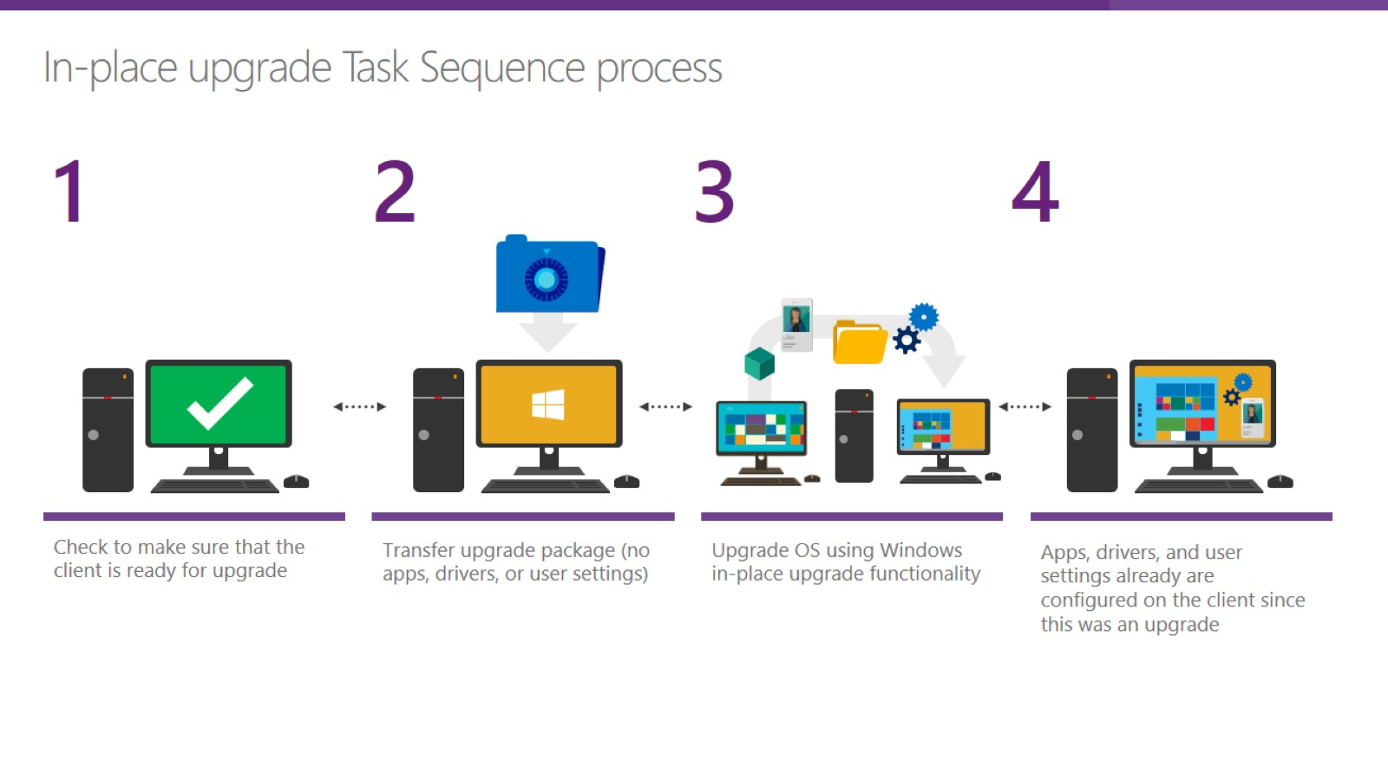

Slide 33
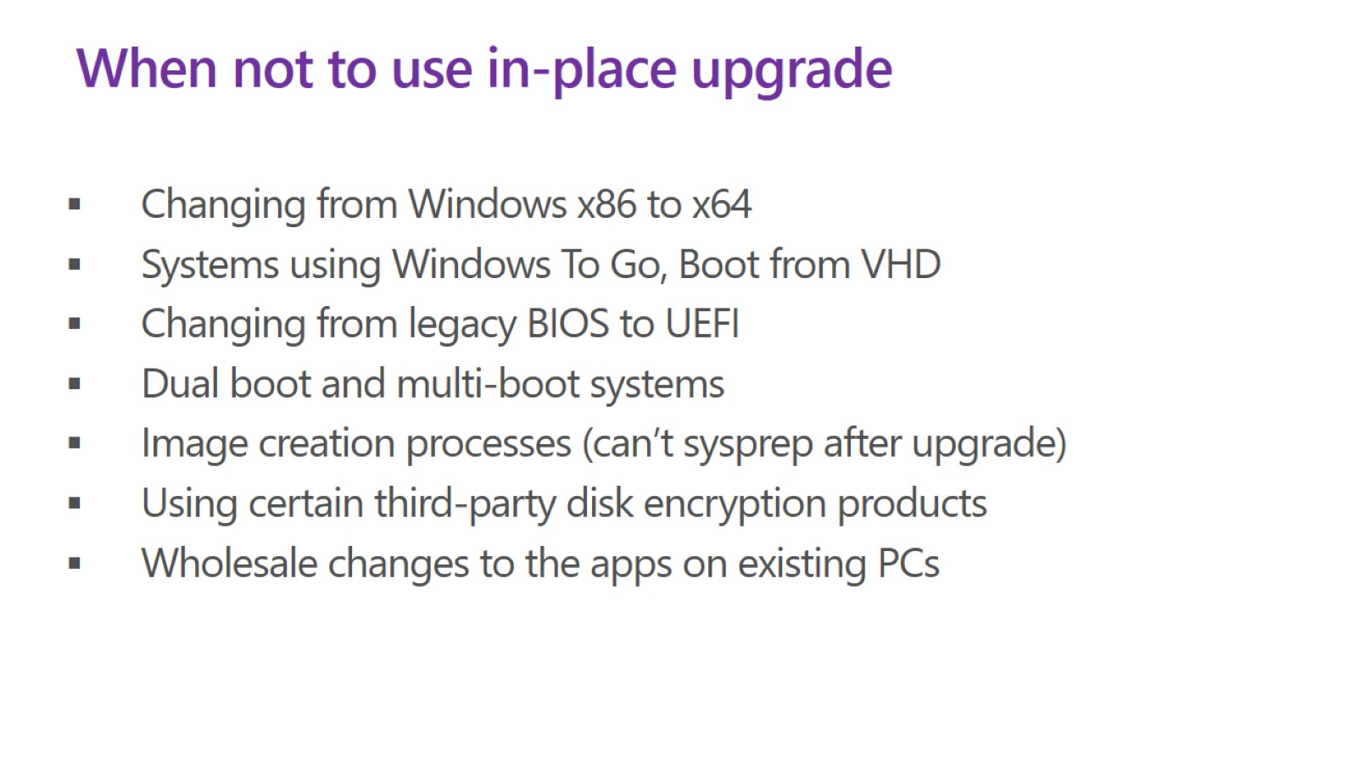
When not to use in-place upgrade

Slide 34
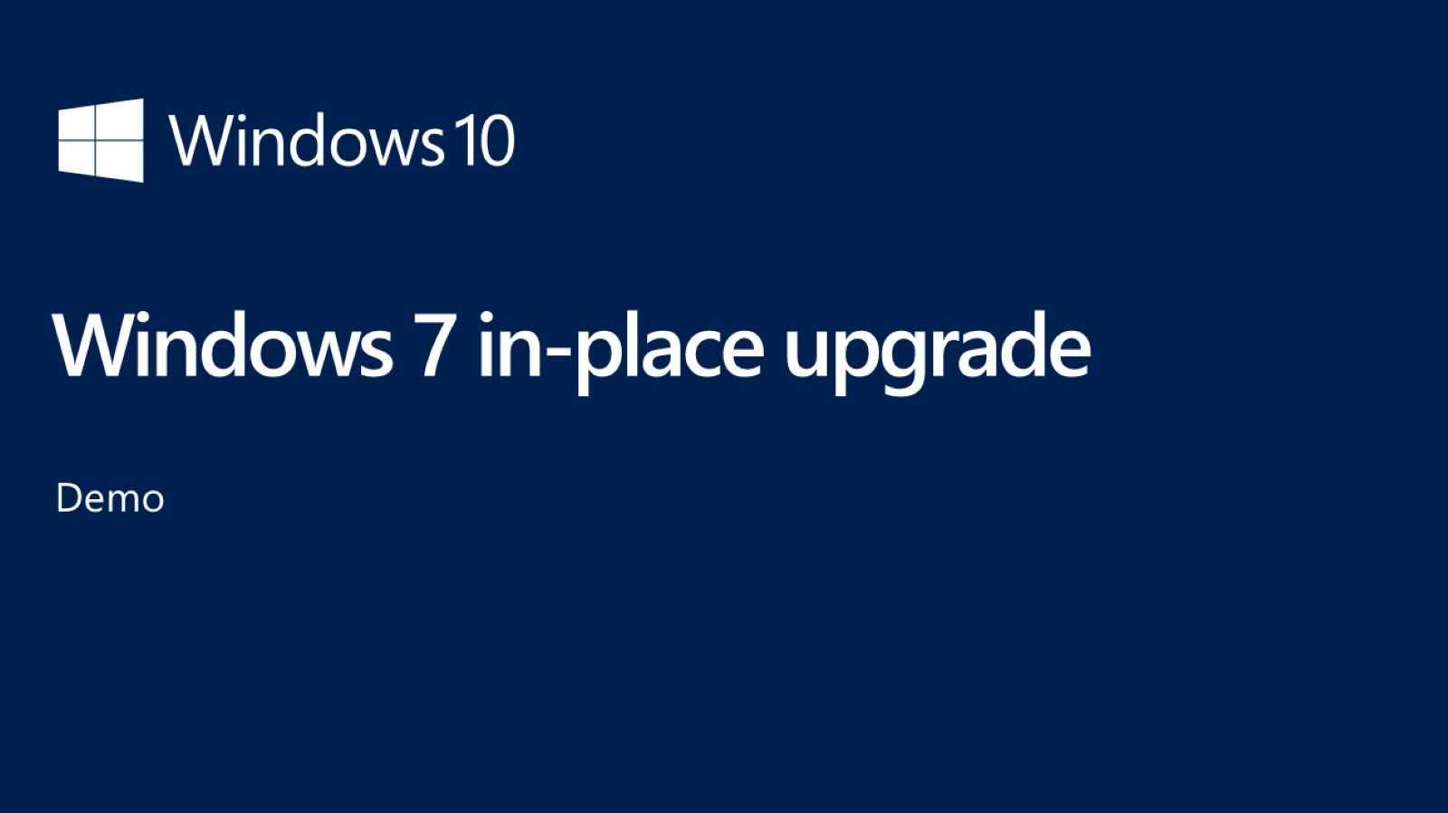
Windows 7 in-place upgrade

Slide 35
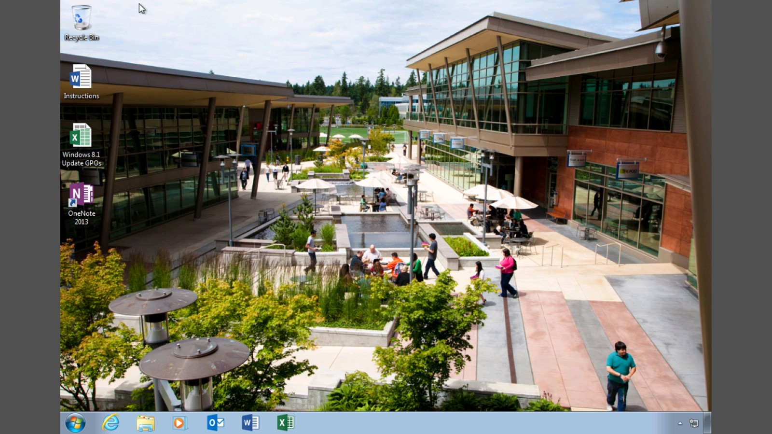

Slide 36
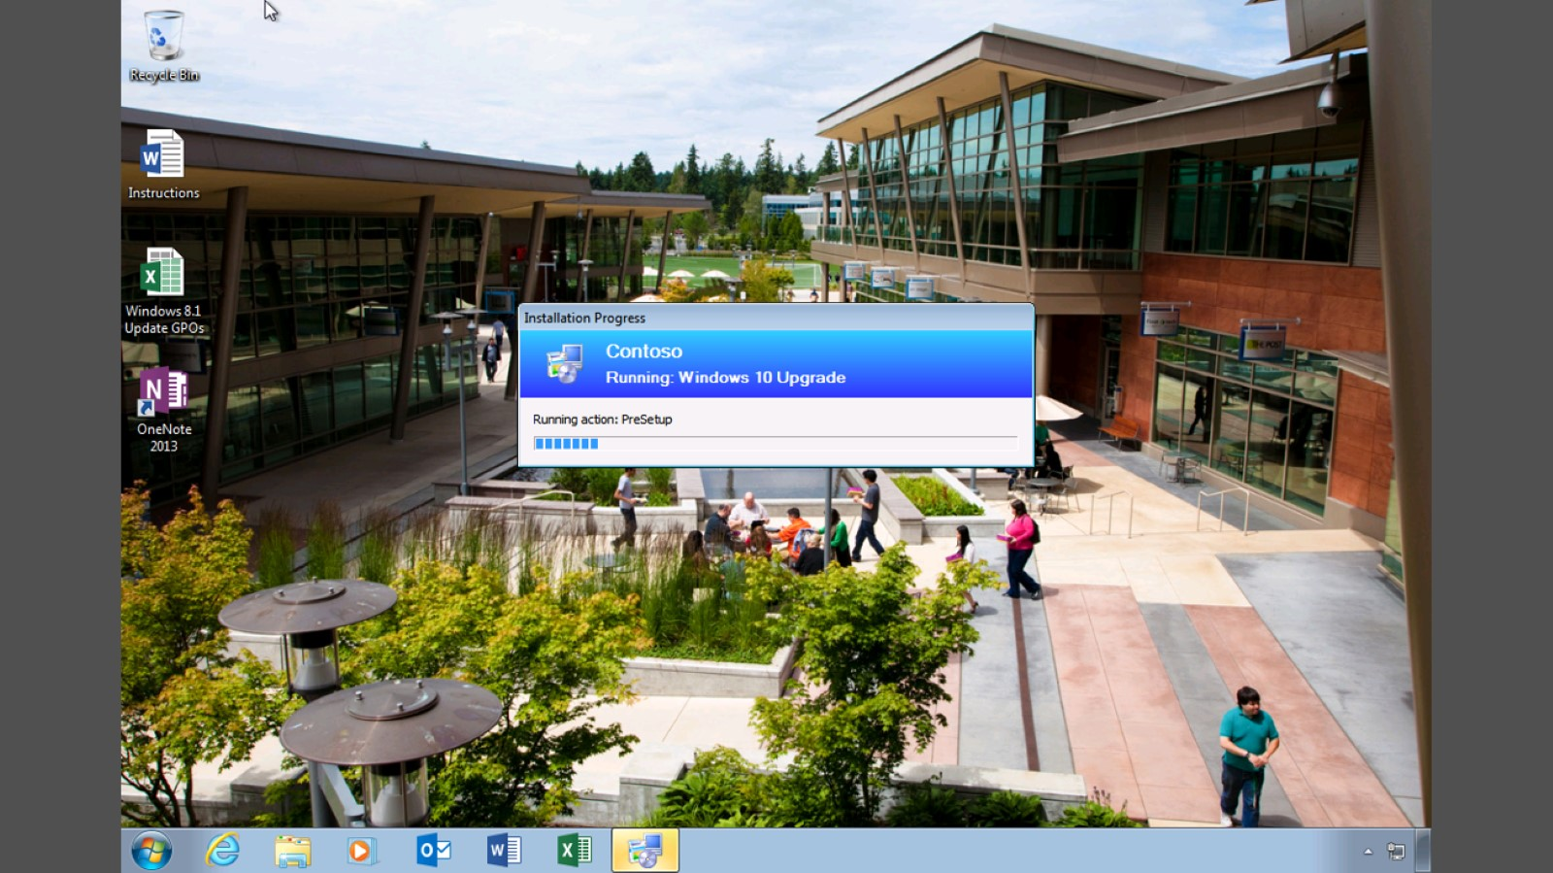

Slide 37


Slide 38
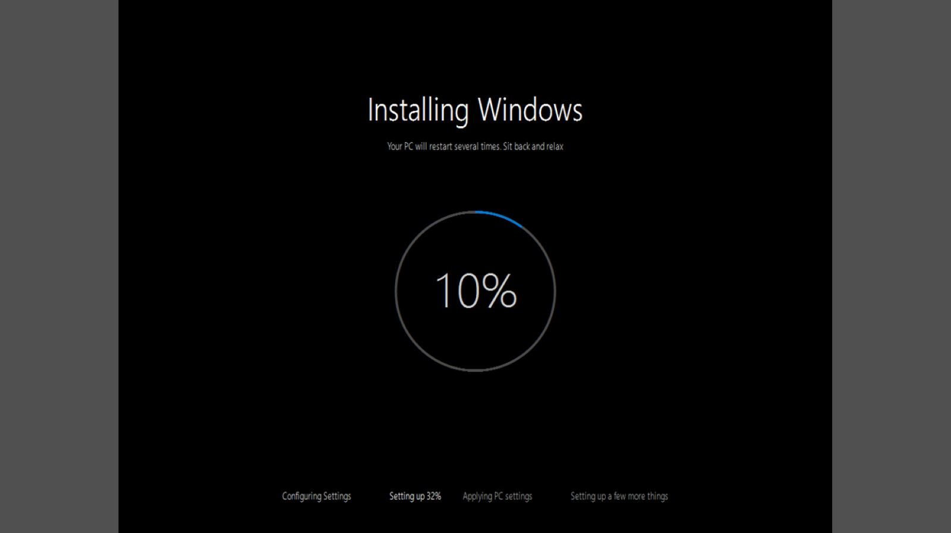

Slide 39
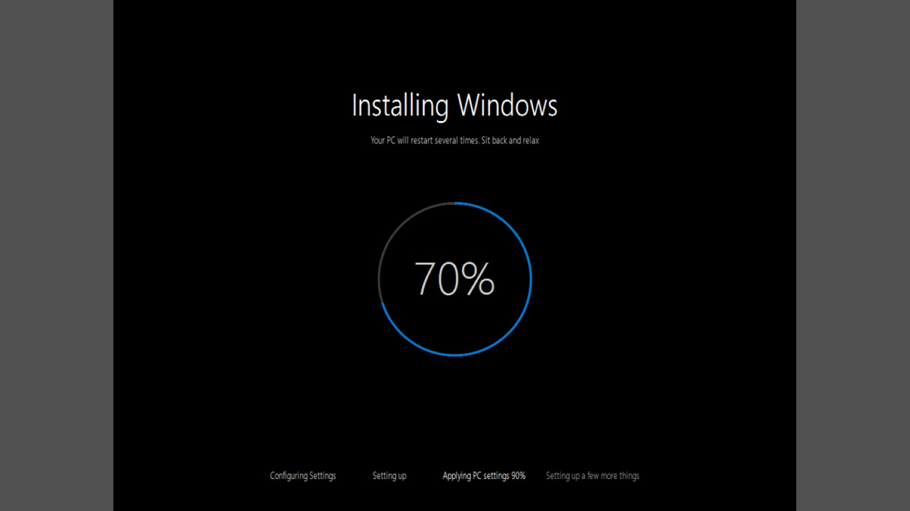

Slide 40
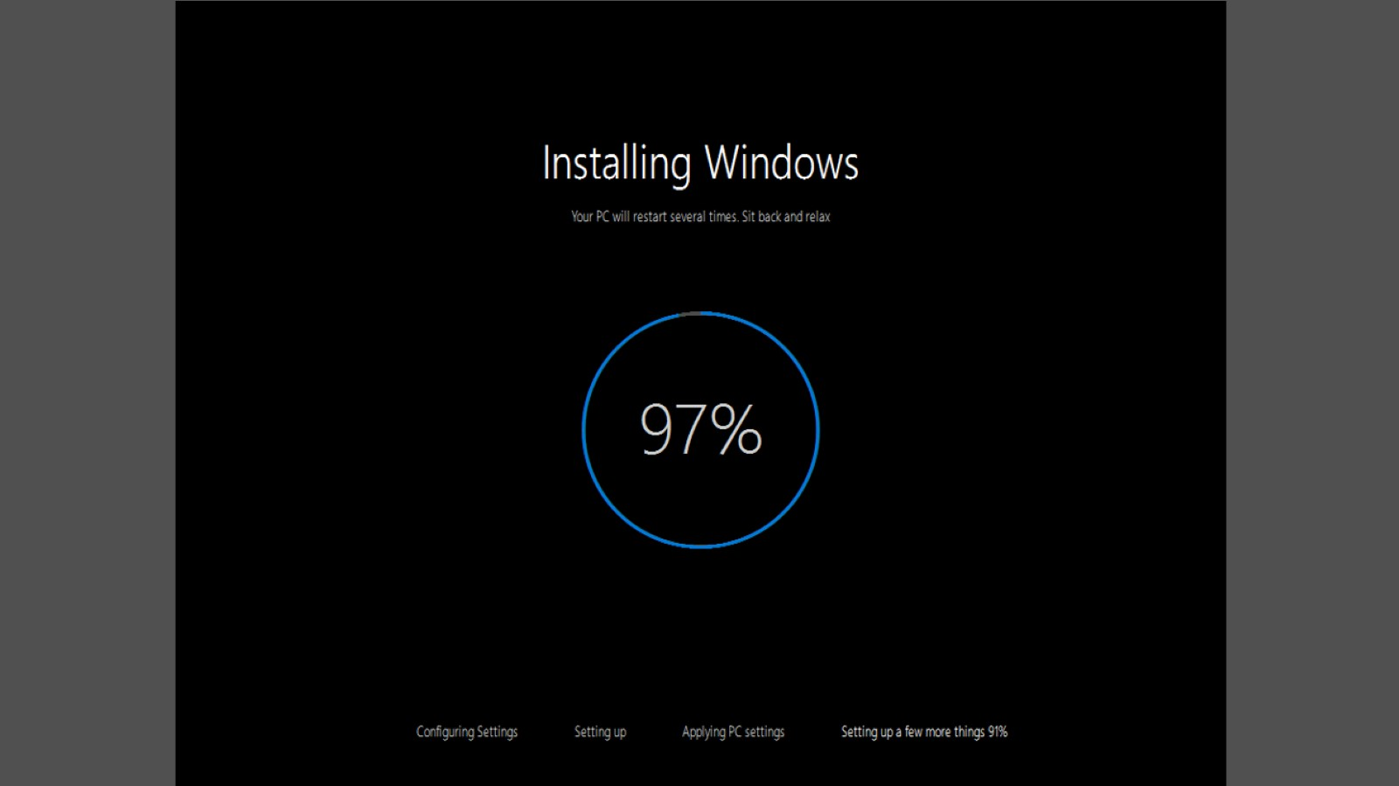

Slide 41
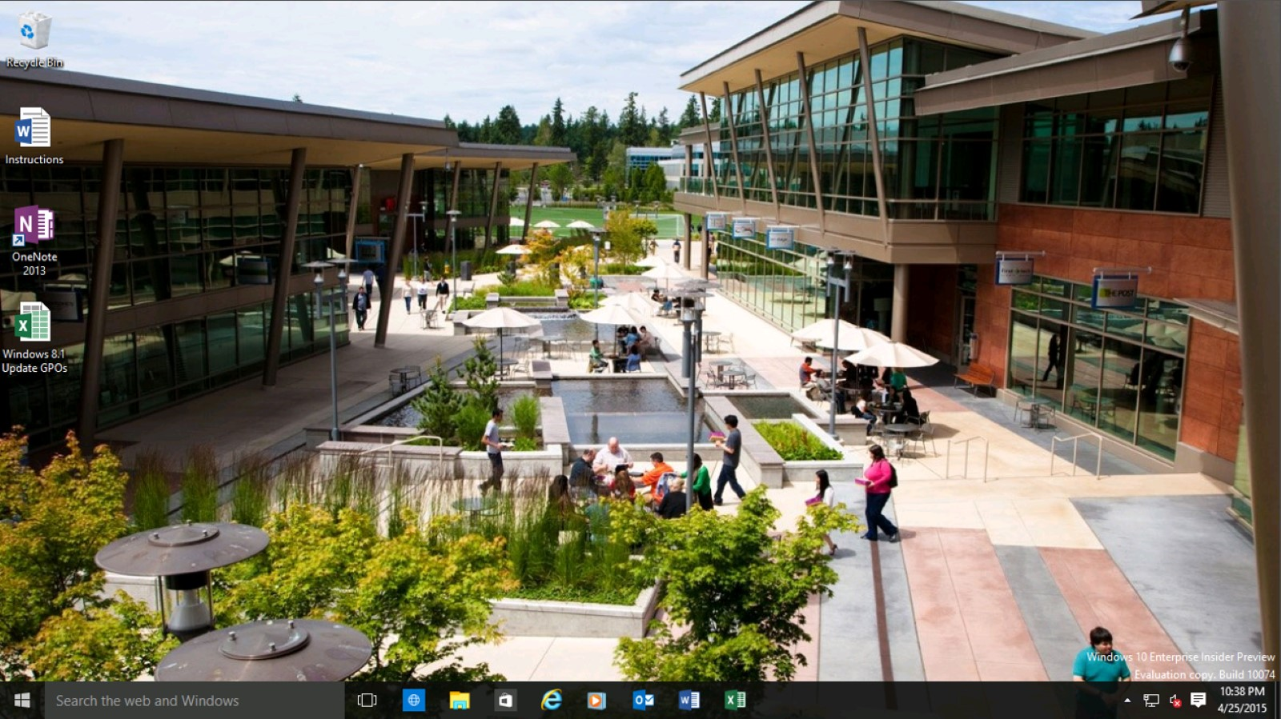

Slide 42
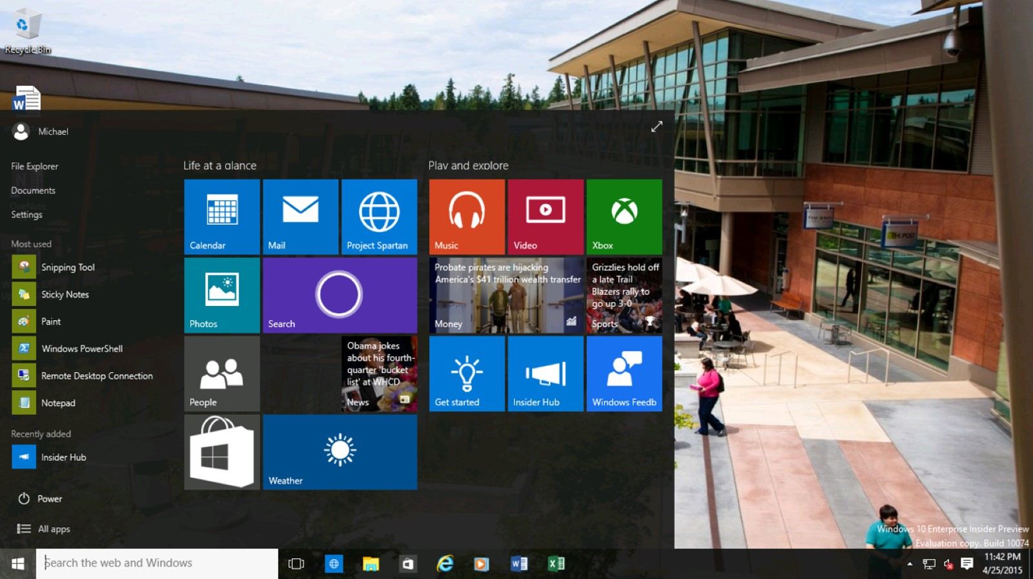

Slide 43
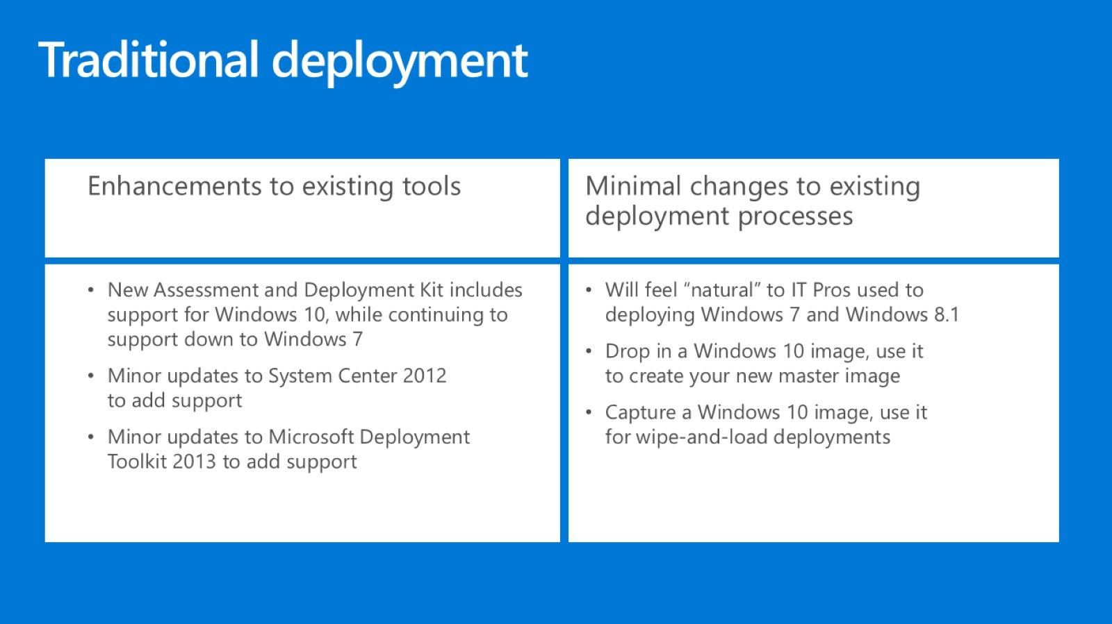
Traditional deployment

Slide 44
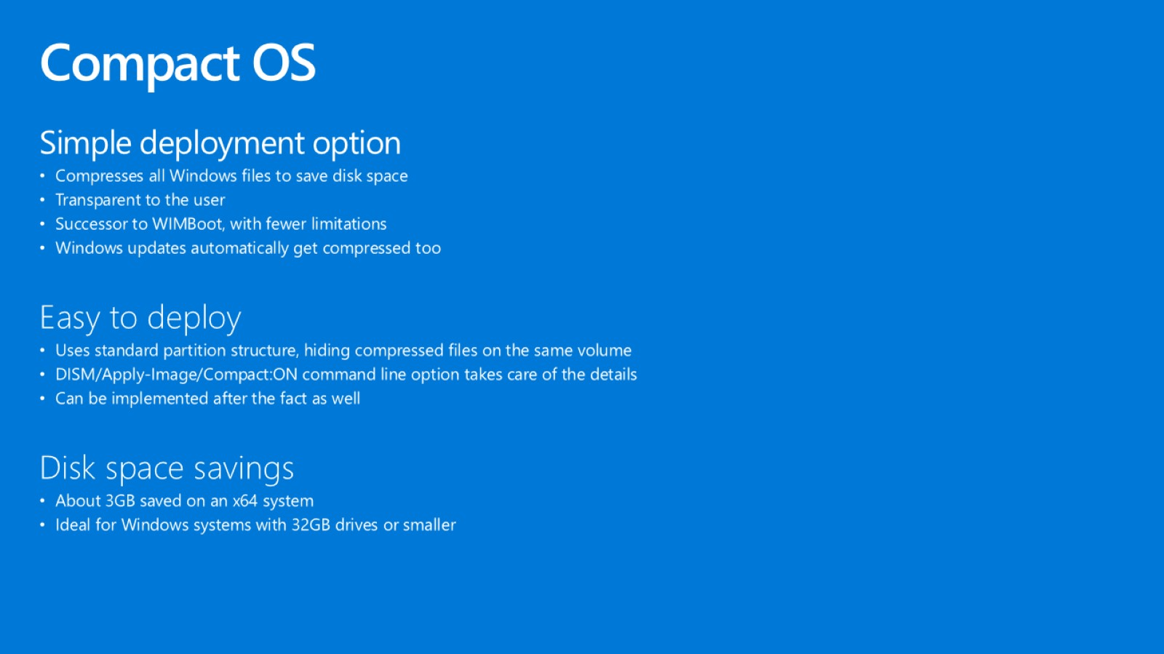
Compact OS

Slide 45

Compact OS

Slide 46
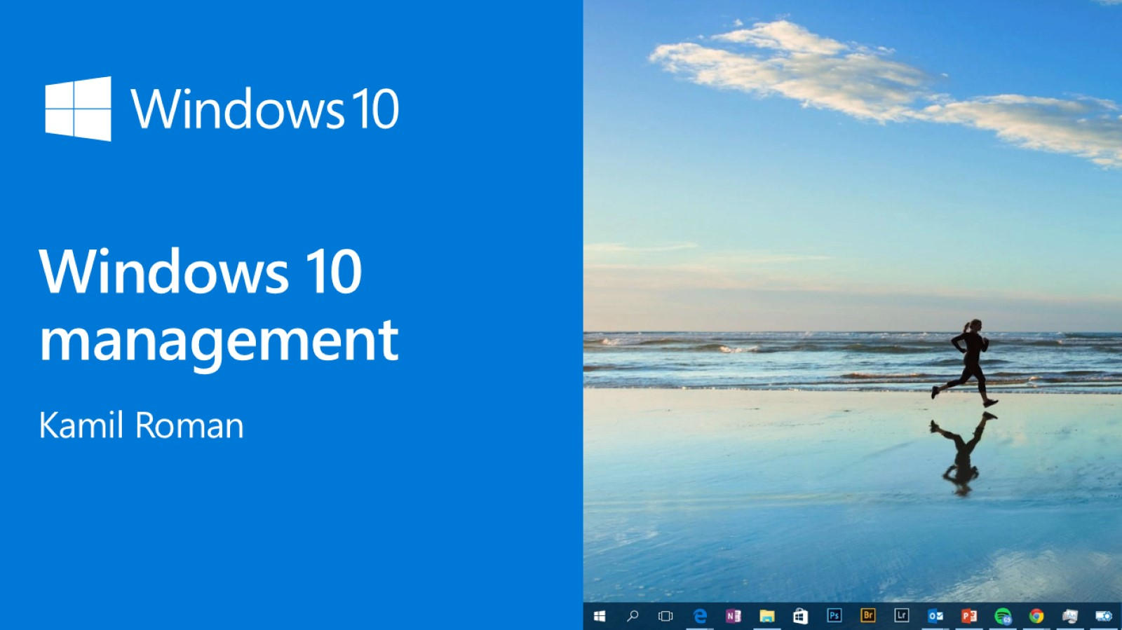
Windows 10 management

Slide 47

Windows as a service

Slide 48
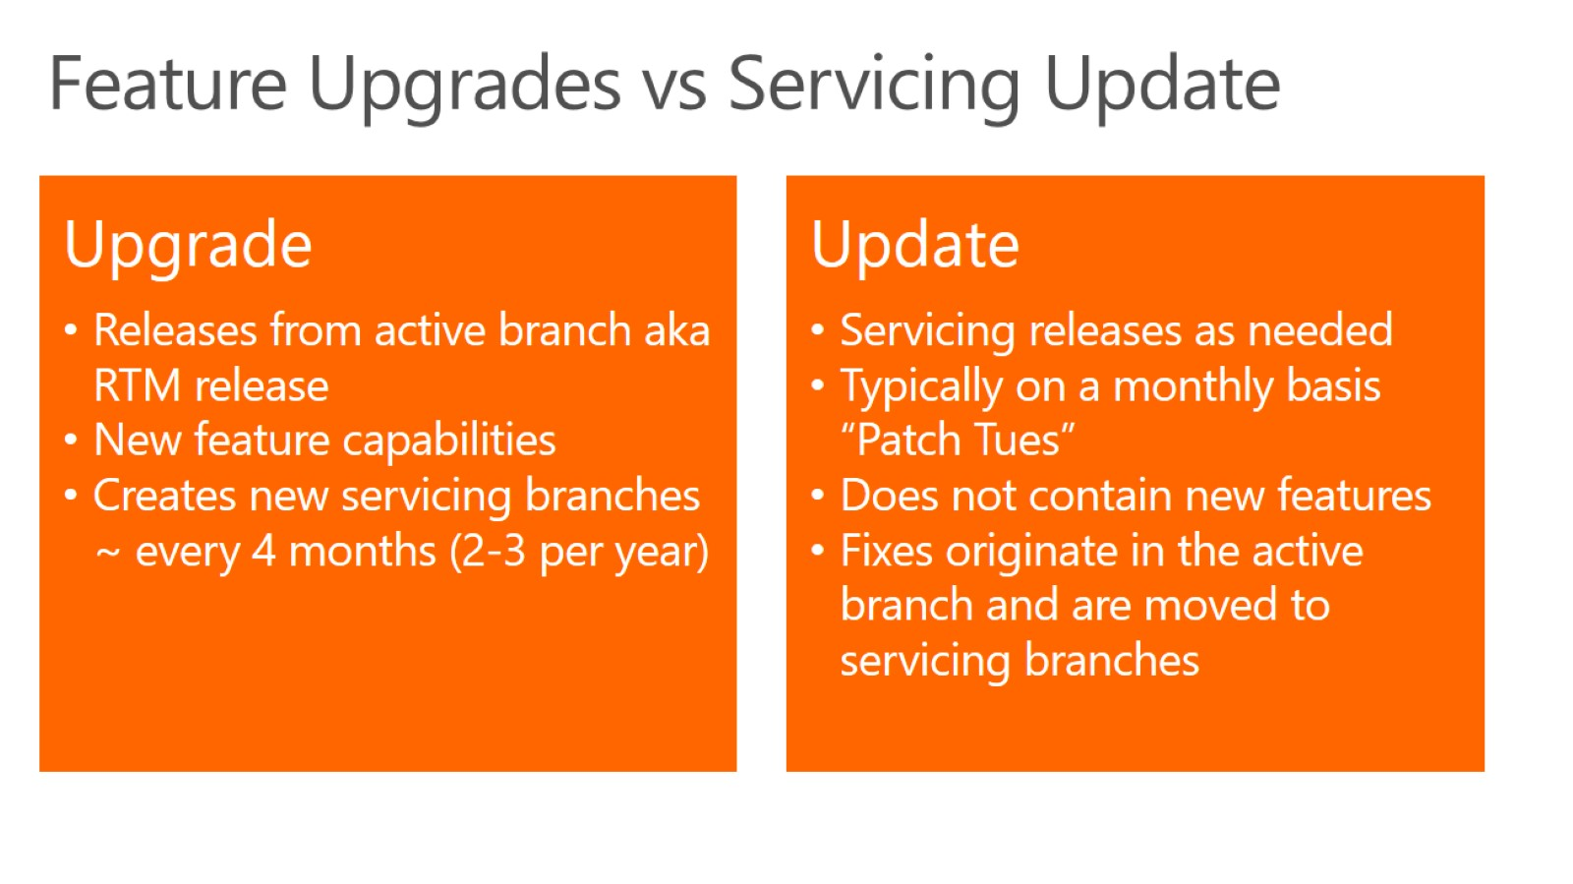

Slide 49
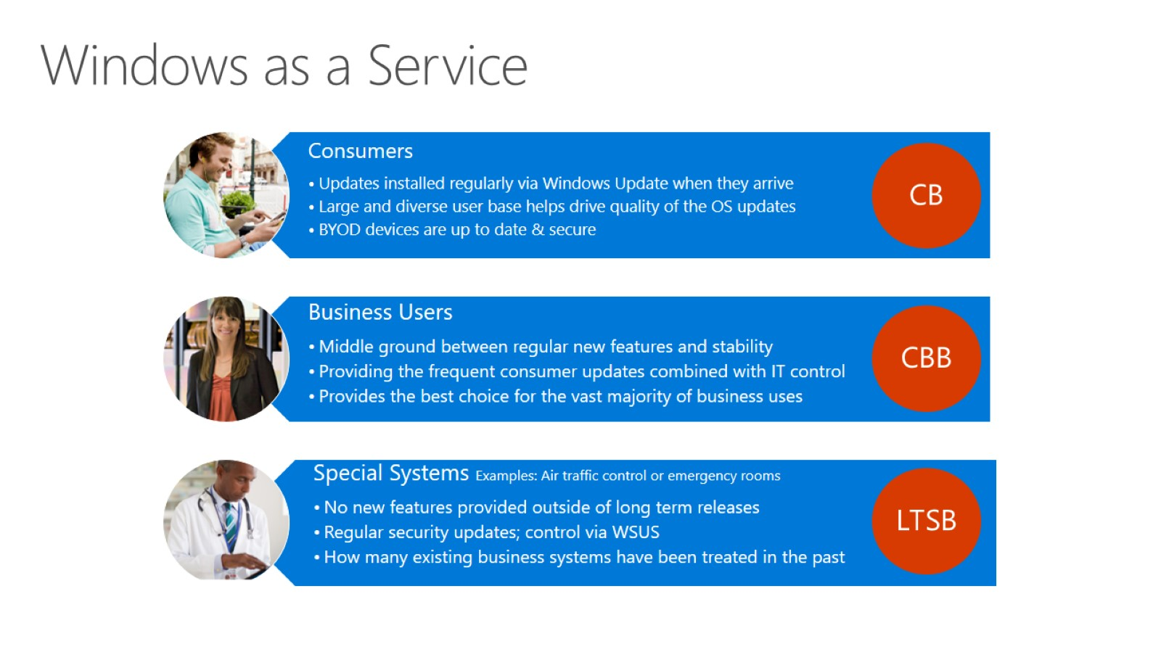
Windows as a Service

Slide 50
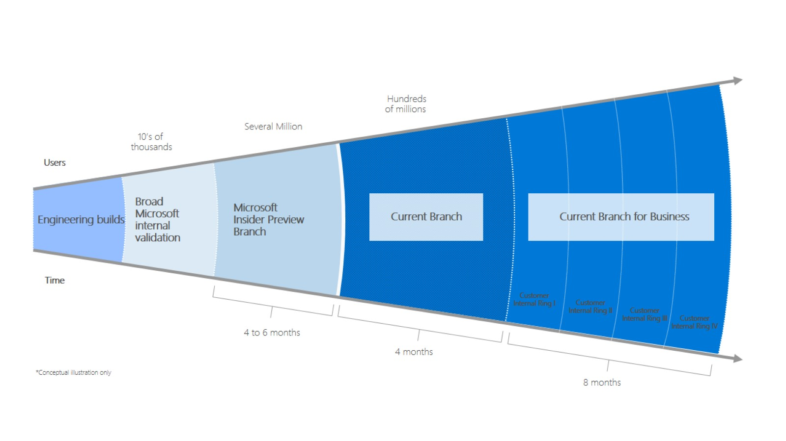

Slide 51
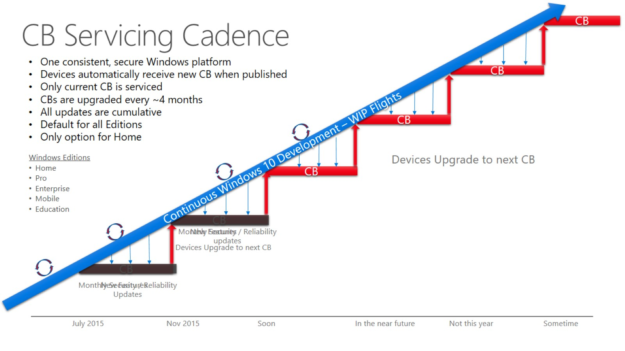

Slide 52
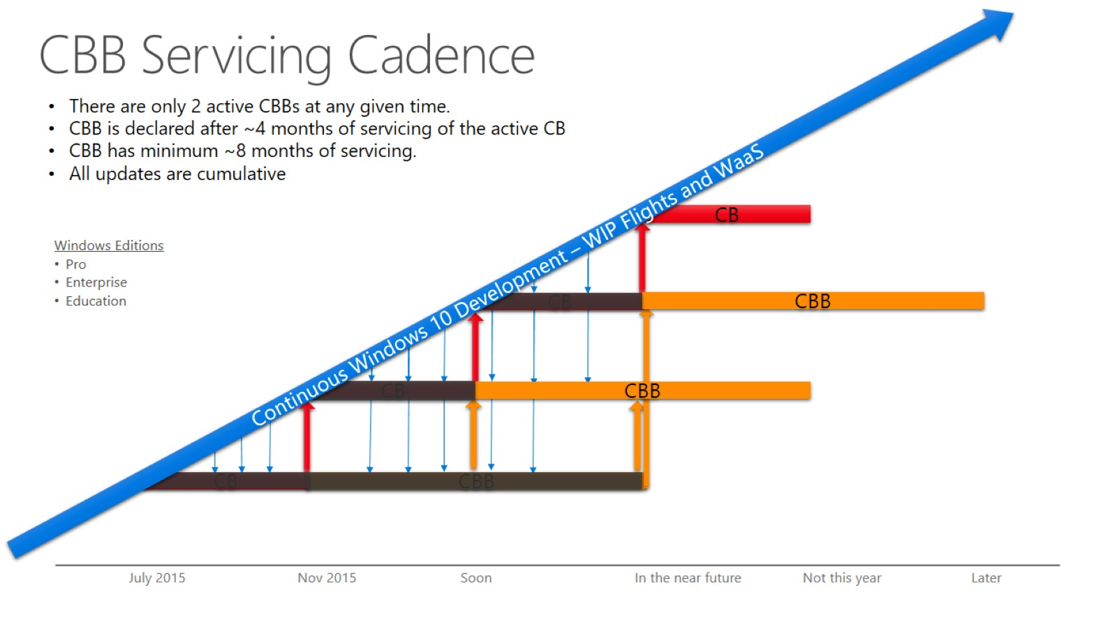
CBB Servicing Cadence

Slide 53
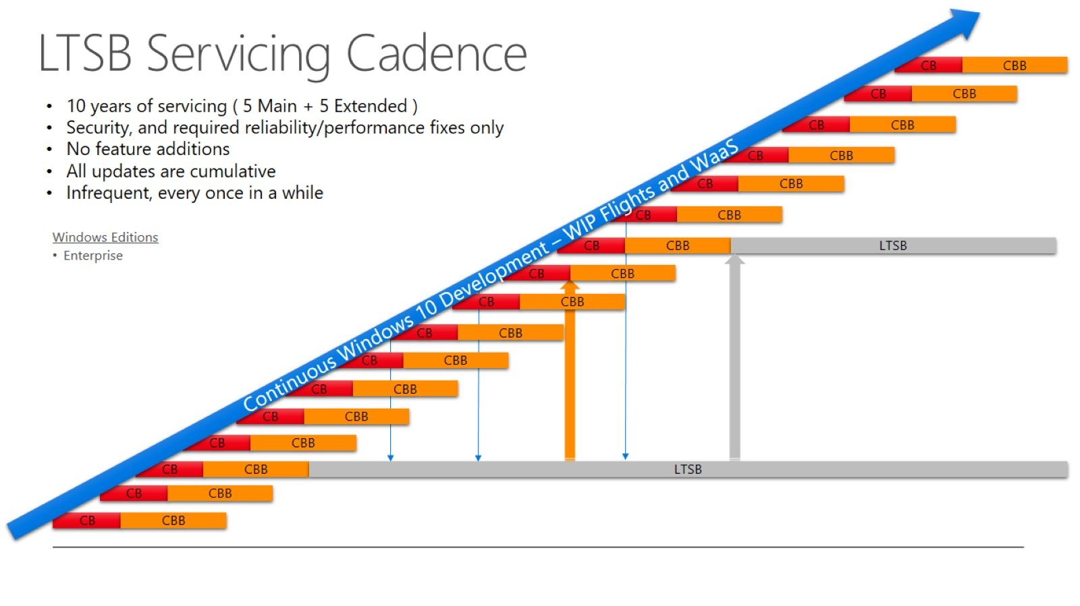
LTSB Servicing Cadence

Slide 54
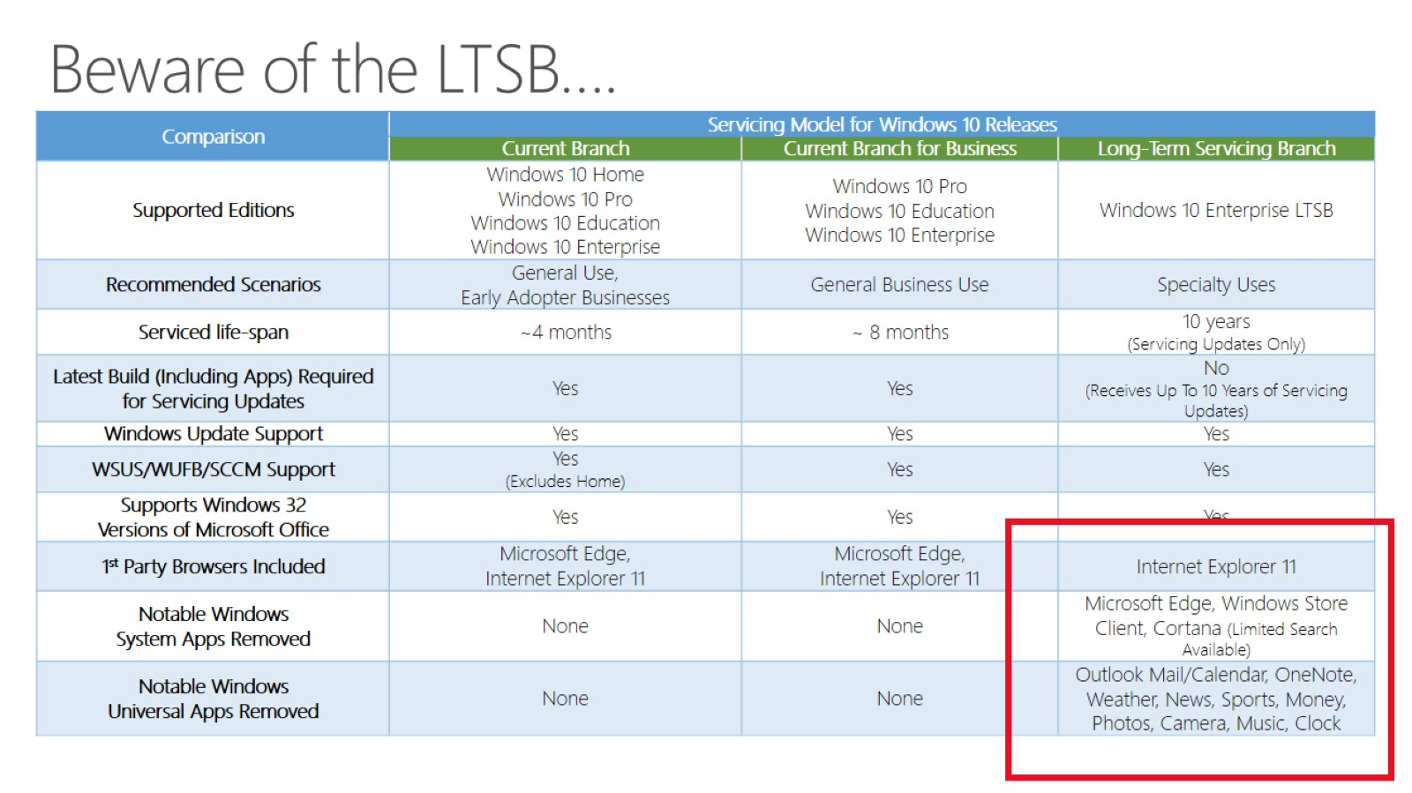
Beware of the LTSB….

Slide 55
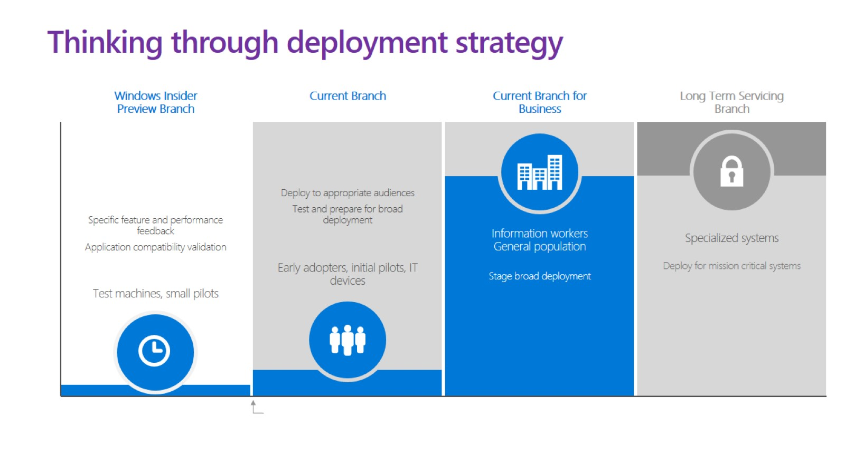
Thinking through deployment strategy

Slide 56
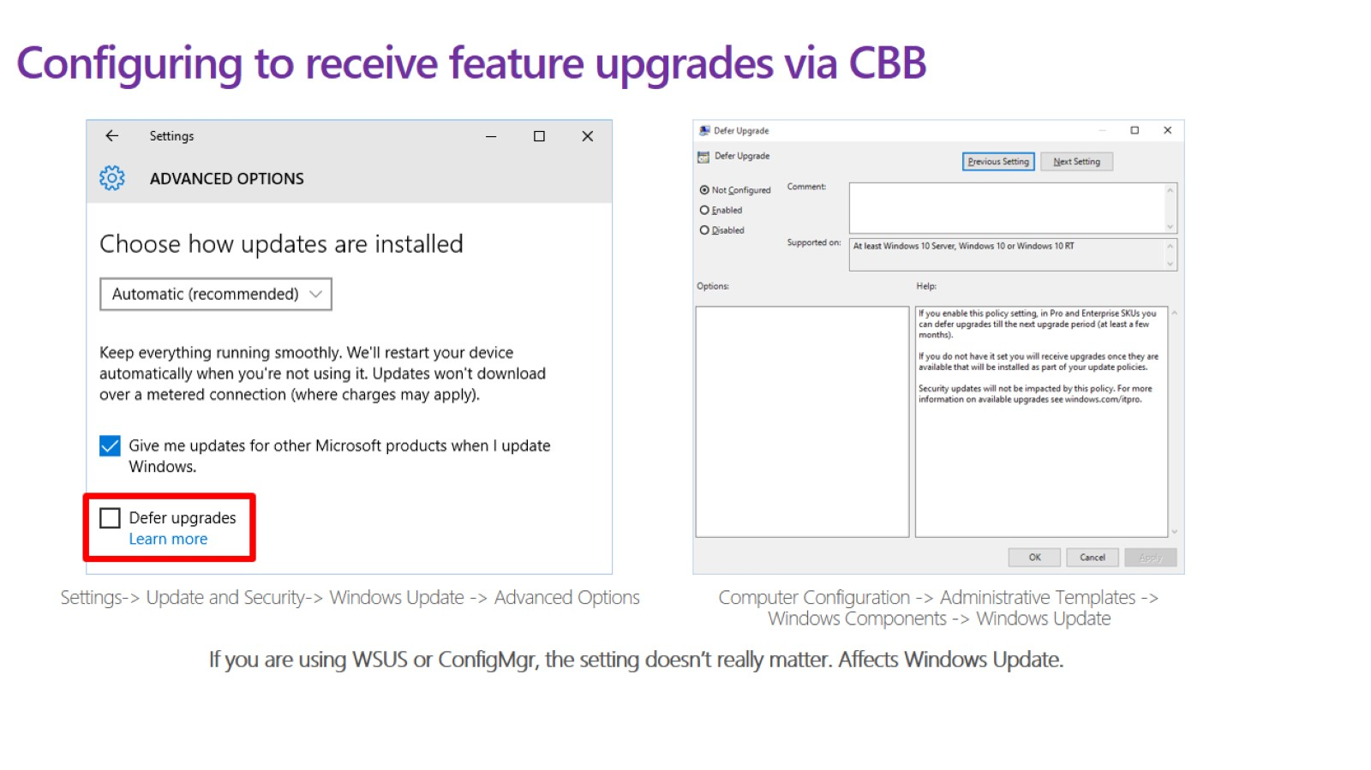
Configuring to receive feature upgrades via CBB

Slide 57
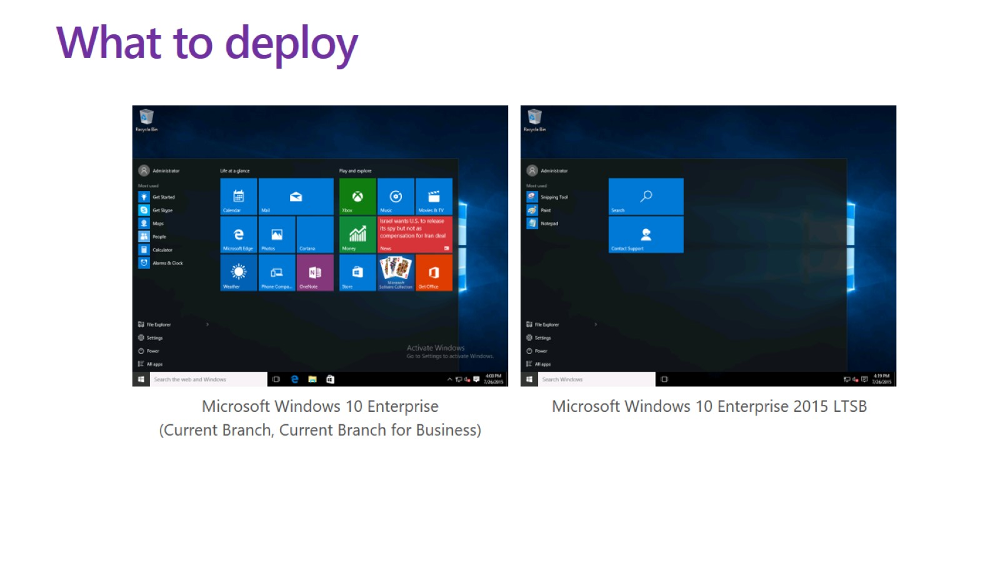
What to deploy

Slide 58

Management choices

Slide 59

Flexibility in Management Choices

Slide 60

Infrastructure Upgrades

Slide 61

Windows 10 deployment

Slide 62

Provisioning, not reimaging

Slide 63

Provisioning, not reimaging

Slide 64

Runtime provisioning to the rescue!

Slide 65

When to use provisioning

Slide 66

How it works

Slide 67

Windows Imaging and Configuration Designer

Slide 68

Applying a package

Slide 69

Provisioning in first run experience

Slide 70

Provisioning in first run experience

Slide 71

Provisioning during runtime

Slide 72

Provisioning during runtime: USB tether

Slide 73

Consistent user interface on desktop and mobile

Slide 74

What can be provisioned

Slide 75

What can be provisioned

Slide 76

What can be provisioned

Slide 77

What can be provisioned

Slide 78

What can be provisioned

Slide 79

What can be provisioned

Slide 80

Security: encryption

Slide 81

Managing the packages

Slide 82

Set up a new device for an employee

Slide 83

Configure a device to be used as a point of sale or inventory terminal

Slide 84

Configure personally owned device to use within an organization (BYOD)

Slide 85

Create persistent configuration by embedding a package in the image

Slide 86

Windows 10 deployment

Slide 87

App and device compatibility

Slide 88

Hardware compatibility

Slide 89

Enterprise investments for Internet Explorer 11

Slide 90

Microsoft Edge + Microsoft Internet Explorer

Slide 91

Reducing the Windows Footprint
New recovery process

Slide 92

Reducing the Windows Footprint
New recovery process

Slide 93

Windows 10 deployment

Slide 94

Assessment and Deployment Kit

Slide 95

MDT 2013 Update 1

Slide 96

ConfigMgr and MDT Support for Windows 10

Slide 97

Windows 10 Activation

Slide 98

Windows Server support for Windows 10

Slide 99

Enterprise preview process

Slide 100

Windows 10 deployment

Slide 101

Consider your deployment approach

Slide 102

Windows 10 security

Slide 103

Windows 10 security

Slide 104

Biometric authentication in Windows 10

Slide 105

Enrollment

Slide 106

Usage

Slide 107

Recovery

Slide 108

Authentication versus identification

Slide 109

Windows Hello security requirements

Slide 110

Live-ness and anti-spoofing?

Slide 111

Windows Hello

Slide 112

Windows 10 security

Slide 113


Slide 114


Slide 115


Slide 116

Windows Hello and Microsoft Passport

Slide 117


Slide 118

Windows 10 security

Slide 119


Slide 120

Virtual Secure Mode

Slide 121


Slide 122


Slide 123


Slide 124


Slide 125


Slide 126


Slide 127


Slide 128

Windows 10 1511

Slide 129

UI improvements

Slide 130

Action center

Slide 131

Windows Settings app

Slide 132

Virtual desktops

Slide 133

Windows 10 -
OS, který chcete!

