Slide 1
Azure Storage services
Jan Pospíšil @pospanet
Senior Technology Evangelist
janpos@microsoft.com

Slide 2
Agenda
Overview
Storage account
  Durability Options
  Limitations
Blob storage
  Page blob
  Block blob
Storage Queues
Premium storage
Azure Files
  Pricing tiers
  Out Of Azure workarouns
Table storage
DocumentDB
Redis
StorSimple
Demos

Slide 3
Introducing Microsoft Azure Storage
Cloud Storage - Anywhere and anytime access
  Blobs, Disks, Tables, Queues and Files
Highly Durable, Available and Massively Scalable
  Easily build “Internet scale” applications
  More than 35 trillion stored objects
  3.5+ Million requests/sec on average
Pay only for what you use
Exposed via easy and open REST APIs
Rich Client Libraries and Tools

Slide 4
Azure Storage Architecture
Import / Export
Client Libraries
(.NET, Java, c++, Android, Node.JS…)
SMB Client
REST
REST
REST
REST
SMB 2.1
Blob/Disk
Endpoint
Table
Endpoint
Queue
Endpoint
File Share
Endpoint
Front End Layer
Massive Scale Out & Auto Load Balancing
Index Layer
Partition Layer
Distributed Replication Layer
Stream Layer

Slide 5
Durability Options
Locally Redundant Storage (LRS)
  Stores 3 replicas of the data within a single zone (facility) in a single region
  Provides data durability for disk, node and rack failures
Geo Redundant Storage (GRS)
  Stores 6 replicas of the data across two regions (3 in each region)
  Provides additional durability to protect data against major regional natural disasters (e.g., tornado, hurricane, fire, etc, destroying a whole region)
  Updates across regions are performed asynchronously
Zone Redundant Storage (ZRS)
  Stores 3 replicas of the data across multiple zones (facilities) within a single region or across regions
  Provides additional durability to protect data against zone failures (e.g., fire burning down a facility)

Slide 6
Secondary Read-Only Access
Customers using Geo Redundant Storage can opt to have read-only access to the eventually consistent copy of the data on Secondary tenant
Applications control which location they read data from
    Primary endpoint
      accountname.<service>.core.windows.net
    Secondary endpoint
      accountname-secondary.<service>.core.windows.net
Consistency
    All Writes go to the Primary
    Reads to Primary are Strongly Consistent
    Reads to Secondary are Eventually Consistent
Our client library SDK provides features for reading from the secondary
    Retry options: PrimaryOnly, SecondaryOnly, PrimaryThenSecondary, etc.

Slide 7
Access Control
Symmetric Shared Key AuthN
  Trusted service that owns the storage accounts
Shared Access Signature (SAS) Delegated AuthZ
  3rd party services
  Mobile device applications
  Restricted access for services
  Allow client applications to directly communicate with Storage rather than scaling a proxy web service
Public (Blob service only)
  CDN access
  Browser based access

Slide 8
Storage Analytics
Storage platform incorporates rich analytics
  Metrics - Monitor service health, capacity, availability and performance
  Logs – Detailed logs of every operation to support troubleshooting
Analytics is not enabled by default – we recommend enabling
  During testing to establish baseline metrics
  In production to assist with troubleshooting
Client libraries also enable access to metrics data via strongly typed objects
Client libraries also have client side logging

Slide 9
Storage Account Limits
TB per storage account | 500 TB
Max 8 KB IOPS per persistent disk (Basic Tier) | 300²
Max 8 KB IOPS per persistent disk (Standard Tier) | 500²
Total Request Rate (1KB object size) per storage account | Up to 20,000 entities or messages per second
Target Throughput for Single Blob | Up to 60 MB per second, or up to 500 requests per second
Target Throughput for Single Queue (1 KB messages) | Up to 2000 messages per second
Target Throughput for Single Table Partition (1 KB entities) | Up to 2000 entities per second
Max ingress per storage account (US) | 10 Gbps if GRS³ enabled, 20 Gbps for LRS
Max egress per storage account (US) | 20 Gbps if GRS³ enabled, 30 Gbps for LRS
Max ingress per storage account (European, Asian) | 5 Gbps if GRS³ enabled, 10 Gbps for LRS
Max egress per storage account (European, Asian) | 10 Gbps if GRS³ enabled, 15 Gbps for LRS

Slide 10
Blob storage
Block Blob (Blobs)
Page Blob (Disks)
Streaming
Sequence of blocks
Up to 200GB (50,000 blocks)
Has to be commited
Random read/write
Array of pages
Up to 1TB
Auto commit

Slide 11
Blob Storage Concepts
http://{account}.blob.core.windows.net/{container}/{blobname}
Account
Container
Blob
Pages/Blocks
PIC01.JPG
images
Block/Page
PIC02.JPG
contoso
Block/Page
videos
VID1.AVI
Notes:
Slide Objectives
Understand the hierarchy of Blob storage
Speaker Notes
The Blob service provides storage for entities, such as binary files and text files.
The REST API for the Blob service exposes two resources:
Containers
Blobs.
A container is a set of blobs; every blob must belong to a container.
The Blob service defines two types of blobs:
Block blobs, which are optimized for streaming.
Page blobs, which are optimized for random read/write operations and which provide the ability to write to a range of bytes in a blob.
Blobs can be read by calling the Get Blob operation. A client may read the entire blob, or an arbitrary range of bytes.
Block blobs less than or equal to 64 MB in size can be uploaded by calling the Put Blob operation.
Block blobs larger than 64 MB must be uploaded as a set of blocks, each of which must be less than or equal to 4 MB in size.
Page blobs are created and initialized with a maximum size with a call to Put Blob.
To write content to a page blob, you call the Put Page operation. The maximum size currently supported for a page blob is 1 TB.
Notes
http://msdn.microsoft.com/en-us/library/dd573356.aspx
Using the REST API for the Blob service, developers can create a hierarchical namespace similar to a file system. Blob names may encode a hierarchy by using a configurable path separator. For example, the blob names MyGroup/MyBlob1 and MyGroup/MyBlob2 imply a virtual level of organization for blobs. The enumeration operation for blobs supports traversing the virtual hierarchy in a manner similar to that of a file system, so that you can return a set of blobs that are organized beneath a group. For example, you can enumerate all blobs organized under MyGroup/.

Slide 12
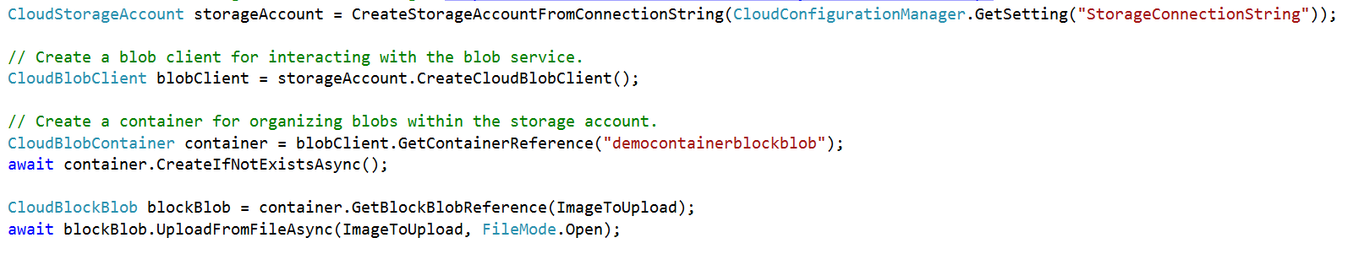
Abstractions – Blobs
Blobs – Massively scalable object store in the cloud
  Simple REST interface (Put, Get, Delete)
  Data sharing – share documents, pictures, video, music, etc.
  Big Data – store raw data/logs and compute/map reduce over data
  Backups – data and device backups

Slide 13
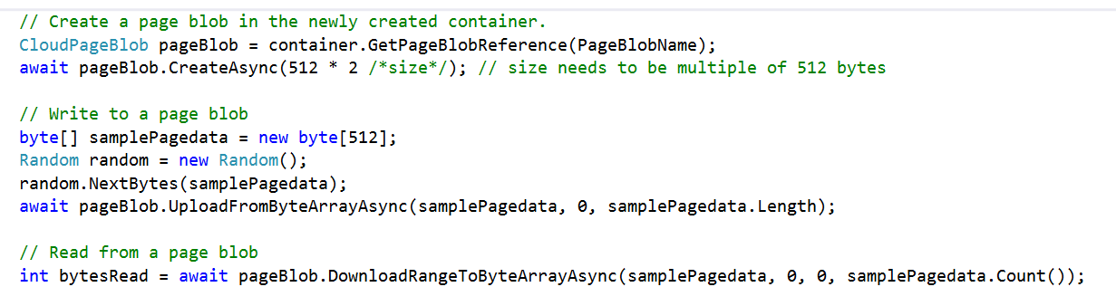
Abstractions – Disks
Persistent disks for VMs in Azure
Disks are VHDs stored in Azure Page Blobs
Page blobs are optimized for random I/O
VM see the VHD/Blob as a disk
  Reads translated to GETs, writes to PUTs
  Blob protected by write-lease
  Reads from the blob (and snapshots) still allowed

Slide 14
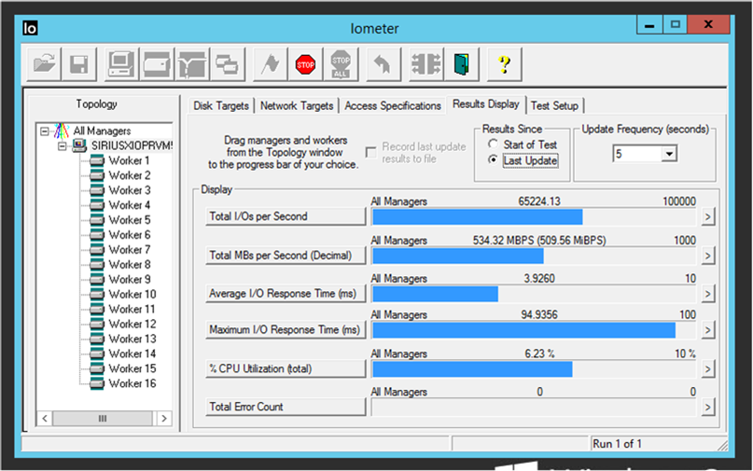
Premium Storage (preview)
Consistent low latency SSD based with predictable IO throughput
Suitable for high-performance IO-intensive database workloads
Single digit milliseconds latencies
Supports up to 1 TB blob/disk size
Stripe up to 32 disks for a total of
32TB and more than 50,000 IOPS
Premium Storage Disks work in
conjunction with a new VM series

Slide 15

Azure Files
Shared Network File Storage for Azure
Availability, durability, scalability are managed automatically
Supports two interfaces: SMB and REST
IaaS VM
IaaS VM
IaaS VM
PaaS VM
IaaS VM
IaaS VM
IaaS VM
PaaS VM
IaaS VM
(Sharing IaaS Disk)
Azure File Share
(PaaS)

Slide 16
Abstractions – Files
Move on-premises applications to cloud
VMs can net use an SMB share using standard file APIs and semantics
SMB 2.1 protocol
VM and storage account within same region
Supports REST and SMB protocol access to same file share
Microsoft Azure
Share data stored in Azure Files among Azure VMs via SMB
Azure Storage
SMB
Blobs
Tables
REST API
Queues
REST API
Files

Slide 17
Azure Files vs Disks
Description | Disk | Azure Files
Relationship with Azure VMs | Required for booting (OS Disk)
Scope | Exclusive/Isolated to a single VM | Shared access across multiple VMs
Snapshots and Copy | Yes | No
Configuration | Configured via portal/Management APIs and available at boot time | Connect after boot (via net use on windows)
Built-in authentication | Built-in authentication | Set up authentication on net use
Cleanup | Resources can be cleaned up with VM if needed | Manually via standard file APIs or REST APIs
Access via REST | Can only access as fixed formatted VHD (single blob) via REST. Files stored in VHD cannot be accessed via REST. | Individual files stored in share are accessible via REST
Max Size | 1TB Disk | 5TB File Share 1TB file within share
Max 8KB IOps | 500 Iops | 1000 IOps
Throughput | Up to 60 MB/s per Disk | Up to 60 MB/s per File Share

Slide 18
Azure Files vs Blobs
Description | Azure Blobs | Azure Files
Durability Options | LRS, ZRS, GRS (and RA-GRS for higher availability) | LRS, GRS
Accessibility | REST APIs | SMB 2.1 (standard file system APIs) REST APIs
Connectivity | REST – Worldwide | SMB 2.1 - Within region REST – Worldwide
Endpoints | http://myaccount.blob.core.windows.net/mycontainer/myblob | \\myaccount.file.core.windows.net\myshare\myfile.txt http://myaccount.file.core.windows.net/myshare/myfile.txt
Directories | Flat namespace however prefix listing can simulate virtual directories | True directory objects
Case Sensitivity of Names | Case sensitive | Case insensitive, but case preserving
Capacity | Up to 500TB containers | 5TB file shares
Throughput | Up to 60 MB/s per blob | Up to 60 MB/s per share
Object size | Up to 1 TB/blob | Up to 1 TB/file
Billed capacity | Based on bytes written | Based on file size

Slide 19
Table Storage Concepts
Account
Table
Entity
Name =…
Email = …
customers
Name =…
Email=
contoso
Photo ID =…
Date =…
photos
Photo ID =…
Date =…
Notes:
Slide Objectives
Understand Tables
Speaker Notes
The Table service provides structured storage in the form of tables.
The Table service supports a REST API that is compliant with the ADO.NET Data Services REST API.
Developers may also use the .NET Client Library for ADO.NET Data Services to access the Table service.
Notes
http://msdn.microsoft.com/en-us/library/dd573356.aspx

Slide 20
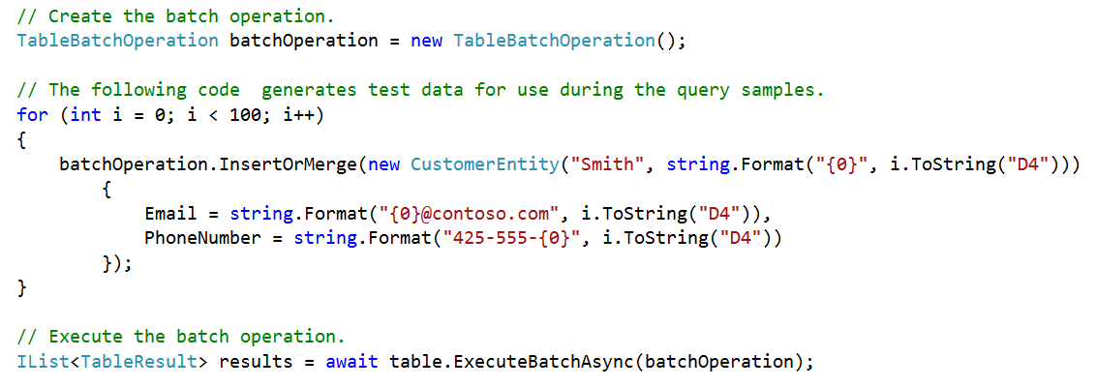
Abstractions – Tables
Tables – Massively scalable NoSQL cloud store
  Key/Attribute(s) store at scale
  Store user, device or any type of metadata for your service
  Auto load balances partitions to meet traffic needs
  OData protocol (AtomPub or JSON)

Slide 21
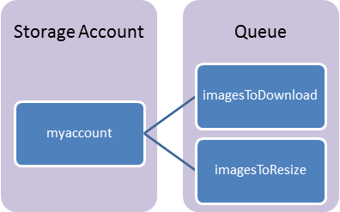
Queue Components
Storage Account: All access to Azure Storage is done through a storage account.
Queue: A queue contains a set of messages.
Message: A message, in any format, of up to 64KB.

Slide 22
Queue-based Load Levelling Pattern
Producers
Consumers
P₁
C₁
Queue
4
3
2
1
P₂
C₂

Slide 23
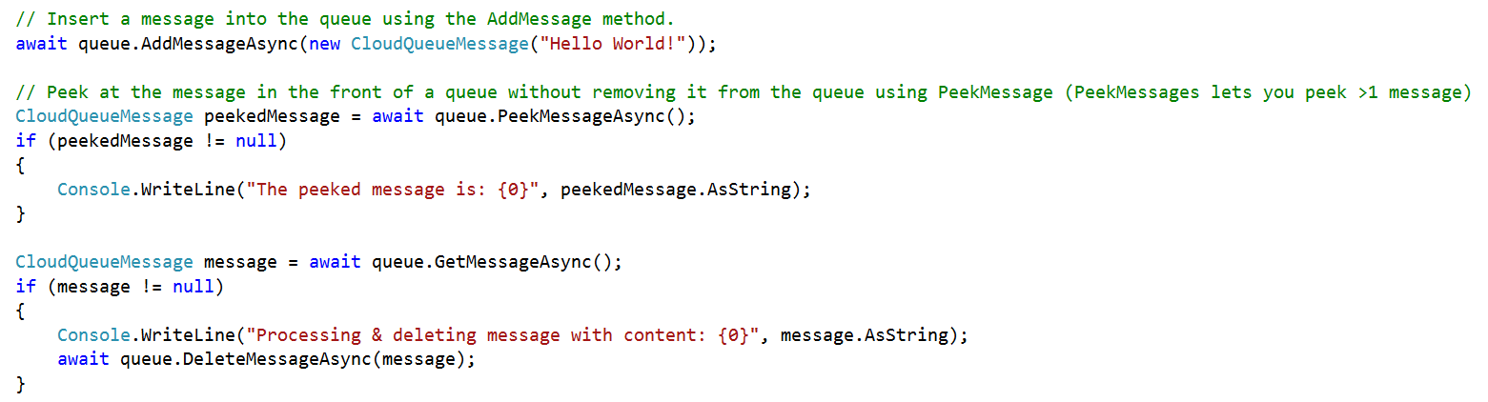
Abstractions – Queues
Queues – Reliable messaging system
  Reliable, low latency, high throughput messaging system
  Decouple components/roles
    Web role to worker role communication
    Allows roles to scale independently
  Implement scheduling of asynchronous tasks
  Building process/work flows

Slide 24
Microsoft Azure
StorSimple

Slide 25
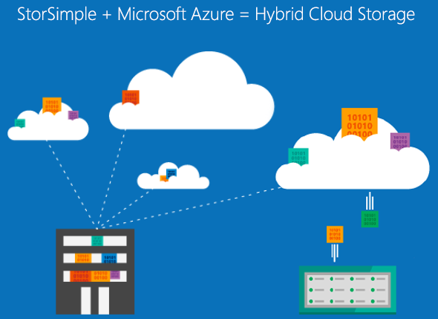
Notes:
StorSimple is a unique hybrid cloud storage solution which provides primary storage, archive and disaster recovery.
This solution optimizes total storage costs and data protection for enterprises.

Slide 26








Addressing storage challenges with StorSimple
Storage Today
Microsoft Azure StorSimple
Manage
data growth
Lower storage costs
Primary Storage
Archival Storage
Disk-based Backup
Simplify data protection and disaster recovery
Increase business agility
StorSimple
Remote Replication
Tape backup and DR
Reduce storage costs by 40-60%

Slide 27
Automatic tiering
Low Threshold
High Threshold
Time
0
Tier is empty in the beginning
1
DATA
New data is written at start of free space
2
DATA
Oldest
Data
Data exceeds high watermark
3
DATA
Old data spills to next tier
4
DATA
Tier returns to low watermark level

Slide 28
Deduplication
4MB
SSD
HDD
64KB Chunks
Dedupe Algorithm
0xabc123
0xaaa123
0xbbb123
0xccc123
Record of hash keys already generated
0xabc123
0xaab123
0xccc123
0xaac123
0xbbc123
0xbcc123
0xabb123
0xaab123
0xccc123

Slide 29
Compression
Performed on data already deduplicated
Heuristics based compression to reduce CPU overhead when data is not compressible
Default algorithm is the standard DEFLATE (loss less compression)
HDD
Deduped Data
0xaab123
0xccc123
Compress Data

Slide 30
Encryption
Performed deduped and compressed data
Encryption key is generated based on the seed value provided
Encryption algorithm is AES-256 with CBC
Security keys maintained by the customer, stored securely on the appliance
Compress Data
0xabc12..
0xabc12..
Data chunk before encryption
Data chunk after encryption

Slide 31
Free training on Microsoft
Virtual Academy
Microsoft Azure Fundamentals
Microsoft Azure-fundamentals-websites
Microsoft-azure-developer-camp-build-a-cloud-native-app
Getting Great Performance out of Azure
Assessing and Improving Your DevOps Capabilities

Slide 32
Get started today at http://azure.microsoft.com

Slide 33
Sign up for the upcoming
Webinars
  Scaling applications on Azure – How to scale and monitor various parts of your application - Date: March 12th 2015
  Azure SQL IaaS vs. PaaS comparison - Date: March 19th 2015
  Migrating solution to Azure – How to start and move into right direction? - Date: March 26th 2015
  Azure Storage Services – Date: April 2nd 2015nd (TBC)

Slide 34
View content on demand
–Its free!
  Building Applications in the Microsoft Cloud – recording of the previous webinar in this series that took place on March 2nd 2015

Slide 35
Reach us at mswebinars@microsoft.com

