Slide 1
IF-less programming in C#
Jiří pokorný
jiri.pokorny@solarwinds.com

Slide 2
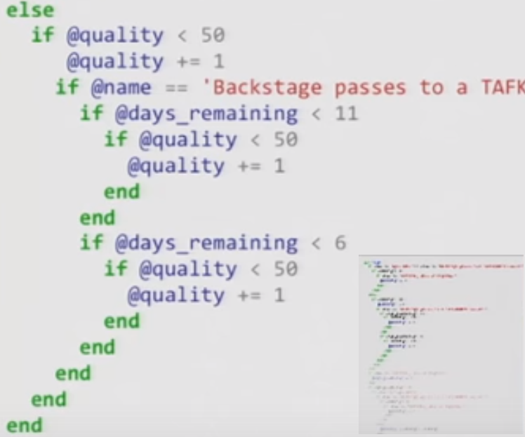
Why IFs considered harmful
GoTo considered harmful
(jumps and decisions
make code complex)
IF is only encapsulated
GoTo statement
=> It also should be
considered harmful
Jules May says
about removing IFs:
  Way to eliminate 90% of bugs
  and 99% technical debt
  IF causes spaghetti code,
  which is unreliable
Notes:
Based on following study: http://www.cs.utexas.edu/users/EWD/ewd02xx/EWD215.PDF

Slide 3
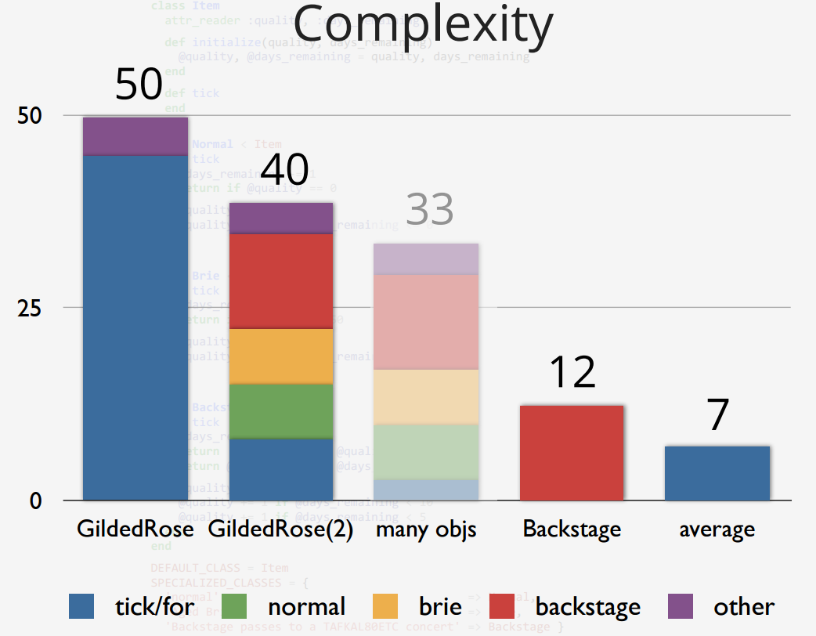
Sandi Metz: RailsConf 2014 - All the Little Things
Complexity is a metric
showing code maintainability
(smaller is better)
Based on this refactoring example:
  Small methods better
  than one large
  Small objects better
  than one large class
  Inheritance is still better
  than no OOP concept
=> Any of the refactorings leads to less IF statements and better code
Original
Small methods
Final - Small objects
Notes:
Chart explanation:
Each valve represents one refactoring step
Each color represents part of code
Number represents complexity – lower is better
Result was multiple classes with average complexit better than original

Slide 4
Jules May: Solutions
The antidote to GOTO
is „Flow-structure“
Structured languages
replace GOTO with:
  For
  While
  throw
The antidote to IF
is „decision-structure“
„Decision-structured“ language would replace IF with:
  The Assert () or …
  Value-polymorphism
  Downcasts
Notes:
„Decision structured languages“ are OOP or Functional languages
Value polymorphism - where method can be overloaed not only by parameter types, but also by their value. It is not posible in OOP like C#, usually available in functional languages.

Slide 5
How to fix in C#
Dont return Null – always create „Null object“
Merge enum switches into only one
Replace multiple contraints with table definition
Replace workflow with polymorphism
Use IoC to create instances (optional example)

Slide 6
How to fix in C# - DEMO 1.
Merge enum switches into only one
  Motivation:
  We need to implement new device plugin. Currently we need to find all places, where device type enum is used and fix them.
  Solution:
  Extract an interface representing all methods, where the switch is used.
  Merge all switch statements into one factory, returning the interface implementation based on device type.

Slide 7
How to fix in C# - DEMO 2.
Dont return Null - Always create „Null object“ instead
  Motivation:
  Searching in large object tree, when returning null for „not found“ means, that you are forced later to check for „if(result != null) …“
  Solution:
  Create „Default“ implementation for the edge case
  and derive implementation for concrete item.

Slide 8
How to fix in C# - DEMO 3.
Replace multiple contraints with table definition
  Motivation:
  Measuring device uses multiple functions how to transform sensor value and you need to change the transformation. Or you need to test each complex part of a complex algorithm.
  Solution:
  Extract all constraints into a table with two colums (condition, algorithm). Use LINQ selection to find required row in the table pointing to expected algorithm.

Slide 9
How to fix in C# - DEMO 4.
Replace workflow with polymorfism
  Motivation:
  You need to put extra step in midle of a tax calculation algorithm.
  Solution:
  Extract steps of the algorithm into separate methods.
  Extract each possible workflow into one class.
  Introduce selection method to pick up expected workflow.

Slide 10
Links
https://www.youtube.com/watch?v=8bZh5LMaSmE
http://michaelfeathers.typepad.com/michael_feathers_blog/2013/11/unconditional-programming.html
https://www.youtube.com/watch?v=z43bmaMwagI&index=17&list=PL4vq9TW3wicqc-NkHx-GIEKoPaeeVpyUK
https://www.youtube.com/watch?v=4F72VULWFvc
http://alisnic.github.io/posts/ifless/

Slide 11
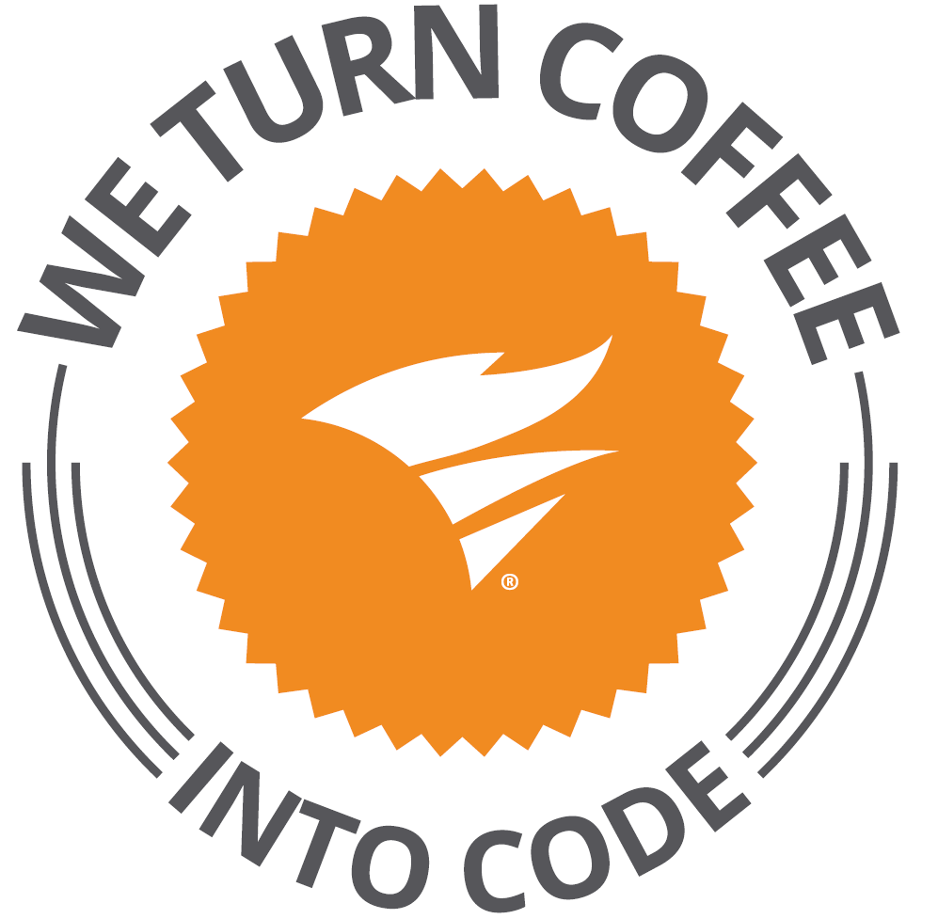
Solarwinds
30+ products for IT Management
Microsoft stack: C#, MS SQL, AngularJS
Brno office – Solarwinds R&D center
https://www.solarwindsmeetup.com/
Career opportunities
  http://solarwinds.jobs/
Visit our booth

