Slide 1
What’s new in .NET MAUI
Roman Jašek
RIGANTI
Microsoft MVP
roman.jasek@riganti.cz

Slide 2








.NET Multi-platform App UI
.NET 7
Cross-platform, native UI
Single project system, single codebase
Deploy to multiple devices, mobile & desktop
.NET MAUI
Android
iOS
macOS
Windows
Notes:
Next I want to talk about .NET MAUI.
.NET MAUI is the evolution of Xamarin.Forms designed to help you deliver high-performance, cross-platform, native desktop & mobile apps all from a single codebase.
.NET MAUI under the hood uses technologies out there today for building native apps on Windows with WinUI, Mac Catalyst for macOS, and of course, iOS and Android. .NET MAUI abstracts all those frameworks into a single framework built on .NET 6.
.NET MAUI on Windows supports WinUI allowing these apps to use all the newest native features on supported versions of Windows 10.
That means you can build all these apps for any device from a single codebase and project system. Instead of learning different stacks and languages for each, you can use one language, one set of libraries, and one UI stack for all of them.
It will release early spring next year. You can watch the progress and help contribute on GitHub in the /dotnet/maui repo.

Slide 3
.NET Multi-platform App UI
.NET 7
Cross-platform, native UI
Single project system, single codebase
Deploy to multiple devices, mobile & desktop
.NET MAUI
Android
iOS
macOS
Windows
Notes:
Next I want to talk about .NET MAUI.
.NET MAUI is the evolution of Xamarin.Forms designed to help you deliver high-performance, cross-platform, native desktop & mobile apps all from a single codebase.
.NET MAUI under the hood uses technologies out there today for building native apps on Windows with WinUI, Mac Catalyst for macOS, and of course, iOS and Android. .NET MAUI abstracts all those frameworks into a single framework built on .NET 6.
.NET MAUI on Windows supports WinUI allowing these apps to use all the newest native features on supported versions of Windows 10.
That means you can build all these apps for any device from a single codebase and project system. Instead of learning different stacks and languages for each, you can use one language, one set of libraries, and one UI stack for all of them.
It will release early spring next year. You can watch the progress and help contribute on GitHub in the /dotnet/maui repo.

Slide 4
Desktop
Desktop – new form factors & scenarios for MAUI

Slide 5
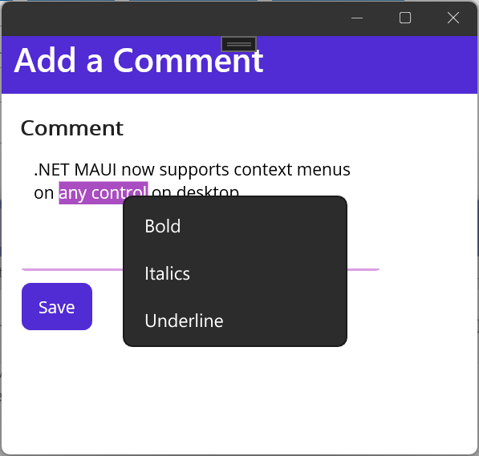
Context menu
Desktop specific feature
Add to any control
Can be hierarchical
<Editor>
<FlyoutBase.ContextFlyout>
<MenuFlyout>
<MenuFlyoutItem Text="Bold" />
<MenuFlyoutItem Text="Italics" />
<MenuFlyoutItem Text="Underline" />
</MenuFlyout>
</FlyoutBase.ContextFlyout>
</Editor>

Slide 6
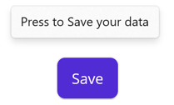
Tooltip
Attached property
Windows, Mac – on hover
Android – long press
Position – centered above pointer
<Button Text="Save"
ToolTipProperties.Text="Press to Save your data" />

Slide 7
Pointer gestures
Support for getting relative position of pointer
<Image Source="dotnet_bot.png">
<Image.GestureRecognizers>
<PointerGestureRecognizer
PointerEnteredCommand=“{Binding PointerEnteredCommand}“
PointerExitedCommand=“{Binding OnPointerExitedCommand}"
PointerMovedCommand=“{Binding OnPointerMovedCommand}" />
</Image.GestureRecognizers>
</Image>

Slide 8
Working with windows
Support for window size & position
Creating multiple windows

Slide 9
.NET Multi-platform App UI
.NET 7
Cross-platform, native UI
Single project system, single codebase
Deploy to multiple devices, mobile & desktop
.NET MAUI
Android
iOS
macOS
Windows
Notes:
Next I want to talk about .NET MAUI.
.NET MAUI is the evolution of Xamarin.Forms designed to help you deliver high-performance, cross-platform, native desktop & mobile apps all from a single codebase.
.NET MAUI under the hood uses technologies out there today for building native apps on Windows with WinUI, Mac Catalyst for macOS, and of course, iOS and Android. .NET MAUI abstracts all those frameworks into a single framework built on .NET 6.
.NET MAUI on Windows supports WinUI allowing these apps to use all the newest native features on supported versions of Windows 10.
That means you can build all these apps for any device from a single codebase and project system. Instead of learning different stacks and languages for each, you can use one language, one set of libraries, and one UI stack for all of them.
It will release early spring next year. You can watch the progress and help contribute on GitHub in the /dotnet/maui repo.

Slide 10
Mobile – performance
Profiling
  dotnet-trace – tracing & startup tracing
  dotnet-dsrouter – connect dotnet trace to running application on mobile
  PerfView – Windows

Slide 11
Android
C# compiles to intermediate language (IL)
IL + JIT in app
IL
+
JIT
.NET
JIT
.AAB
C#
Bindings
Runs
natively
Notes:
AAB – Android App Bundle

Slide 12
Android – application startup & speed
Improved AOT Profile
  Added Flyout content
  Added version with FlyoutPage (instead of Shell)
Reducing Java Interop Calls
  Removing unnecessary repeated calls – View.Context
  Grouping calls together – Measure(int, int), get_MeasuredWidth(), get_MeasuredHeight()
  “Packing” multiple values from Java – 2 integers into long
Use explicit Android compiler optimizations
…

Slide 13
Android - Startup times - Pixel 5
Application | Xamarin | MAUI – Preview | MAUI – .NET 6 | MAUI - .NET 7
Android | 306.5 | 210.5 | 182.8
Without Shell | 498.6 | 683.9 | 464.2
With Shell | 817.7 |  | 568.1 | 545.4
.NET Podcast App |  | 1299.9 | 814.2 | 759.7

Slide 14
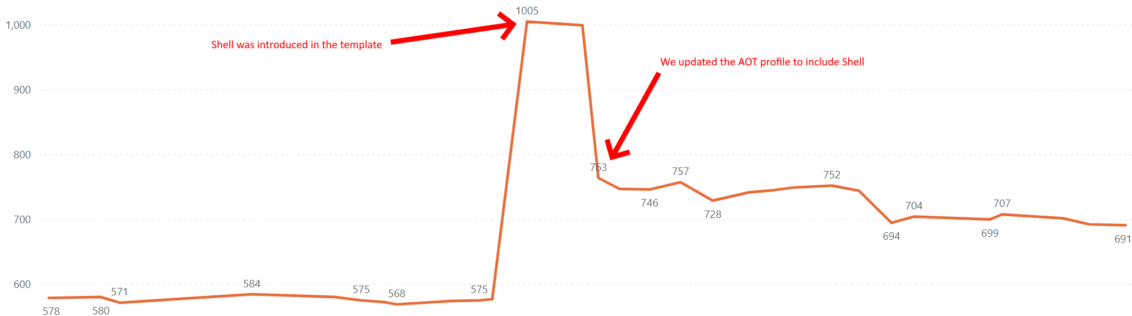
Android - Startup times – Pixel 4a

Slide 15
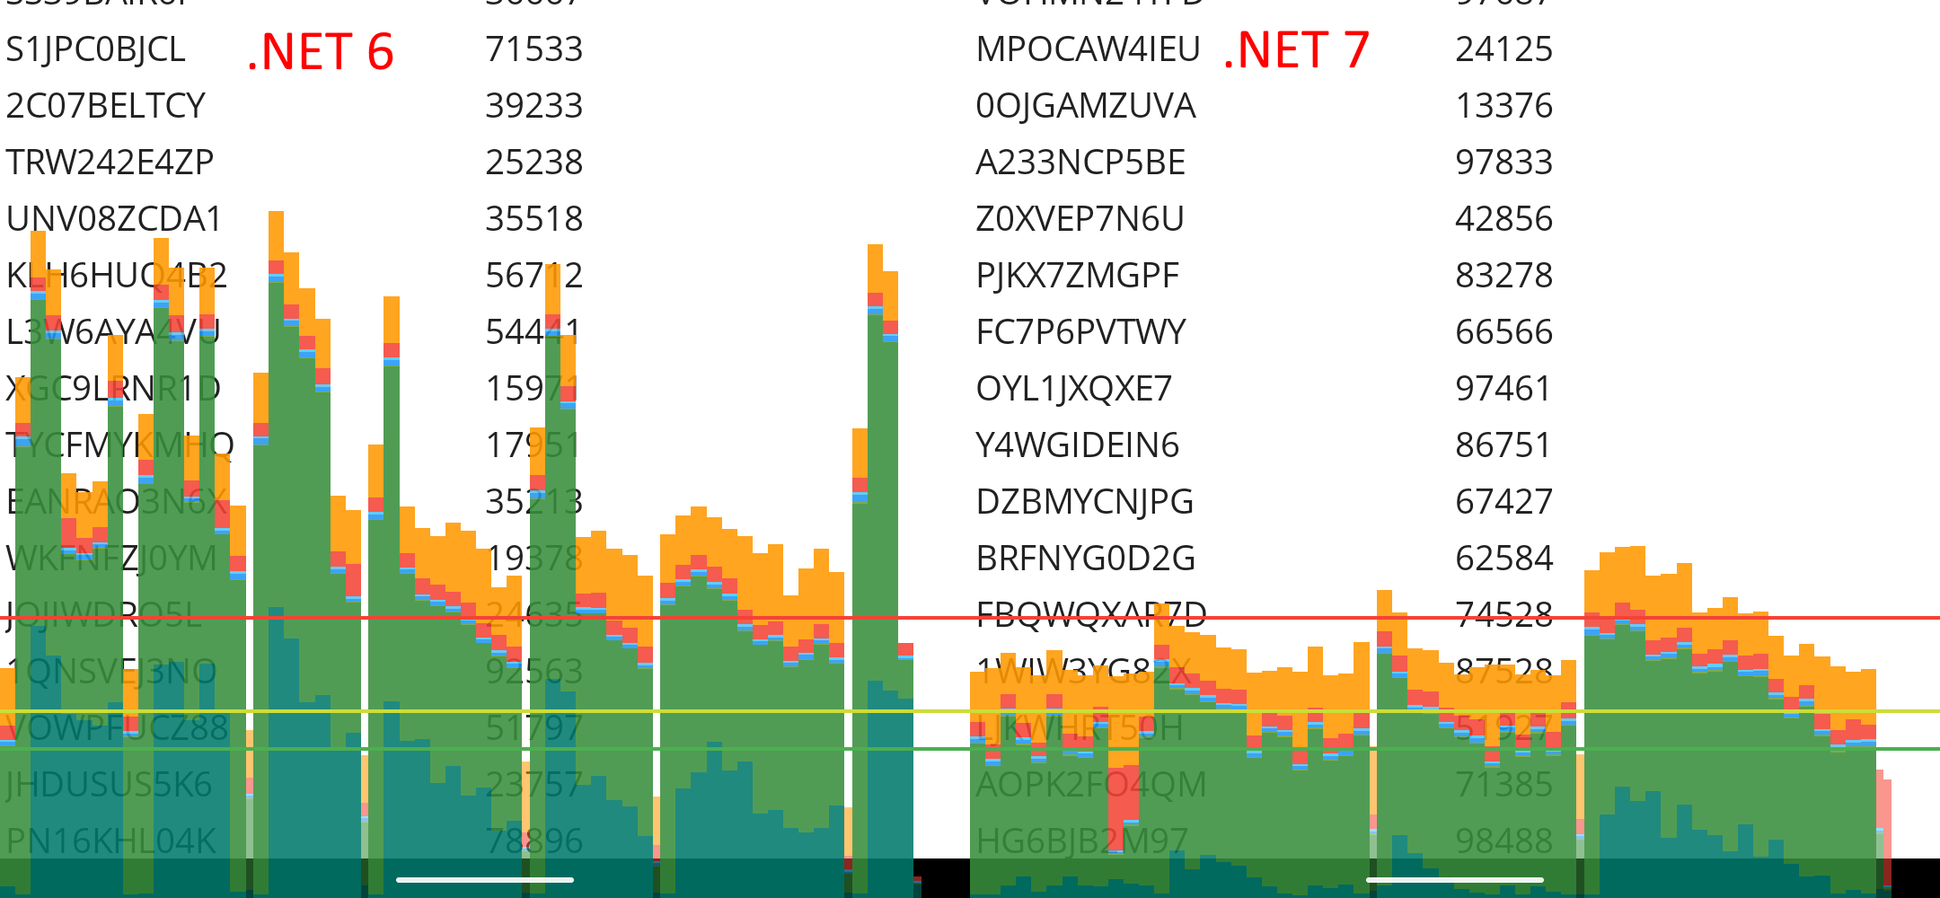
CollectionView with 10 000 rows – Pixel 4a

Slide 16
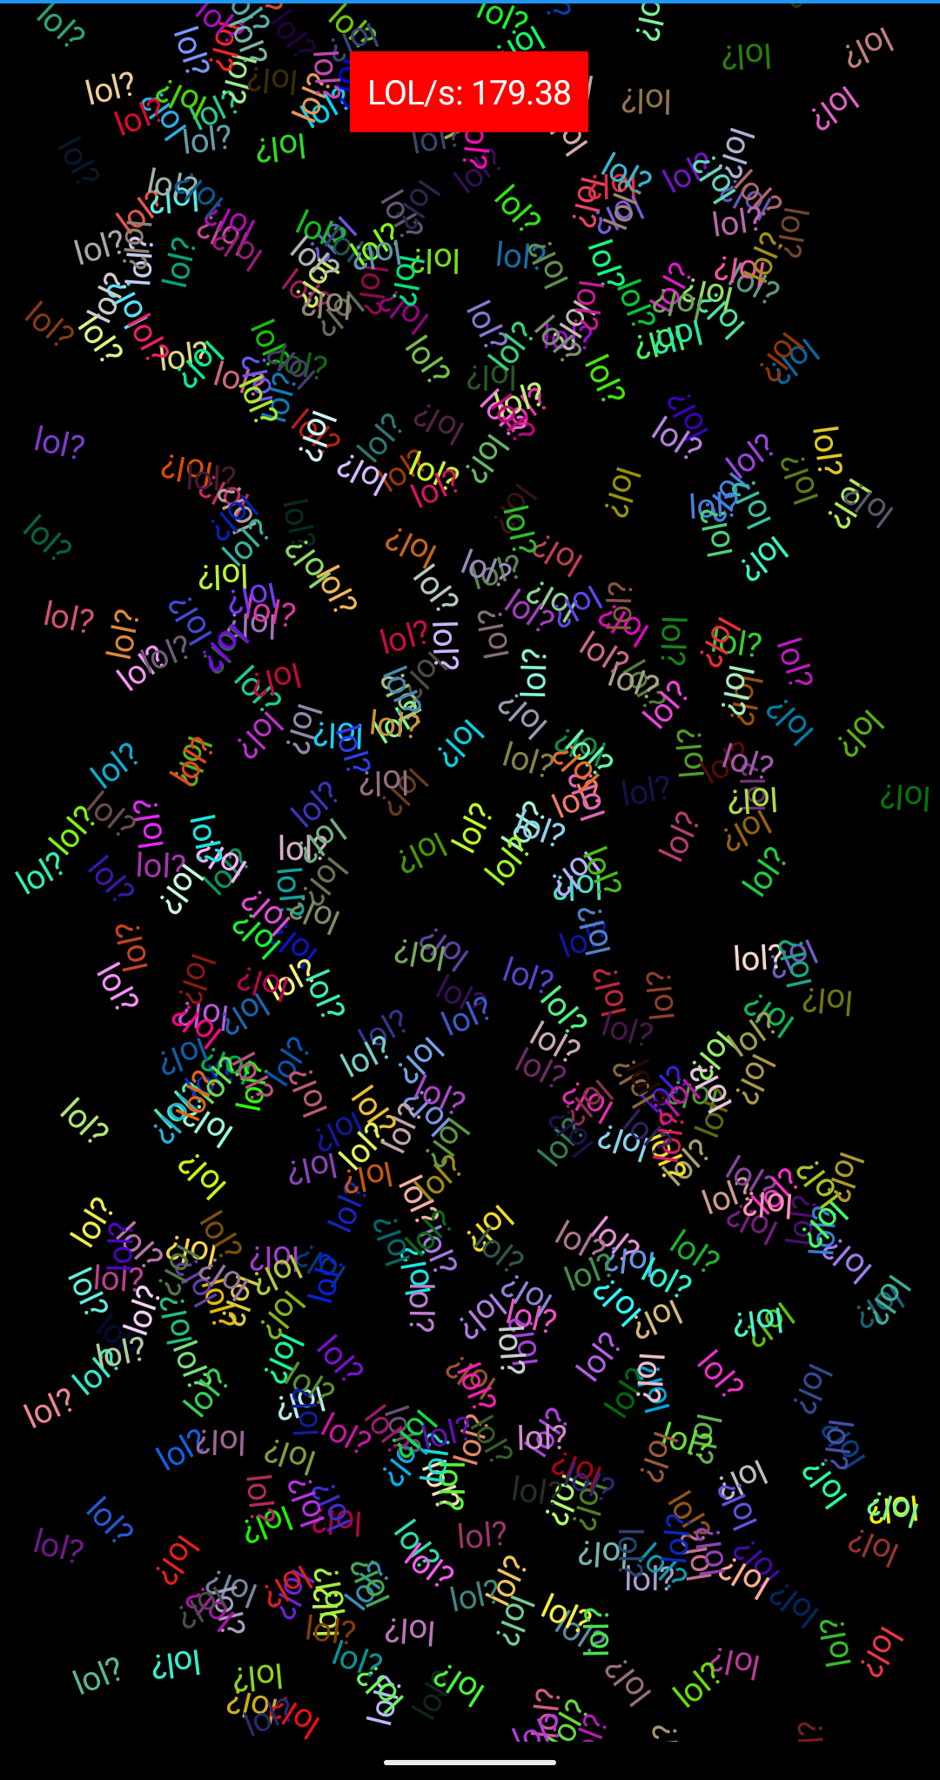
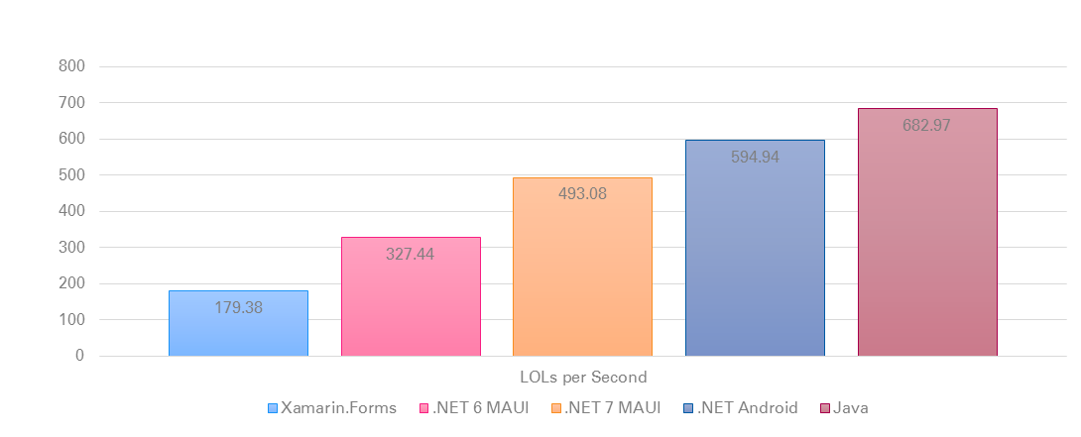
LOLs / sec – Pixel 5
Labels with random color and rotation

Slide 17
iOS
Fully ahead-of-time (AOT) compiled to native ARM binary
ARM
BINARY
.NET
AOT
.IPA
C#
Bindings
Runs
natively

Slide 18
iOS – Application size
App Size Reporting Tools
  dotnet-appsize-report (iOS)
  apkdiff (Android)
Improved AOT output for generics
  Makes difference for unreachable methods in referenced libraries
Application | MAUI - .NET 6 | MAUI - .NET 7
With Shell | 12.64 | 12.48
.NET Podcast App | 25.08 | 23.91

Slide 19
Performance – .NET blog
Jonathan Peppers
https://devblogs.microsoft.com/dotnet/performance-improvements-in-dotnet-maui/#reduce-java-interop-calls
https://devblogs.microsoft.com/dotnet/dotnet-7-performance-improvements-in-dotnet-maui/

Slide 20
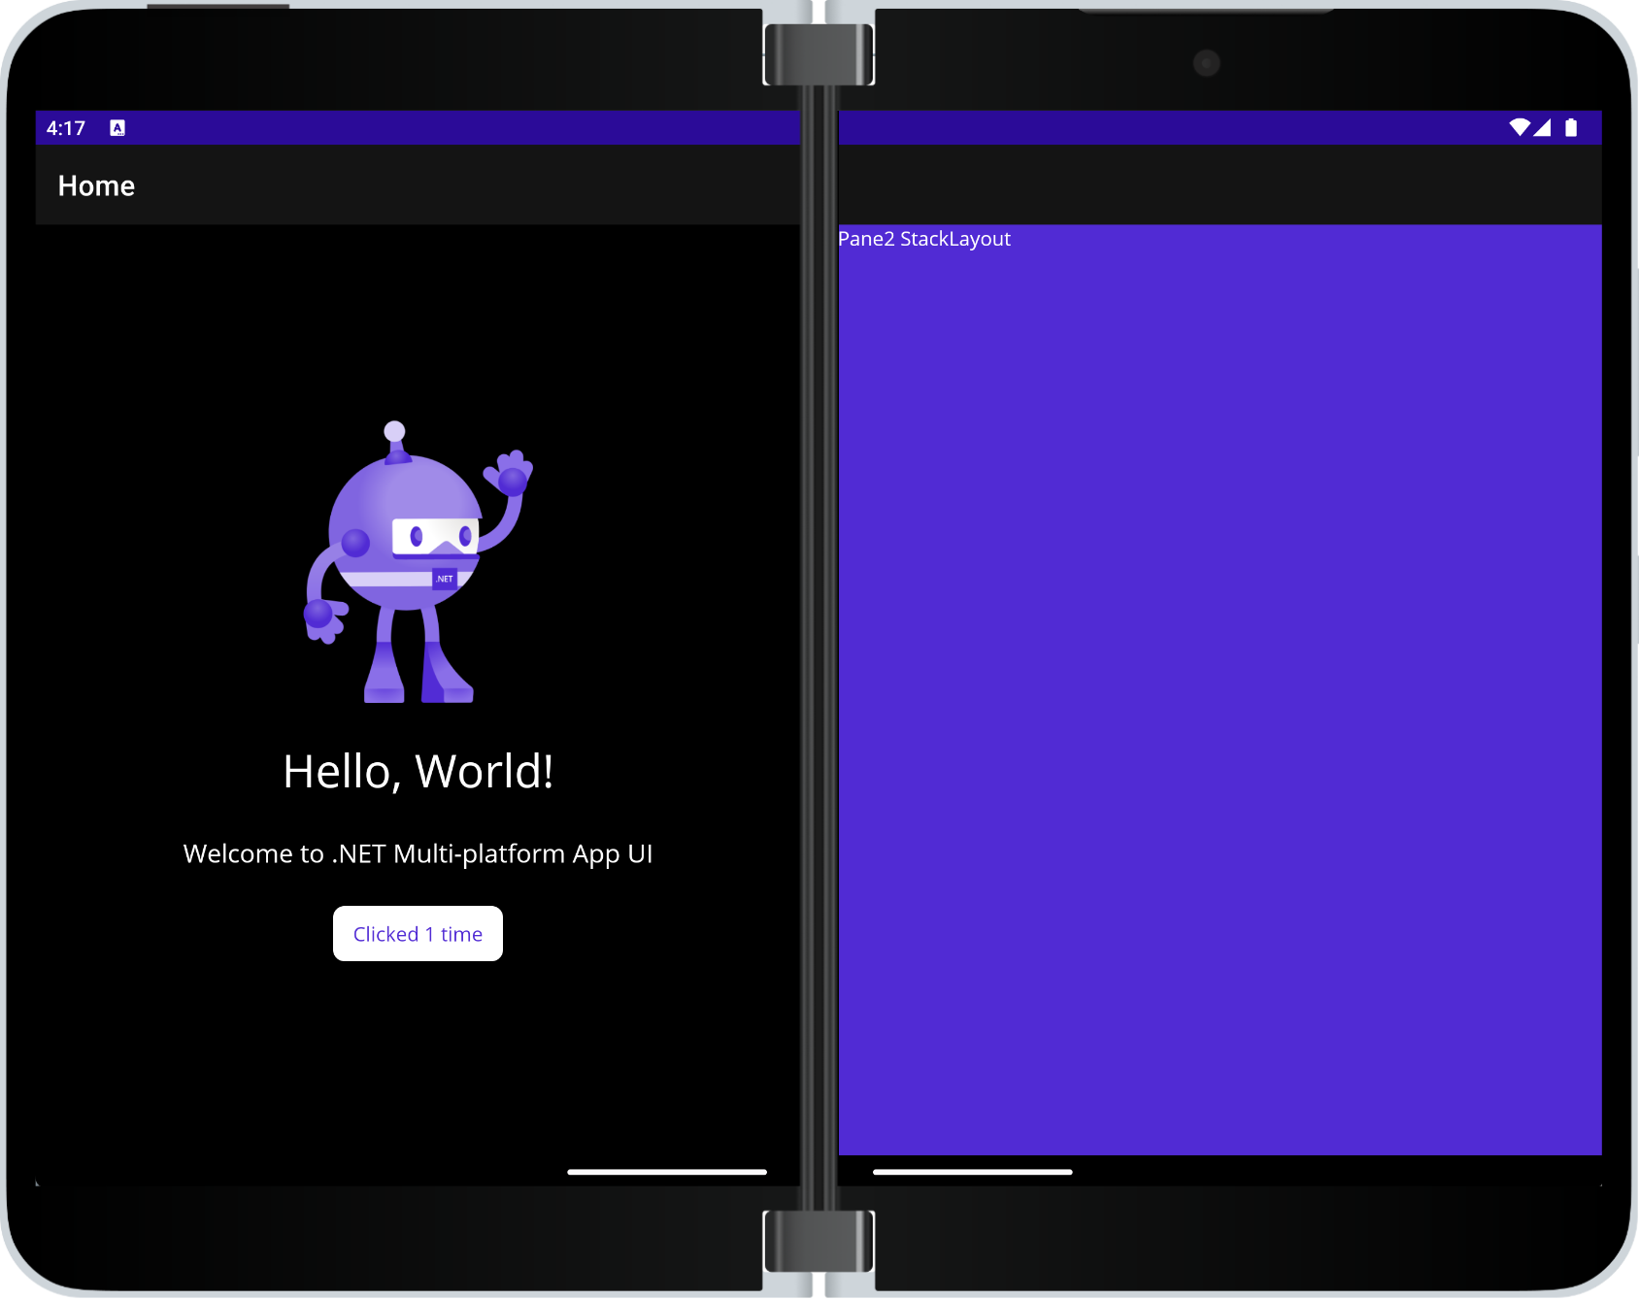
TwoPaneView layout

Slide 21
Map Control
Added in state as in Xamarin Forms
  Multiplatform
  Support for pins, polygons, polylines, geocoding, geolocation…
Android, iOS, Mac OS – supported
Windows – unsupported – no control in WinUI
  Open in external application
  Use embedded web map
Separate package - Microsoft.Maui.Controls.Maps
Initialization
  builder.UseMauiMaps()
  Request access to location services – platform specific

Slide 22
.NET Multi-platform App UI
.NET 7
Cross-platform, native UI
Single project system, single codebase
Deploy to multiple devices, mobile & desktop
.NET MAUI
Android
iOS
macOS
Windows
Notes:
Next I want to talk about .NET MAUI.
.NET MAUI is the evolution of Xamarin.Forms designed to help you deliver high-performance, cross-platform, native desktop & mobile apps all from a single codebase.
.NET MAUI under the hood uses technologies out there today for building native apps on Windows with WinUI, Mac Catalyst for macOS, and of course, iOS and Android. .NET MAUI abstracts all those frameworks into a single framework built on .NET 6.
.NET MAUI on Windows supports WinUI allowing these apps to use all the newest native features on supported versions of Windows 10.
That means you can build all these apps for any device from a single codebase and project system. Instead of learning different stacks and languages for each, you can use one language, one set of libraries, and one UI stack for all of them.
It will release early spring next year. You can watch the progress and help contribute on GitHub in the /dotnet/maui repo.

Slide 23
Project migration – Upgrade Assistant
Updates csproj files
Adds relevant TargetFrameworks
Removes unsupported Nuget packages
Adds known ports of Nuget packages
Switches using Xamarin.Forms with using Microsoft.Maui
Removes using Xamarin.Essentials
Manual Migration Guide
James Montemagno – updating app on live stream
And…still in preview

Slide 24
.NET Multi-platform App UI
.NET 7
Cross-platform, native UI
Single project system, single codebase
Deploy to multiple devices, mobile & desktop
.NET MAUI
Android
iOS
macOS
Windows
Notes:
Next I want to talk about .NET MAUI.
.NET MAUI is the evolution of Xamarin.Forms designed to help you deliver high-performance, cross-platform, native desktop & mobile apps all from a single codebase.
.NET MAUI under the hood uses technologies out there today for building native apps on Windows with WinUI, Mac Catalyst for macOS, and of course, iOS and Android. .NET MAUI abstracts all those frameworks into a single framework built on .NET 6.
.NET MAUI on Windows supports WinUI allowing these apps to use all the newest native features on supported versions of Windows 10.
That means you can build all these apps for any device from a single codebase and project system. Instead of learning different stacks and languages for each, you can use one language, one set of libraries, and one UI stack for all of them.
It will release early spring next year. You can watch the progress and help contribute on GitHub in the /dotnet/maui repo.

Slide 25
WinUI 3 & Windows App SDK
Used as native UI framework on Windows
WinUI 3 Gallery
Version 1.2 released in November 2022
  Support for Widgets (Windows 11)
  Media playback controls
  Voice and video calling
  Performance and reliability improvements
Can be used
  Separately – Windows desktop project
  As part of MAUI – custom handlers

Slide 26
.NET 8
Public previews – probably in February
Focus areas for .NET MAUI
  Improve upgrade path from Xamarin to MAUI
  Speed up UI rendering
  Reduce developer inner-loop time
    Build time
    Hot reload improvements
GitHub .NET 8 milestones
  .NET 7 + Servicing: 104 closed, 16 open
  .NET 8 Planning: 28 closed, 268 open

Slide 27


