Slide 1
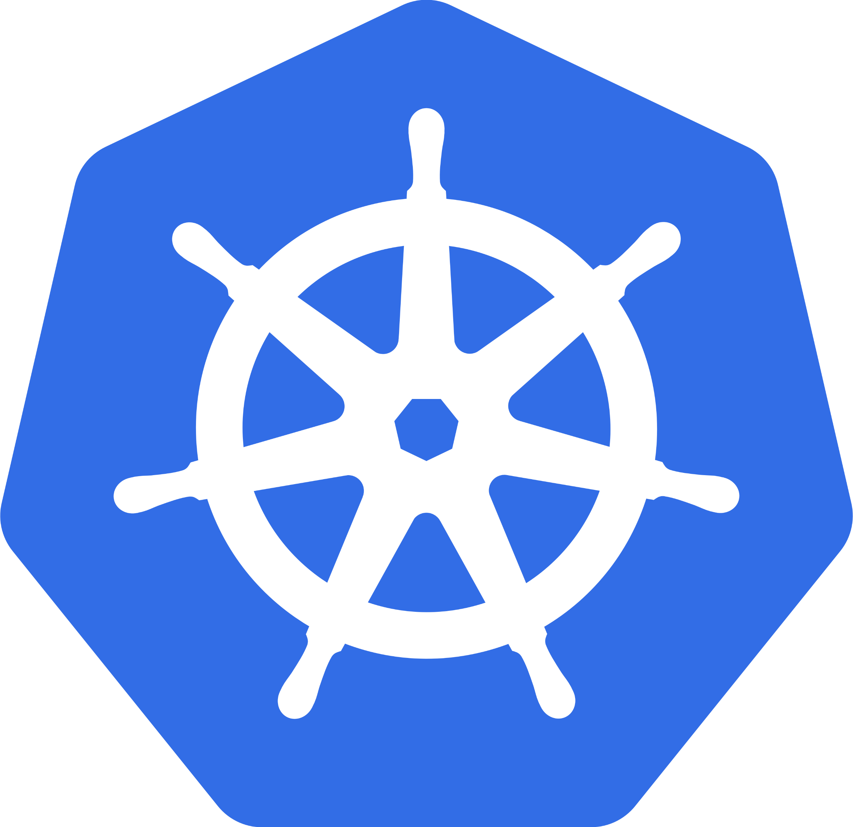
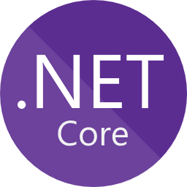
kubernetes
Running dotnet core microservices in K8S
Jan Remunda
Software Architect
jan.remunda@notino.com

Slide 2
monolithic architecture
The monolithic architecture is an architectural style that structures the application as a single executable component.
Simple to develop, simple to deploy, simple to scale
Can be suitable model for starting completely new project (new company)
Once the application becomes large and the team grows in size
  Applications becomes extremely large
  Rapid, frequent and reliable delivery becomes impossible
  Technology stack becomes increasingly obsolete, but a rewrite is expensive

Slide 3
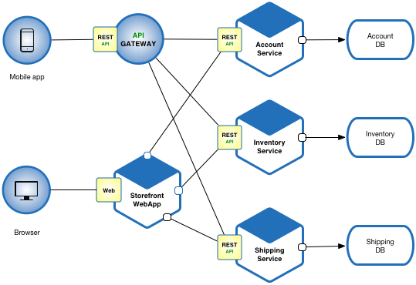
microservice architecture
Highly maintainable and testable
Loosely coupled
Independently deployable
Organized around business capabilities
Owned by
a small team

Slide 4
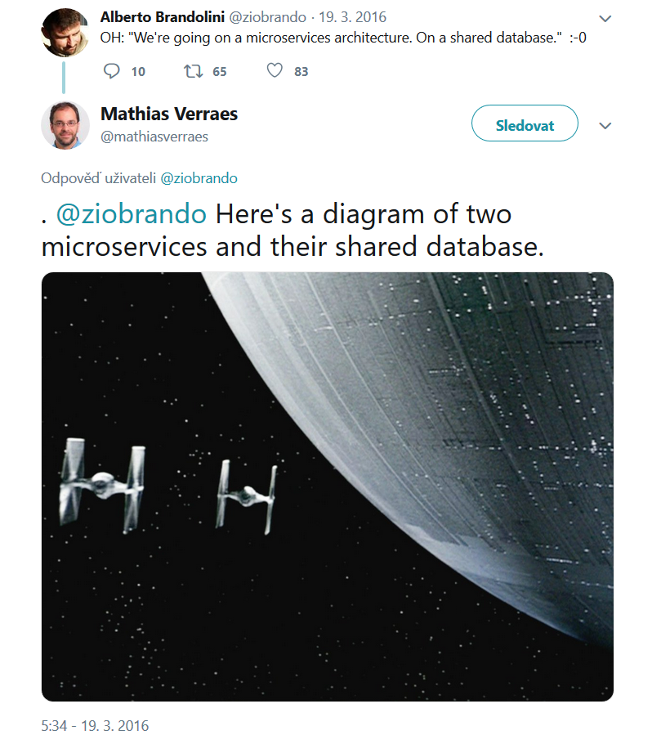

Slide 5
NOTINO platform
Split multiple monolithic systems to set of services organized around business domains.
Provide platform that would allow quick development of new features without impact to quality of other services.
Independent teams developing and maintaining their own services (dev/ops).
Distributed, scalable, resilient services running on-premise and in cloud.
Tools for developers, dotnet/TS/React libraries, conventions, lectures, docs.
Micro-frontends for scaling frontend development

Slide 6
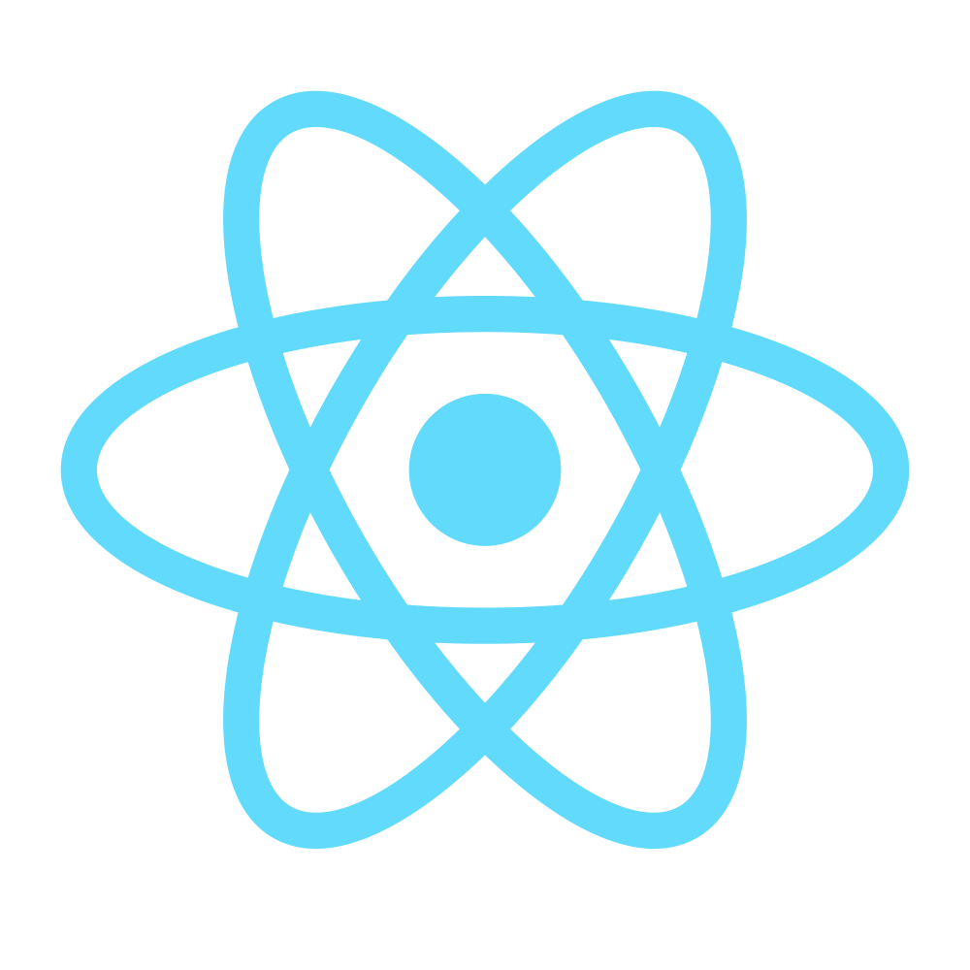
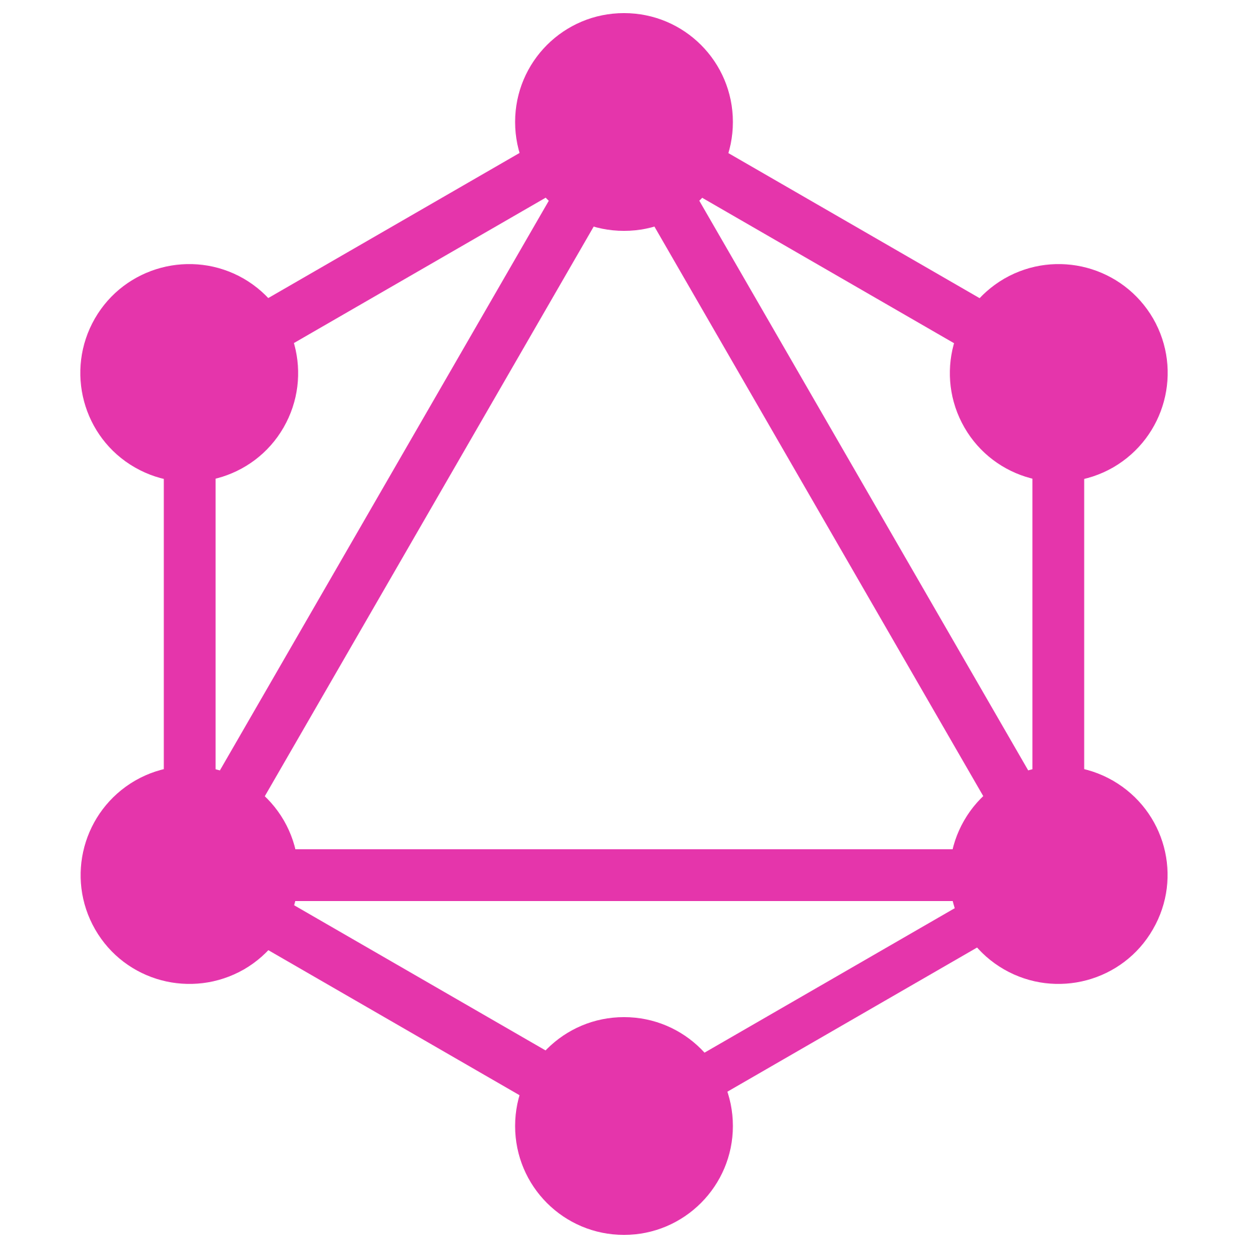

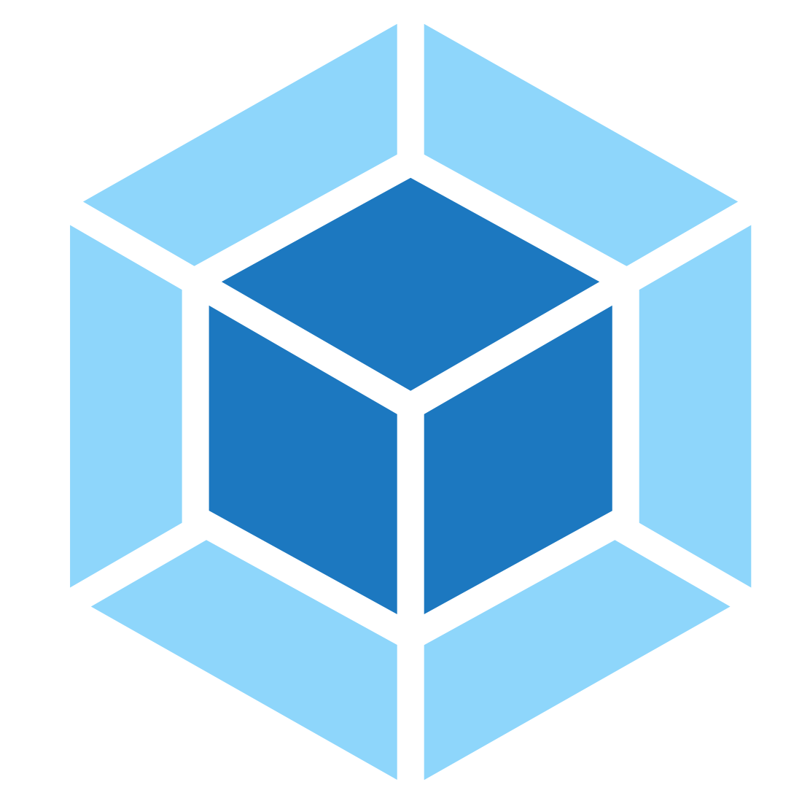


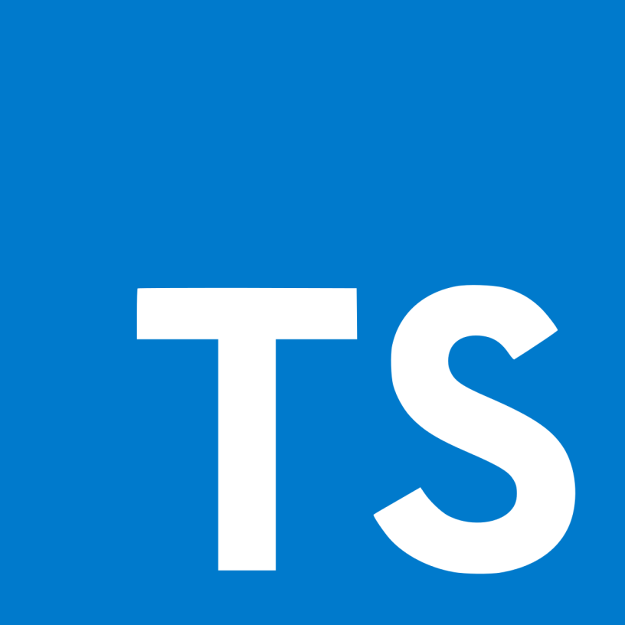
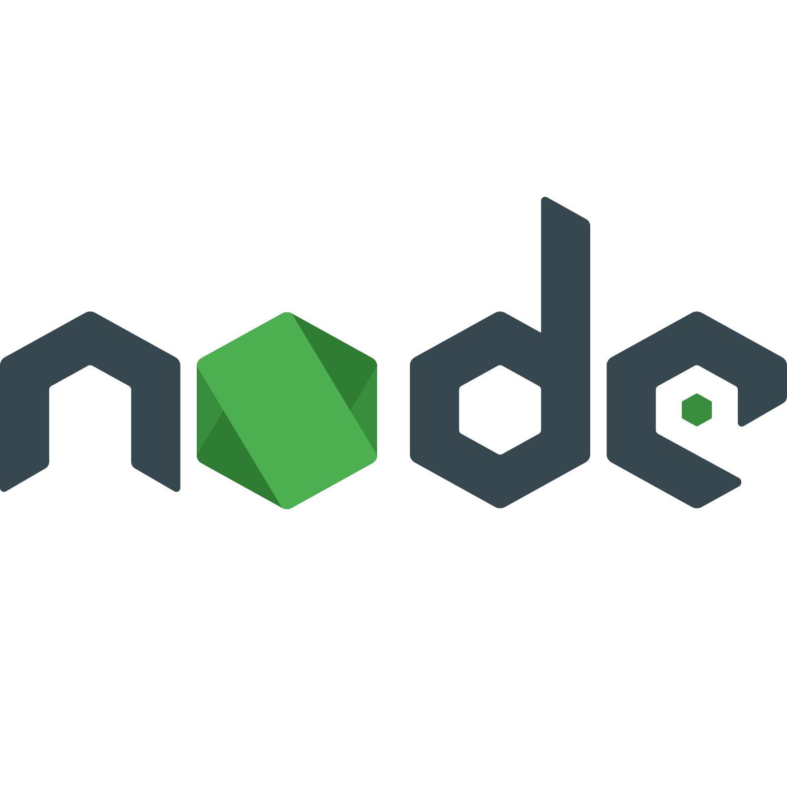
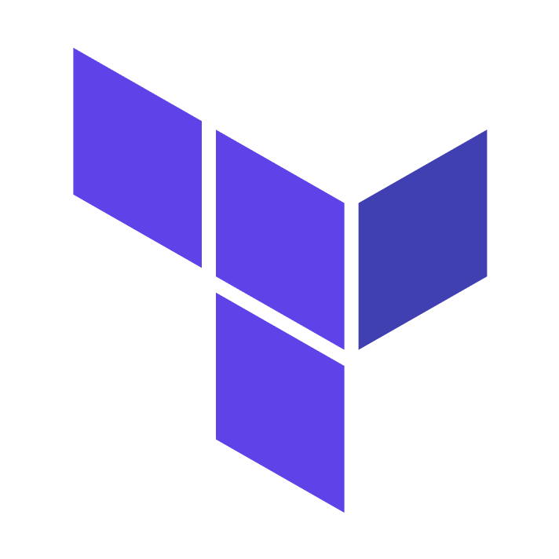

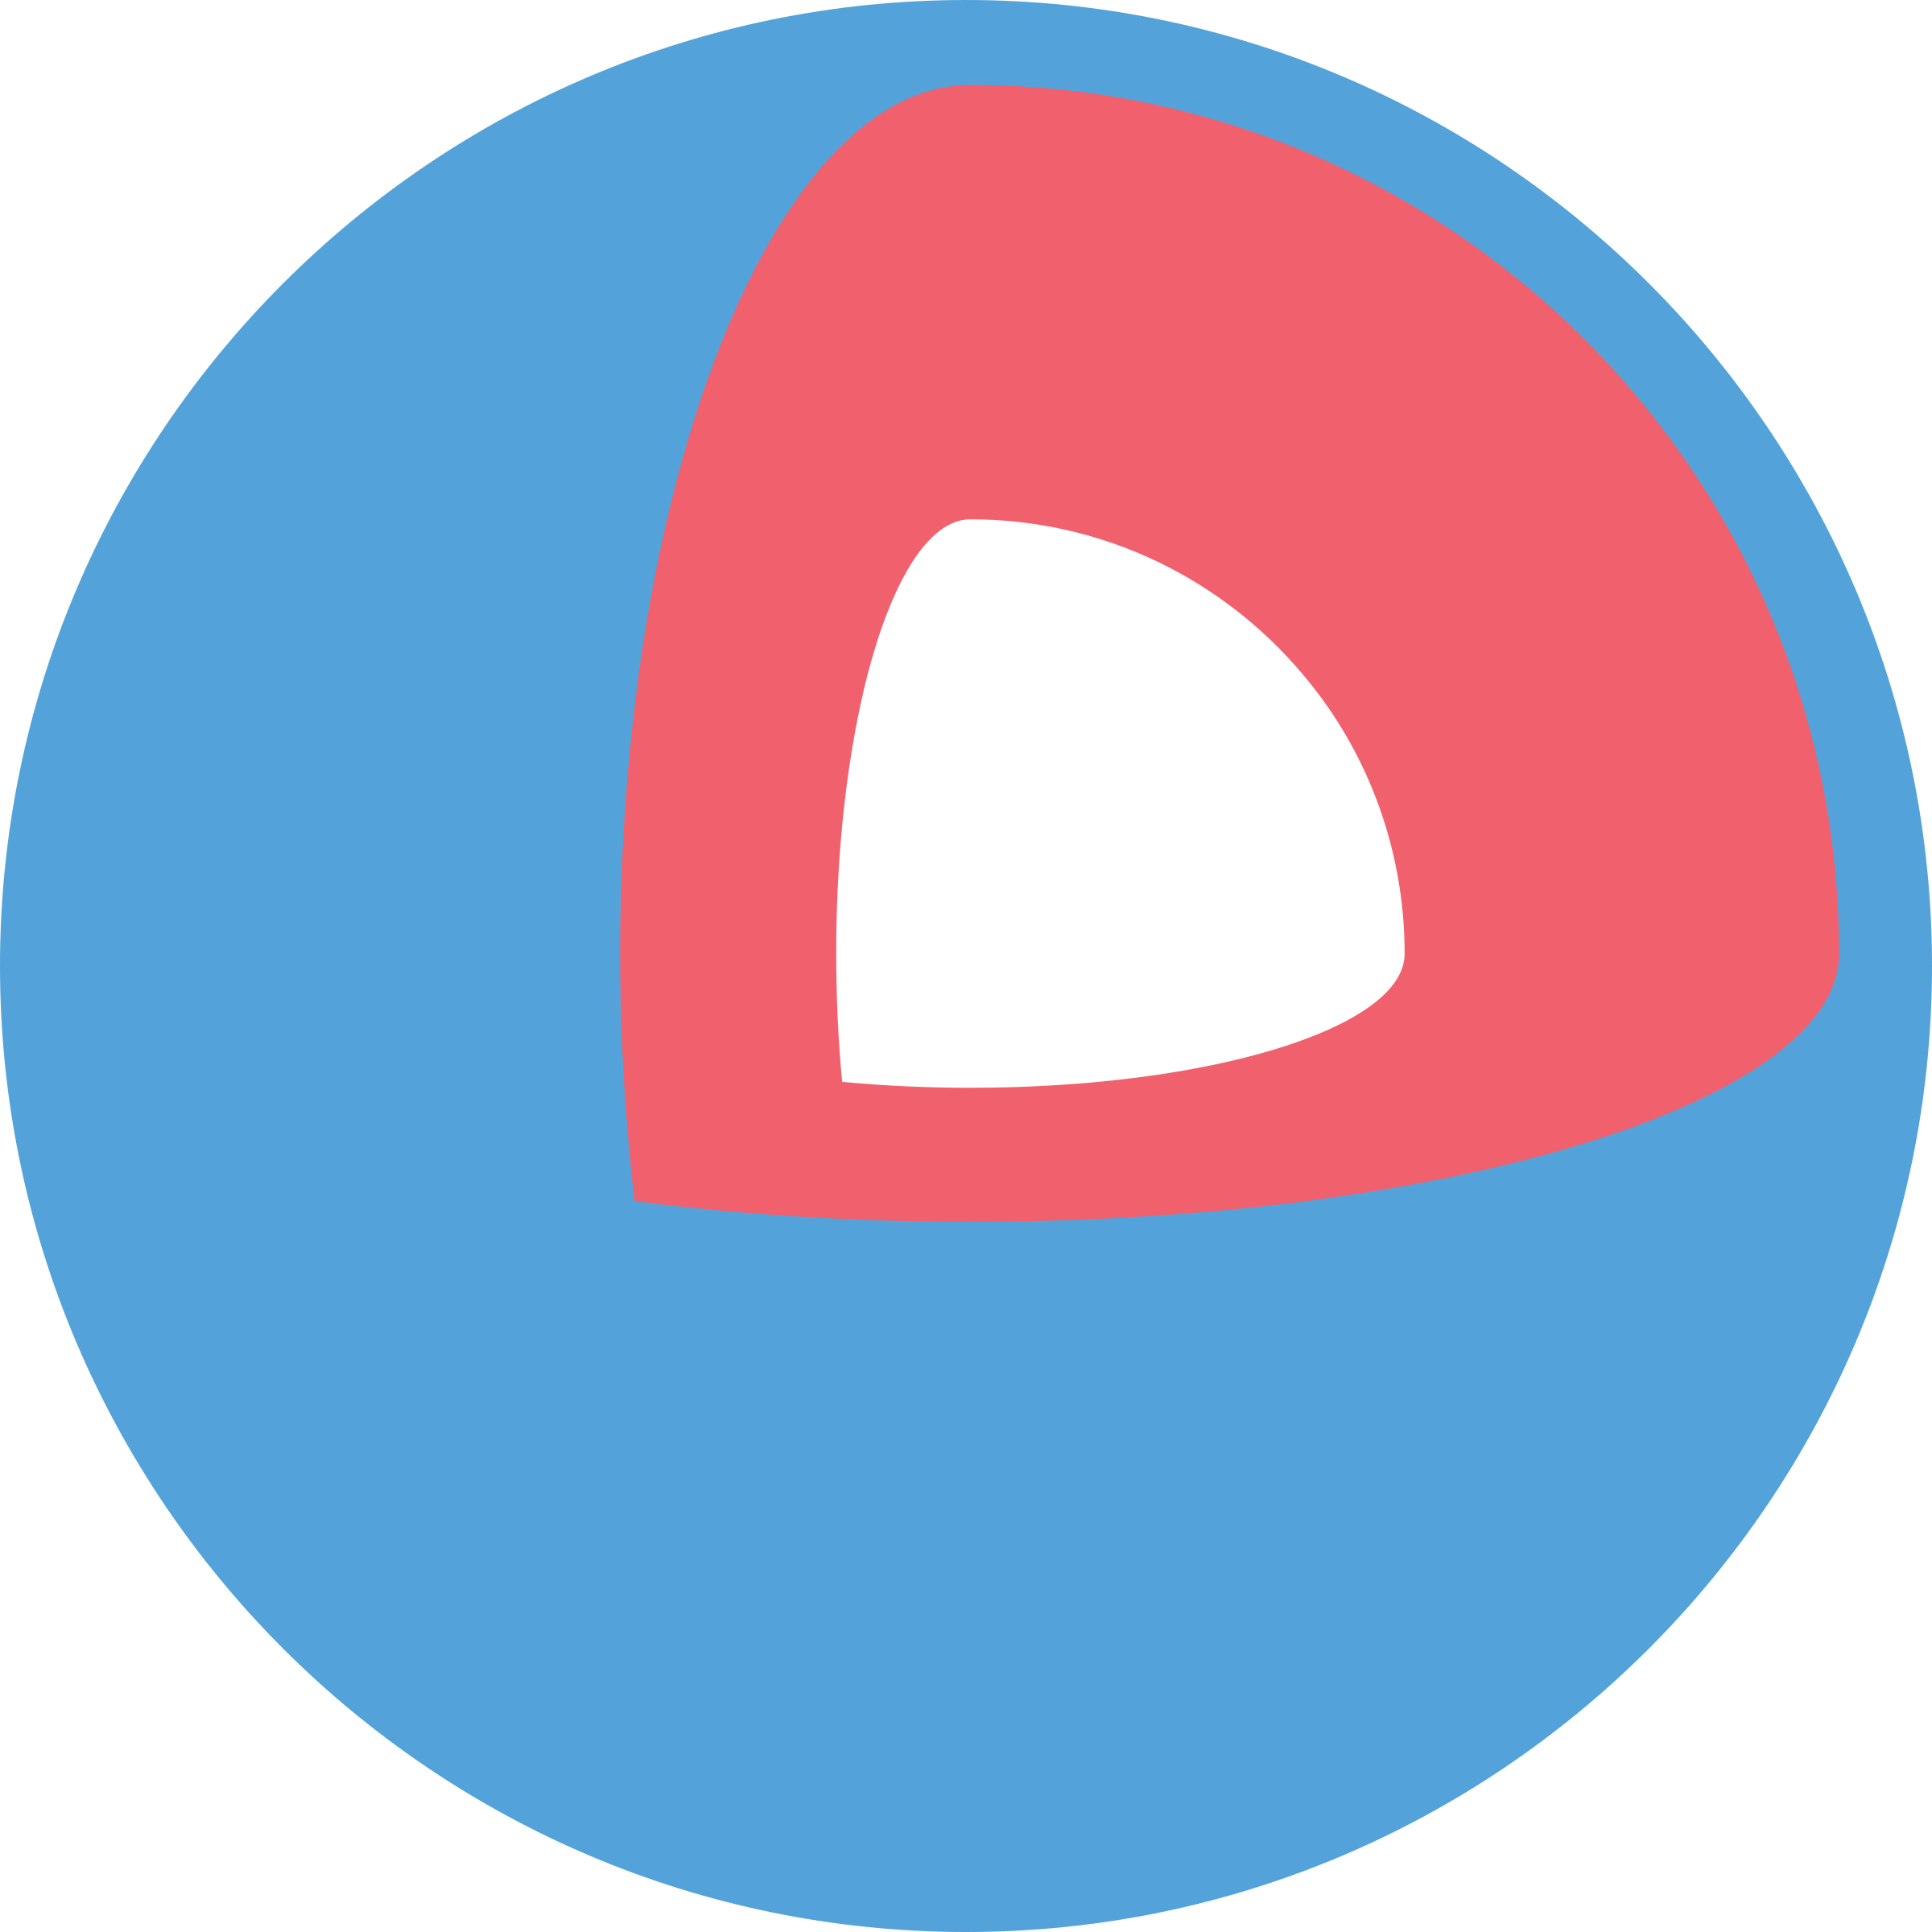
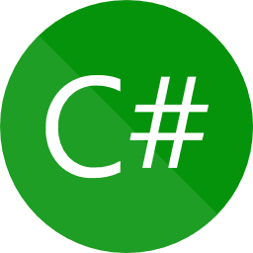


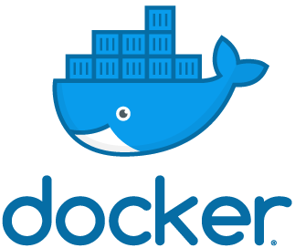
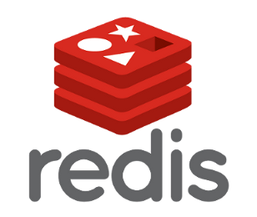
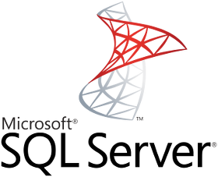
NOTINO platform

Slide 7


Slide 8
ASP.NET core Dockerization
Docker is a set of platform-as-a-service (PaaS) products that use operating-system-level virtualization to deliver software in packages called containers.
Microsoft provides SDK and Runtime docker containers on Docker HUB
You can build your project and a runtime container in 1 Dockerfile using multistage builds
Containers share only kernel
Great for testing – run Redis, SQL, MQ… with one command
Better for stateless services
Production ready

Slide 9
ASP.NET core Dockerization
DEMO

Slide 10
Kubernetes container orchestration
Platform for automating deployment, scaling, and operations of application containers across clusters of hosts
Supports Docker containers
Runs on multiple nodes
Declarative deployment
Kubernetes building blocks ("primitives")
  Pod (1-n containers, 1 IP, localhost access)
  Deployment (maintains sets of replicas)
  Service (discovery, load-balancing, TCP/UDP -> POD)
  Ingress (URL -> Service)
  Namespace (split of resources to environments, teams, domains, etc.)
  Volume (temp/persistent storage)
  Secret, ConfigMap, Daemonset, Statefullset, Job, CronJob, etc.

Slide 11
Kubernetes Probes
Defined action to check state of the app inside running container
Can be http URL or Shell command
Liveness Probe
  The kubelet uses liveness probes to know when to restart a Container.
Readiness
  The kubelet uses readiness probes to know when a Container is ready to start accepting traffic.
  When a Pod is not ready, it is removed from Service load balancers.

Slide 12
Kubernetes microservices must-haves
Docker containers
HTTP API (with swagger)
Prometheus Metrics
Logging (Logstash UDP)
Jaeger Distributed Tracing
Grafana dashboard
Kubernetes Probes
Health Check endpoint
Configuration: JSON, YAML, env vars,
args, Config Maps, Secrets
Service Catalog registration
Gitlab CI pipelines
Helm/Kustomize Deployment
Transient-Error handling
Authentication
SSDT SQL Server DB Deployment
Containers Security Scanning

Slide 13
Kubernetes container orchestration
DEMO

Slide 14

Thank you
Jan Remunda
jan.remunda@notino.com
https://www.linkedin.com/in/janremunda

