Slide 1
Writing scalable code
Martin Hejtmanek, Kentico

Slide 2

Me, myself and Kentico
Kentico
Founded in 2004
Profit-driven, based in Brno
Gartner Magic Quadrant (WCM)
Two product lines
Kentico EMS (Enteprise Marketing Solution)
  Since 2004
  Traditional, On-premise, All-in-one, WCMS
  www.kentico.com/ems
Kentico Cloud
  Since 2015
  Omni-channel, Headless, Cloud, SaaS, CMS
  www.kenticocloud.com
Martin Hejtmanek
martinh@kentico.com
Joined in 2005 as developer
Today
CTO
Head of architects for Kentico Cloud
Kentico Cloud developer
Notes:
Two products – One established, One former internal startup
Split position

Slide 3






Scalability success & goals
Kentico EMS
Multitenant project - 1800+ simple golf club sites on a single cluster (8 servers, 1 SQL DB)
Large news sites – 700k+ news articles (150k new news articles in a year)
Large e-shops – Around 1.5M products (automotive parts)
Online marketing – Scaled to 100M Contacts, 1B Activities on 1 SQL DB (since 2014)
Kentico Cloud
Smaller projects with 10k+ content items / assets
Gaining enterprise traction
Goal 300k content items / assets per project in H1/2019
Notes:
These are our numbers with the two products
Multitenant sites
Large sites
High traffic

Slide 4


On-premise
SaaS
Release once a year
Hotfixes
Isolated installations
Custom code
Local optimizations
Can skip version
More options to resolve local inefficiencies
Client mistake = Their own problem
Unable to track all live usages and scenarios
Close to impossible deploy critical fix to everyone
Continuous releases
Multi-tenant by definition
Shared resources
Micro-services
All at the same version(s)
Easier to deploy fix
Known data and use cases at any time
Client mistake = Vendor’s problem
Can’t optimize for everyone
Harder to implement and validate fix
Notes:
On-premise and SaaS shares some similar aspects, but with different solutions and priorities
On-premise –
SaaS – More flexible, but need to be more careful

Slide 5


“The project is too small to handle performance. We will handle it later.”
50 Shades of scalability delays
“We are in feature race, no time to handle performance. We will take the risk.”
“The market is commoditized, we need to work on differentiators.”
“We can’t spend the whole quarter on optimizations. Does not fit the strategy.”
“I had no idea we had so much performance technical debt.”
“We can’t sell big projects. We are losing money.”
“We don’t have features. We are losing money.”
Notes:
Some typical conversations around scalability
In the end, the problem gets so large that it influences the company strategy
You either lose money on not being able to sell, or postponing planned features

Slide 6

Keeping under control
Notes:
The goal of this presentation is to give you hints for scalability that you can easily execute during your normal development
Thinks about it
Divided into several categories

Slide 7
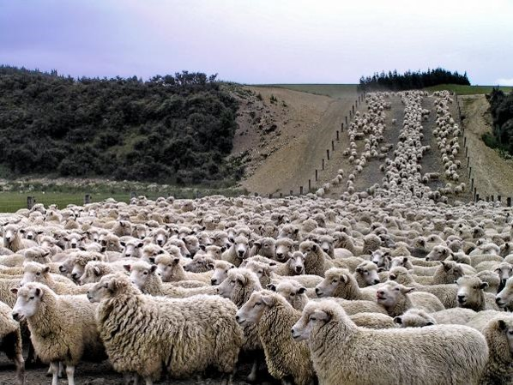
Counting
http://outrageoussports.com.au/australian-sports/get-no-at-the-sheep-counting-competition/
Notes:
Counting costs is the absolute basis of thinking about scalability

Slide 8
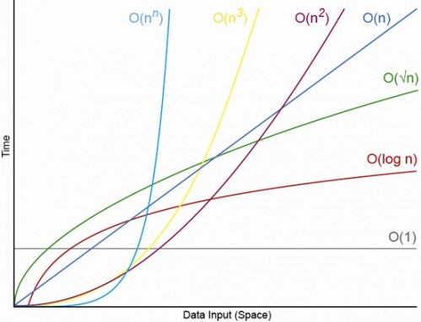
Abstract counting
O(n*log n)
Not really scalable
Fair trade-off
Scalable
Notes:
But the counting is abstract, we are interested in trends and orders of magnitude, not exact numbers
Typical goal in data processing is to convert sqr(n) to n*log n
The cause of each scalability issue is a loop

Slide 9
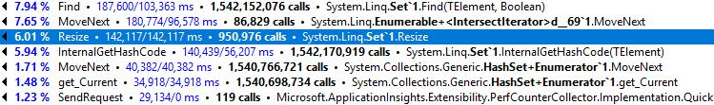
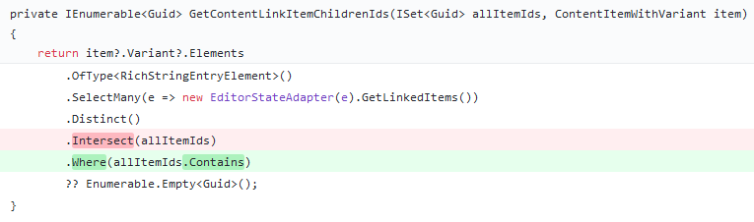
Small mistakes make a big difference
2 Nested loops on 22k items O(n) ~= 500M calls O(n²)
Great intention doesn’t always provide great results, think twice
http://referencesource.microsoft.com/#System.Core/System/Linq/Enumerable.cs,ae06318d1f5fb355
Notes:
This will show you one example of our code that we optimized
Subtle change may have significant results
Where and contains is quite clear, let’s look at the intersect

Slide 10
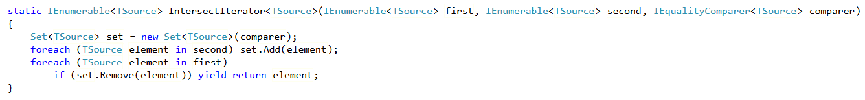


Enumerable consequences
O(m*log n)
O(n*log m)
VS.
O(m*log n)
Create larger set at top level - O(n*log n)
foreach item in allItems (22k)
n – All items (22k)
m – Found items (10 in avg.)
Intersect – O(n*log n + m*log n)
= 22k * 14 + 10 * 14
Where contains – O(m*log n)
= 10 * 14
Notes:
Intersect is a good example how enumerable operations may be inefficient due to lack of knowledge
The bare minimum needed is one loop and one lookup, but the lookup must be over the larger and it must be a set

Slide 11
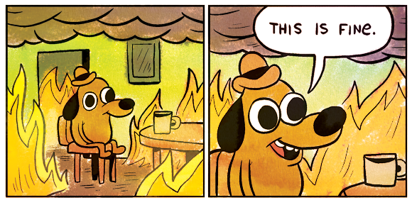
Key questions
How would I implement that operation?
Guess the implementation of what you are using (not so many probable options)
If unable, check the source code if available, e.g. http://referencesource.microsoft.com/
How does it combine with other functionality?
O(n) is fine
O(n) inside another O(n) is not so much fine
What happens with 10 x / 100 x more data?
Helps you realize potential O(n²) and worse
Notes:
Couple of hints that will help you realize how your code stands

Slide 12

Grouping
Notes:
Grouping, aka optimizing access to chunks

Slide 13
External factors
Async call
HTTP request
Database call
Filesystem call
Access to memory with page-miss
New thread
Anything outside of your current thread is extra overhead
Round-Trip-Time
Cryptography
Locking
1M processor instructions is OK
1M HTTP requests is impossible
Even 1k HTTP requests is too much
Reduce as much as possible
Notes:
Mostly needed when there are “external factors” = actions that execute outside current context
Each order of distance from processor multiplies latency of such actions

Slide 14
Bulk vs. one-by-one
One-by-one
Continuous feedback
Continue smoothly upon fail
Not scalable with external factors
Large overhead
Bulk processing (all-in-one)
Scalable
Feedback for all at once
When one fails, all fail (no easy recovery)
May timeout on larger data set
Batch processing
Scalable (with the right batch size)
Continuous feedback (by chunks)
When one fails, continue with chunk
Most costly for implementation
Notes:
Just a brief overview of choices we have
In general when external factors are involved, we should use bulk or batch processing

Slide 15
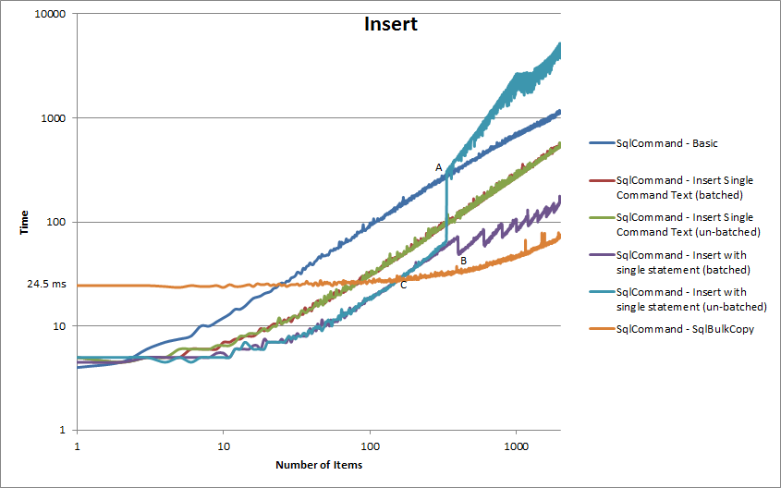

But isn’t bulk overkill for low load?
Yes …
Does anyone care?
Not really …
Low load
One-by-one – 5% CPU
Bulk – 50% CPU
High load
Bulk – 100% CPU
One-by-one – 10000% CPU
Notes:
Often used argument against doing things bulk-first is low load performance
But the reality is, the machine can take it
Unless you have time to do micro-optimizations and implement both bulk and one-by-one, bulk is better

Slide 16

Isolation
Notes:
How to keep problematic clients off the others

Slide 17
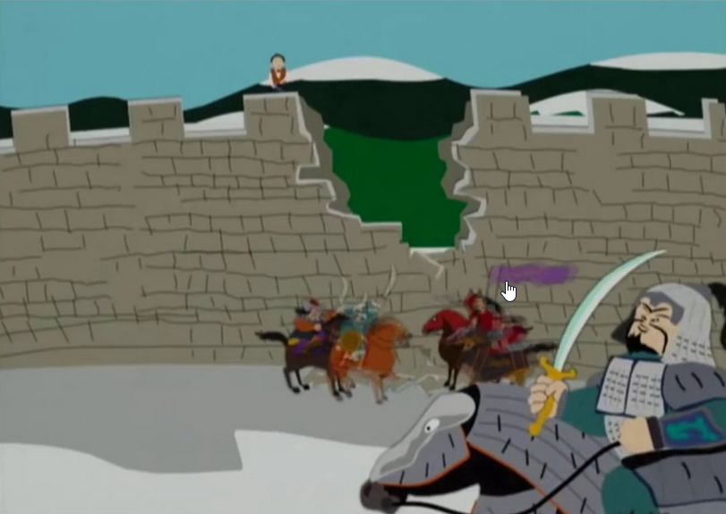
Isolation
Multi-tenant solutions
Overall infrastructure performance is not a sum of peaks
Just a fraction of theoretical peak
One tenant should not significantly influence other tenants when overloading
Allow parallelism of tenants, leave the rest on thread scheduler
Run heavy processes per tenant
Heavy = data processed at once = #tenants_processed_at_once * avg_cost_per_tenant
Notes:
Isolation is important especially for multitenant solutions to prevent draining resources
Resources are limited
There are many existing solutions to this
Just allow the system parallelization

Slide 18

Rate / throughput limitation
Reduce too much parallelism from one client
Keep resources available for other clients
Resource governance per tenant
There are often libraries for that
Notes:
Parallelism prevents DoS
But for properly responsive system one needs to prevent blocking majority of resources
Rate limitation is the easiest way to do it

Slide 19

Waste
Notes:
Waste is something that you used, but didn’t really need
In large solutions, it often multiplies needed resources

Slide 20
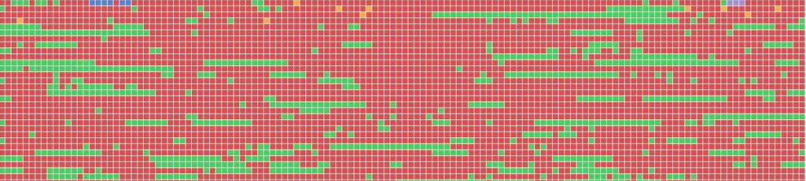
Data storage and referencing
Keep the amount of referenced data at the lowest possible amount at all levels
Avoid load and immediate drop
Not only at database level
Data storage with partitioning by tenant
Avoid continuous storage
Honor default partitioning in data flow
By tenant is always safer than all-in-one
Everything eventually loads by blocks
Avoid fragmentation side-effects
Insert new data
Make space
Notes:
Waste is produced mostly by loading or handling data not directly related to data you need
Two typical cases
Continuous storage
Partitioning vs. fragmentation

Slide 21
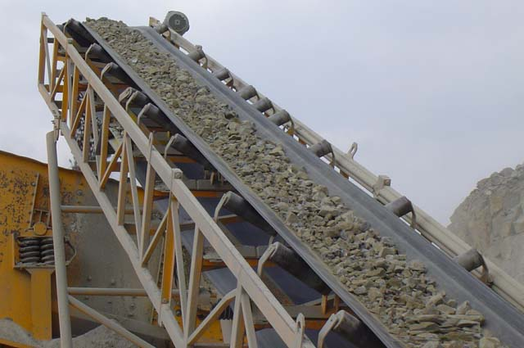
Streaming / paging
Prevent missed memory pages
Avoid load and keep all for large sets of data
Processing all
ICollection (pagesize) - Paging
vs.
IEnumerable
vs.
ICollection (all)
Ideal – Stream processing (Unordered)
Better memory management
Notes:
Sometimes it is just about not referencing all data in memory
Bulk processing improves performance but may have pitfalls
If you cut the problem into pieces, the resources will not starve

Slide 22

Data duplication
(Read-only) cloning
To prevent direct write-through to cache
Often used as first (easy) solution
Consequences O(n)
Memory allocation
CPU time for mapping
Memory cleanup (GC)
How to avoid?
Be careful with writing (error-prone)
Use Immutable data, reference original – Prevent write-through by default
Notes:
Talking about memory, avoid replication of unneeded data
Cloning is often used at the repository level, but causes a lot of allocation and therefore deallocation
One option is to try to be careful
But having it checked by the compiler is always safer

Slide 23
Selectivity in DB
Simple perspective
Each query result is a set of data and potentially harmful to have it in memory as a whole
Complex perspective
Each query result is a set of data which may be further optimized (or not)
  May be stream unless DISTINCT
  May be reduced based on projections (data really used)
Nested constructs / queries harder to optimize automatically
  Mathematically possible
  But often complex, solution is often just best practice (familiar?)
Overall – Unless you want to stuck with DB implementation details, think Simple view
Notes:
People often think that offloading the operation to database solves the problem
Entity framework etc. does effectively only basic operations
But at the database side the problem is the same
Think about what the database engine must do for you

Slide 24
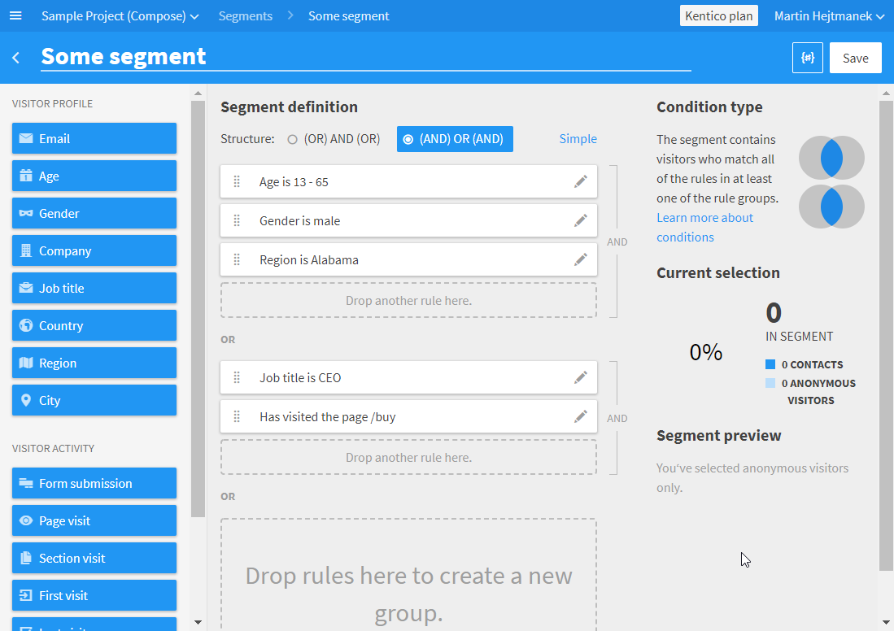
Segments in Kentico Cloud
Notes:
One of our features in Kentico Cloud - segmentation

Slide 25
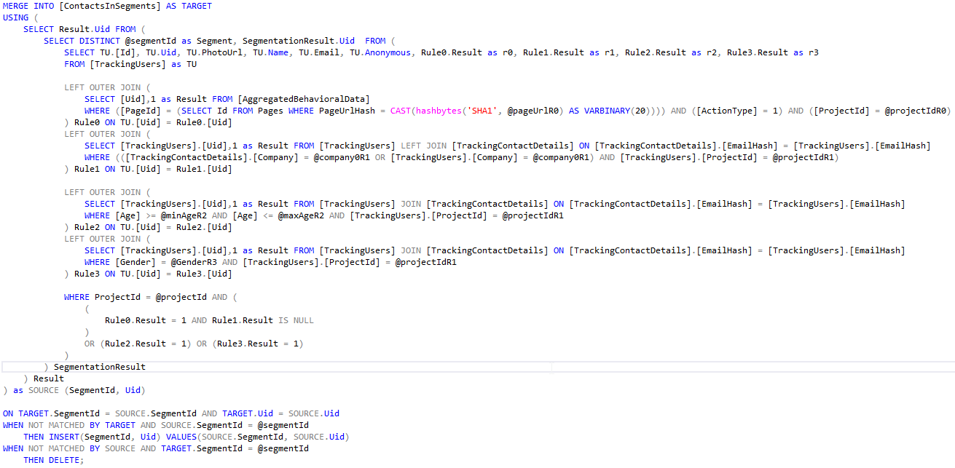
Segment recalculation
Not used columns
All contacts as initial data = Total consumptions based on total number of contacts
Filtering too late
Notes:
Segment recalculation query
With a lot of waste involved
The goal of the query is to get the IDs and update previous state

Slide 26
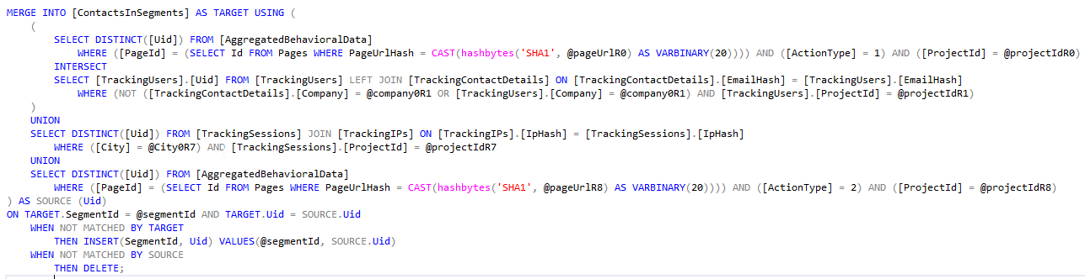
0 initial data = Total consumption based on just matching results
Filter ASAP = Each level returns just matching Uids
Result comparison
420k contacts
Original - 1:01:05 (1 hour +)
Updated - 0:00:06 to 0:00:23 (6 seconds to 23 seconds)
Union / Intersect = Combine results ASAP
Notes:
Altered query does the same, but cuts unnecessary data ASAP
Improvements are dramatic

Slide 27

False positives
Notes:
Last part about threats which are not really threats

Slide 28
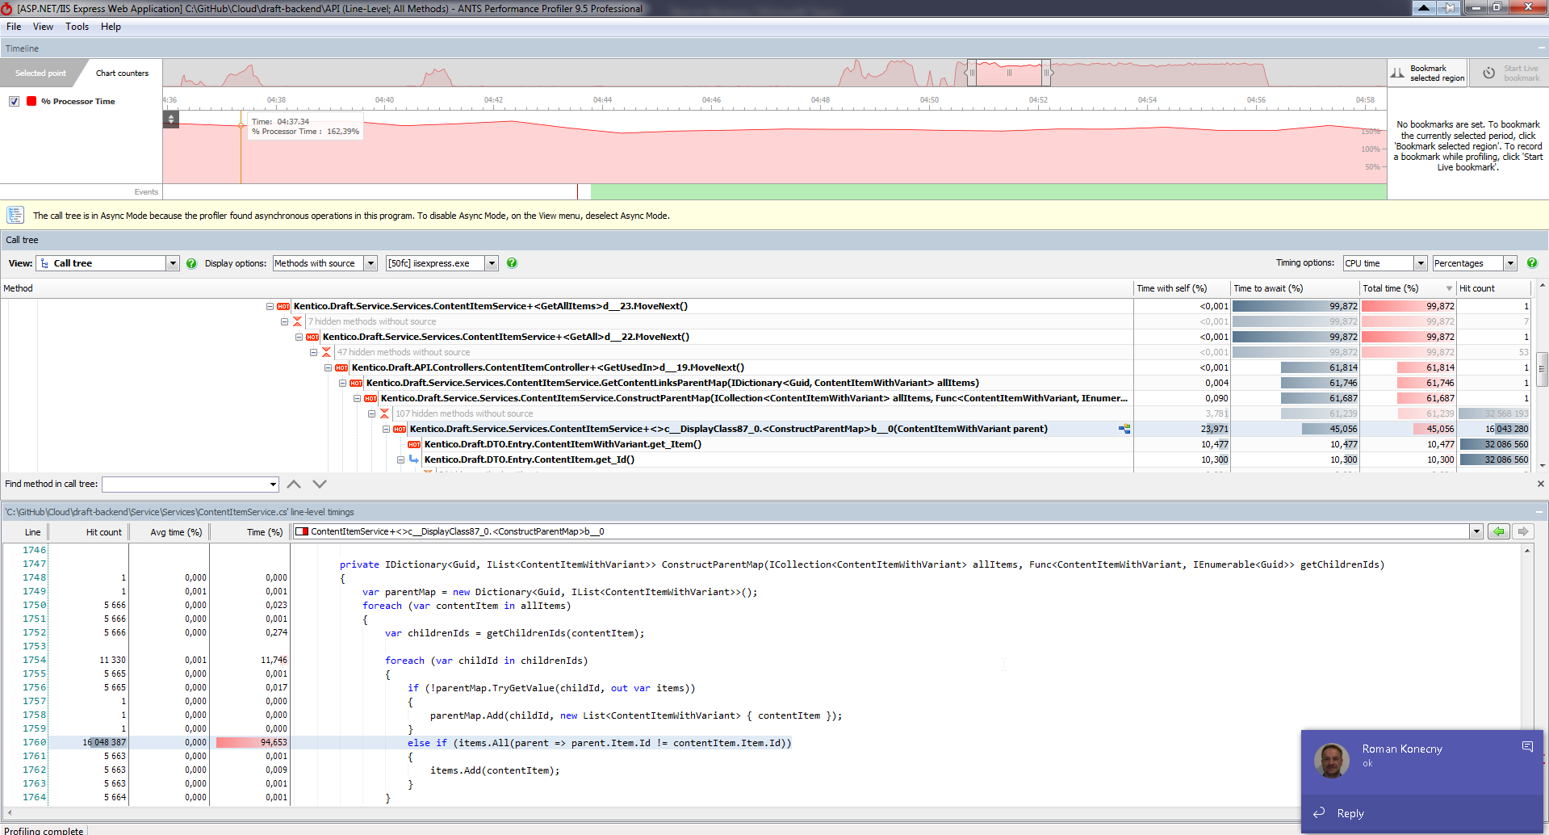
False positives
Notes:
We generated some sample data and run load test
Found some problematic parts

Slide 29
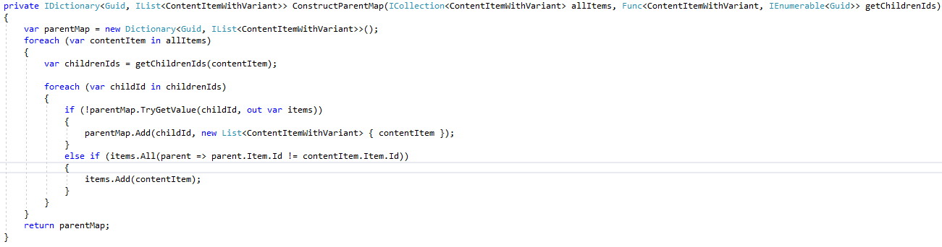

Likely and unlikely data distribution
Do not optimize for hypothetical worst cases which are unlikely
N = 22k
22k = O(n)
Children = References from content item to other items
X*22k each ? = O(n) -> O(n²)
O(log n) = 14 - Insignificant
1 to 22k = 11k avg. = O(n) -> O(n³)
22k * 22k * 11k = 5 x 10¹²
Notes:
Original counting of complexity
Worst case was unrealistic

Slide 30

Be realistic …
Consider archetypes
22k = O(n)
Does anybody really reference everything from everywhere?
1 .. 50 max (max exceptionally) = 10 avg. = O(1) -> O(n)
O(log n)
1 .. 50 max (linear) = 25 avg. = O(1) -> O(n)
22k * 10 * (25 + 14) = 8.5M = 8.5 x 10⁶
Notes:
News site / article archetype … no more than couple of tens of references
And the overall complexity is … reasonable
So why it was found as bottleneck in the first place

Slide 31
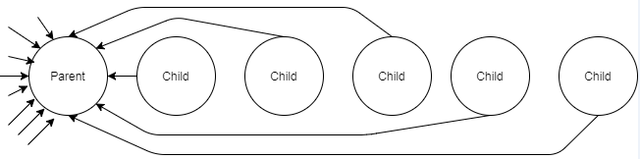
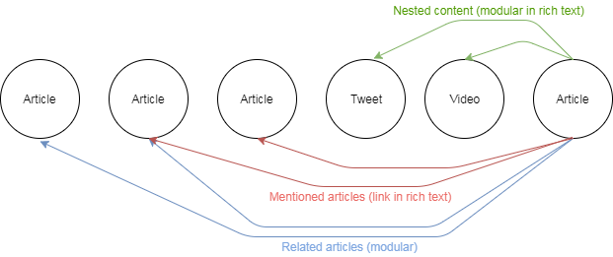
Conclusion
Wrong sample data
The way it was, all links to single parent
Reality in real-world is more like this
Nothing obvious we could do with algorithm
Use just necessary subset
Consider optimization at caller side / caching
Notes:
The testing data did not correspond to production reality
In the end, we dropped the optimized code, and used caching so this executes less often

Slide 32



Summary + Cheat sheet
Counting
Grouping
Isolation
Waste
False positives
Technical debt
Notes:
To summarize, even if you aren’t explicitly told, think about the scalability
At least about these very basic aspects
And don’t forget that if you don’t, it will hunt you later

Slide 33
Questions?
Martin Hejtmanek
martinh@kentico.com
Notes:
That is all ☺

