Slide 1
Dostaň zo svojho Windows 10 maximum
Daniel BAČA
daniel.baca@wug.sk

Slide 2
Osnova
Vízia a krutá realita
Program Insider – buď o krok vpred
Hyper-V
Container
Microsoft sa nám zamiloval
Šikovný pomocníci

Slide 3

Xbox 360
Xbox One
Unified core
and app platform
Converged
OS kernel
Windows 8.1
Windows 8
Converged
app model
Windows 10
Windows Phone 8.1
Windows Phone 8
Easy for users to get & stay current
Windows Phone 7.5
Windows on Devices

Slide 4
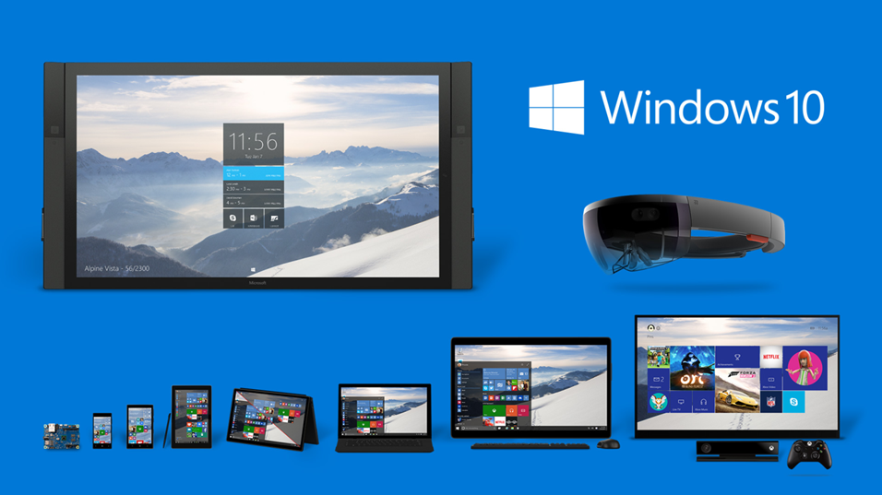
Big family

Slide 5
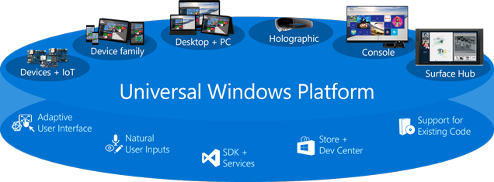
Universal Windows Platform

Slide 6
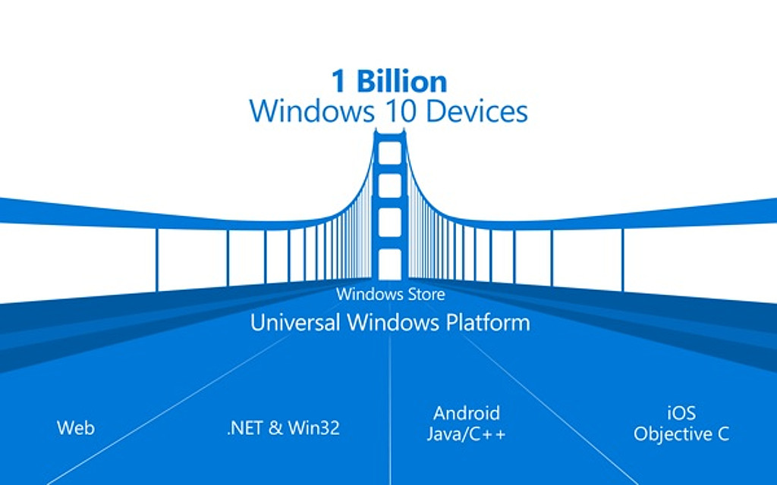
One Windows Store

Slide 7
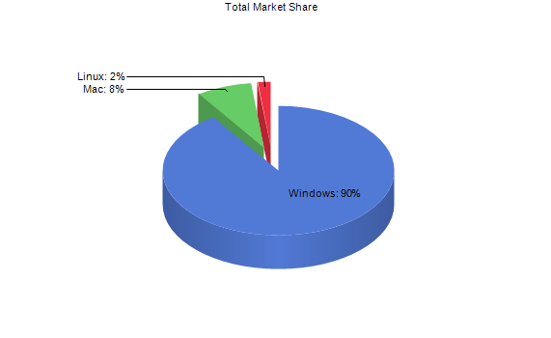
Desktop Operating System
Notes:
http://netmarketshare.com/
Export >> Word

Slide 8
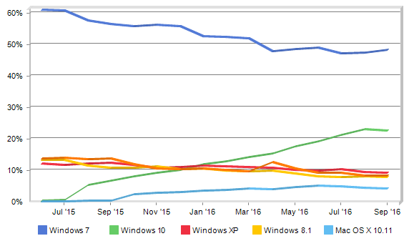
DeskTop OS Share Trend
Month | Windows 7 | Windows 10 | Windows XP | Windows 8.1 | Mac OS X 10.11 | Other
June, 2015 | 60.98% | 0.16% | 11.98% | 13.12% | 0.03% | 13.74%
September, 2016 | 48.27% | 22.53% | 9.11% | 7.83% | 4.07% | 8.19%
Notes:
http://netmarketshare.com/
Desktop Top Operating System Share Trend

Slide 9
Windows 10
30 Septembra 2014 Technical Preview
29 Júl 2015 – ostrá verzia
2 August 2016 > Redstone > Anniversary Update

Slide 10
Windows 10 editions
Windows 10 Home
Windows 10 Pro
Windows 10 Educational
Windows 10 Enterprise
Windows 10 Mobile
Windows 10 Mobile Enterprise

Slide 11
Windows 10 editions - compare

Slide 12
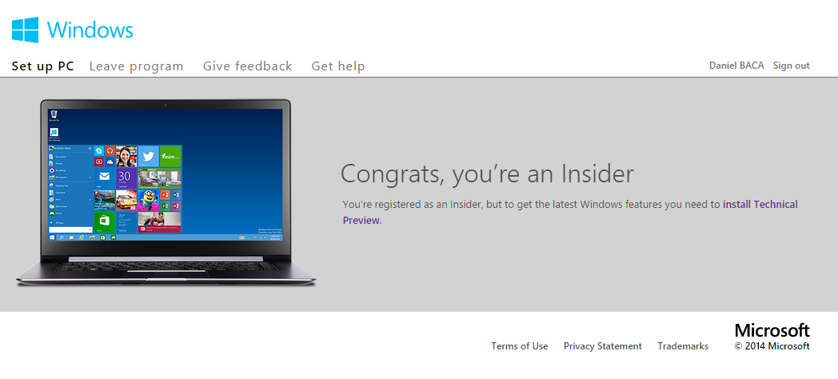
Insider program
Notes:
https://insider.windows.com/Home/SetupPC

Slide 13
Insider program

Slide 14
Insider program - steps
Prihlásiť sa do programu
Vybrať si režim
    Fast
    Slow
    Release Preview

Slide 15
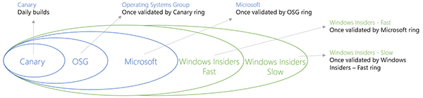
Insider program - builds

Slide 16
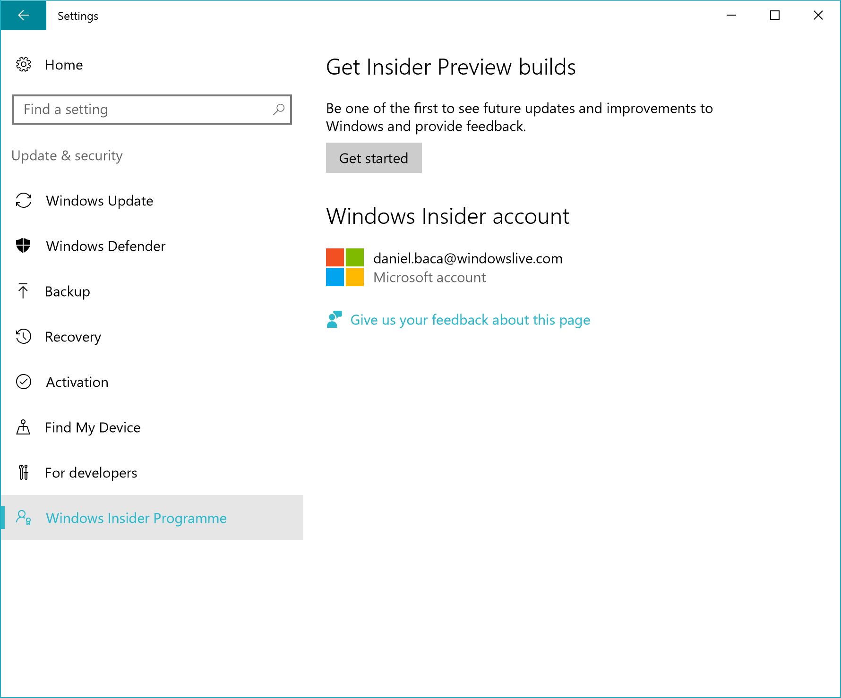
Insider program - start

Slide 17
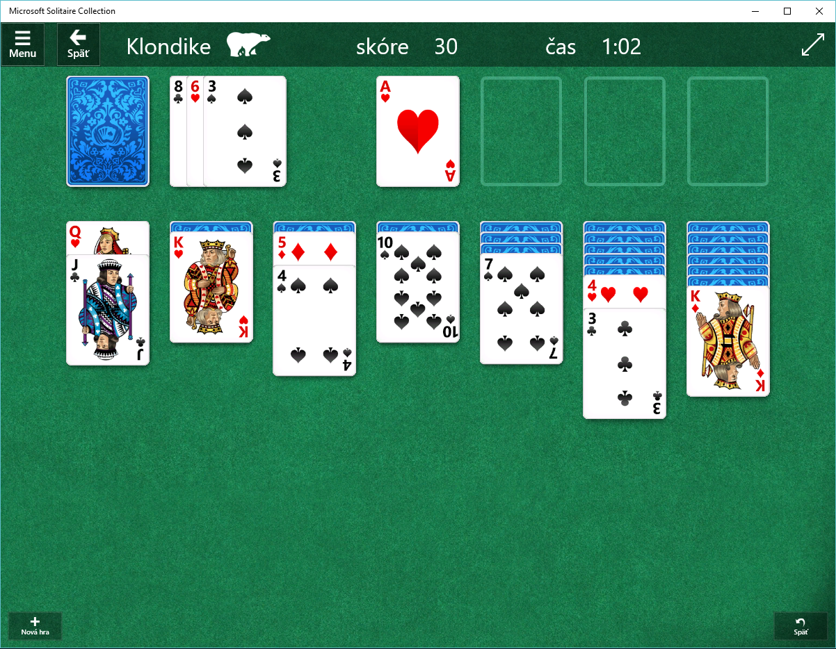
Top app

Slide 18
Top apps
Notification center
Cortana
Edge – webový prehliadač

Slide 19
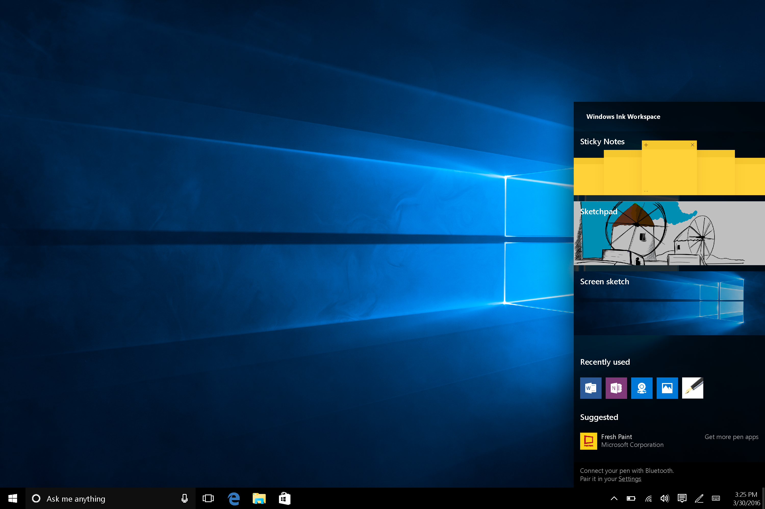
Windows Ink

Slide 20
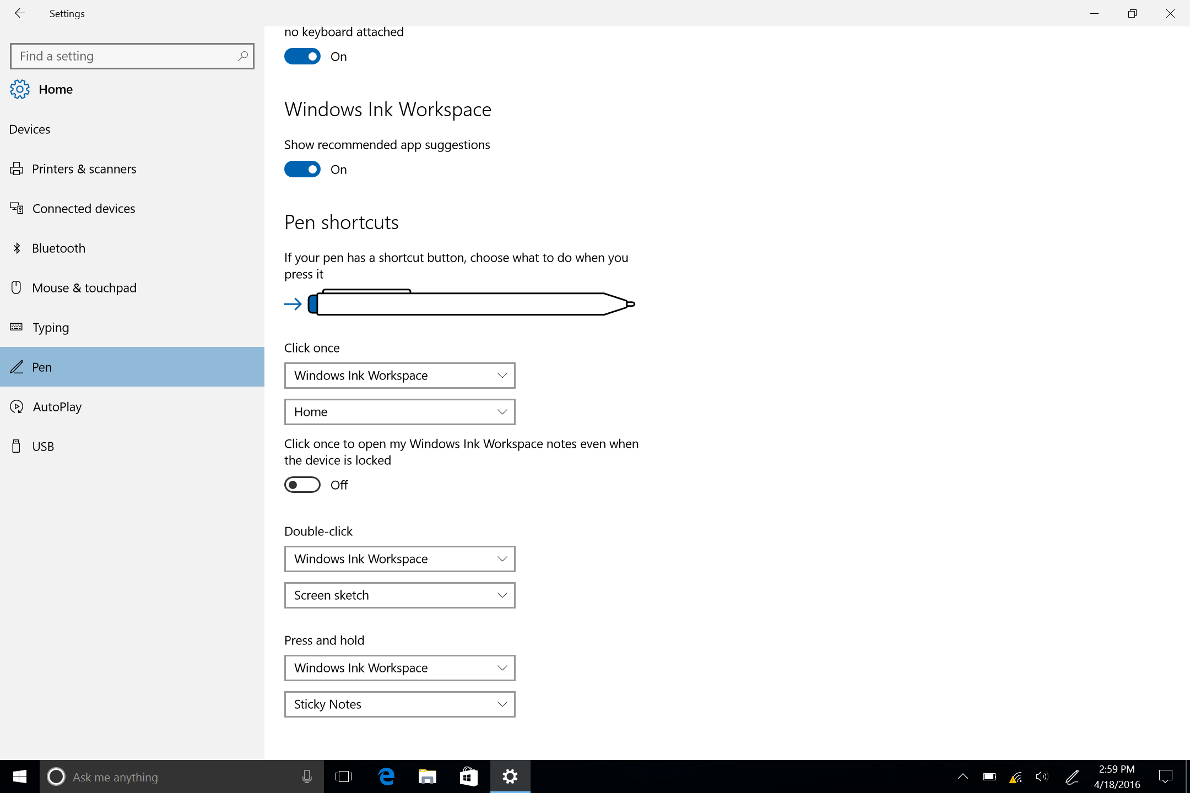
Custom Pen Experiences

Slide 21
Hyper-V

Slide 22
Operating System Requirements
Windows 10 Enterprise
Windows 10 Professional
Windows 10 Education
Note
Windows 10 Home edition can be upgraded to Windows 10 Professional.
Settings >Update and Security > Activation. Here you can visit the store and purchase an upgrade.

Slide 23
Supported guest operating systems

Slide 24
Supported guest operating systems

Slide 25
Supported guest operating systems

Slide 26
Hyper-V features available in Windows Server only
Virtualizing GPUs using RemoteFX
Live migration of virtual machines from one host to another
Hyper-V Replica
Virtual Fiber Channel
SR-IOV networking
Shared .VHDX

Slide 27
Requirements
Minimum 4 GB RAM for the Host
Intel VT-x processors (as of this writing)
EPT Support

Slide 28
Hardware Requirements
64-bit Processor with Second Level Address Translation (SLAT).
CPU support for VM Monitor Mode Extension (VT-c on Intel CPU's).
Minimum of 4 GB memory. As virtual machines share memory with the Hyper-V host, you will need to provide enough memory to handle the expected virtual workload.
The following items will need to be enabled in the system BIOS:
Virtualization Technology - may have a different label depending on motherboard manufacturer.
Hardware Enforced Data Execution Prevention

Slide 29
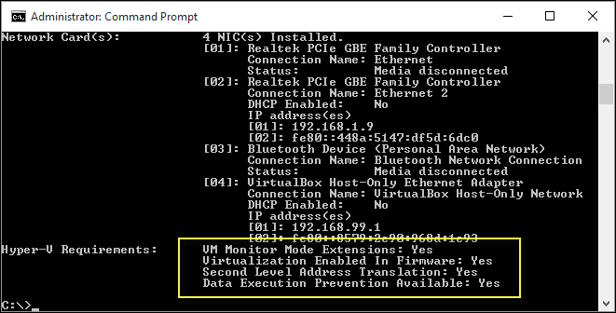
Verify Hardware Compatibility
systeminfo.exe
Notes:
systeminfo.exe

Slide 30
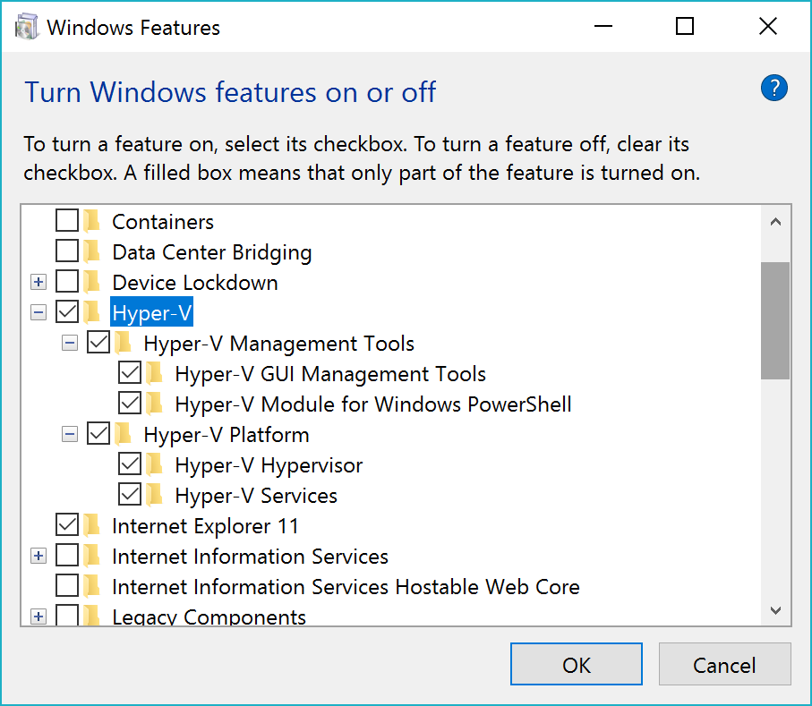
Install the Hyper-V role

Slide 31
Boot OS from VHD

Slide 32
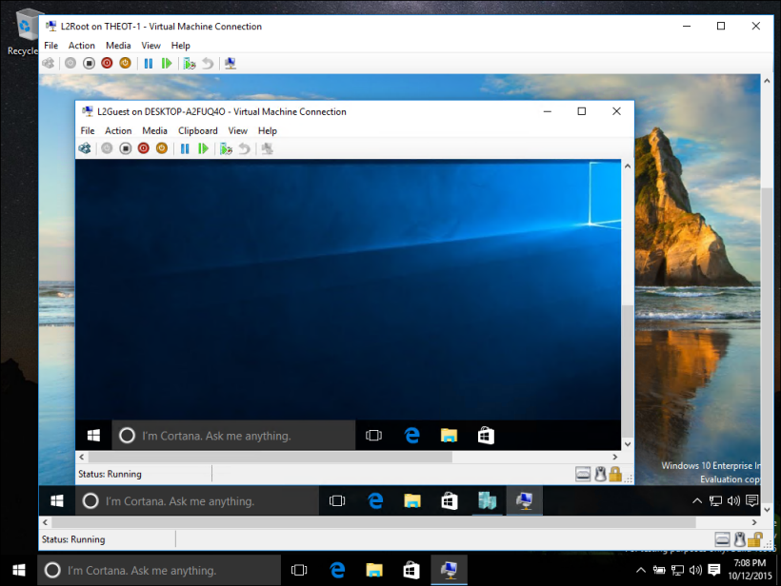
Nested Virtualization

Slide 33
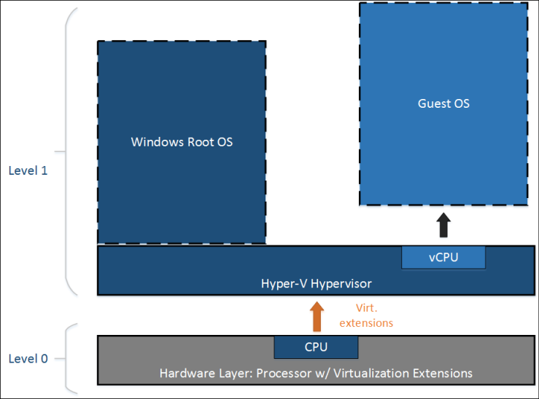
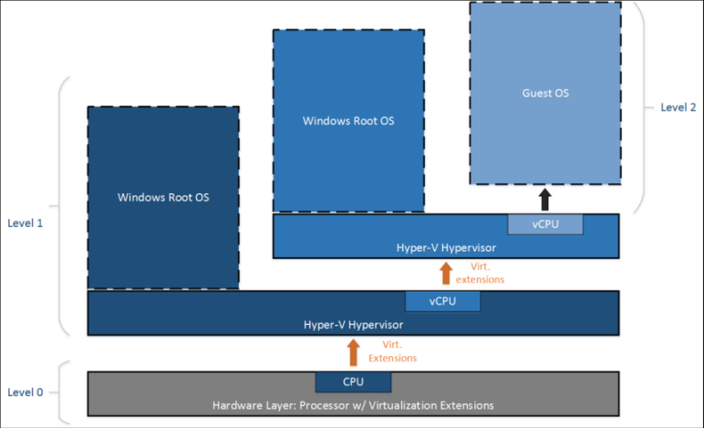
Nested Virtualization

Slide 34
Nested Virtualization
Enable Nested Virtualization
Set-VMProcessor -VMName <VMName> -ExposeVirtualizationExtensions $true
Disable Nested Virtualization
Set-VMProcessor -VMName <VMName> -ExposeVirtualizationExtensions $false

Slide 35
Nested Virtualization
Nested VM running Hyper-V must have dynamic memory disabled

Slide 36


Developers
Operations

Slide 37


Physical
Virtual

Slide 38
Containers
Windows Server containers
Hyper-V containers

Slide 39
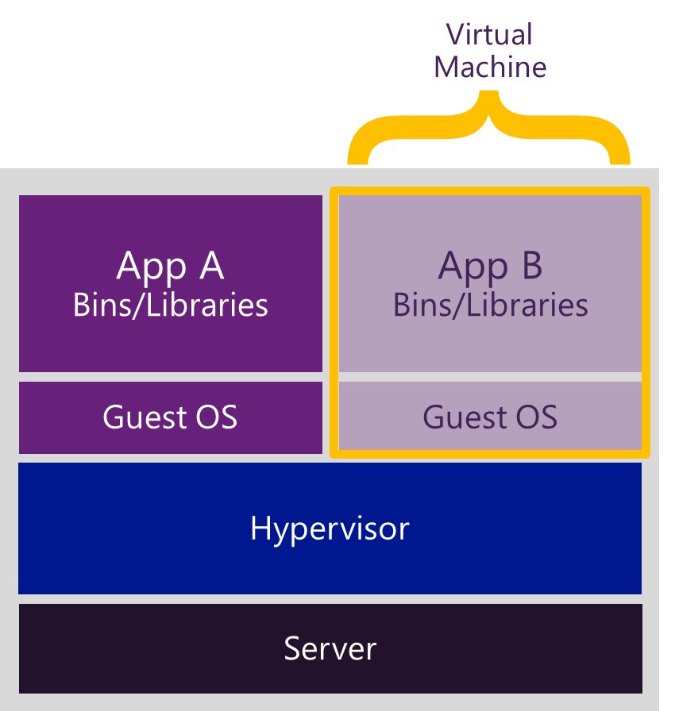
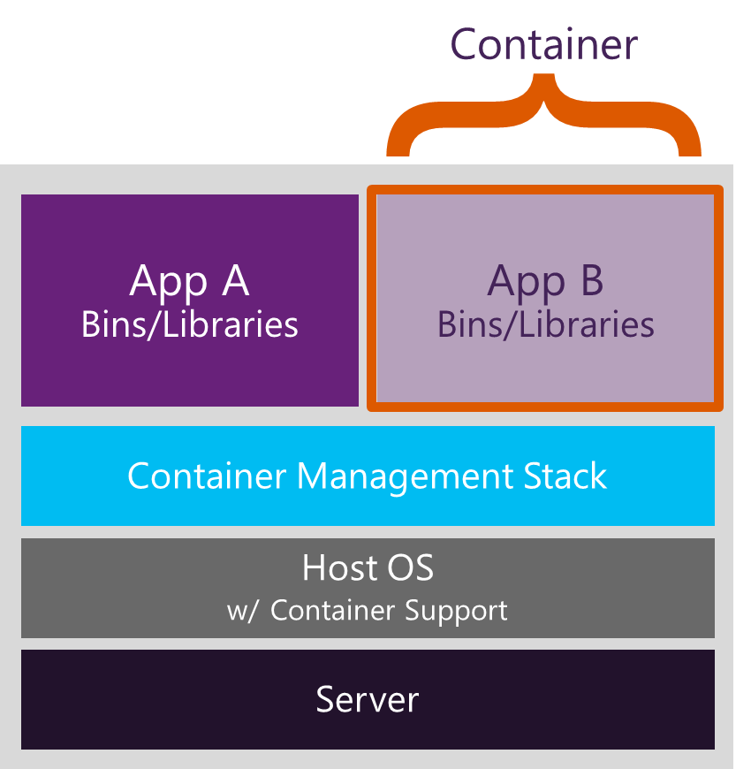
Containers

Slide 40
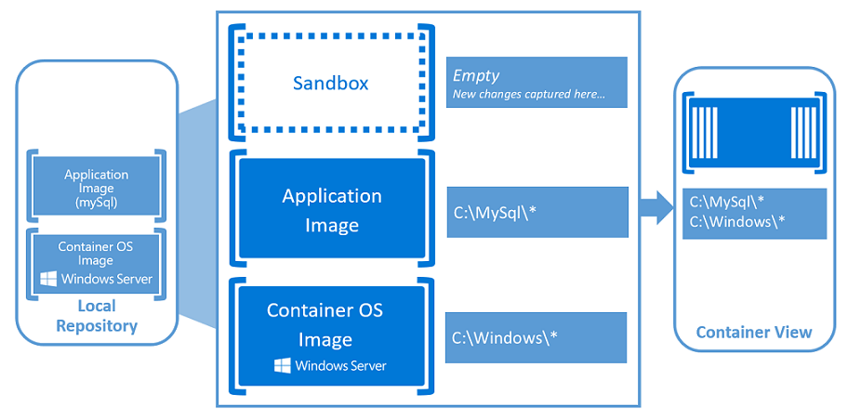
Containers

Slide 41



Container Run-time
Operating
System
Image
Physical Host

Slide 42

Container Run-time
Host Operating System
Operating
System
Operating
System
Image
Virtual
machine(s)
Hardware Virtualization

Slide 43

Container Run-time
Containers
Host Operating System

Slide 44
Container Run-time
Containers
Guest Operating
System
Image
Host Operating System
Virtual
machine(s)
Hardware Virtualization

Slide 45
Microsoft in Love

Slide 46

Microsoft in Love

Slide 47

Microsoft in Love

Slide 48
Microsoft in Love

Slide 49
Developer mode for Linux

Slide 50
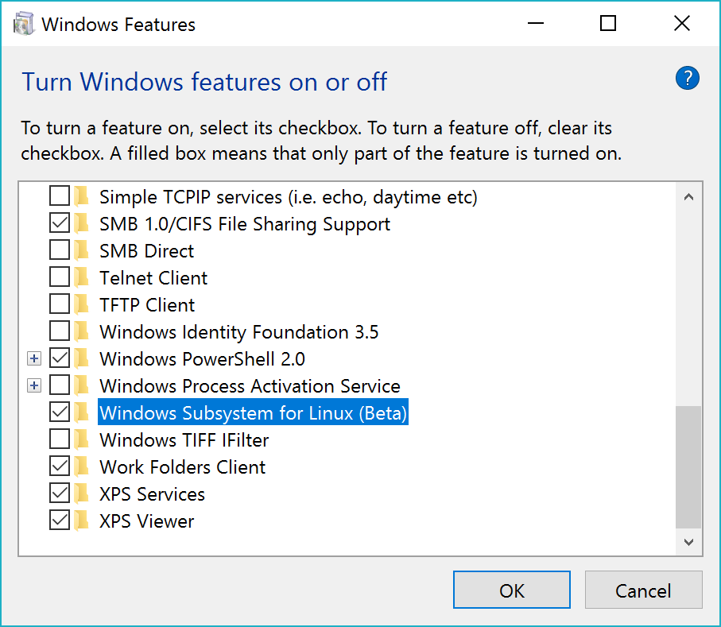
Linux turn ON

Slide 51
Ubuntu on Windows

Slide 52
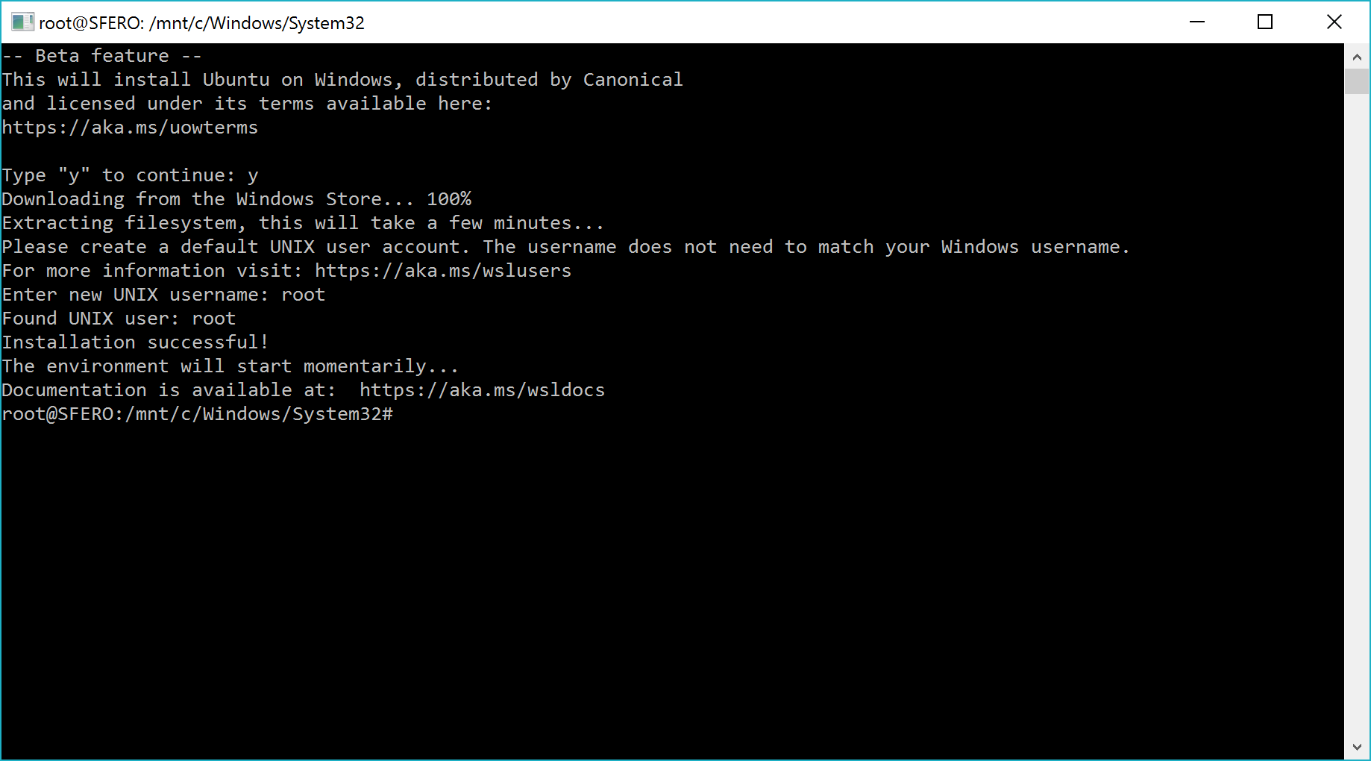
Ubuntu on Windows
Notes:
https://aka.ms/wsldocs

Slide 53
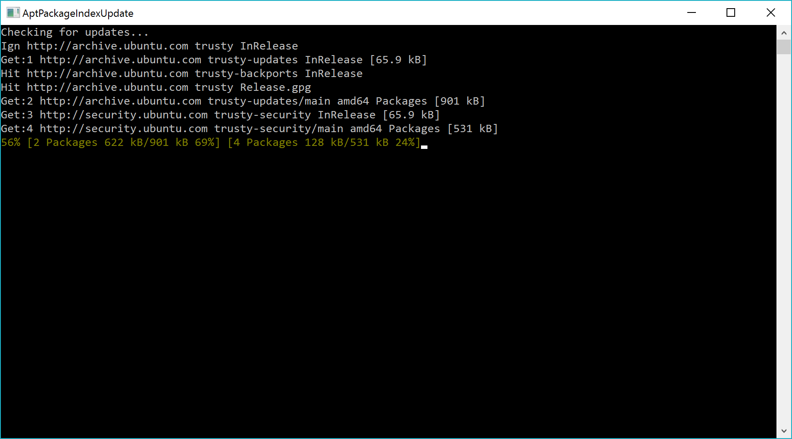
Ubuntu on Windows

Slide 54
Ubuntu on Windows

Slide 55
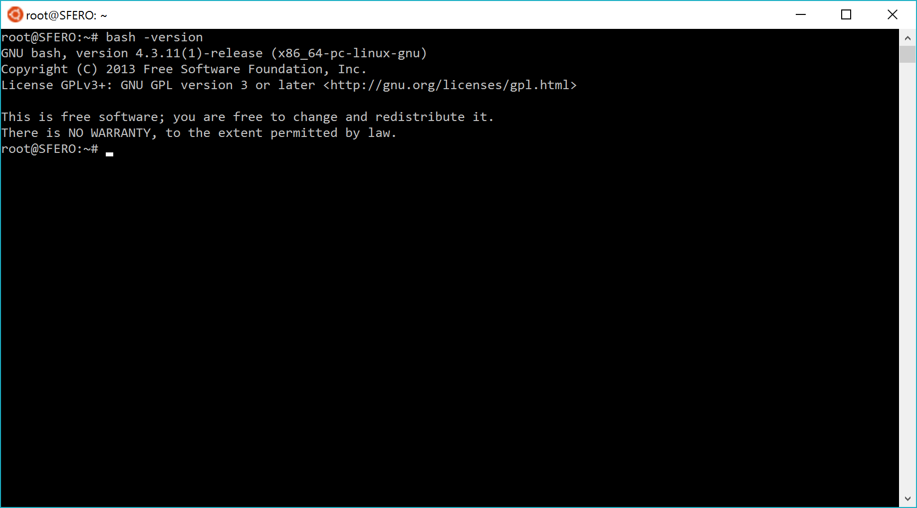
Ubuntu on Windows

Slide 56
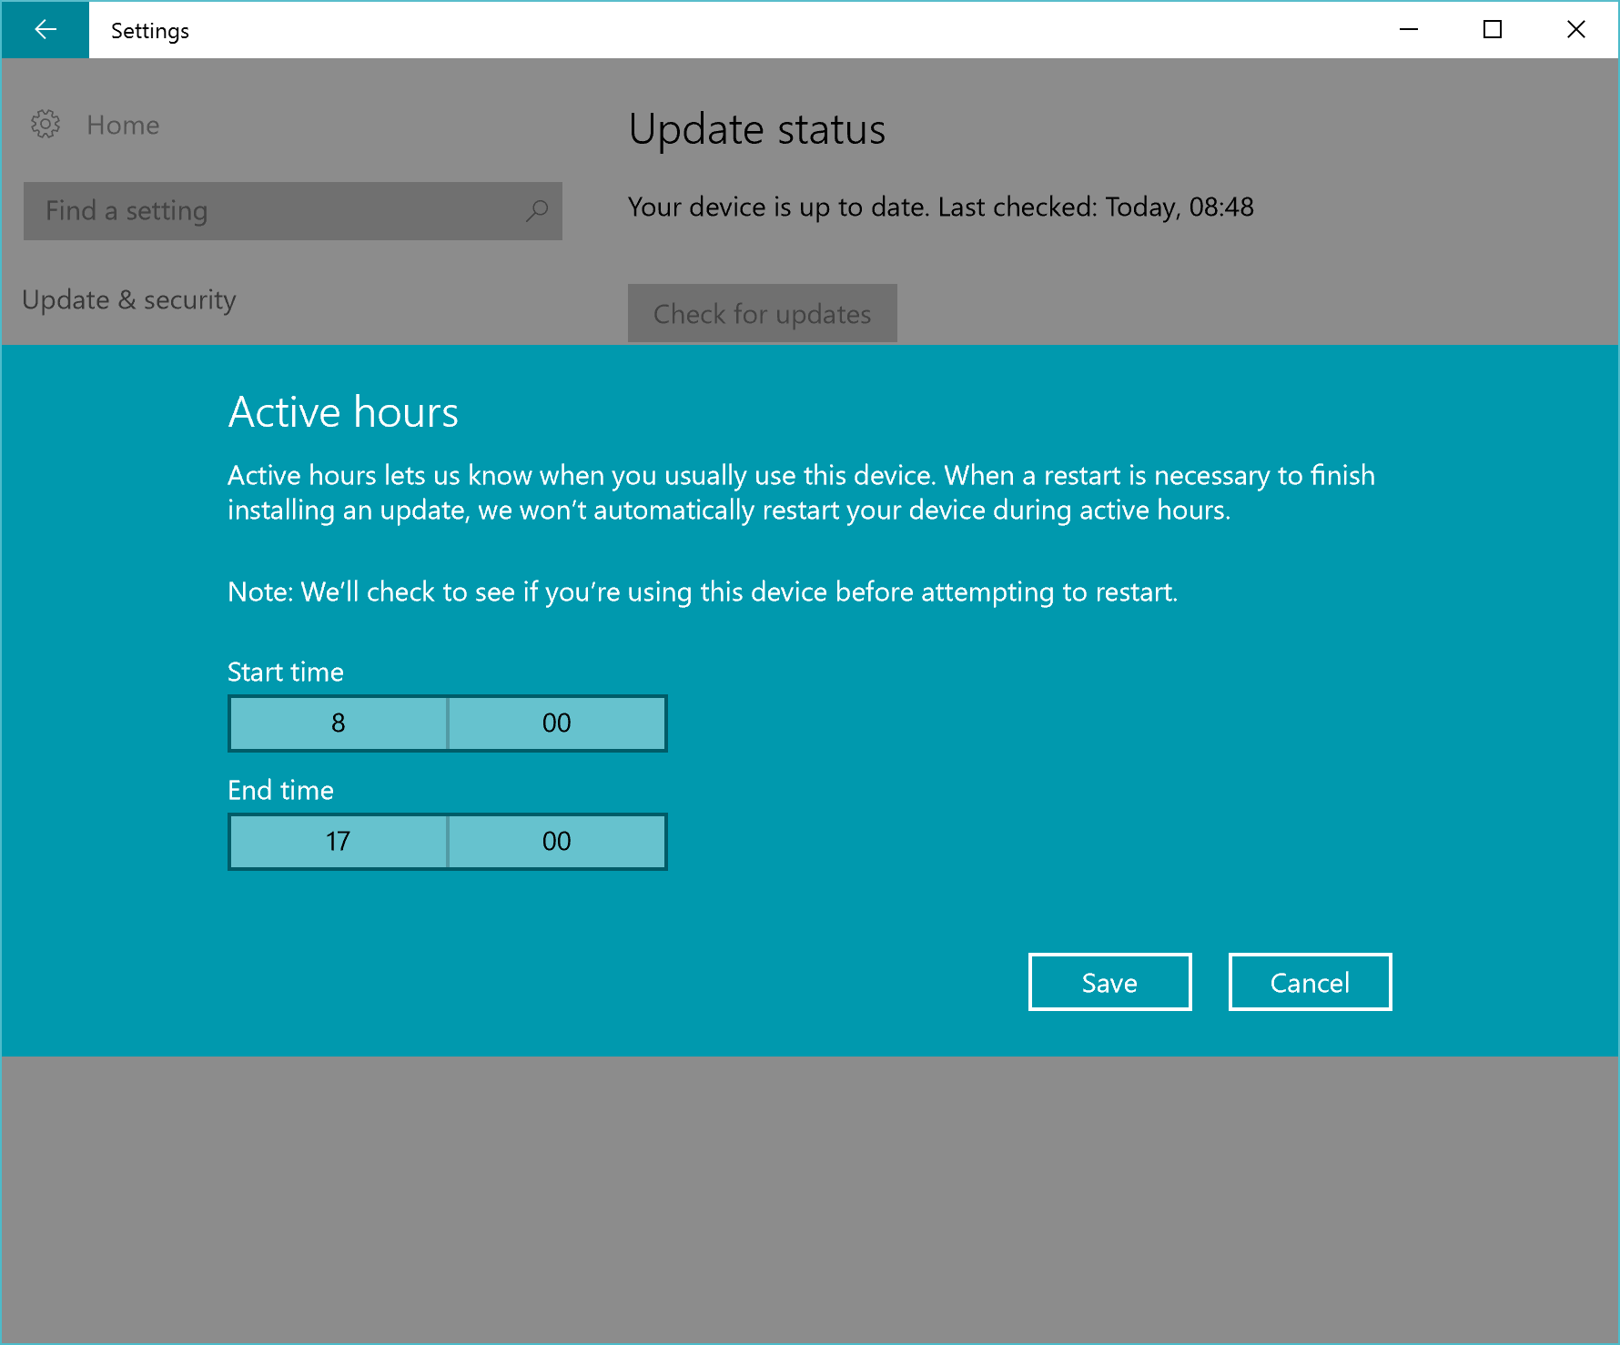
Active hours

Slide 57
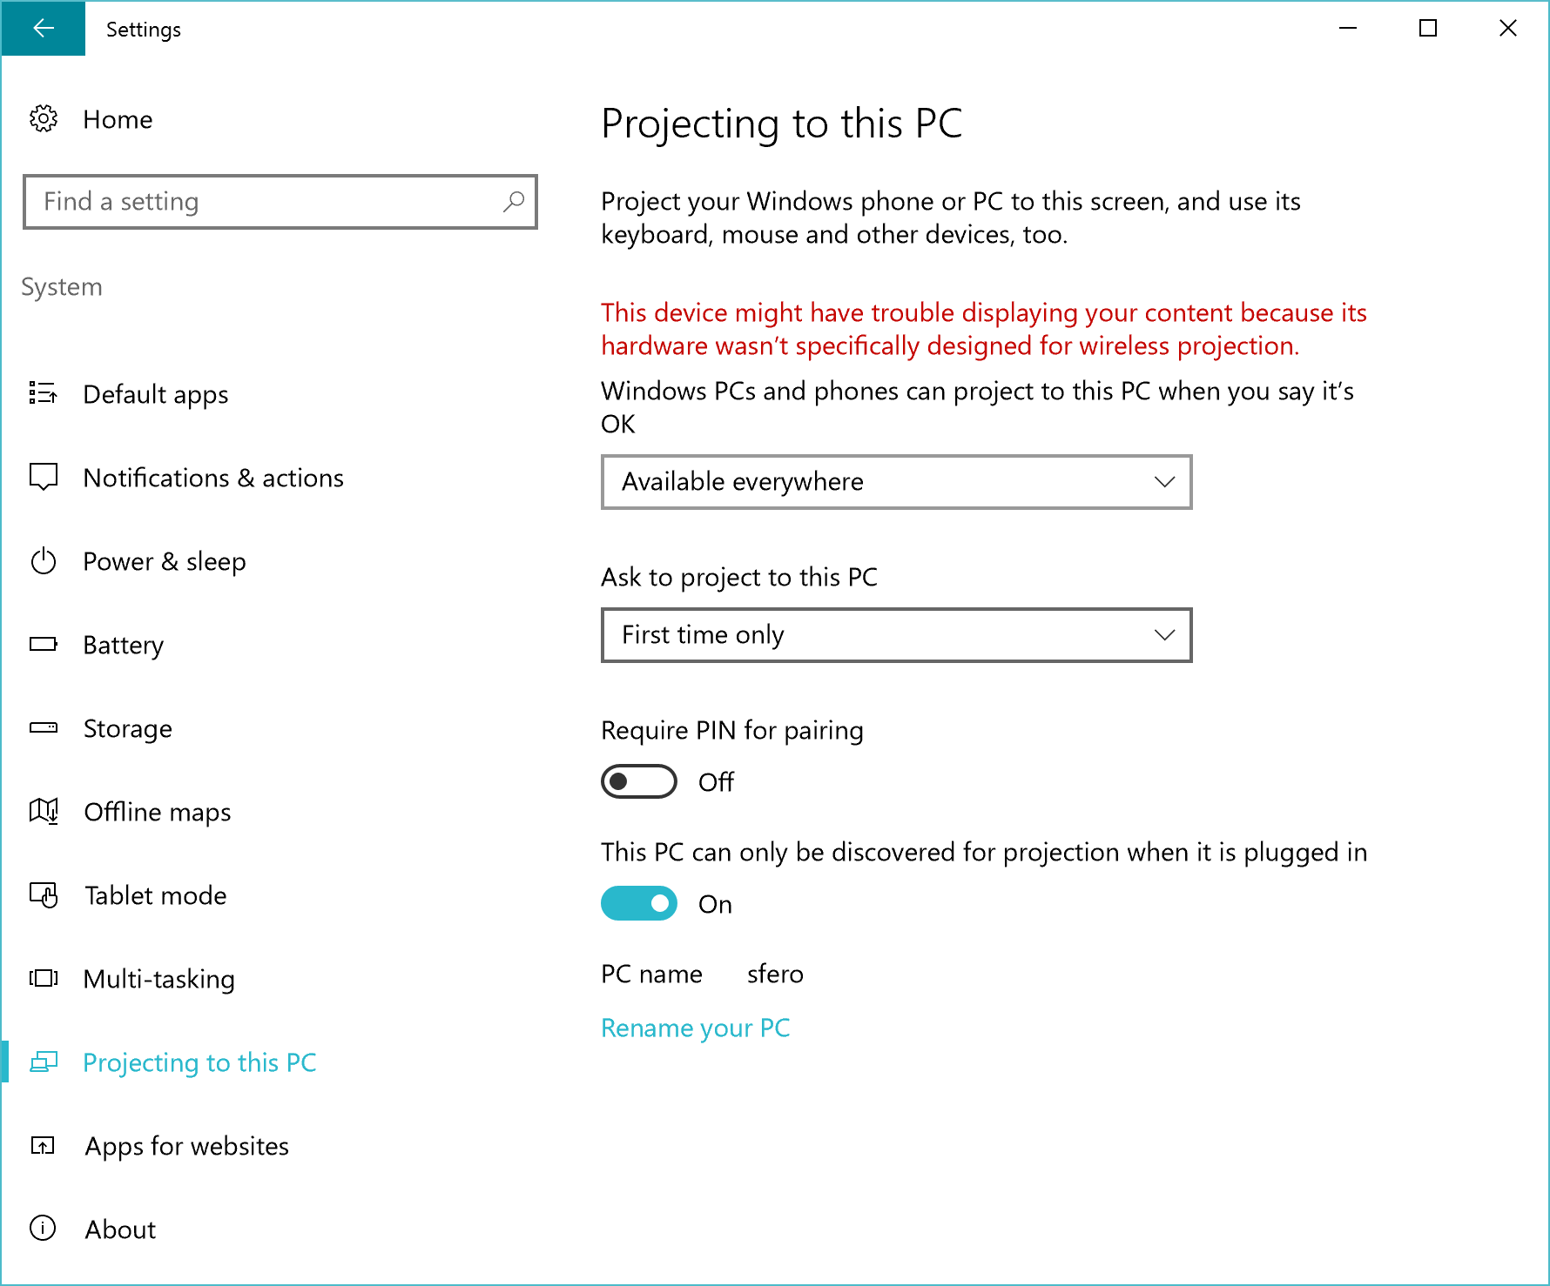
Connect app

Slide 58
Connect app

Slide 59
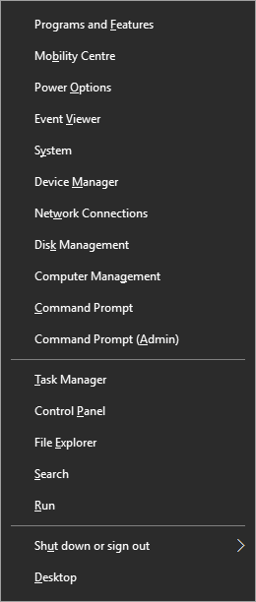
Quick Link menu
Right-click the Start Menu
Windows Key + X

Slide 60
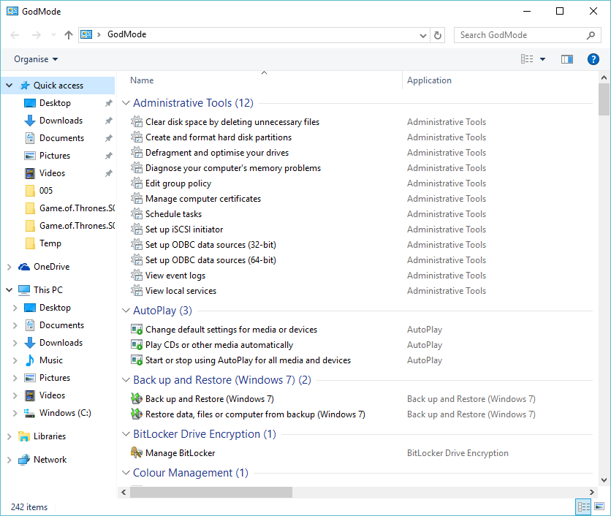
GodMode
Notes:
GodMode.{ED7BA470-8E54-465E-825C-99712043E01C}

Slide 61
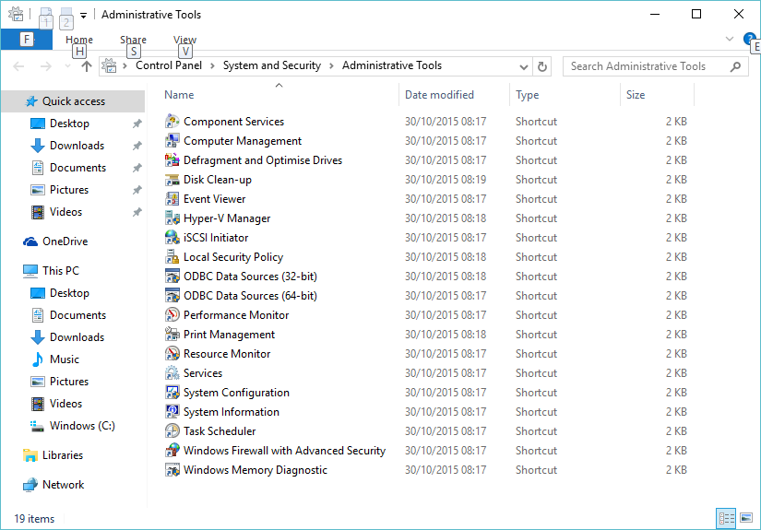
Administrative Tools

Slide 62
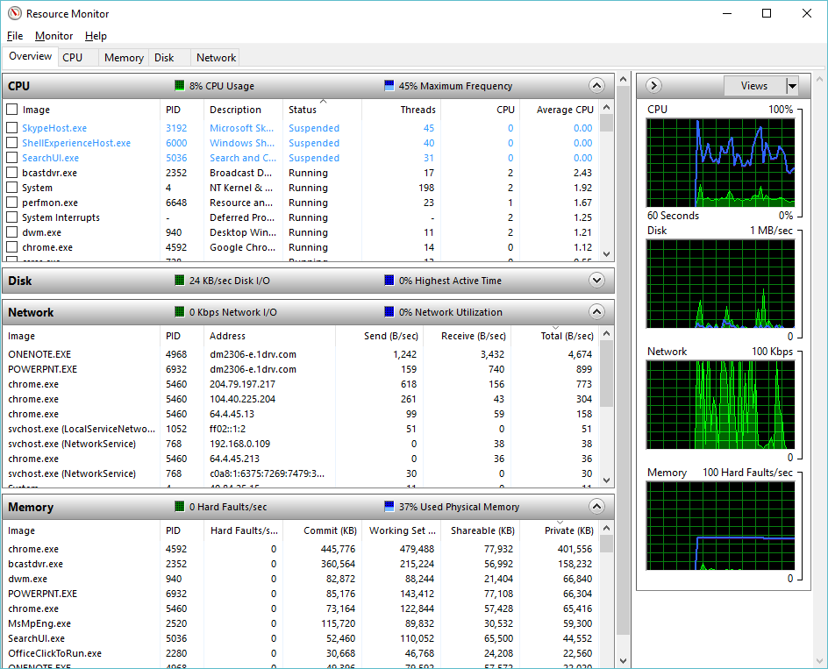
Resource Monitor

Slide 63
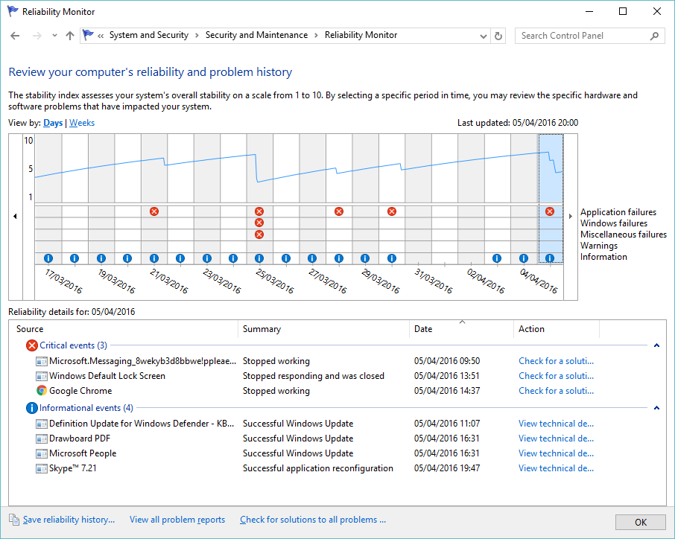
Reliability Monitor
Notes:
perfmon /rel

Slide 64
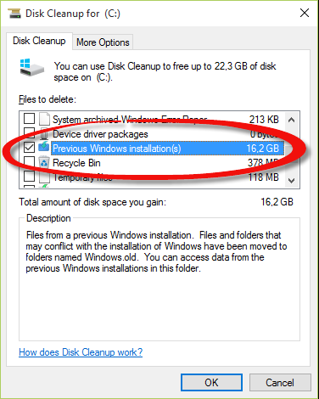
Disk Cleanup

Slide 65
Problem Steps Recorder

Slide 66

Game bar

Slide 67
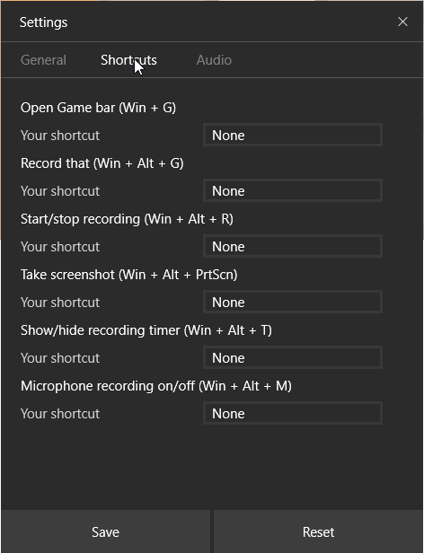
Game bar

Slide 68
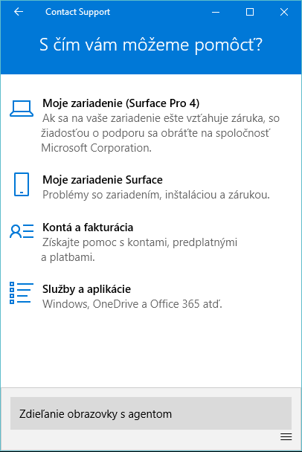
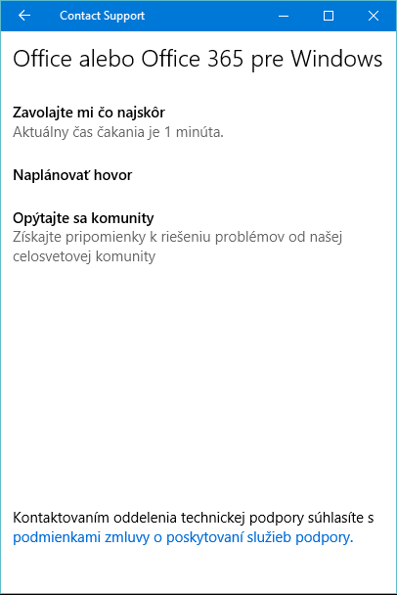
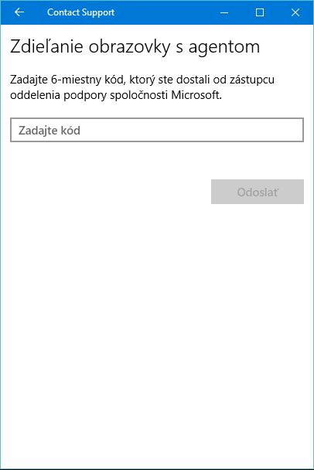
Contact Support

Slide 69
Priestor pre Vaše otázky
Ing. Daniel BAČA
daniel.baca@wug.sk

Slide 70
Ďakujem za pozornosť
Daniel BAČA
daniel.baca@wug.sk

