Slide 1
Storage Spaces 2012R2/2016
Erik Caha
erik.caha@biexperts.cz

Slide 2
Storage Spaces
Hyper-V Clusters
Software Defined Storage Platform
for the Private Cloud
SMB
Scale-Out File Server Clusters
Storage Spaces Virtualization and Resiliency
Shared JBOD
Storage

Slide 3

Reduced Mean Time To Recovery
Mirror Spaces Rebuild
  Parallelized Recovery
Increased Throughput
  Optimized Disk Utilization
  Utilization of spare capacity
    Hot Spare no longer necessary in R2
Performance improvements to radically reduce MTTR
Rebuild Metric | Measurement
Data Rebuilt | 2,400 GB
Time Taken | 49 min
Rebuild Throughput | > 800 MB/s
3TB HDDs, 2-way, 4-column Mirror Space
Source: Internal Testing, No Foreground Activity
Storage Space

Slide 4
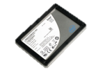
Storage Spaces – Storage Tiering
Optimized Data Placement
  Pool consists of both SSDs and HDDs
  Tiers within a Storage Space
  Hot Data (SSDs), Cold Data (HDDs)
  Sub-File-Level Data Movement
  Complements write-back caching
Administrative Controlled Pinning
  Pin hot files to faster SSD tier
  Example: VDI Pooled VM’s VHD
Virtual Machines
Storage Space
SSD Tier
400GB EMLC SAS SSD
Hot Data
Cold Data
HDD Tier
4TB 7200RPM SAS HDD
Tiered Storage Spaces provides persistent performance improvement for hot data
The best of both worlds:
SSD Performance & HDD Capacity

Slide 5
Storage Spaces - Write-Back Cache
Random Disk Access
  Inherent to storage access patterns with virtualized deployments
  SSDs provide higher IOPs for random access
Improved performance for
real-world workloads
  SSDs absorb random writes at high IOPS levels
  Seamless integration and familiar management
Virtual Machines
Storage Space
SSD Tier & WBC
400GB EMLC SAS SSD
Hot Data
Cold Data
HDD Tier
4TB 7200RPM SAS HDD
Windows Server 2012 R2 maximizes performance and capacity
The Spaces Write-Back Cache absorbs spikes in random write activity

Slide 6
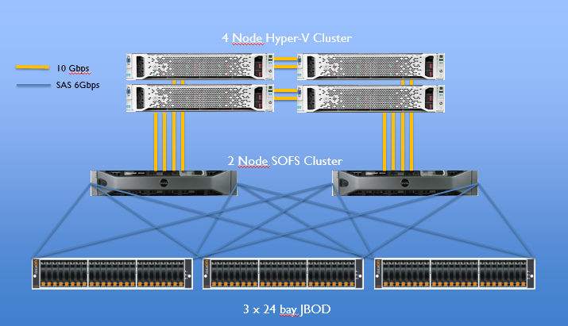
Demo Hardware Layout
>200’000 IOPS
>2GB/s Throughput
<100K CHF

Slide 7
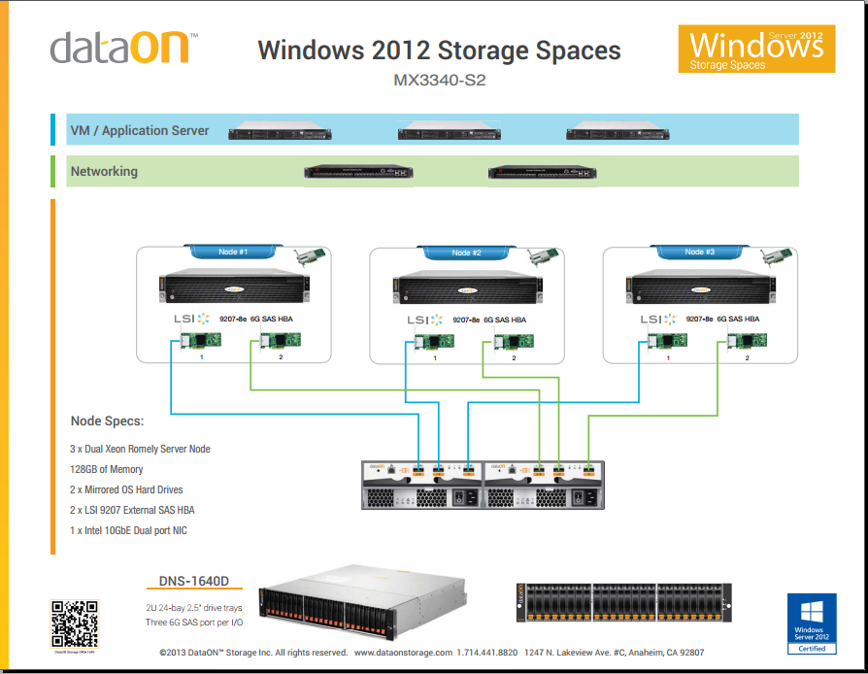

Slide 8
Network fault tolerance with SMB Multichannel
CONTINUOUS APPLICATION AVAILABILITY
  Automatic detection and use of multiple network connections between SMB client and server
  Helps server applications be resilient to network failure
  Transparent Failover with recovery of network failure if another connection is unavailable
  Improved throughput
    Bandwidth aggregation through NIC Teaming
    Multiple nodes/CPUs for network processing with RSS-capable network adapters
  Automatic configuration with very little administrative overhead
SMB
client
Network
SMB
server
NIC
NIC
File
copy
File
copy
NIC
NIC

Slide 9
Na co si dát pozor / co je špatně
Komplikované zapojení
Tiering & WB cache
RSS, RDMA, scaling – pozor
Rebuild – distribuce dat – nefunguje
Separátní sítě – pozor

Slide 10
Traditional Storage Array
Compute
Virtual
Machines
Virtualization
Host
Connectivity
Fibre Channel / iSCSI storage network
Storage Array
SAN

Slide 11
Anatomy of a Storage Array
Compute
Virtual
Machines
Virtualization
Host
Connectivity
Fibre Channel / iSCSI storage network
Storage Array
SAN
Controller
Controller
Storage Software
Storage Software
Disk Connectivity
Backplane
Disks
Raw Storage

Slide 12
Lowering costs with WS 2012 Shared Storage Spaces
Compute
Virtual
Machines
Virtualization
Host
Low cost SMB3 storage network
Connectivity
Connectivity
SMB3 Storage Network Fabric
Scale-out File Server
NAS
NAS
Low cost storage backend
Storage Software
SAS Connectivity
SAS
Enclosure (JBOD)
Raw Storage

Slide 13

Storage Spaces Direct - more scale + lower costs
New in
WS 2016
Compute
Virtual
Machines
Virtualization
Host
More scale – no SAS Fabric
Connectivity
SMB3 Storage Network Fabric
Scale-out File Server
NAS
Lower cost storage backend
Storage Software
Raw Storage

Slide 14
Hyper-converged with Storage Spaces Direct
Compute and Storage
Virtual
Machines
Lower cost storage
Compute + Storage on same node
Virtualization
and Storage
Host
Storage Software
New in
WS 2016

Slide 15
Low cost Disaster Recovery
Site A
Site B
Storage Replica
Storage Software
Storage Software
Sync or Async
Replication
New in WS 2016

Slide 16
Hyper-Converged
Low cost

Slide 17

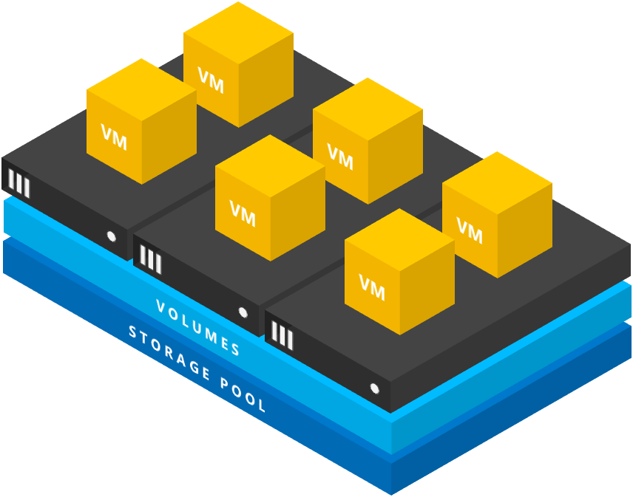




Hyper-converged Storage Spaces Direct
BRK3088: Discover Storage Spaces Direct, the ultimate software-defined storage for Hyper-V
    Performance
    Always-on built-in cache
    Unlocking NVMe SSD
    Fast VM creation and snapshots
    Fault Tolerance
    Drive lifecycle and automatic repair
    Server fault tolerance and maintenance
    Rack and chassis awareness
    Efficiency
    Erasure coding (LRC) with quicker data reconstruction
    Accelerated erasure coding for better performance
    RDMA enabled networking for better efficiency
    Management
    Fault detection
    Performance and capacity metrics
    Storage Quality of Service
    Cost
    Included in Windows Server 2016 Data Center edition
    Industry standard servers with internal drives

Slide 18



Industry-standard servers with internal drives

Slide 19
No shared storage, no fancy cables – just Ethernet

Slide 20
Let’s cluster them

Slide 21
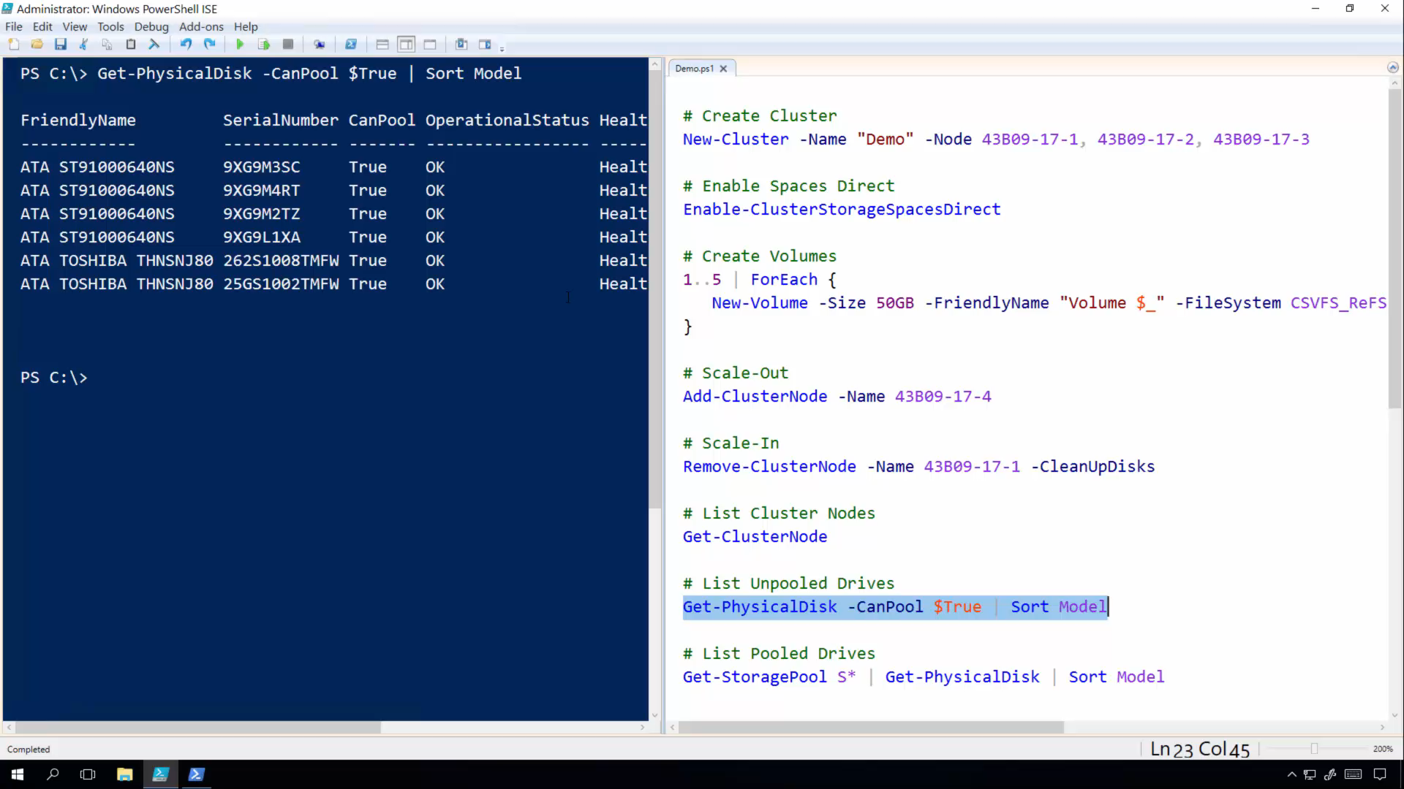

Slide 23
Software-defined “pool” of storage

Slide 24
P O O L

Slide 25
V O L U M E S
P O O L
We’re ready to create volumes!

Slide 26
V O L U M E S
P O O L

Slide 27
V O L U M E S
P O O L
Add new node to cluster

Slide 28
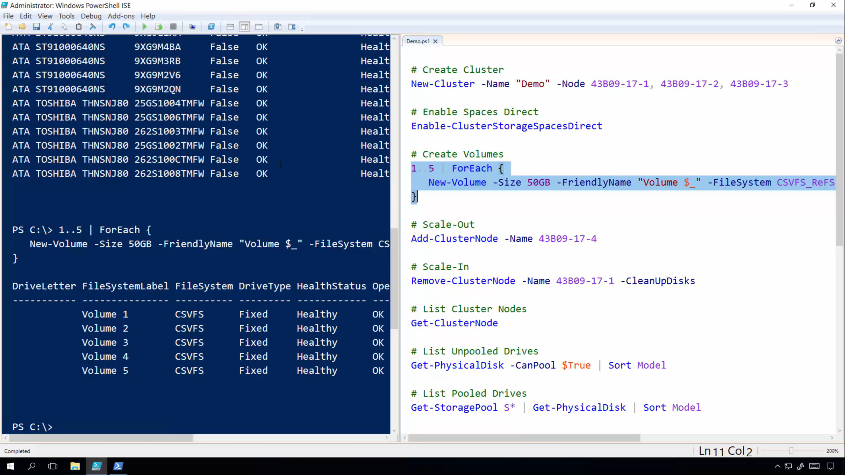

Slide 29
V O L U M E S
P O O L

Slide 30
V O L U M E S
P O O L

Slide 31
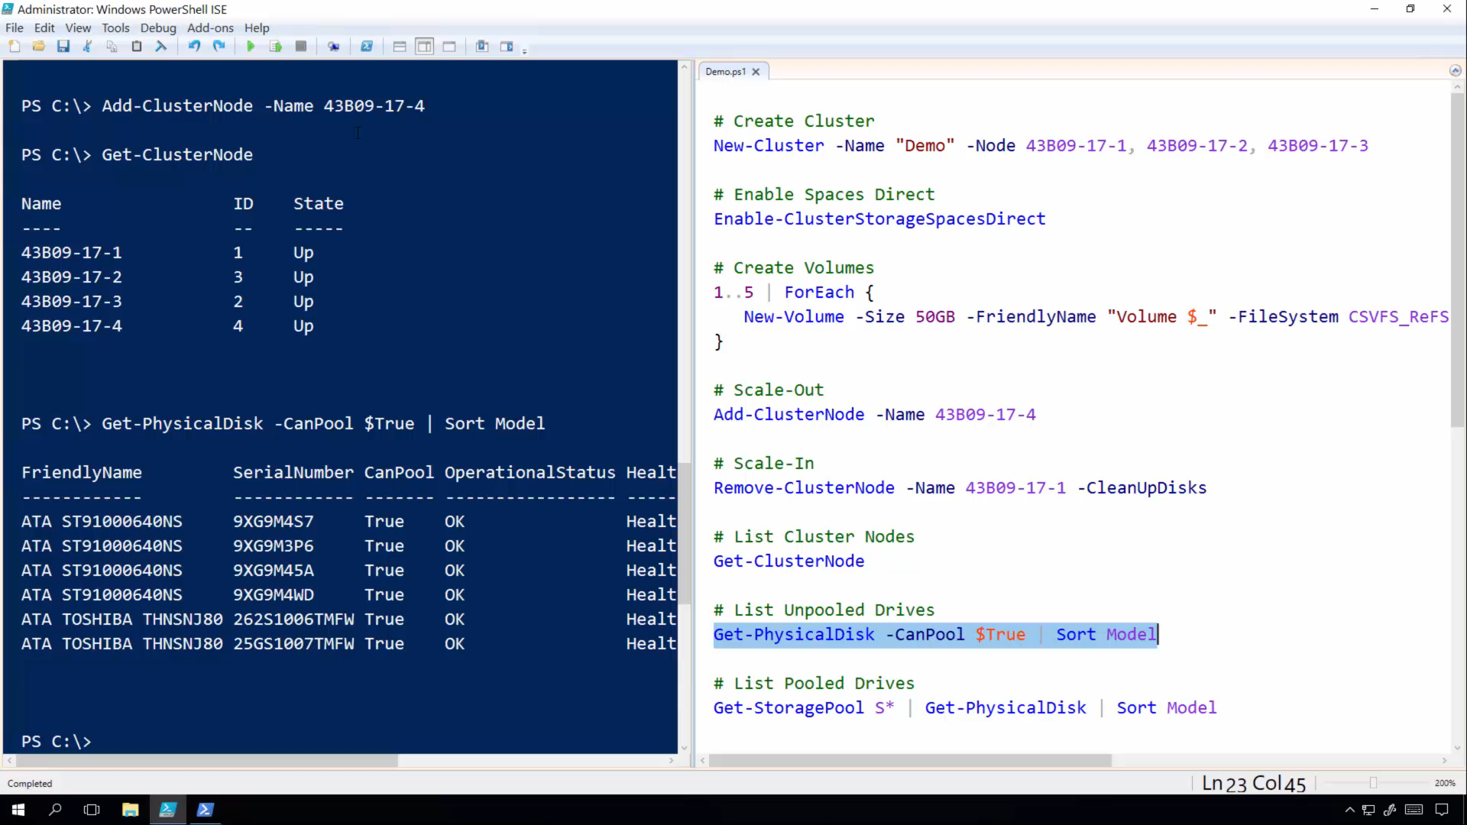

Slide 32
Announcing
2-node Storage Spaces Direct
Scales from Branch Office to Enterprise

Slide 33



Storage Health Service
One monitoring point
for everything.
Aggregated metrics,
fast and in-box.
Disk replacement,
completely automated.

Slide 34
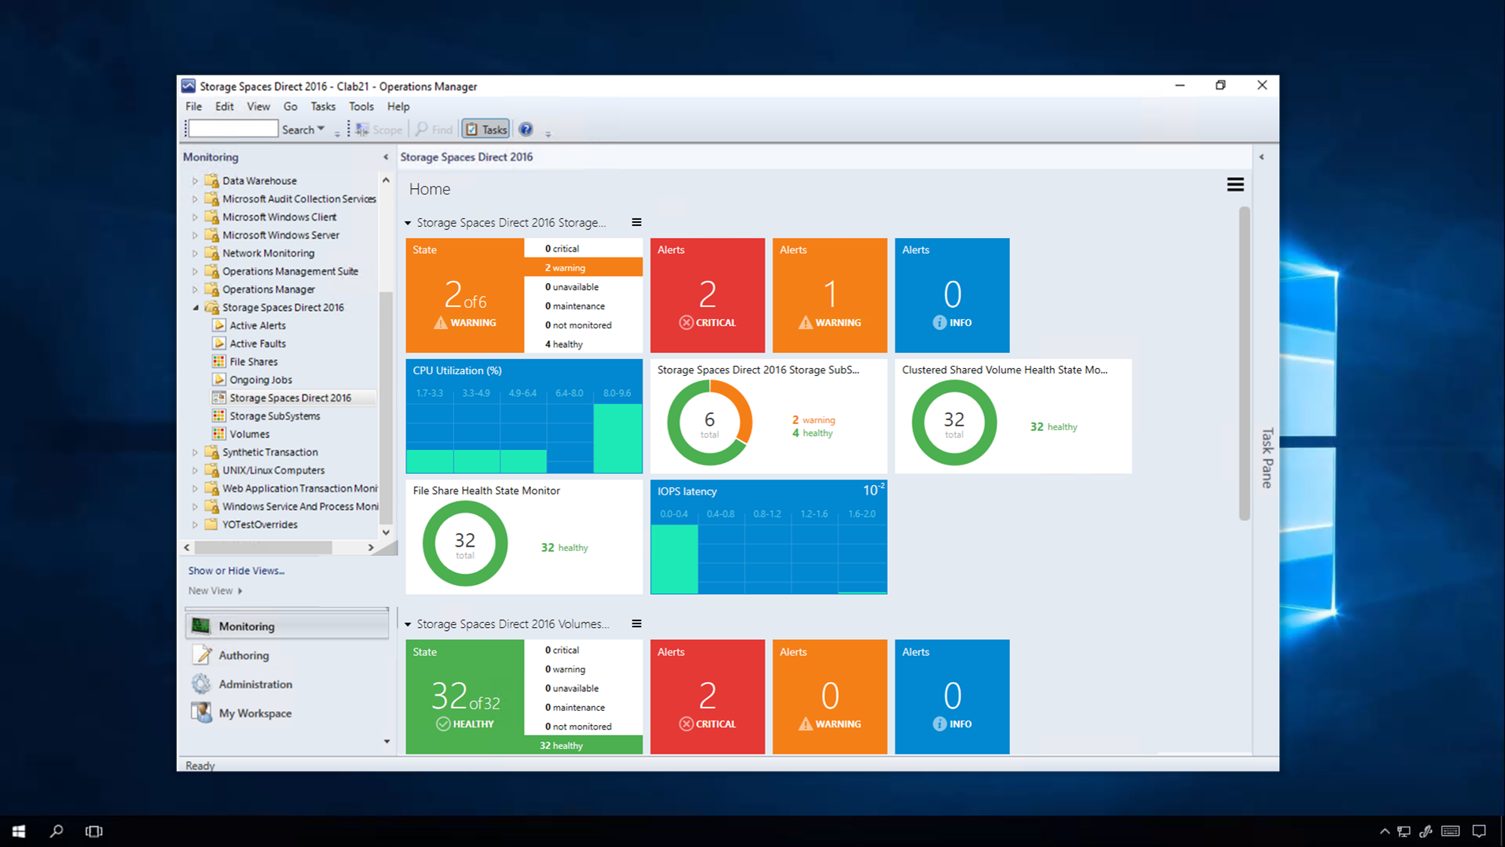

Slide 35
Zdroje
Ignite BRK2169
Storage Spaces z TechEd America 2014

