Slide 1
Ukázková aplikace je ke stažení na https://www.wug.cz/brno/akce/836-WUG-Days-2016/program
u přednášky „Jak na testovatelné webové aplikace“ jako „AddNodeWizard.zip“.
Vyžaduje Visual Studio 2015.

Slide 2
How to write testable web applications
Jiří Tomek
jiri.tomek@solarwinds.com

Slide 3
Agenda
Testing? Why should I care?
Test pyramid
Different kinds of tests
  Unit tests
  Integration tests
  End to end tests
Sample application
  AngularJS, ASP.NET WebApi 2

Slide 4
Why testing?
Tests define the behavior of application
Allow safe changes and refactoring
Simplify debugging
  Debugging against unit test is much cheaper than against live application
Improve code quality
What to test?
  Consider gain/price ratio
  Parts that have high impact on functionality bring more benefit

Slide 5
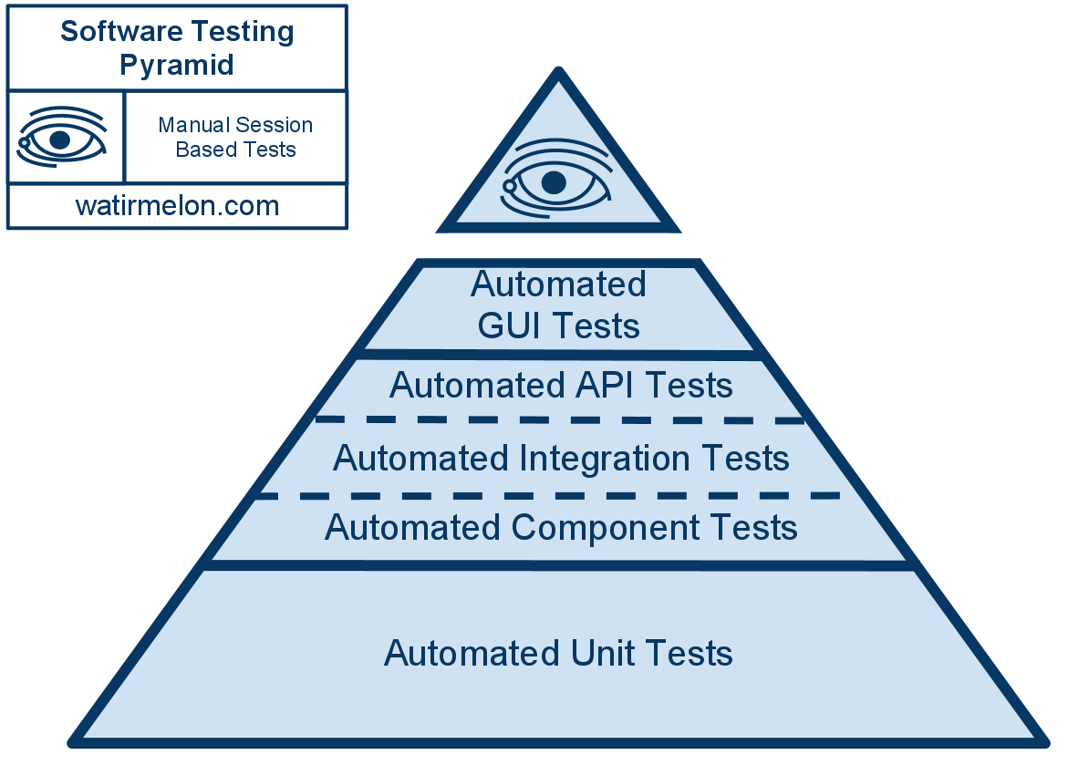
Test pyramid
To the top:
- less reliable
- higher price
- slower feedback

Slide 6
Unit tests
Unit test is code as any other
  Needs to be maintained
  Can be debugged
Tests just one class/component
Should be:
  Easy to write
  Readable
  Reliable
  Fast
  Independent
  Deterministic
  No need for special test code
It’s cheapest kind of test

Slide 7
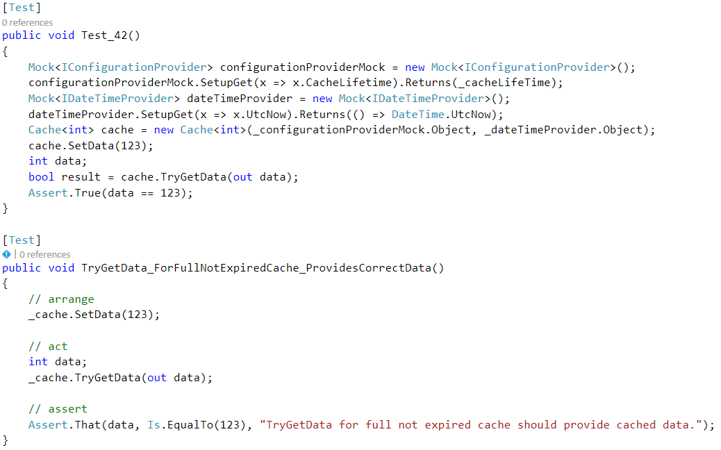
Readable
Name of the test clearly says what it does
Code is clean and easily understandable

Slide 8
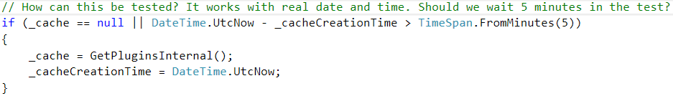
Enemies of testable code
Static classes/methods
  You can’t replace them with custom logic for testing
Singleton
  Only one instance holding the state
  Can’t parallelize tests
  Can’t reset to default state
Global state
  Environment variables
  Configuration files

Slide 9
SOLID
SOLID principles
  Single responsibility principle
    Class does just one thing
  Open/Closed principle
    Class is opened for extension but closed for changes
    Easy to add new functionality without need to touch existing code
  Liskov substitution principle
    Class can be replaced by its subclass without affecting functionality
  Interface segregation
    Interface should be small and focused
  Dependency Inversion
    Concrete classes depend on abstract interfaces, not vice versa

Slide 10
Integration tests
Test more classes or components together
Focused on component integration
  Correct use of API
Good to use when
  Testing component alone is too complex to setup
  Component integration is not trivial
  To test complex workflow
More expensive than unit tests but still good
  Slower
  Harder to maintain

Slide 11
End-to-end tests
Run against live application
Test whole application or its major part
Use public interface of application
  API
  UI
Most expensive
  Time to setup the test
  Time to setup the environment
  Execution time
Protractor - http://www.protractortest.org/

Slide 12
UI tests
Test UI behavior
Without real backend
  Mock API
Protractor HTTP mock - https://github.com/atecarlos/protractor-http-mock

Slide 13
Sample application

Slide 14
Web application
Presentation layer
  Web browser
  TypeScript/JavaScript, AngularJS, HTML, CSS
Business layer
  Web server
  ASP.NET WebApi 2, C#
Data layer
  Entity framework
  SQL database
AngularJS, JS, HTML, CSS
ASP.NET WebApi 2
SQL DB

Slide 15
Testable?
Covered by automated tests
End-to-end tests
UI behavior
Client logic
MVC
Backend
DB
Unit tests
Integration tests

Slide 16
Switch to VS

Slide 17
Useful links
TypeScript - https://www.typescriptlang.org/
Moq - https://github.com/Moq/moq4/wiki/Quickstart
AngularJS – https://angularjs.org
Protractor - http://www.protractortest.org/
Protractor HTTP mock - https://github.com/atecarlos/protractor-http-mock
Effort - https://github.com/tamasflamich/effort

Slide 18
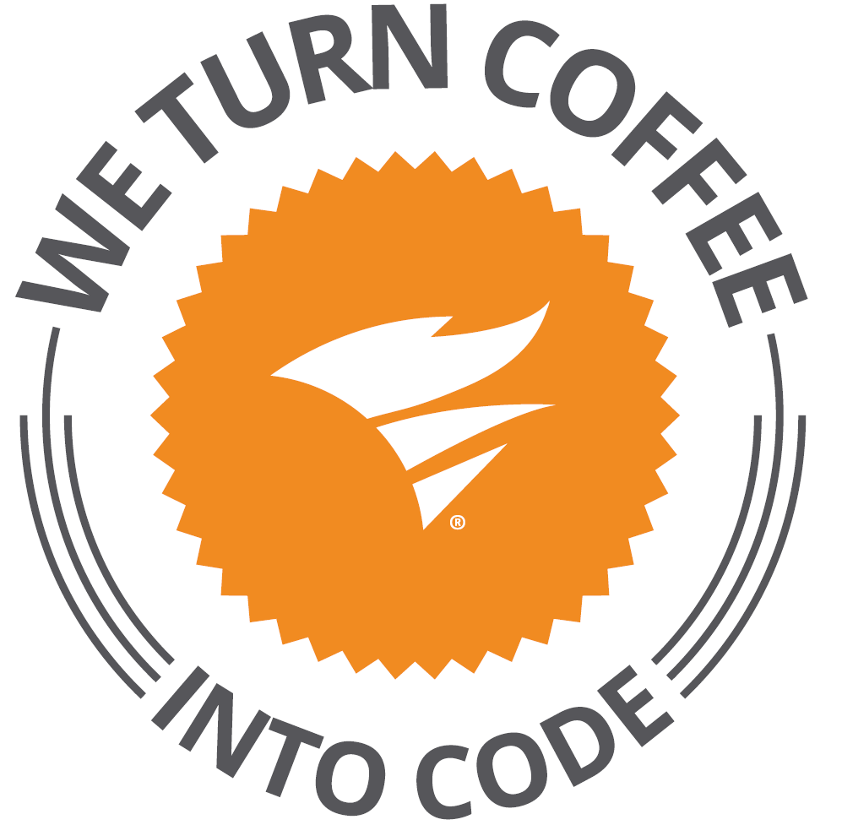
SolarWinds
30+ products for IT Management
Microsoft stack: C#, MS SQL, AngularJS
Brno office – SolarWinds R&D center
https://www.solarwindsmeetup.com/
Career opportunities
  http://solarwinds.jobs/
Visit our booth

