Slide 1
SQL Server Virtualization Best Practices

Slide 2
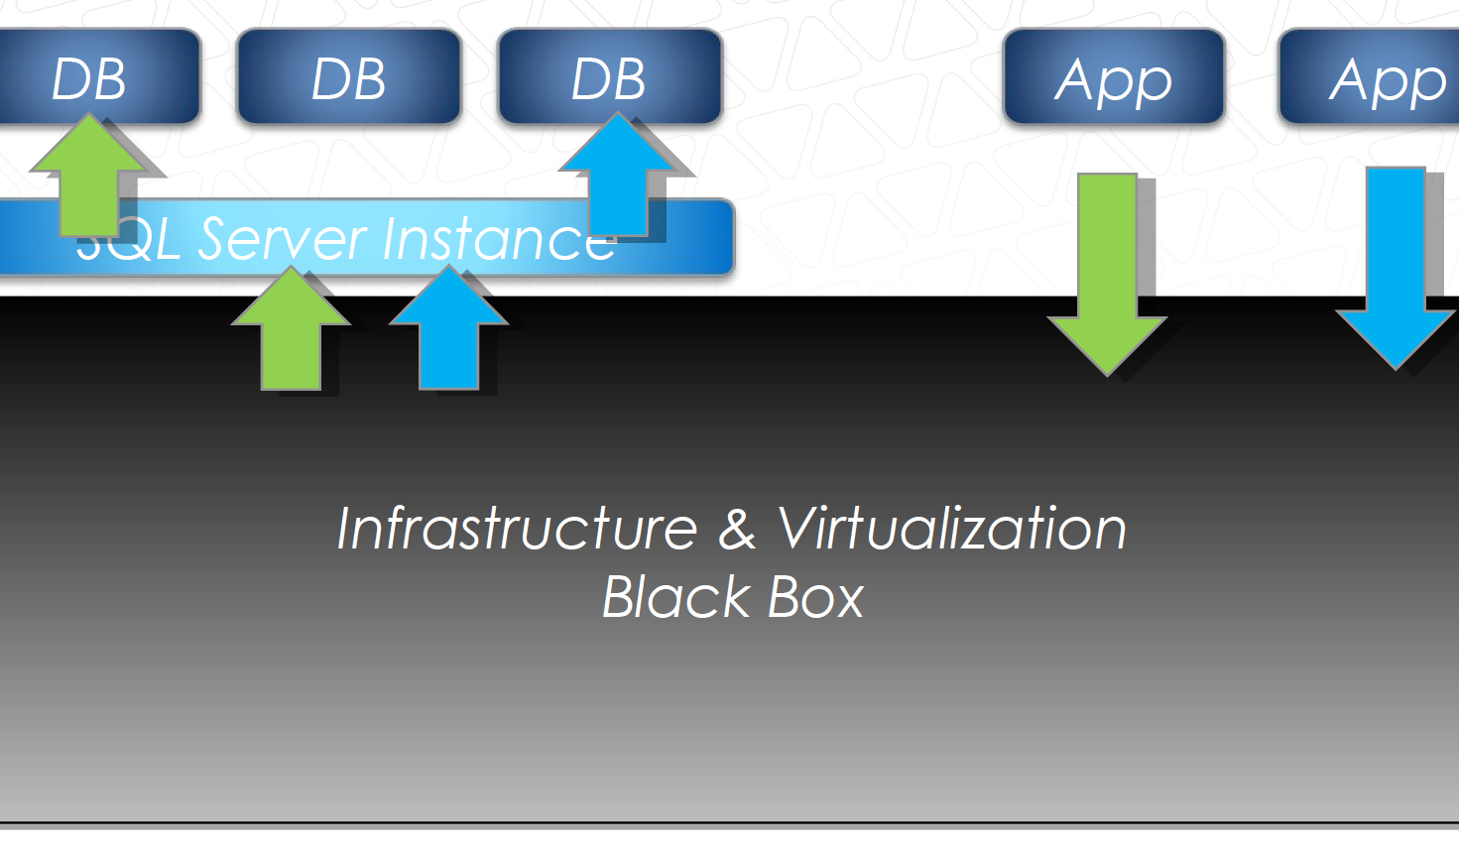
What is Virtualization?
Abstraction of hardware & OS
Resources & queues
Limits in the environment
Resource limitations (hard)
Queue contention (soft)

Slide 3
Right – sizing SQL Workloads
VM resource allocations
  vCPU
  Memory
  Storage presentation
One size does not fit all workloads
Inappropriate resource allocations can hurt VM performance

Slide 4
vCPU Sizing
vCPU counts matter!
Size for what you need today
Too many vCPUs = BAD (probably)
Too few vCPUs = BAD (usually)
Workload / server specific

Slide 5
CPU Sizing - NUMA
Not done at just vCPU count
vNUMA configuration also matters
Closely align with pNUMA
Adds efficiency by aligning with underlying hardware
Performance difference improves
with larger VMs

Slide 6
CPU Sizing - vNUMA
Get physical machine configuration
Try to fit VM inside one NUMA node
Otherwise, balance across number NUMA nodes
Test configurations for best results

Slide 7
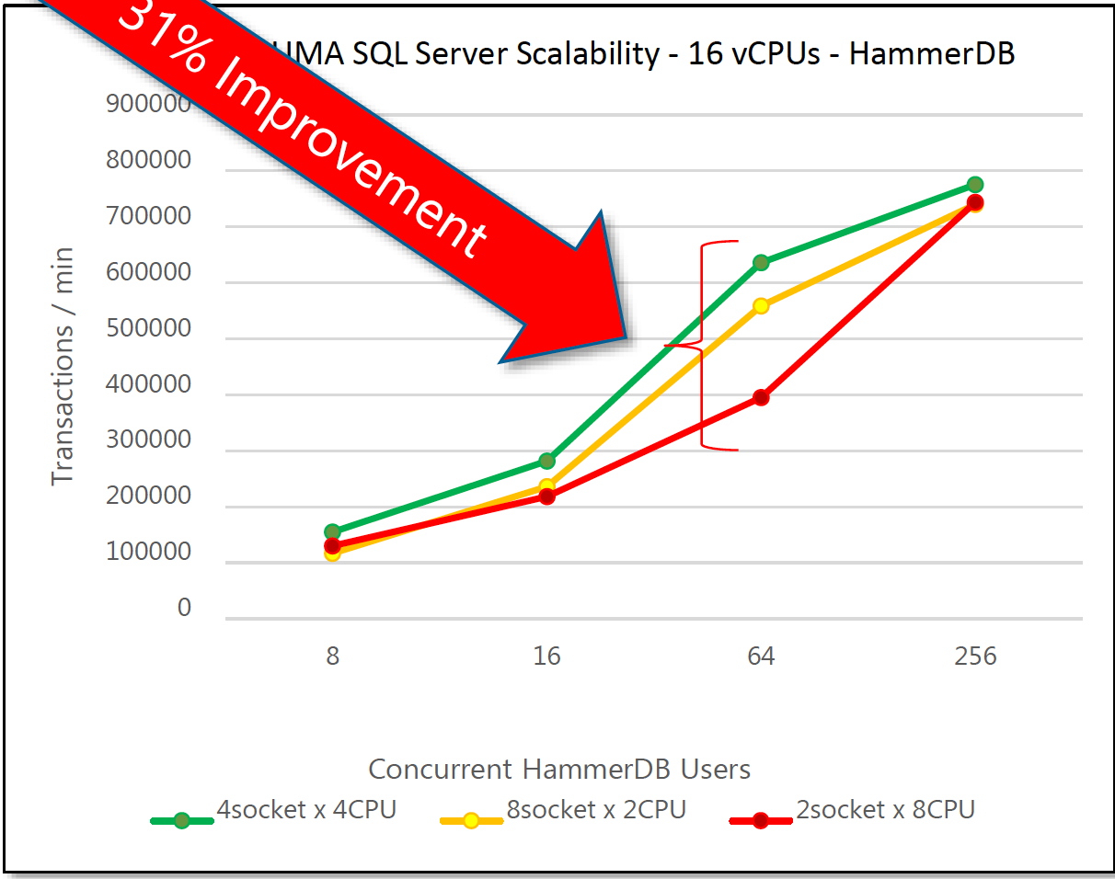
CPU Sizing – vNUMA Results
Example: 16 vCPU VM
What’s better?
  2 vSocket x 8 vCore?
  4 vSocket x 4 vCore?
  8 vSocket x 2 vCore?
Varies by workload, hardware
Test it for yourself!
Factor also SQL Server licensing

Slide 8
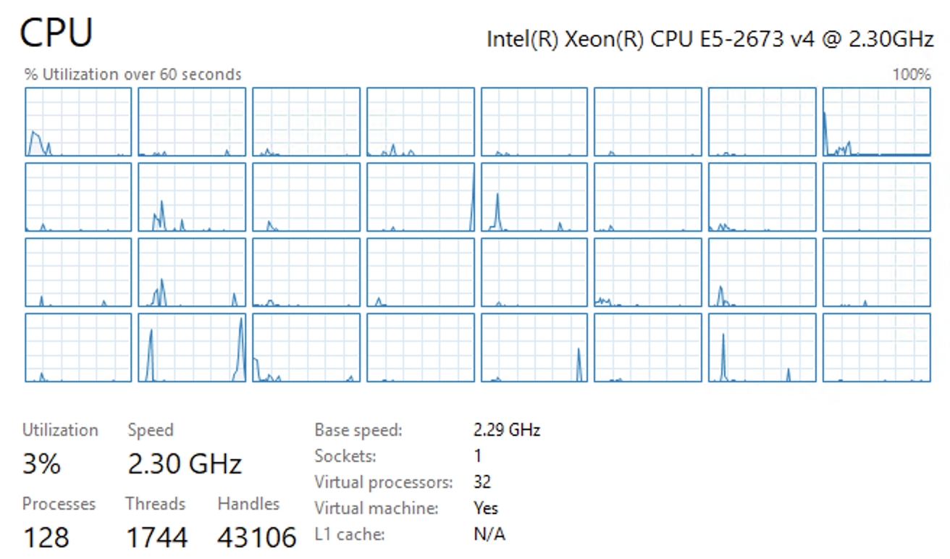
Hyper-V vCPU

Slide 9
How To Size vCPUs
Understand the workload parallelism, concurrent volume
Determine averages, maximums, and percentiles
Determine the appropriate profiling period
< 40% utilization avg – too many CPUs
> 60% utilization avg – too few CPUs
Factor CPU waits inside SQL Server
Vary according to your circumstances
Accomodate safe vCPU to logical CPU ratio

Slide 10
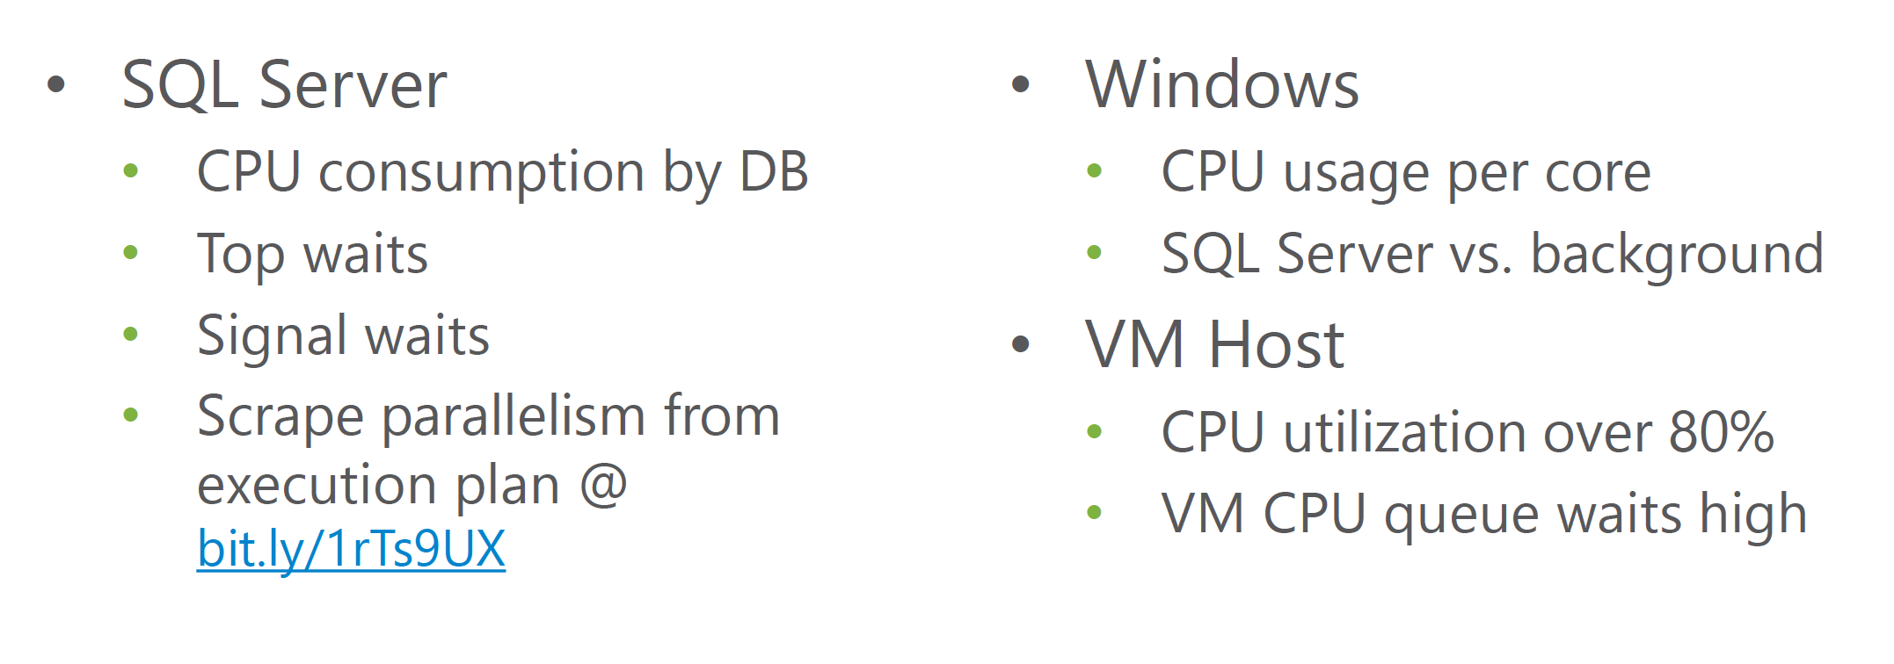
CPU - Metrics

Slide 11
DEMO
vCPU configuration

Slide 12
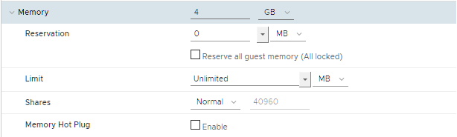
Memory
SQL Server data must be in buffer pool
More memory ≈ less I/O
Less I/O = less waiting on shared storage & queues
No host memory overcommitment
Too much memory = lower VM consolidation ratio
Balancing act

Slide 13
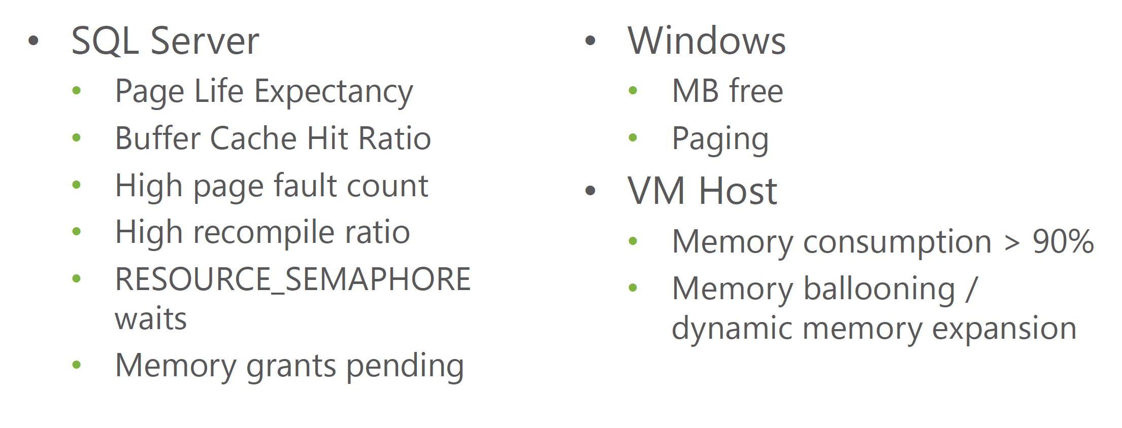
Memory - Metrics

Slide 14
DEMO
Memory Configuration

Slide 15
Storage
Much less variable in nature
Most shared resource
Most critical
Most complex
Most problematic
Slowest piece of the stack
Random I/O disk patterns
Many individual points of contention

Slide 16
Do‘s and Don‘ts
Upgrade your system
  There‘s more than OS!
  NIC, HBA, BIOS, other Firmware

Slide 17
Do‘s and Don‘ts
BIOS Settings
  Disable C state
  Disable Power Management
  Enable Virtualization Support
  Data Execution Prevention
  SLAT
  Use Hyperthreading
  Disable SCSI BIOS

Slide 18
Do‘s and Don‘ts
Storage
  Storage is slow, learn to like it
  Use read & write cache
  Do not architect your storage to make the hypervisor/management operating system go fast
  Enable RSS on SMB-carrying adapters. If you have RDMA-capable adapters, absolutely enable that.

Slide 19
Do‘s and Don‘ts
Network
  1GbE, really? Let‘s talk about 10GbE
  Use NIC Teaming
  Don‘t use too many Hyper-V Network Switches

Slide 20
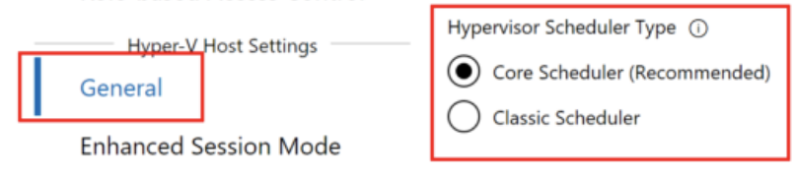
Do‘s and Don‘ts
CPU Scheduler
  Classic or Core Scheduler?

Slide 21

Summary
One VM size does not fit all workloads
Profile and record your workload performance characteristics
Analyze the numbers
Adjust VM configuration and validate
Repeat as often as your workload changes

