Slide 1
SQL Server Disaster Recovery
Let‘s have a plan!
Marek Chmel
Lead Database Administrator @ AT&T
Microsoft MVP: Data Platform
MCSE: Data Management & Analytics

Slide 2
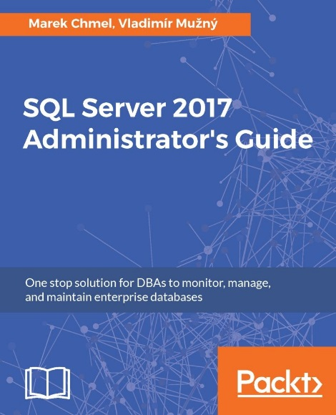
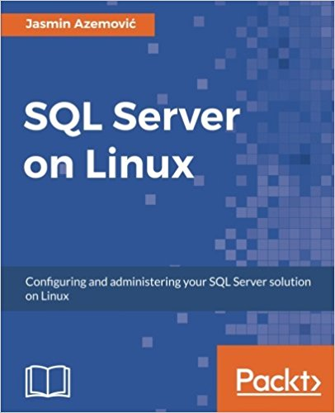
About Me
Lead Database Administrator, SQL Team at&tCzech Republic
Microsoft MVP Data Platform
Certified Ethical Hacker
Microsoft Certified Trainer: Regional Lead

Slide 3
Agenda
Disaster Recovery
High Availability vs. Disaster Recovery
SQL Server 2017 features for High Availability & DR

Slide 4
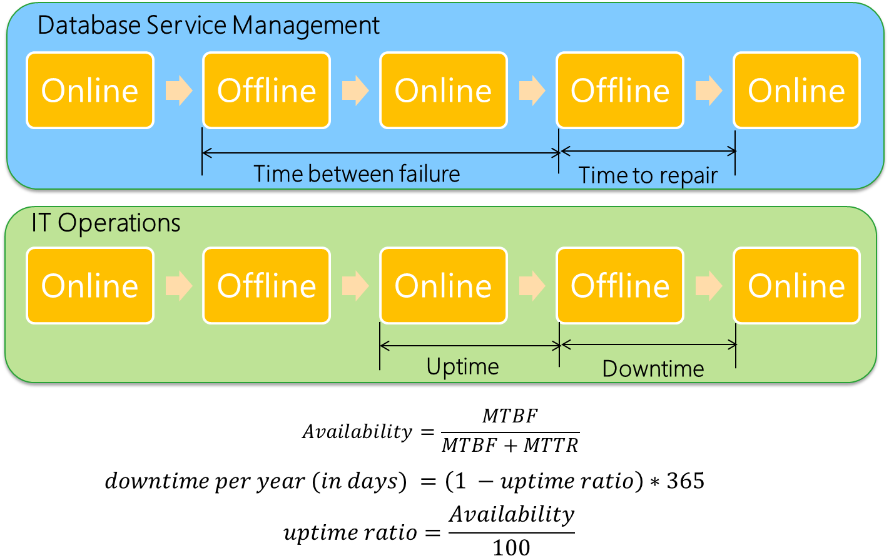
High Availability

Slide 5
High Availability
Availability | Downtime per year
99% | 3.65 Days
99.9% | 8.76 Hours
99.99% | 52.56 Minutes
99.999% | 5.26 Minutes
99.9999% | 31.5 Seconds
99.99999% | 3.15 Seconds
Operations Log (12 hours)
  Recovered from previous failure at 00:00:00 Hours
  Malfunctioned again at 10:00:00 Hours
  Repaired and operational at 10:06:00 Hours
Availability (Service)
  Mean Time Between Failures (MTBF) = 10 Hours
  Mean Time To Repair (MTTF) = 0.1 Hour
  Availability = 10/(10+0.1) = 99%
Downtime (Systems)
  Uptime ratio = 99/100 = 0.99
  Downtime per year (in days) = (1-0.99)*365 = 3.65 Days

Slide 6
What is causing downtime
Planned
Software releases
OS Patch releases
SQL Server service packs and hotfixes
Database maintenance and upgrades
Unplanned
Hardware component failure
Security breaches
Human error
Natural disasters

Slide 7
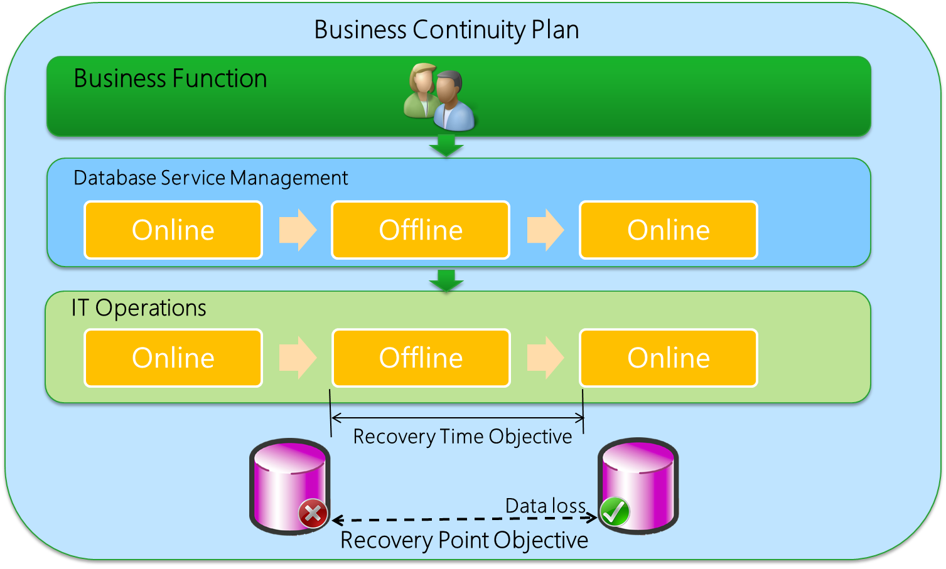
RTO & RPO
Do RPO & RTO give us the whole picture of the environment readiness?

Slide 8
Mission-critical availability
Reliable
    Detects failures reliably
    Handles multiple failures at a time
Integrated
    Provides a unified, simplified solution
    Streamlines deployment, management, and monitoring
Flexible
Reuses existing investments
Offers SAN/DAS environments
Efficient
Allows use of HA hardware resources
Supports fast, transparent failover

Slide 9
High availability and disaster recovery

Slide 10
Failover Cluster Instances
Cluster node
Cluster node
Server failover
Shared storage
Multi-node clustering
Passive secondary nodes
Failover in minutes
Windows and Linux failover clusters supported
SQL Server failover cluster instance
SQL Server 2017
SQL Server 2017
Shared storage

Slide 11
Configuring failover clusters on Linux
Set up and configure the operating system on each cluster node
Install and configure SQL Server
on each cluster node
Configure shared storage and move database files
Install and configure Pacemaker
on each cluster node
Create the cluster
Services
SQL
SQL
Pacemaker
Cluster software
Corosync
Linux Server
Linux Server
Hardware
Shared storage

Slide 12

Always On Availability Groups
Failover cluster
Failover cluster
Azure region
Azure region
Storage
Storage
Availability Groups: High availability + disaster recovery solution when one or several databases failover together
SQL Server 2017 supports one primary and up to eight secondaries for a total of nine replicas
Secondaries can be enabled as read-only replicas, which can be load balanced

Slide 13
Availability Groups + failover clustering (Windows)

Slide 14
Mission-critical availability on any platform

Slide 15
Enhanced Always On AGs (SQL Server 2016)

Slide 16
Enhanced Always On AGs (SQL Server 2017)

Slide 17
Enhanced Always On AGs (SQL Server 2017)

Slide 18
New Features for HA/DR in SQL 2019
Up to five synchronous replicas
Secondary-to-primary replica connection redirection
Always On Availability Group on Docker containers with Kubernetes
Accelerated Database Recovery
  Fast and consistent database recovery
  Instantaneous transaction rollback
  Aggressive log truncation

